Slide 1
Cold-Start Demand Forecasting in Retail:

Slide 2
Scenario
You’re launching a product in a new city where you only have a few weeks of sales. Use
sales from other cities plus context (price, promos, weather, holidays) to forecast the
next 13 weeks for the new city and explain the drivers behind your forecast.

Slide 3
Objective
Forecast units for new city (Jaipur), all SKU ids for the next 13 weeks (weekly).

Slide 4
Data Preprocesing
Load Data
Sales (panel), price plan, promos, weather, calendar
Parse Dates
Convert week_start & week_end → datetime (weekly alignment)
Promo Flag
Check SKU × Market × Week overlap with promo periods
Create binary promo_flag
Prepare Future Data
Build full grid (weeks × markets × SKUs)
Merge with price, weather, calendar, promos
Feature Engineering
Time index (sequential weeks)
Week-of-year seasonality (sin_week, cos_week)
Month, quarter features

Slide 5
Modelling
Inputs
Training DataFrame (train_df)
Selected features
Categorical columns
Steps
Validate feature data types (must be int, float, or bool)
Convert categorical columns → category dtype
Build LightGBM dataset (lgb.Dataset)
Train 3 models:
Mean model → regression objective
Lower model (5% quantile) → captures downside risk
Upper model (95% quantile) → captures upside potential
Output
model_mean, model_lower, model_upper

Slide 6
Forecast:
Inputs:
Trained models (model_mean, model_lower, model_upper)
Future DataFrame (future_df)
Steps
Validate feature data types
Cast categorical columns → category dtype
Run predictions using trained models
Add columns:
forecast → mean prediction
lower_90 → 5% lower bound
upper_90 → 95% upper bound
Clip all outputs to non-negative values
Output
Predictions DataFrame with forecast + confidence intervals

Slide 7
App
App Name:Cold-Start Demand Forecasting in Retail
Built with: Streamlit + LightGBM
Key Features:
13-week sales forecasts
90% prediction intervals
Driver attribution (explainability)
Shock impact (holidays, promos, events)
Weather sensitivity
Interactive forecast explorer + CSV export

Slide 8
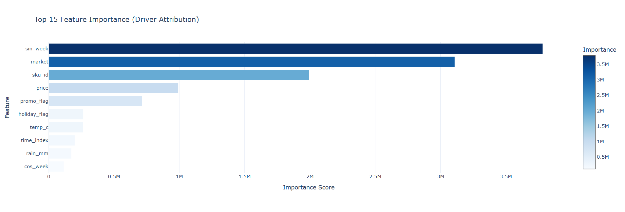
Results
Forecasts are mainly driven by seasonality, product/market identity, and pricing.
Promotions and holidays provide shock-driven demand boosts.
Weather acts as a secondary factor, influencing demand variability.

Slide 9
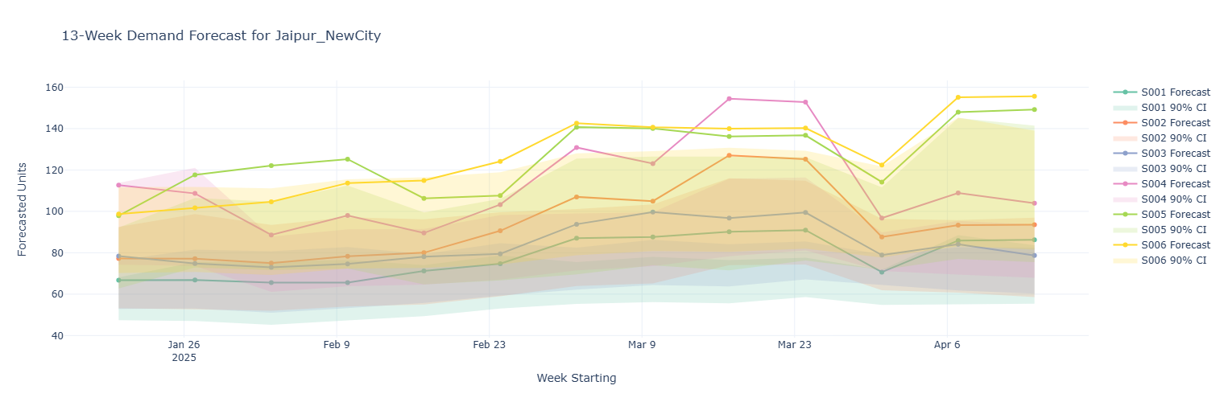
Most SKUs show a gradual upward trend across the 13 weeks.
Suggests increasing adoption of products in the new market (Jaipur).
S006 and S004 consistently forecasted at higher values
Likely to fast-moving skus

