Slide 1
Digital Payment Insights
EXECUTIVE TAKEAWAY | PAYSPHERE FINTECH
What 182,125 training transactions show about where scarce analyst time should go first.
182,125
5,000 | 8,743
2,990
1.64%
training transactions
users | device IDs
labelled fraud cases
fraud-label rate
Notes:
OPENING (30s): The ask today is a decision on how PaySphere points review capacity, not a request for new tooling.
Three numbers frame it. First, an IQR outlier rule flags 6.19% of transactions (11,278 of 182,125), roughly six times what a 99th-percentile tier flags by definition. Second, first-seen devices do not carry a higher fraud-label rate: 1.51% vs 1.65% for previously seen devices (baseline 1.64%). Third, about 63% of the simulated review queue comes from just two single-signal rules.
Our recommendation: prioritise combined-signal and extreme-amount cases, watch single flags rather than queueing them, and validate in a human-reviewed pilot.
SOURCES: Baseline stats (182,125 transactions; 2,990 labelled fraud; 1.64%; 11,278 IQR outliers; 5,000 users; 8,743 devices) from the verified source-data baseline. 1.51%, 1.65% and the ~63% queue share are read from the supplied charts (device_comparison, alert_reasons); the values are approximate to the pixel.
CAVEAT: Fraud label is original. Alerts, customer and device attributes are synthetic rule outputs — never describe them as real reviews or proven fraud.

Slide 2
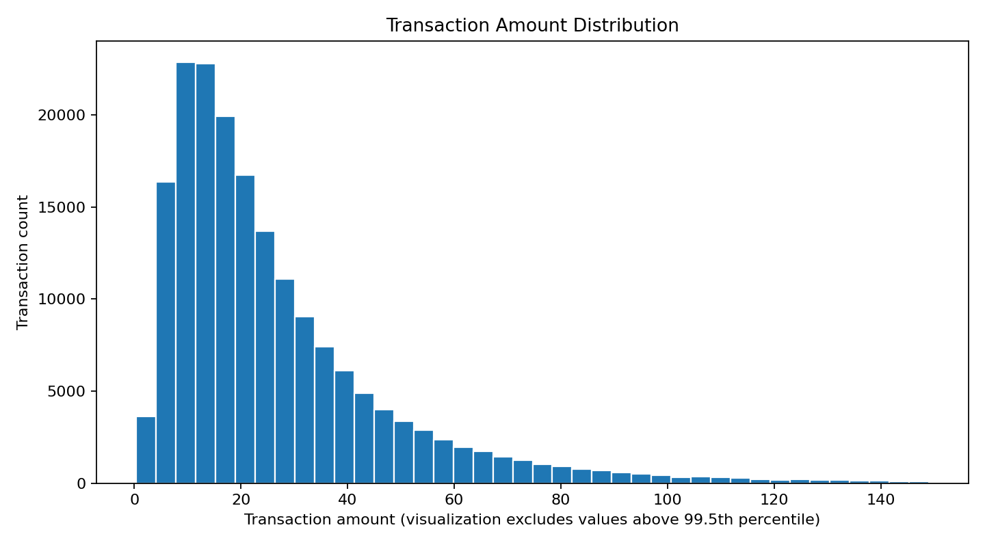
Normal spend is small and skewed: an IQR rule flags 6× more transactions than a 99th-percentile tier
FINDING 1 | TRANSACTION AMOUNT
20.07
27.30
Median amount
Mean (> median)
72.86
124.50
95th percentile
99th percentile
6.19% vs 1.00%
IQR outliers (11,278) vs share above p99 (~1,821, by definition)
BUSINESS MEANING
Anchor amount alerts to percentile tiers (p95, p99), not an IQR fence.
Source: baseline statistics (n = 182,125) and supplied amount_distribution chart (histogram excludes values above the 99.5th percentile). Amount units are unspecified. Ranges are global; segment-level ranges rely on synthetic segments.
Notes:
KEY MESSAGE: "Normal" is a small-ticket, right-skewed distribution — so an outlier rule built for symmetric data over-flags.
Median 20.07 vs mean 27.30 confirms the skew; p95 is 72.86 and p99 is 124.50. IQR flags 11,278 transactions (6.19%). A p99 cut flags 1% by construction, about 1,821 transactions — so IQR produces ~6.2× the volume.
IMPLICATION: use percentile tiers for amount alerts (e.g., p95 for watch, p99 for review) and tune the thresholds in the pilot.
SOURCES: All figures from the verified baseline; ~1,821 = 1% × 182,125 (arithmetic). Histogram is the supplied chart and clips values above the 99.5th percentile for readability.
CAVEATS: Amount units undocumented — no currency symbol. Ranges shown are global; segment-level normal ranges depend on synthetic customer segments and were not part of the supplied evidence.

Slide 3
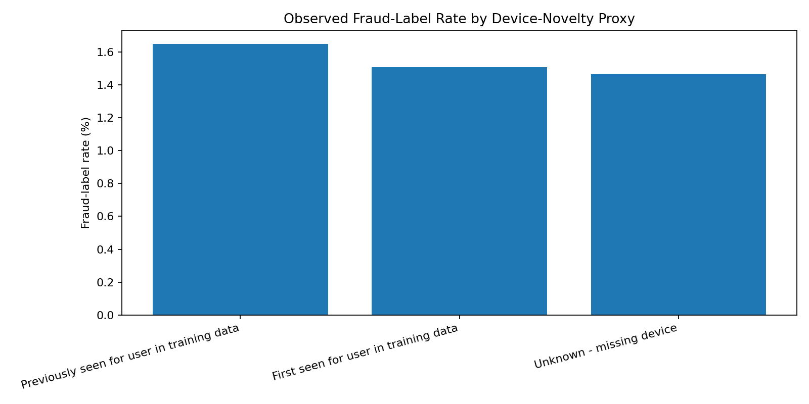
First-seen devices carry no extra fraud-label risk, yet drive the largest share of simulated alerts
FINDING 2 | DEVICE NOVELTY
0.91×
Fraud-label rate, first-seen vs previously seen devices (1.51% vs 1.65%)
~32%
of the simulated alert queue is "first-seen user-device pair" (~5.4k alerts)
BUSINESS MEANING
Device novelty alone is a weak review trigger. Use it as context inside a multi-signal score, not as a standalone alert.
Caveats: "first seen" is a training-data proxy, not a verified new-device flag. Device attributes are synthetic. Differences are small and not significance-tested.
Source: supplied device_comparison and alert_reasons charts; rates and queue size read from chart bars (approximate). Baseline fraud-label rate 1.64%. Fraud label is original; device flags and alerts are synthetic.
Notes:
KEY MESSAGE: The rule that generates the most alerts is not backed by a higher fraud-label rate.
Fraud-label rate by device novelty proxy: previously seen ~1.65%, first seen ~1.51%, unknown/missing device ~1.46%; overall baseline 1.64%. First-seen is 0.91× the previously-seen rate. Yet "first-seen user-device pair" is the largest reason in the simulated queue (~5.4k of ~16.7k, ~32%).
IMPLICATION: Do not queue a transaction on device novelty alone; treat it as one input to a combined score.
SOURCES: Values are read from the supplied charts and are approximate. Queue total ~16.7k is the sum of the five chart bars.
CAVEATS: "First seen" means first seen in the training data — a proxy, not a true new-device flag. Device attributes and alerts are synthetic. We have not tested significance; the claim is "no elevated rate", not "new devices are safer".

Slide 4
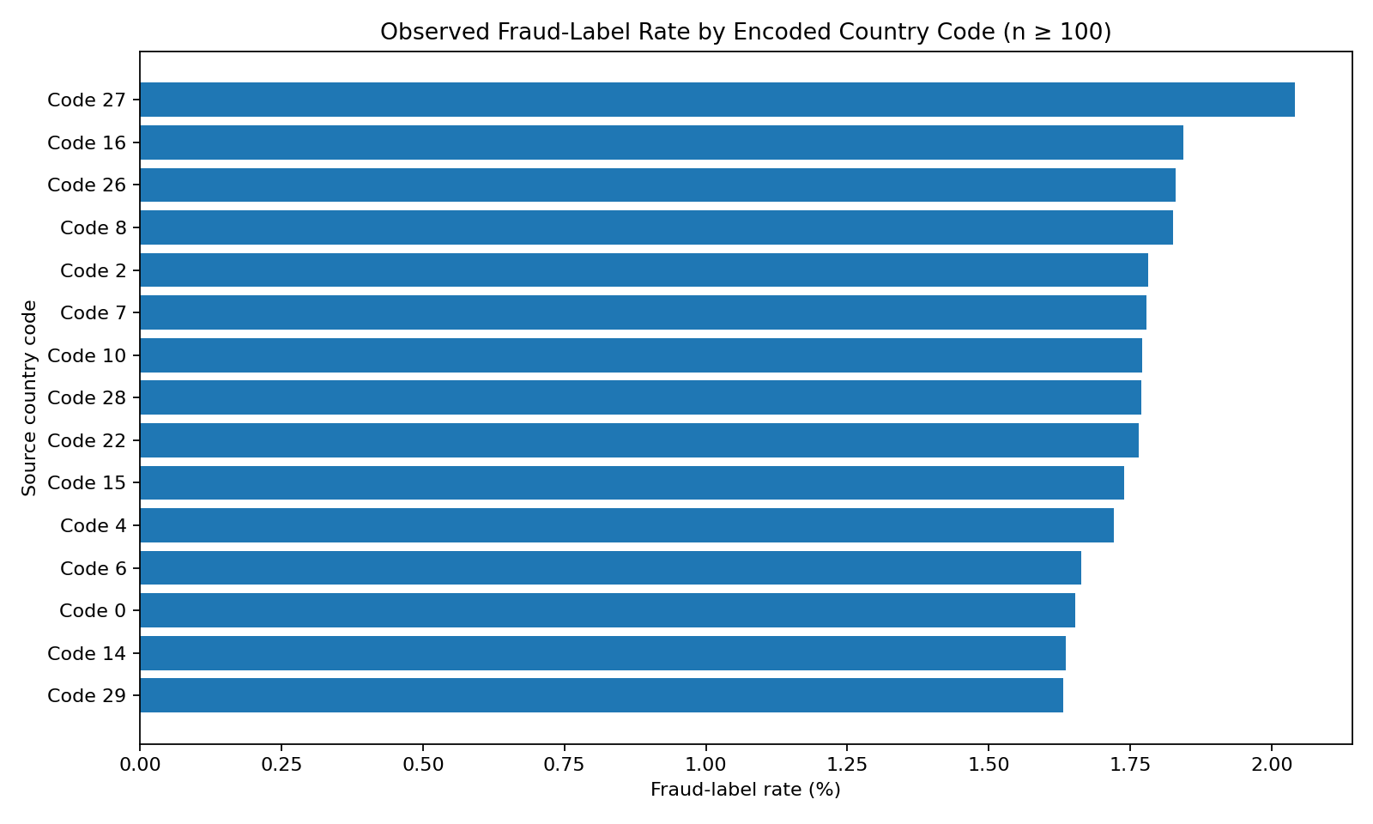
Risk is diffuse: no country code, merchant category or time bucket justifies a blanket rule
FINDING 3 | UNUSUAL PATTERNS ARE DIFFUSE
GEOGRAPHY
2.04% top code vs 1.64% baseline
Code 27 is 1.24× baseline; 14 of the 15 codes shown sit between 1.63% and 1.85%.
TIME
~228 transactions per hourly bin
All bins except the final partial one stay within about ±20%. No spike; clock-hour not verifiable.
MERCHANT
8.9%–10.1% synthetic alert rate
Top 15 encoded categories span just 1.13×. Rates reflect rules, not proven risk.
BUSINESS MEANING Blanket country, merchant or time rules add friction for little lift. Combine signals.
Source: supplied country_code_fraud_rates (n ≥ 100 per code; 15 codes shown), elapsed_hour_volume and merchant_alert_rates charts; values read from chart (approximate). Country codes and merchant categories are encoded IDs; timestamp unit and reference time are unverified.
Notes:
KEY MESSAGE: There is no single country, merchant category or time bucket that stands out enough to act on alone.
Geography: the highest fraud-label rate among the 15 country codes shown (n ≥ 100) is code 27 at ~2.04%, 1.24× the 1.64% baseline; the other 14 shown codes sit between ~1.63% and ~1.85%.
Time: volume is flat at roughly 228 transactions per elapsed-hour bin (182,125 across ~800 bins); apart from the final, partial bin, bins stay within about ±20%. That means no volume spike.
Merchant: synthetic alert rates across the top 15 encoded categories range from ~8.9% to ~10.1%.
IMPLICATION: Blocklist-style rules by country, merchant or time would add customer friction for little lift. Keep these as context features.
CAVEATS: Timestamp unit and reference are unverified — we make no claim about clock-hours. Country codes and merchant categories are encoded IDs; we have not named them. Merchant alert rates are rule-generated, so they reflect our rules rather than independent risk. No significance testing was done on the country differences.

Slide 5
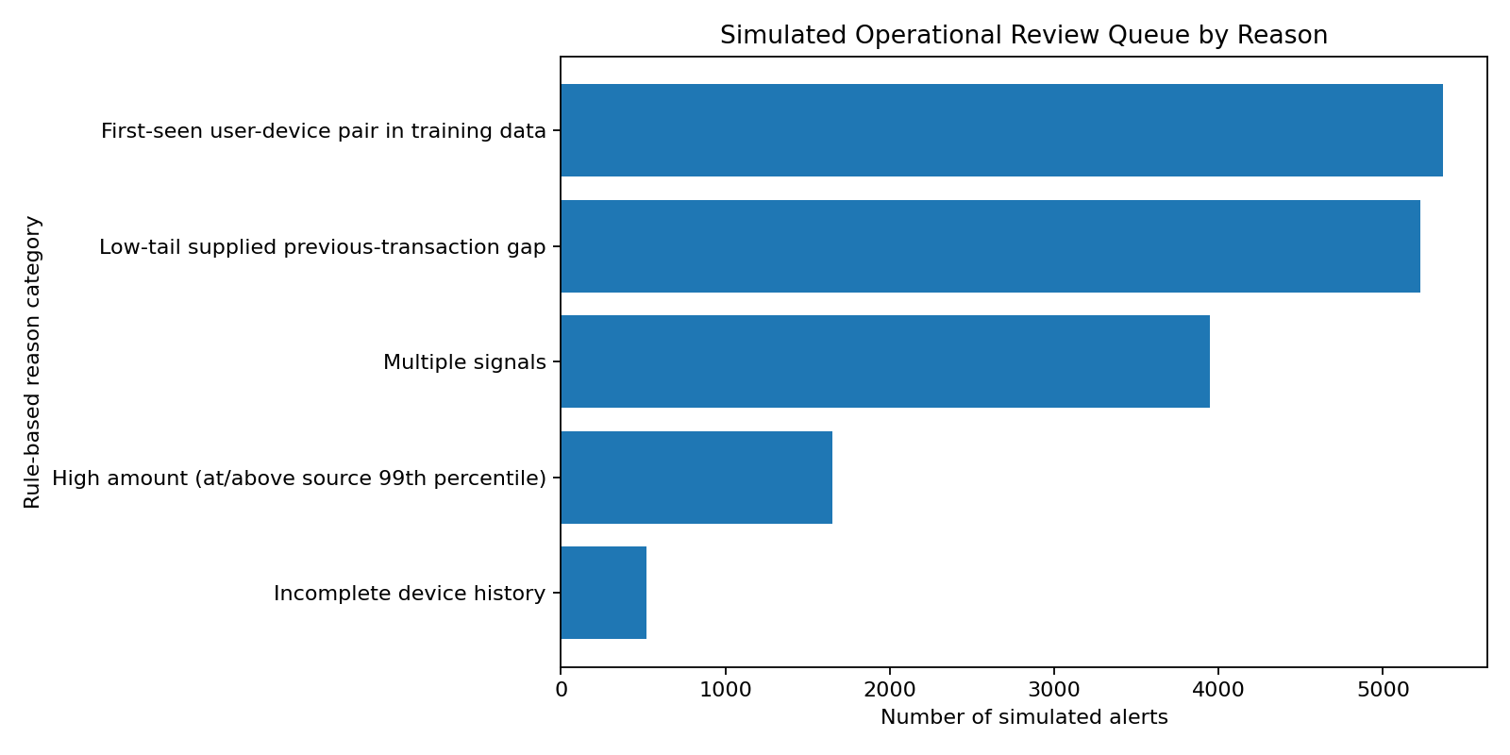
Two single-signal rules generate ~63% of the simulated review queue — the first place to tighten
MONITORING PRIORITIES | SIMULATED REVIEW QUEUE
REVIEW FIRST
1
Multiple signals + ≥ p99 amount
~5.6k alerts | ~34% of queue
MONITOR, SAMPLE
2
First-seen device, low-tail gap
~10.6k alerts | ~63% of queue
FIX THE DATA
3
Incomplete device history
~0.5k alerts | ~3% of queue
Tiering is a design proposal. The queue is synthetic and has no outcome labels, so tier-level hit rates must be proven in the pilot.
Source: supplied alert_reasons chart; counts read from chart bars (~5,370 | ~5,230 | ~3,950 | ~1,660 | ~520; total ~16.7k) and tier sums computed from them. Alerts are synthetic, rule-generated — not actual manual reviews or proven fraud.
Notes:
KEY MESSAGE: Most of the simulated queue comes from single weak signals; the smaller combined-signal and extreme-amount groups are the natural priority tier.
Chart-read counts: first-seen user-device pair ~5,370 (32%); low-tail previous-transaction gap ~5,230 (31%); multiple signals ~3,950 (24%); high amount ≥ source p99 ~1,660 (10%); incomplete device history ~520 (3%). Total ~16.7k.
PROPOSED TIERS: Tier 1 = multiple signals + high amount (~5.6k, ~34%) for analyst review first. Tier 2 = first-seen device and low-tail gap (~10.6k, ~63%) for sampled monitoring, not full review. Tier 3 = incomplete device history (~0.5k, ~3%) as a data-quality fix.
CAVEATS: This is a hypothesis. The simulated queue has no outcome labels, so we cannot yet say Tier 1 is riskier — that is exactly what the pilot measures. We have no evidence that the low-tail gap rule lacks signal; we simply have not seen a lift for it. Alerts are not real reviews.

Slide 6
Approve a three-tier, human-reviewed pilot — and never block on a single flag
MANAGEMENT RECOMMENDATION
1
Tier the queue
PILOT MEASUREMENT PLAN
Send multi-signal and ≥ p99 amount cases to analysts first; move first-seen device and low-tail gap to sampled monitoring.
Shadow mode
Tiered human review
Decision gate
2
Retire blunt rules
Lift
Tier-wise fraud-label rate vs the 1.64% baseline
Replace the IQR fence with p95/p99 tiers. No country, merchant or time blocklists.
Load
Alert volume and analyst workload per tier
Truth
Confirmed review outcomes, once logged
3
Fix data before scaling
Confirm the timestamp unit and reference, complete device history, and log real review outcomes.
Gate: scale only if Tier 1 shows a higher confirmed-risk rate than Tier 2. Targets are set from the pilot baseline, not assumed today.
Decision requested: approve the pilot scope. All alert figures are simulated; no customer-facing action is taken in shadow mode.
Notes:
THE ASK: Approve a pilot, not a rollout.
1) Tier the queue — Tier 1 (multi-signal + ≥ p99 amount) to analysts first; Tier 2 (first-seen device, low-tail gap) to sampled monitoring; Tier 3 (incomplete device history) is a data fix. 2) Retire blunt rules — replace the IQR fence with p95/p99 percentile tiers; no country, merchant or time blocklists. 3) Fix data first — confirm the timestamp unit and reference time, complete device history, log real review outcomes.
PILOT: Phase 1 shadow mode (score and log, no customer action) → Phase 2 tiered human review → Phase 3 decision gate. Measure lift (tier-wise fraud-label rate vs 1.64% baseline), load (alerts and analyst workload per tier), and truth (confirmed review outcomes once logged). Gate: scale only if Tier 1 outperforms Tier 2. We deliberately set no ROI or target numbers — those come from the pilot baseline.
SAFEGUARDS: Human in the loop; no automated declines on a single flag.
CAVEATS: All alerts are simulated and rule-generated; the fraud label is the only original outcome field. No ROI, savings or fraud-loss impact is claimed anywhere in this deck.

