Slide 1
Intel’s Transactional Synchronization Extensions Tutorial
Ju Chen

Slide 2
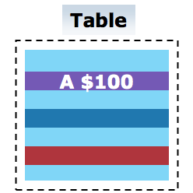

The need for synchronization
Alice wants $50 from A
→ A was $100, A now is $50
Bob wants $60 from A
→ A now $50
Insufficient Funds!

Slide 3
The need for synchronization - concurrent execution
Alice’s Execution | Bob’s Execution
LD: R0=100 | LD: R0=100
SUB → (R0=50) | SUB -> (R0=40)
ST → (A=50)
 | ST → (A=40)
Alice wants $50 from A
→ A was $100, A now is $50
Bob wants $60 from A
→ A was $100, A now is $40
A should -10! The bank lost $50

Slide 4
Challenge: How to solve?

Slide 5
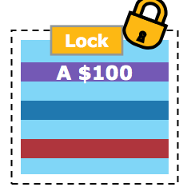
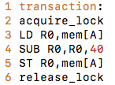
The need for synchronization - Lock based solution
Alice’s Execution | Bob’s Execution
acquire_lock | acquirelock
LD
SUB
ST
release_lock
 | LD
 | SUB
 | ST
Alice wants $50 from A
→ Alice locks the table
→ A was $100, A now is $50
Bob wants $60 from A
→ Bob waits till lock release
→ A was $50, insufficient funds

Slide 6
Problem Solved?

Slide 7
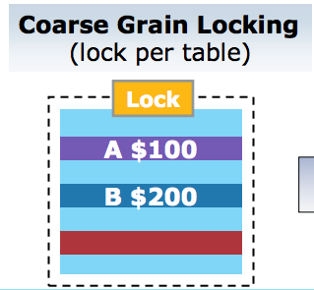
Lock granularity Optimization: coarse grained is inefficient
1s fo finish 1 transaction
2s to finish 2 transaction
1,000,000 transaction?
11 days!!
Alice wants $50 from A
→ Alice locks the table
Bob wants $60 from B
→ Bob waits till lock release
Run in serial, Inefficient!

Slide 8
Challenge: How to solve?

Slide 9
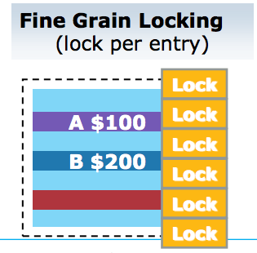
Lock granularity Optimization: fine grained lock
Alice wants $50 from A
→ A locks A
Bob wants $60 from B
→ Bob locks B
Run in parallel, efficient!

Slide 10
Problem solved?

Slide 11
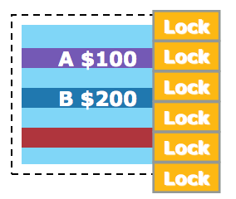
Fine grain locking is burdensome
Alice takes 10$ from A,B,C,D,E and transfers the money to F,G,H,I,J
Programmers need to identify all the locks!
Alice transfers $20 from A to B
→ Alice locks A and B
→ Transfer
→ Alice unlocks A and B
Too many locks!

Slide 12
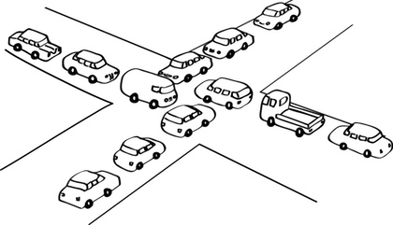
Fine grain locking is error prone - what happens in below?
Alice transfers $20 from A to B
→ Alice locks A
→ Alice locks B
Bob transfers $50 from B to A
→ Bob locks B
→ Bob locks A
Dead lock!

Slide 13
TSX - fine grained performance + coarse grained programming effort
 | Performance | Programming Simplicity
Coarse Grained Lock | x | ✅
Fine Grained Lock | ✅ | x
TSX | ✅ | ✅

Slide 14

TSX Interface - xbegin, xend
Syntax:

Slide 15
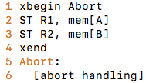
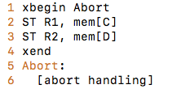
TSX Interface - xbegin, xend
Example: Thread 1 Thread 2

Slide 16
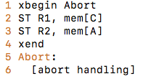
TSX Interface - xbegin, xend
Example: Thread 1 Thread 2

Slide 17
Rollback
A = 100 | B = 100
A: 100->150 | B: 100->50
Conflit!!
A: 150->100 | B: 50->100
A = 100 | C = 100
A: 100->80 | C: 100->90
Conflict
A: 80->100 | C: 90->100
rollback
rollback

Slide 18
Challenge: Can we partially rollback transaction?
A = 100 | B = 100
A: 100->150 | B: 100->50
Conflit!!
A: 150->100 | B: keep as 50
A = 100 | C = 100
A: 100->80 | C: 100->120
Conflict
A: 80->100 | C: keep as 120
rollback
rollback

Slide 19
Transactional process is ALL or NOTHING!
A = 100 | B = 100
A: 100->150 | B: 100->50
Conflit!!
A: 150->100 | B: keep as 50
A = 100 | C = 100
A: 100->80 | C: 100->120
Conflict
A: 80->100 | C: keep as 120
rollback
rollback
Bank won $50!
Bank lost $20!

Slide 20
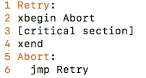
TSX Interface - abort handling
Syntax:

Slide 21
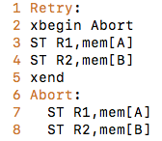
Abort handling: Is this correct?
Wrong! Race condition in the abort path

Slide 22
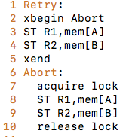
Abort handling:

Slide 23
Problem Solved?

Slide 24
Abort handling:
Correct, but not efficient

Slide 25
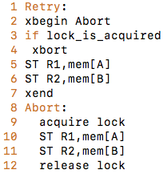
Abort handling (use of xabort)
Standard abort handling

Slide 26
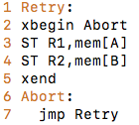

Implementation
1, Cache serves as buffer storing intermediate update
2, When flushing (commit), HW takes care of conflicts
Cache 0 [A] [B]
Cache 1 [A’] [B’]
Main Memory

