Slide 1
CIS 655 - Advanced Computer Architecture Homework 1&2 – Reference solutions

Slide 2
Homework-1

Slide 3
1.11 Availability is the most important consideration for designing servers, followed closely by scalability and throughput. a) We have a single processor with a failures in time (FIT) of 100. What is the mean time to failure (MTTF) for this system? Failures in time (FIT) is traditionally reported as failure per billion hours of operation. 1 Billion = 10^9 FIT = 100 / (10^9) MTTF = 1/FIT = 1/ (100/10^9) = 10^9/100 = 10^7 b) If it takes 1 day to get the system running again, what is the availability of the system? Availability of the system = MTTF/ (MTTF + MTTR) = 10^7 / (10^7 + 24) = 0.999 ~= 1 (MTTR - Mean Time to Repair) c) Imagine that the government, to cut costs, is going to build a supercomputer out of inexpensive computers rather than expensive, reliable computers. What is the MTTF for a system with 1000 processors? Assume that if one fails, they all fail. FIT = 1000 (processors) * 100 (FIT per processor) = 10^5 MTTF = 1/FIT = 1/(10^5/10^9) = 10^9/10^5 = 10^4

Slide 4
1.15 Assume that we make an enhancement to a computer that improves some mode of execution by a factor of 10. Enhanced mode is used 50% of the time, measured as a percentage of the execution time when the enhanced mode is in use. a) What is the speedup we have obtained from fast mode? Let the running time of the enhanced part be T, since it occupies 50% of running time, the overall running time is T+T. Before optimization, the running time of the enhanced part is 10T, the running time of un-enhanced part remains T, so the overall running time is 10T+T = 11T. Therefore, the speedup will be 11T/2T = 5.5 b) What percentage of the original execution time has been converted to fast mode? 10T/11T = 0.91

Slide 5
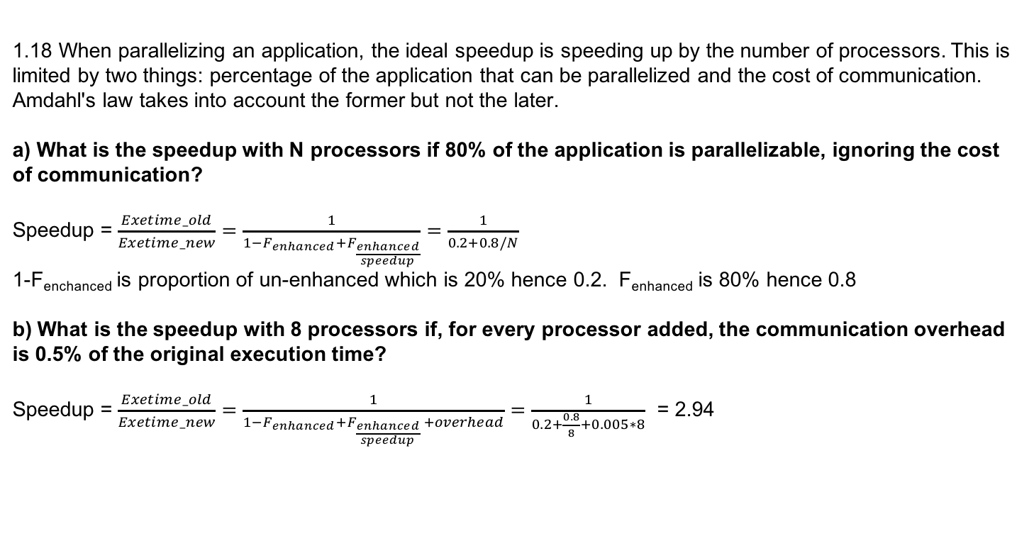
1.18 When parallelizing an application, the ideal speedup is speeding up by the number of processors. This is limited by two things: percentage of the application that can be parallelized and the cost of communication. Amdahl's law takes into account the former but not the later. a) What is the speedup with N processors if 80% of the application is parallelizable, ignoring the cost of communication? Speedup = $\frac{Exetime_old}{Exetime_new}=\frac{1}{1−F_{enhanced}+F_{\frac{enhanced}{speedup}}}=\frac{1}{0.2+0.8/N}$ 1-F_{enchanced} is proportion of un-enhanced which is 20% hence 0.2. F_{enhanced} is 80% hence 0.8 b) What is the speedup with 8 processors if, for every processor added, the communication overhead is 0.5% of the original execution time? Speedup = $\frac{Exetime_old}{Exetime_new}=\frac{1}{1−F_{enhanced}+F_{\frac{enhanced}{speedup} }+overhead}=\frac{1}{0.2+\frac{0.8}{8}+0.005∗8}$ = 2.94

Slide 6
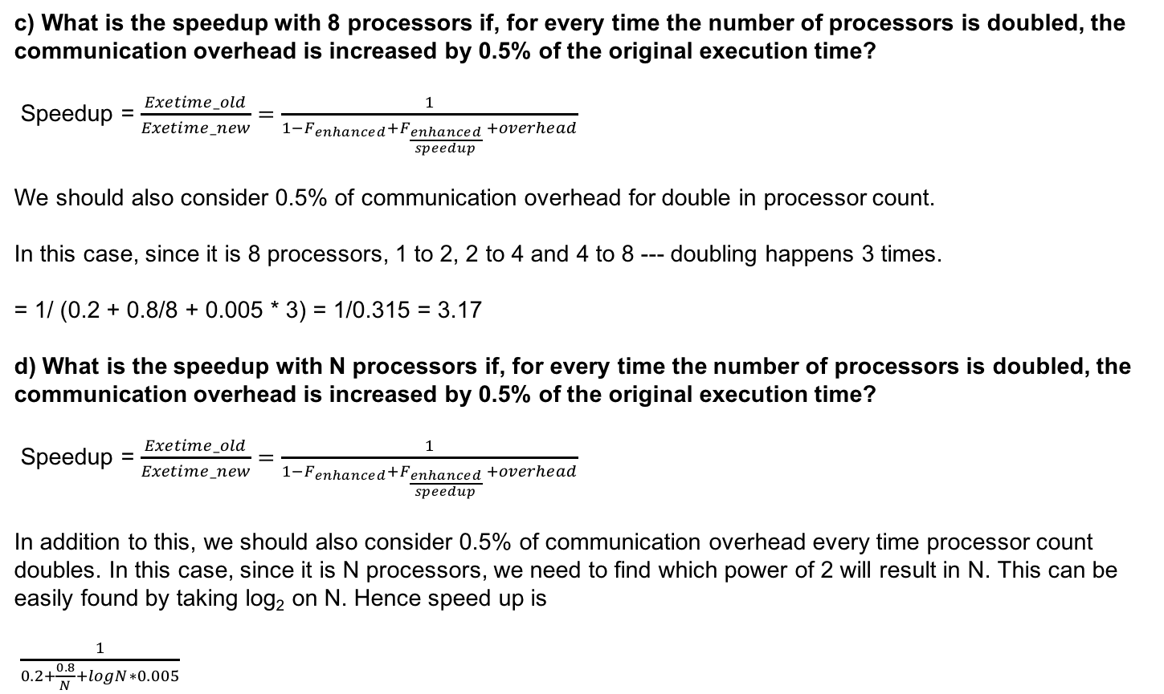
c) What is the speedup with 8 processors if, for every time the number of processors is doubled, the communication overhead is increased by 0.5% of the original execution time? Speedup = $\frac{Exetime_old}{Exetime_new}=\frac{1}{1−F_{enhanced}+F_{\frac{enhanced}{speedup} }+overhead}$ We should also consider 0.5% of communication overhead for double in processor count. In this case, since it is 8 processors, 1 to 2, 2 to 4 and 4 to 8 --- doubling happens 3 times. = 1/ (0.2 + 0.8/8 + 0.005 * 3) = 1/0.315 = 3.17 d) What is the speedup with N processors if, for every time the number of processors is doubled, the communication overhead is increased by 0.5% of the original execution time? Speedup = $\frac{Exetime_old}{Exetime_new}=\frac{1}{1−F_{enhanced}+F_{\frac{enhanced}{speedup} }+overhead}$ In addition to this, we should also consider 0.5% of communication overhead every time processor count doubles. In this case, since it is N processors, we need to find which power of 2 will result in N. This can be easily found by taking log₂ on N. Hence speed up is $\frac{1}{0.2+\frac{0.8}{N}+logN∗0.005}$

Slide 7
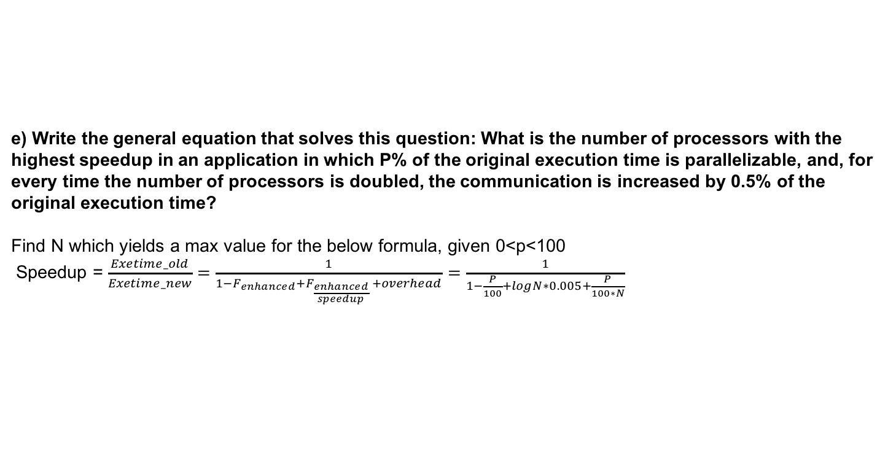
e) Write the general equation that solves this question: What is the number of processors with the highest speedup in an application in which P% of the original execution time is parallelizable, and, for every time the number of processors is doubled, the communication is increased by 0.5% of the original execution time? Find N which yields a max value for the below formula, given 0<p<100 Speedup = $\frac{Exetime_old}{Exetime_new}=\frac{1}{1−F_{enhanced}+F_{\frac{enhanced}{speedup} }+overhead}$ $=\frac{1}{1−\frac{P}{100}+logN∗0.005+\frac{P}{100∗N}}$

Slide 8
Homework - 2

Slide 9
How to interpret 1+2 cycles for SW/LW, 1 + 1 cycles for branch
[Textbook exercise 3.2] “A one-cycle instruction has latency 1 + 0, meaning zero extra wait states. So, latency 1 + 1 implies one stall cycle; latency 1 + N has N extra stall cycles ”
Assumption: 2 cycles extra stall for SW/LW due to memory access. 1 cycles extra stall for branch due to decision made during ID. “with the separate adder and a branch decision made during ID, there’s only a 1-clock cycle stall on branches”
What will happen if there’s hazard? “Once a hard has been detected, the control unit insert the pipeline stall and prevent the instructions from advancing” - Textbook C38
Assumption: The static branch predictor needs to see the results from the ID stage before makes the decision (statement made in question text)

Slide 10
0 | 1 | 2 | 3 | 4 | 5 | 6 | 7 | 8 | 9 | 10 | 11 | 12 | 13 | 14 | 15 | 16 | 17 | 18 | 19
F | D | E | M | -- | -- | W
 | F | D | -- | -- | -- | -- | E | M | -- | -- | W
 |  | F | -- | -- | -- | -- | D | -- | -- | -- | -- | E | M | W
 |  |  |  |  |  |  | F | -- | -- | -- | -- | D | E | M | W
 |  |  |  |  |  |  |  |  |  |  |  | F | D | -- | E | M | -- | -- | W
 |  |  |  |  |  |  |  |  |  |  |  |  | F | -- | D | E | -- | -- | M
 |  |  |  |  |  |  |  |  |  |  |  |  |  |  |  | F | -- | -- | D
LW R3, 0(R0)
LW R1,0(R3)
ADDI R1, R1, #1
SUB R4,R3,R2
SW R1, 0(R3)
BNZ R4,LOOP
LW R3, 0(R0)
1 cycle delay if no prediction
1 cycle delay if static branch prediction
0 cycle delay if dynamic branch prediction

Slide 11
1 | LD F2, 0(R1)
2 | stall
3 | stall
4 | MUL F4,F2,F0
5 | LD F6, 0(R2)
6 | stall
7 | stall
8 | stall
9 | stall
10 | stall
11 | ADD F6,F4,F6
12 | stall
13 | stall
14 | stall
15 | stall
16 | SD F6,0(R2)
17 | DADDIU R1,R1,#8
18 | DADDIU R2,R2,#8
19 | stall
20 | DSLTU R3,R1,R4
21 | stall
22 | stall
23 | BNEZ R3, f00
24 | stall
Dependency Check
1,4 | check
4,11 | check
11,16 | check
17,20 | check
20,23 | check
branch | check
Latency Requirement
P Result | U Result | Latency
FP MUL | FP ALU | 6
FP ADD | FP ALU | 4
FP MUL | FP Store | 5
FP ADD | FP Store | 4
Integer op/load | any | 2
24 cycles unschedule for 1 loop

Slide 12
1 | LD F2, 0(R1)
2 | stall
3 | stall
4 | MUL F4,F2,F0
5 | LD F6, 0(R2)
6 | DADDUI R1,R1,#8
7 | stall
8 | DADDUI R2,R2,8
9 | DSLTU R3,R1,R4
10 | stall
11 | ADD F6,F4,F6
12 | stall
13 | stall
14 | stall
15 | BNEZ R3,foo
16 | SD F6, -8(R2)
Dependency Check
1,4 | check
4,11 | check
11,16 | check
6,9 | check
9,15 | check
8,16 | check
branch | check
Latency Requirements
P Result | U Result | Latency
FP MUL | FP ALU | 6
FP ADD | FP ALU | 4
FP MUL | FP Store | 5
FP ADD | FP Store | 4
Integer op/load | any | 2
16 cycles scheduled for 1 loop

Slide 13
To reach to same performance means:
Execution time unscheduled = Execution time scheduled
Which means,
24 * clock_cycle_time_unscheduled = 16 * clock_cycle_time_scheduled
So that,
clock_cycle_time_unscheduled/clock_cycle_time_scheduled = 2/3

Slide 14
1 | LD F2, 0(R1)
2 | LD F3,8(R1)
3 | LD F4,16(R1)
4 | MUL F5,F2,F0
5 | MUL F6,F3,F0
6 | MUL F7,F4,F0
7 | LD F8,0(R2)
8 | LD F9,8(R2)
9 | LD F10,16(R2)
10 | DADDUI R1,R1,24
11 | ADD F8,F8,F2
12 | ADD F9,F9,F3
13 | DADDUI R2,R2,24
14 | ADD F10,F10,F4
15 | DSLTU R3,R1,R4
16 | SD F8,-24(R2)
17 | SD,F9,-16(R2)
18 | BNZ R3,foo
19 | SD,F10,-8(R2)
Dependency Check
1,4 | check
2,5 | check
3,6 | check
4,11 | check
5,12 | check
6,14 | check
11,16 | check
12,17 | check
14,19 | check
13,]16,17,19] | check
10,15 | check
15,18 | check
branch | check
Latency Requirements
P Result | U Result | Latency
FP MUL | FP ALU | 6
FP ADD | FP ALU | 4
FP MUL | FP Store | 5
FP ADD | FP Store | 4
Integer op/load | any | 2
19 cycles scheduled for 3 loops

