Slide 1
CIS 655/CSE 661 - Advanced Computer Architecture
Introduction (1.1)
Dr. Yuzhe (Richard) Tang

Slide 2
Administrivia
Instructor
Dr. Yuzhe (Richard) Tang
Office: 4-193, Sci-Tech Building
Office hours: TBA
TA/Grader
Ju Chen: jchen133@syr.edu
TBA
Notes:
Good morning everyone. First let me introduce myself. My name is Yuzhe Tang. I recently joined SU as a new faculty member in the EECS department. My office is room 4-193 in the Sci-Tech building. You can find me in the office hours which is to be announce. Also you can reach me through email.
My email address is as ytang100@syr.edu. When you are about to send me an email, please include a prefix in your email subject. You should use [CIS655] or [CSE661]. This will prevent msg to go to my spam folder.
We will have 2.5 Tas for this course, one of them is Maria Abi Saad. This is her email

Slide 3
Websites
Course website:
tristartom.github.io/teaching/17s-cis655/index.html
Syllabus, lectures and programming projects
Blackboard (BB)
https://blackboard.syr.edu/
Solution submission/grades
Make sure that you can see this class in Blackboard
Notes:
This course will be coordinated on blackboad mainly. So make sure you can see the class on the website. Also familarize yourself with blackboard if it is the first time you are using it. Know how to find lecture slides, assignment, grades and forum.
We will use the textbook from Hennessy and patterson, which can be purchased from the bookstore.

Slide 4
Textbooks and prerequisites
Textbook
Slides/lecture notes are the most important!
Computer Architecture: A Quantitative Approach, by Hennessy and Patterson (5th Edition)
(Optional) CSAPP: Computer Systems: A Programmer's Perspective, by Randal E. Bryant and David R. O'Hallaron
(Optional) OSPP: Operating Systems: Principles and Practice, Second Edition, by Thomas Anderson, Michael Dahlin
Pre-requisites
Programming skills (C/C++, assembly)
Intel x86 guide [link], UVA [link]
Knowledge about computer systems (OS/Linux)
Student body
CIS/CSE graduate students (core course)

Slide 5
Being an SU Student
Student Status
Good Standing, or Hold
Make sure you understand what each means
Grade and Transcript Issues
Course drop deadlines
link: www.syracuse.edu/academics/calendars/quarter-term/
Add deadline* Jan. 16
Financial drop deadline* Jan. 23
Academic drop deadline* Feb. 23
After that, you get the grade you get, stays on transcript
Grades stay on transcript, counts for your GPA
Very hard to compensate an F!

Slide 6
Honor Code
Syracuse University has an Academic Integrity Policy
Read it! (http://supolicies.syr.edu/ethics/acad_integrity.htm)
Violations WILL be reported!
Grading based on your own work
Do NOT allow ANYONE see your work
Do NOT try to look at ANYONE’s work
ANYONE includes other students, friends, family, resources from the Internet, etc.
Work includes code snippet, hw solutions, etc
Penalties for cheating are high
Best-case scenario: lose a letter grade
Worst-case scenario: expelled from the University
Don’t take chance! Cheating WILL be detected.
JUST DON’T CHEAT!

Slide 7
Evaluation
Course attendance/Pop quizzes
10%
Homework and labs: 30% + 25%
Individually with NO collaborations
NO late submission!
Programming labs (25%)
Exams: 35%

Slide 8
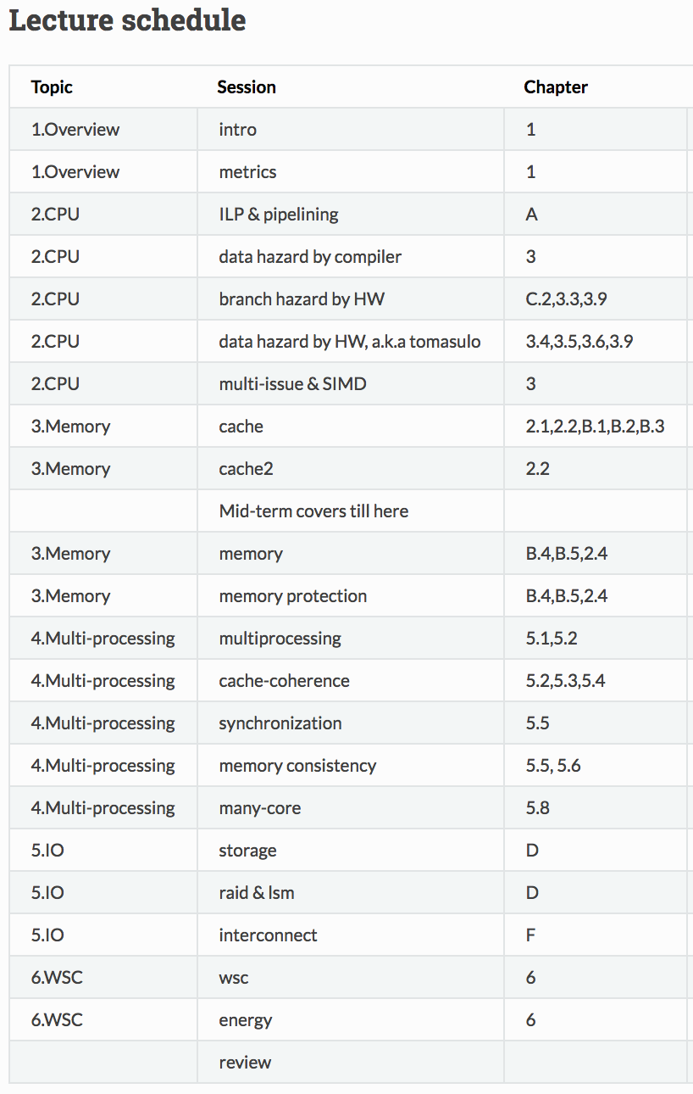
Topics (temporary)
CPU
Memory
Multiprocessing
IO
Storage
Network
Misc/Cloud

Slide 9
Let’s begin the tour of CA
First by a hello-world demo (CSAPP-chapter 1)
Then by a lecture on what’s going on there.

