Slide 1
CIS 655/CSE 661 - Advanced Computer Architecture
Metrics (1.2)
Dr. Yuzhe (Richard) Tang

Slide 2
Dependability

Slide 3
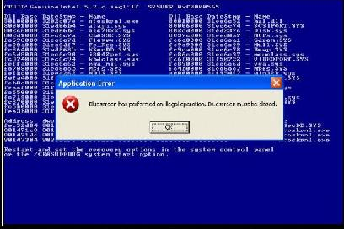
Dependability
Computer failure at all layers
Software crash
hardware faults
CPU Failure when dense
Power loss, network partition
Failures are common for large systems
Large number of desktops:
→Desktop machines are prone to failure
→More likely to fail with more machines

Slide 4
Dependability is important
The case of SLA (Service Level Agreement)
Between cloud provider and customer
Anticipated latency for a request.
“99% requests completed within 100 msec.”
When SLA violated, Amazon pays you $ back

Slide 5
Defining failure
Service accomplishment(A): satisfying SLA
Service interruption(I): violating SLA
Failure: state A → state I
Restorations: state I → state A
A
Failure
Restorations
Failure
I
Time-line

Slide 6
Quantitative Dependability Metrics
Module reliability
Mean time to failure (MTTF)
Mean time to repair (MTTR)
Mean time between failures (MTBF) = MTTF + MTTR
Module availability = MTTF / MTBF
MTTR
MTTF
A
Failure
Restorations
Failure
I
MTBF
Time-line

Slide 7
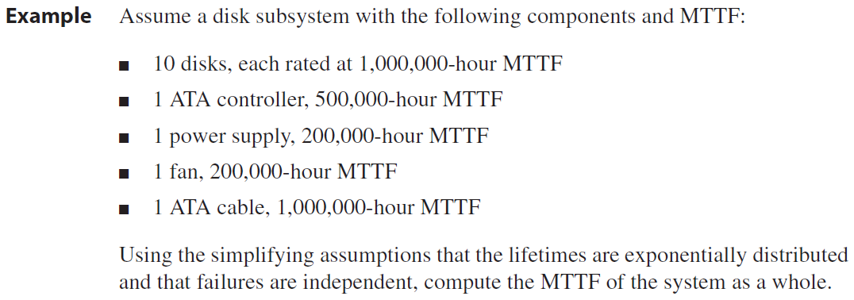

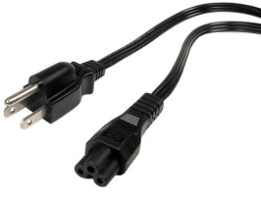
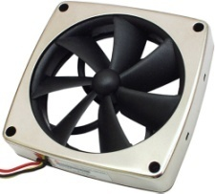
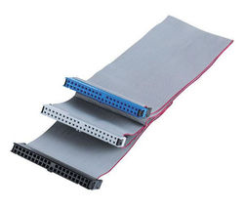
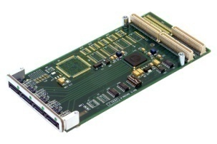

Overall dependability
Disk subsystem
…

Slide 8
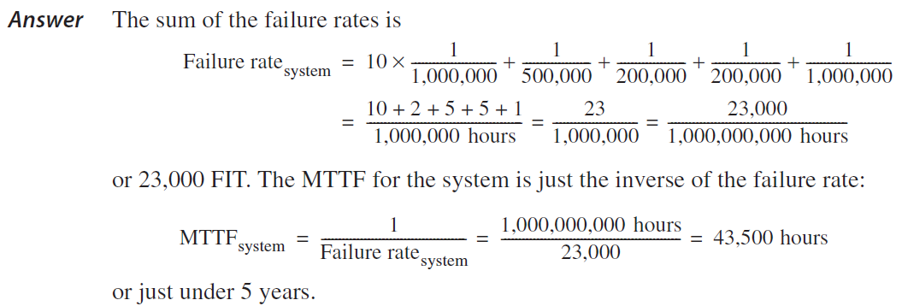
Overall dependability
Disk subsystem
…

Slide 9
Evaluation
Consider a computer of a CPU, a main memory, a disk device, a keyboard, a network card and a power supply module. Each component has an MTTF of 1 million hours. What is the overall MTTF of running our “hello” demo (repeated) on this computer?
Notes:
200,000 hour MTTF (because network card does not affect the demo).

Slide 10
Measuring Perf. With Benchmarks

Slide 11
Performance metrics
Two common metrics
Latency (how long to do X)
Also called response time and execution time
Throughput (how often can it do X)
Analogy to car assembly line
Takes 6 hours to make a car (latency is 6 hours per car)
A car leaves every 5 minutes (throughput is 12 cars per hour)
Overlap results in Throughput > 1/Latency
Notes:
Throughput -> parallel and concurrency

Slide 12
Benchmark: Why
Performance dependent to system setup and workload.
Latency of Program A on CPU A is not that of Program A on CPU B.
Performance comparison
CPU A is faster than CPU B
Fair comparison: same programs, same memory, etc
This is benchmark!
Standardized system setup and workloads

Slide 13
Benchmark Types
Real applications and application suites
Desktop: SPEC CPU2006 (INT/FLOATP)
Server:
CPU: SPECrate,MPI, OpenMP
IO: SPECWeb, SPECSFS, TPC suites
Embedded system: Dhrystone, EEMBC
Kernels, top programs, synthetic benchmarks
Kernel: “Representative” parts of real applications
Toy/synthetic bchmrks: stress-test functions/features
Easier and quicker to set up and run
Often not really representative of the entire app
Notes:
Synthetic is not reliable as kernel benchmark

Slide 14
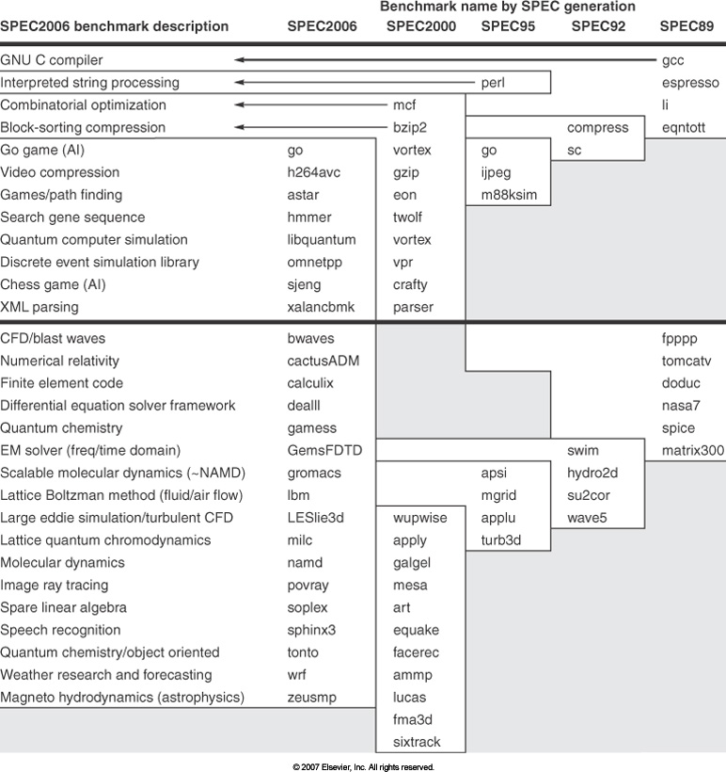
SPEC CPU (integer)
“Representative” applications keeps growing with time!

Slide 15
SPEC CPU (floating point)

Slide 16
TPC Benchmark Suit (DB)
Measure transaction-processing throughput
Benchmarks for different scenarios
TPC-C: warehouses and sales transactions
TPC-H: ad-hoc decision support
TPC-W: web-based business transactions
YCSB[1]: cloud serving applications
Setup:
Requires full OS support, a working DBMS
Long simulations to get stable results
Notes:
Ycsb -> yahoo cloud serving benchmark

Slide 17
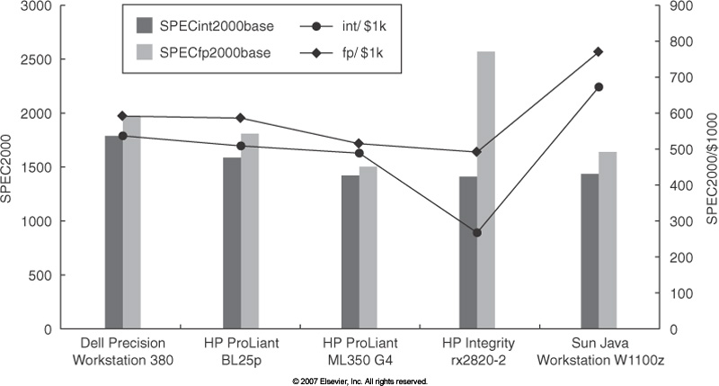
Price-Performance
Notes:
Fp > floating point computation, int -> integer computation

Slide 18
CPU Perf. and Speedup

Slide 19
CPU Performance Equation (1)
ISA, Compiler Technology
Organization, ISA
Hardware Technology, Organization
A.K.A. The “iron law” of performance
Notes:
Cpu time = number of seconds/number of programs gives time to run each program

Slide 20
CPU Time example
Program takes 33 billion instructions to run
CPU processes instructions at 2 cycles per inst
Clock speed of 3GHz
33*10^9/1
2/1
1/3*10^9
= 22 seconds

Slide 21
CPU Performance Equation (2)
How many cycles it takes to execute an instruction of the type
For each type of instruction
How many instructions of the type are there in the program
Notes:
Load and store instructions
ALU instructions
Jump or branch instructions
Cycles to run these instructions are different

Slide 22
CPU performance w/ different insts
Instruction Type | Frequency | CPI
Integer | 40% | 1.0
Branch | 20% | 4.0
Load | 20% | 2.0
Store | 10% | 3.0
Total Insts = 50B, Clock speed = 2 GHz
=50*10^9*(1.0*0.4 + 4.0*0.2 + 2.0*0.2 + 3.0*0.1)*1/2/10^9 =47.5

Slide 23
Comparing Performance: Speedup
“X is n times faster than Y”
Execution time
Wall clock time: includes all system overheads, user-perceivable time
CPU time: only computation time
Exclude the IO wait time…
“Throughput of X is n times that of Y”
Notes:
time loop.sh (understand user time, system time, real time)

Slide 24
Relation to benchmark
“X is n times faster than Y on A”
Speedup might be specific to the running benchmark
X is 10 times faster than Y on A, and 1.5 times on B, but Y is 2 times faster than X on C, and 3 times on D, and…
So does X have better performance than Y?
Which would you buy?

Slide 25
Summarizing Performance
Arithmetic mean
Average execution time
Gives more weight to longer-running programs
Weighted arithmetic mean
More important programs can be emphasized
But what do we use as weights?
Different weight will make different machines look better

Slide 26
Speedup
 | Machine A | Machine B
Program 1 | 5 sec | 4 sec
Program 2 | 3 sec | 6 sec
What is the speedup of A compared to B on Program 1?
What is the speedup of A compared to B on Program 2?
What is the average speedup?
What is the speedup of A compared to B on Sum(Program1, Program2) ?
4/5
6/3
½*(4/5 + 6/3)
(4 + 6)/(5 + 3)

Slide 27
Amdahl’s Law

Slide 28
Amdahl’s Law (1)
What if enhancement does not enhance everything?
Notes:
1- Fraction -> part that is not affected by optimisation
Speedup -> fraction enhanced by optimisation

Slide 29
Amdahl’s Law (2)
Make the Common Case Fast
VS
Important: Principle of locality Approx. 90% of the time spent in 10% of the code

Slide 30
Car Analogy
Turbo – no benefit when stuck in traffic
10 miles at 50 mph on highway (100 mph with turbo)
2 miles at 10 mph on campus (no benefit from turbo)
Overall speedup?
Sol:
10 mile highway: 12 min
2 mile campus road: 12 min
S = 1 / (1/2 + 1/2/2) = 1.333

Slide 31
Price-Performance
Hey, turbo is still a net win (we get there faster)
Consider the cost, too:
Without Turbo
Car costs $8,000 to manufacture
Selling price is $12,000 → $4K profit per car
If we sell 10,000 cars, that’s $40M in profit
With Turbo
Car costs extra $3,000
Selling price is $16,000 → $5K profit per car
But only a few gear heads buy the car:
We only sell 400 cars and make $2M in profit

Slide 32
CPU Design is Similar
How much effective performance do I get out of it?
100% speedup for small fraction of time wasn’t a big win for the car example
How much more do I have to charge for it?
Extra development, testing, marketing costs
How much more can I charge for it?
Does the market even care?
How does the price change affect volume?

Slide 33
Another Car Analogy
Let’s say we already have Turbo… now Turbo++
Now 200 mph with Turbo++ on 10 miles of highway
Still no benefit on campus (2 miles)
Overall speedup of Turbo++ over Turbo? Is it the same as overall speedup of Turbo over “Plain”
No! The “Fraction improved” part has changed!

Slide 34
Amdahl’s Law (3)
Diminishing Returns
Generation 1
Total Execution Time
Green Phase
Blue Phase
Generation 2
over Generation 1
Total Execution Time
Green
Blue
Generation 3
over Generation 2
Total Execution Time
Blue

