Slide 1
CIS 655/CSE 661 - Advanced Computer Architecture
CPU: ISA & Pipelining (2.1)
Dr. Yuzhe (Richard) Tang

Slide 2
ISA

Slide 3
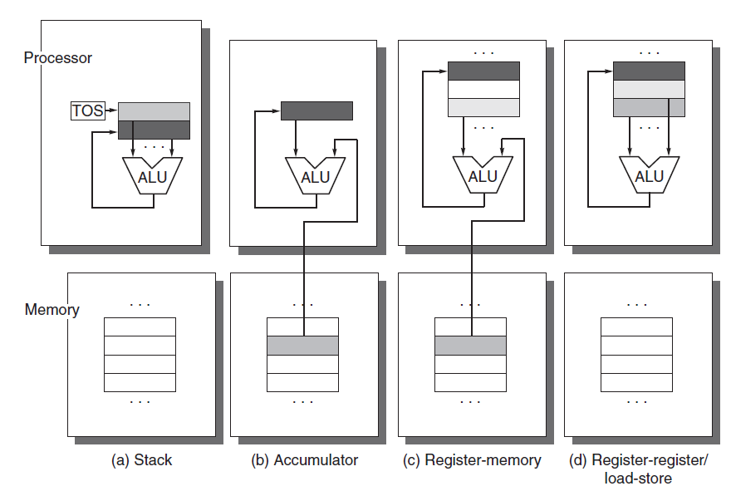
ISA Principles
ISA design: instruct ALU (or MUX, etc) to work
Memory
CPU internal storage:
Stack
Accumulator
General register
Register-memory
Register-register

Slide 4
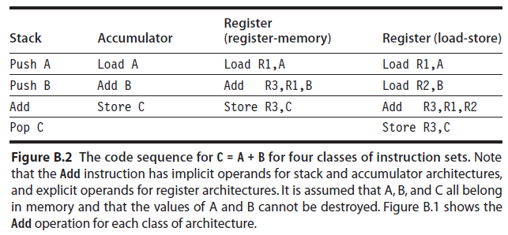
ISA Principles: internal storage
C = A + B (A,B,C in memory)

Slide 5
ISA Principles: Others
Type of operands:
Granularity of memory objects:
1 byte (8), half-word/Short(16), or word/Integer (32)
Memory addressing:
Byte ordering in an object: big/little endian
0x56: 56(l), 65(b)
Type of operations:
ALU, data transfer, control, system, FP, etc
Control flow (not PC+X)
Jumps, conditional branch, procedure calls/returns, (interrupt/exception), syscall, etc

Slide 6
X86 (a CISC ISA)
Register-memory
Byte-addressing
Words are stored in memory with little-endian byte order.
Memory segmentation
DS: stack, heap, etc
CS
Demo: /proc/self/maps
Operating modes: real, long, protected (ring 0-3)
General-purpose registers: eax,rbx, r8-15, etc
The case of x86-64
- 64-bit general-purpose processor registers (e.g. rax, rbx),
- 64-bit integer arithmetic and logical operations,
- 64-bit virtual addresses.

Slide 7
RISC
RISC: Simplify
Internal storage: Load-store register
32 registers (MIPS), each per 32 or 64 bits.
Few instructions:
ALU instr:
ADD R1, R2, R3
Load/store instr:
LD R1, A
Branch/jumps:
BEQ addr.

Slide 8
Simple RISC Implementation
LdPC
PC
LdA
A
B
LdB
LdMAR
MAR
LdIR
IR
Regs
Din
Memory
WrREG
Addr Din
WrMEM
func
ALU
regno
Dout
Dout
DrPC
DrALU
DrREG
DrMEM

Slide 9
Pipelining (5-stage)

Slide 10
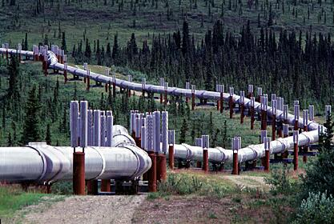
Oil Transport Analogy
Plan A: Move 1,000,000 gallons of oil at a time
Buy a tanker ship, then repeat:
Fill with oil, sail for 30 days, empty, go back
Plan B: Move 100 gallons of oil at a time
Buy a speedboat, then repeat:
Take barrel of oil, sail for 2 days, unload, go back
Plan C: Deep pipelining

Slide 11

RISC’s 5-stage pipeline
Instructions impl. in 5 stages
IF(instruction fetch): fetch based on PC
ID(instruction decode): read I and Reg.
EX(Execution): ALU operations
MEM (Memory access): LD/SD
WB: Write-back cycles: result → Reg

Slide 12
Pipelined
M
X
1
ADD
ADD
P
C
Instr
Mem
RF
BEQ
A
Data
Mem
M
X
ALU
M
X
SE
D
IF
ID
EX
MEM
WB
Notes:
SE: sign-extend from 16-bit to 32-bit, without changing sign and values.
MX: for multiplication operations
A: address
D: data

Slide 13
Without pipeline – done in 1 cycle
Control instruction
M
X
ALU/Mem instruction
1
ADD
ADD
P
C
Instr
Mem
RF
A
Data
Mem
M
X
ALU
M
X
SE
D

Slide 14
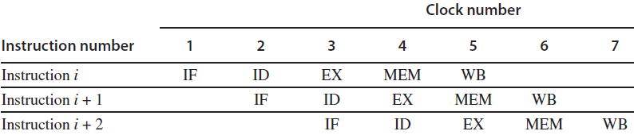
Without pipeline
Instruction takes 1 cycle
1 cycle (non-pipeline) : 5 usec
1 clock
0 1 2 3 4 5 6 7 8 9 10 11 12 13 14 15

Slide 15
With pipeline – Cycle 1
M
X
1
ADD
ADD
P
C
Instr
Mem
RF
BEQ
A
Data
Mem
M
X
ALU
M
X
SE
D
IF
ID
EX
MEM
WB

Slide 16
With pipeline – Cycle 2
M
X
1
ADD
ADD
P
C
Instr
Mem
RF
BEQ
A
Data
Mem
M
X
ALU
M
X
SE
D
IF
ID
EX
MEM
WB

Slide 17
With pipeline – Cycle 3
M
X
1
ADD
ADD
P
C
Instr
Mem
RF
BEQ
A
Data
Mem
M
X
ALU
M
X
SE
D
IF
ID
EX
MEM
WB

Slide 18
With pipeline – Cycle 4
M
X
1
ADD
ADD
P
C
Instr
Mem
RF
BEQ
A
Data
Mem
M
X
ALU
M
X
SE
D
IF
ID
EX
MEM
WB

Slide 19
With pipeline – Cycle 5
M
X
1
ADD
ADD
P
C
Instr
Mem
RF
BEQ
A
Data
Mem
M
X
ALU
M
X
SE
D
IF
ID
EX
MEM
WB

Slide 20
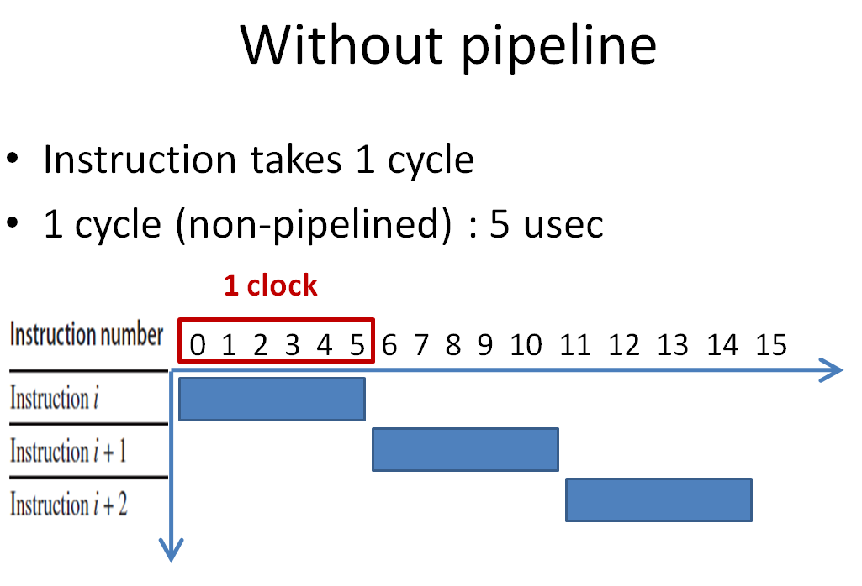
With pipeline: Is it faster?
Instruction takes 5 cycles now!
1 cycle (pipelined) : 1 usec = 5 usec/5 stages
1 clock
Throughput improved:
“3 instr. in 7 usec” vs “3 instr. in 15 usec”

Slide 21
What about latency?
Instruction latency longer now
Latch at end of each stage adds latency
Longest stage determines clock cycle time
Example:
Pipelining is for instruction throughput, not latency!!!
IF | 1.0 ns
ID | 0.6 ns
EX | 0.9 ns
MEM | 1.2 ns
WB | 0.4 ns
Design | Cycle time | # of cycles | Inst Latency
1-stage | 4.1 ns (sum) | 1 | 4.1 ns
5-stage | 1.2 ns (max) | 5 | 6.0 ns

Slide 22
Super-pipelining!
Speedup ~ number of stages
Idea: let’s have a lot of stages
How about >30? Think Pentium 4.
Clock / 30 → higher clock frequency!
How about 10000 pipeline stages?!
Problem: hurdles of pipelining!
Will be covered in next class.

