Slide 1
CIS 655/CSE 661 - Advanced Computer Architecture
ILP Data-Hazard Avoidance (2.2)
Dr. Yuzhe (Richard) Tang

Slide 2
ILP / Pipelining Hazards

Slide 3
Instruction-Level Parallelism (ILP)
Basic idea: Execute multiple instructions in parallel
Maximize instruction throughput
Pipelining is a basic and ideal way to realize ILP
Pipelining w stalls
Timeline

Slide 4
ILP in Practice: Pipelining Hazards
Pipelining hazards
A situation where (strictly) pipelining the program execution leads to incorrect result.
Causes:
Limited HW resources: Structural hazard
Data dependency in program: Data hazard
Dependency may/may not cause data hazards
Branch instructions: Branch hazard (next class)
Dependency & hazards
Dependency but no hazards
DADD R1, R2, R3
SD R1, O(R4)
DADD R1, R2, R3
…. (100 insns)
SD R1, O(R4)

Slide 5
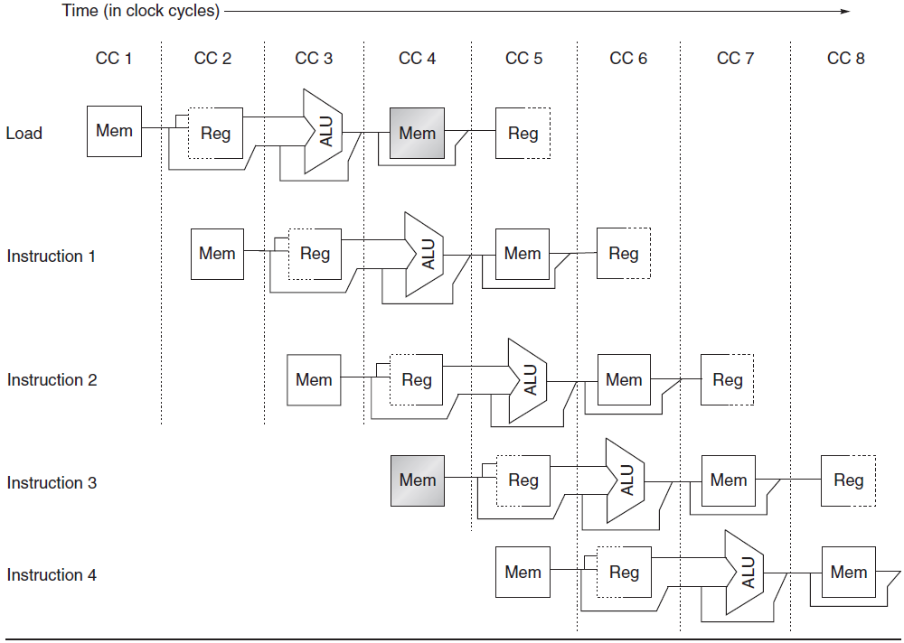
Structural Hazard
Caused by resource conflicts: e.g. registers

Slide 6
Structural Hazard Avoidance
Stalls
When a sequence of instructions encounters this hazard, the pipeline will stall one of the instructions until the required unit is available.

Slide 7
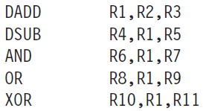
Data Hazard
Data hazard:
Pipelined execution changes the ordering data are accessed (i.e. read or written).
Caused by data dependence in program

Slide 8
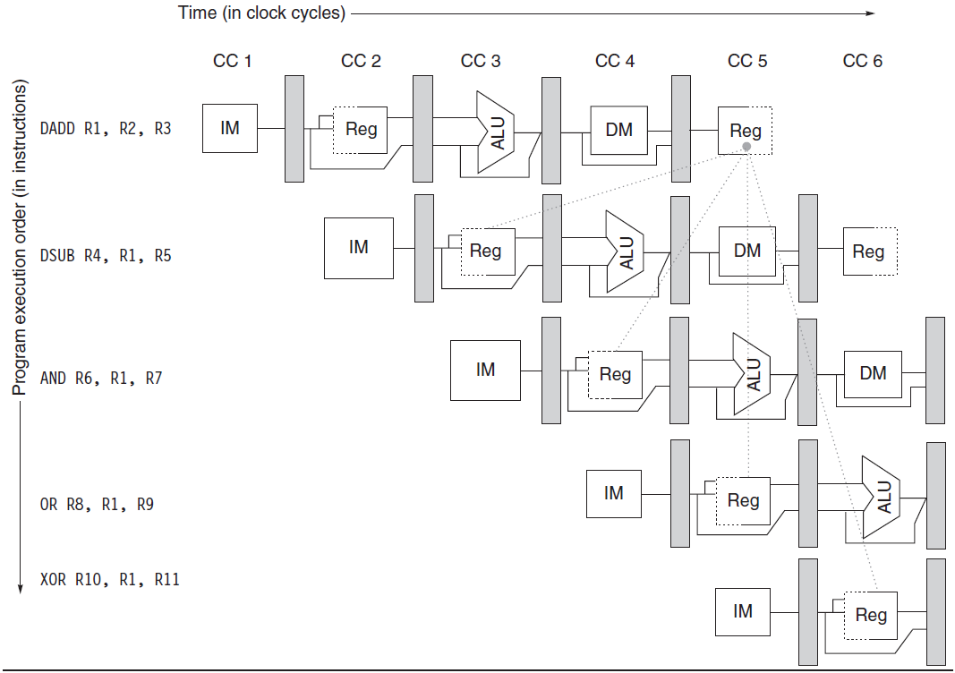
Data Hazard

Slide 9
Data Hazard Avoidance: Forwarding/Stalls
Data hazard:
When pipeline changes the ordering of read/write access in sequential access.
Forwarding
Stalls

Slide 10
Data/Name Dependences

Slide 11
Data Dependence
Data dependence
Instruction j is data-dependent on instruction i if
Instruction i produces a result that may be used by instruction j
Or more generally, operands of instruction i and j overlap
Dependent instructions cannot be executed simultaneously
Notes:
Loop-Level Parallelism
Unroll loop statically or dynamically
Use SIMD (vector processors and GPUs)

Slide 12
Data Dependences
R1 = R2 + R3
R4 = R1 * R4
Register dependencies
RAW, WAR, WAW, based on register number
Memory dependencies
Based on memory address
This is harder
Register names known at decode
Memory addresses not known until execute
SD R1, O(R4)
LD R2, O(R4)
Notes:
R1 = R2 + R3
R4 = R1 * R4

Slide 13
Data Dependencies
R1 = R2 + R3
R4 = R1 * R4
RAW: Read-After-Write
A writes to a location, B reads from the location, therefore B has a RAW dependency on A
True Dependence
WAR: Write-After-Read
A reads from a location, B writes to the location, therefore B has a WAR dependency on A
Anti-Dependence
WAW: Write-After-Write
A writes to a location, B writes to the location, therefore B has a WAW dependency on A
Output Dependence
R1 = R2 + R3
R2 = R3 * R4
R1 = R2 + R3
R1 = R3 * R4
Name dependence

Slide 14
Impact of Ignoring Dependencies
Read-After-Write
Write-After-Read
Write-After-Write
A: R1 = R2 + R3
B: R4 = R1 * R4
A: R1 = R3 / R4
B: R3 = R2 * R4
A: R1 = R2 + R3
B: R1 = R3 * R4
R1
5
A
7
7
R1
5
A
3
3
R1
5
A
7
B
27
B
R2
-2
-2
-2
R2
-2
-2
-2
R2
-2
-2
-2
R3
9
9
B
9
R3
9
9
-6
R3
9
9
9
R4
3
3
21
R4
3
3
3
R4
3
3
3
R1
5
5
A
7
R1
5
5
A
-2
R1
5
B
27
A
7
B
R2
-2
-2
-2
R2
-2
-2
-2
R2
-2
-2
-2
R3
9
B
9
9
R3
9
-6
-6
R3
9
9
9
R4
3
15
15
R4
3
3
3
R4
3
3
3
Notes:
Each is an example of how you will get the wrong results if you reorder two instructions that have a register dependency.

Slide 15
False Dependences
Name dependences are false dependences
WAW, WAR
Can be solved by renaming registers
Assuming there are enough registers

Slide 16
Eliminating WAR Dependencies
WAR dependencies are from reusing registers
A: R1 = R3 / R4
B: R3 = R2 * R4
A: R1 = R3 / R4
B: R5 = R2 * R4
X
R1
5
A
3
3
R1
5
5
A
-2
R1
5
5
A
3
B
B
B
R2
-2
-2
-2
R2
-2
-2
-2
R2
-2
-2
-2
R3
9
9
-6
R3
9
-6
-6
R3
9
9
9
R4
3
3
3
R4
3
3
3
R4
3
3
3
R5
4
-6
-6
With no dependencies, reordering
still produces the correct results
Notes:
example shows how using a different architected register removes WAR

Slide 17
Eliminating WAW Dependencies
WAW dependencies are also from reusing registers
A: R1 = R2 + R3
B: R1 = R3 * R4
A: R5 = R2 + R3
B: R1 = R3 * R4
X
R1
5
A
7
B
27
R1
5
B
27
A
7
R1
5
B
27
A
27
R2
-2
-2
-2
R2
-2
-2
-2
R2
-2
-2
-2
R3
9
9
9
R3
9
9
9
R3
9
9
9
R4
3
3
3
R4
3
3
3
R4
3
3
3
R5
4
4
7
Same solution works
Notes:
example shows similar for WAW

Slide 18
RAW: Compiler Scheduling & Loop Unrolling

Slide 19
RAW Hazard Avoidance by Scheduling
Stalling is not enough
Then scheduling! The idea is to schedule or re-order the execution of instructions so that the dependency can go away.
Compiler approach: compiler scheduling, loop unrolling
HW approach: CPU OOO (out-of-order execution)
Correctness principle: OOO should execute “correctly”
To comply with program dependencies
Same state as if they’re executed one-at-a-time in order
ISA: “Outside appearance”
Internally (micro-architecture): “whatever order you want”
Micro-architecture basically includes everything not explicitly defined in ISA.
Out-of-order execution
Timeline

Slide 20
ILP in a Loop
Loop: L.D F0,0(R1)
ADD.D F4,F0,F2
S.D F4,0(R1)
DADDUI R1,R1,#-8
BNE R1,R2,Loop
RAW
for (i=999; i>=0; i=i-1)
x[i] = x[i] + s;
Compile
RAW
RAR
RAW

Slide 21
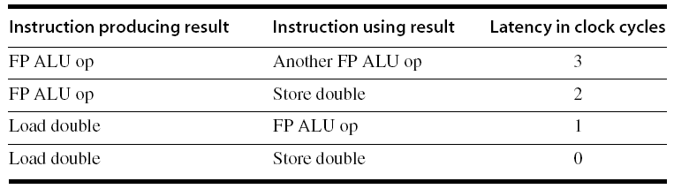
Pipeline Stalls
No stall cycles are needed for RAR; the latencies only apply for RAW!
Loop: L.D F0,0(R1)
ADD.D F4,F0,F2
S.D F4,0(R1)
DADDUI R1,R1,#-8
BNE R1,R2,Loop
Loop: L.D F0,0(R1)
stall
ADD.D F4,F0,F2
stall
stall
S.D F4,0(R1)
DADDUI R1,R1,#-8
stall (integer load latency is 1)
BNE R1,R2,Loop
RAW
RAW
RAR
RAW
Notes:
DADDUI: double-word add unsigned

Slide 22
Can Compiler Do Anything?
Stalls are inserted/enforced by HW
Can compiler help?
Pipeline scheduling
Given the gap/stalls between mutually-dependent instructions, fill it by putting independent instructions
Re-order the instruction

Slide 23
Pipeline Scheduling
8
Unscheduled code:
Loop: L.D F0,0(R1)
stall
ADD.D F4,F0,F2
stall
stall
S.D F4,0(R1)
DADDUI R1,R1,#-8
stall (integer load latency is 1)
BNE R1,R2,Loop
8
Scheduled code:
Loop: L.D F0,0(R1)
DADDUI R1,R1,#-8
ADD.D F4,F0,F2
stall
stall
S.D F4, 0 (R1)
BNE R1,R2,Loop
0
8
0
8
DADDUI before ADD, LD, SD!
What about values?
Maintain the correct “outside appearance”.

Slide 24
Call for Larger Code Block
Scheduled code:
Loop: L.D F0,0(R1)
DADDUI R1,R1,#-8
ADD.D F4,F0,F2
stall
stall
S.D F4,8(R1)
BNE R1,R2,Loop
Idea: The larger the code block is, the more opportunities there are for scheduling instructions.

Slide 25
Loop unrolling: Initial state
Regular loop
Unscheduled code:
Loop: L.D F0,0(R1)
stall
ADD.D F4,F0,F2
stall
stall
S.D F4,0(R1)
DADDUI R1,R1,#-8
stall (integer load latency is 1)
BNE R1,R2,Loop
Scheduled code:
Loop: L.D F0,0(R1)
DADDUI R1,R1,#-8
ADD.D F4,F0,F2
stall
stall
S.D F4,8(R1)
BNE R1,R2,Loop
for (i=999; i>=0; i=i-1)
x[i] = x[i] + s;
Loop unrolled
Unscheduled code:
Loop: L.D F0,0(R1)
stall
ADD.D F4,F0,F2
stall
stall
S.D F4,0(R1)
DADDUI R1,R1,#-8
stall (integer load latency is 1)
L.D F0,0(R1)
stall
ADD.D F4,F0,F2
stall
stall
S.D F4,0(R1)
DADDUI R1,R1,#-8
stall (integer load latency is 1)
BNE R1,R2,Loop
for (i=999; i>=0; i=i-2){
x[i] = x[i] + s;
x[i+1] = x[i+1] + s;
}

Slide 26
Loop unrolling
Unscheduled unrolled code:
Loop: L.D F0,0(R1)
stall
ADD.D F4,F0,F2
stall
stall
S.D F4,0(R1)
DADDUI R1,R1,#-8
stall (integer load latency is 1)
BNE R1,R2,Loop;
L.D F0,0(R1)
stall
ADD.D F4,F0,F2
stall
stall
S.D F4,0(R1)
DADDUI R1,R1,#-8
stall (integer load latency is 1)
BNE R1,R2,Loop
Scheduled unrolled code:
Loop: L.D F0,0(R1)
L.D F5,-8(R1)
ADD.D F4,F0,F2
ADD.D F9,F5,F2
DADDUI R1,R1,#-16
S.D F4,16(R1)
S.D F9,8(R1)
BNE R1,R2,Loop
Unscheduled code:
Loop: L.D F0,0(R1)
stall
ADD.D F4,F0,F2
stall
stall
S.D F4,0(R1)
DADDUI R1,R1,#-8
stall (integer load latency is 1)
BNE R1,R2,Loop
Scheduled code:
Loop: L.D F0,0(R1)
DADDUI R1,R1,#-8
ADD.D F4,F0,F2
stall
stall
S.D F4,8(R1)
BNE R1,R2,Loop
Eliminate conditional branch instructions
for (i=999; i>=0; i=i-1)
x[i] = x[i] + s;
Unscheduled code:
Loop: L.D F0,0(R1)
stall
ADD.D F4,F0,F2
stall
stall
S.D F4,0(R1)
DADDUI R1,R1,#-8
stall (integer load latency is 1)
L.D F0,0(R1)
stall
ADD.D F4,F0,F2
stall
stall
S.D F4,0(R1)
DADDUI R1,R1,#-8
stall (integer load latency is 1)
BNE R1,R2,Loop
for (i=999; i>=0; i=i-2){
x[i] = x[i] + s;
x[i+1] = x[i+1] + s;
}
More chances for reordering
-16

Slide 27
Loop unrolling: Outcome
Unscheduled code:
Loop: L.D F0,0(R1)
stall
ADD.D F4,F0,F2
stall
stall
S.D F4,0(R1)
DADDUI R1,R1,#-8
stall (integer load latency is 1)
BNE R1,R2,Loop
Unscheduled code:
Loop: L.D F0,0(R1)
stall
ADD.D F4,F0,F2
stall
stall
S.D F4,0(R1)
DADDUI R1,R1,#-8
stall (integer load latency is 1)
BNE R1,R2,Loop
Scheduled code:
Loop: L.D F0,0(R1)
DADDUI R1,R1,#-8
ADD.D F4,F0,F2
stall
stall
S.D F4,8(R1)
BNE R1,R2,Loop
for (i=999; i>=0; i=i-1)
x[i] = x[i] + s;
Unscheduled code:
Loop: L.D F0,0(R1)
stall
ADD.D F4,F0,F2
stall
stall
S.D F4,0(R1)
DADDUI R1,R1,#-8
stall (integer load latency is 1)
L.D F0,0(R1)
stall
ADD.D F4,F0,F2
stall
stall
S.D F4,0(R1)
DADDUI R1,R1,#-8
stall (integer load latency is 1)
BNE R1,R2,Loop
Scheduled unrolled code:
Loop: L.D F0,0(R1)
L.D F5,-8(R1)
ADD.D F4,F0,F2
ADD.D F9,F5,F2
DADDUI R1,R1,#-16
S.D F4,16(R1)
S.D F9,8(R1)
BNE R1,R2,Loop
for (i=999; i>=0; i=i-2){
x[i] = x[i] + s;
x[i+1] = x[i+1] + s;
}

Slide 28
Want More Speedup?
Unroll by a factor of 4, 8, …
# of iterations divisible by the unrolling factor
Eliminate unnecessary instrs, remove stalls
Loop:L.D F0,0(R1)
ADD.D F4,F0,F2
S.D F4,0(R1) ;drop DADDUI & BNE
L.D F6,-8(R1)
ADD.D F8,F6,F2
S.D F8,-8(R1) ;drop DADDUI & BNE
L.D F10,-16(R1)
ADD.D F12,F10,F2
S.D F12,-16(R1) ;drop DADDUI & BNE
L.D F14,-24(R1)
ADD.D F16,F14,F2
S.D F16,-24(R1)
DADDUI R1,R1,#-32
BNE R1,R2,Loop
Limiting infinite unrolling
Limited number of live registers
Code size (increasing time on IF stage)

Slide 29
Conclude: Pipelining Hazard Avoidance
Basic solution: Stalling pipeline
Structural hazard: forwarding, renaming
Data hazard
Compiler: compiler scheduling and loop unrolling
Hw: dynamic scheduling (or out-of-order execution OOO)
Branch hazard
Branch prediction (next class)
Implementation and application:
Compiler-based static approaches
Not so successful outside of scientific applications
Hardware-based dynamic approaches
Used in server and desktop processors
Not used as extensively in PMD processors

