Slide 1
CIS 655/CSE 661 - Advanced Computer Architecture
Branch Hazard Avoidance by Prediction (2.3)
Dr. Yuzhe (Richard) Tang
Textbook: 3.3, 3.9, C.2

Slide 2
Branch Hazard & Prediction (Overview)

Slide 3
Branch Hazards
Branch instruction is fundamentally hard to execute inside pipeline
Don’t know which instruction to fetch after the branch
Branch outcome only known after the EX stage
Don’t know which instruction to continue before the EX stage.
And it matters! Approx. 20% of all instructions are branches

Slide 4
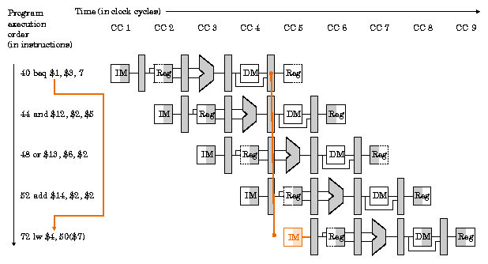
Why Branch is Hard to Pipeline
Cite: http://www.cs.fsu.edu/~hawkes/cda3101lects/chap6/F6.50.gif

Slide 5
Branch Hazard Avoidance
Stalls (until branch finishes WB)
Predict the branch:
Fetch/decode on the predicted path
On EX:
Option 1: Don’t execute until branch resolved
Option 2: Execute anyway (speculation)
Recover from misprediction
Restart fetch from correct path

Slide 6
Branch Prediction
Need to know two things
Direction: Whether the branch is taken or not
Target: The target address if it is taken
Direct jumps, Function calls
Direction known (always taken), target easy to compute
Indirect jumps, function returns
Direction known (always taken), target difficult
Conditional Branches (typically PC-relative)
Direction difficult to predict, target easy to compute
Foo(){
B;
C;
}
Main(){
A;
Foo();
D;
}
If (v == 1){
A;
} Else {
B;
}

Slide 7
Branch Direction Prediction

Slide 8
Static Branch Prediction
Direction prediction on conditional branches
Static: fixed rule, or compiler annotation
NT: Always predict NT
easy to implement
30-40% accuracy … not so good
T: Always predict T
60-70% accuracy
BTFNT (Backward T, Forward NT)
Going backward is a good sign of loop
Loops usually have a number of iterations, so this is like always predicting that the loop is taken
“BEQL” is “branch if equal likely”

Slide 9
Advanced Branch Prediction
Dynamic branch prediction for direction
Basic 2-bit predictor
Two-level predictor
Tournament predictor
Combine multiple types of predictors

Slide 10
One-Bit Branch Predictor
Branch history table (BHT) 2^k entries, each of 1 bit
Branch PC (k bits)
Index
Use this entry to predict this branch:
0: predict not taken
1: predict taken
Note: we know this before we even fetch the instruction
When branch direction resolved, go back into the table and update entry: 0 if not taken, 1 if taken

Slide 11
One-Bit Branch Predictor (cont’d)
0xDC08: for(i=0; i < 100000; i++)
{
0xDC44: if( ( i % 100) == 0 )
tick( );
0xDC50: if( (i & 1) == 1)
odd( );
}
T
T
N
Correct!
Correct!
N
N
N
Correct!
Wrong!
T
N
T
Predict based on what happened the last time.

Slide 12
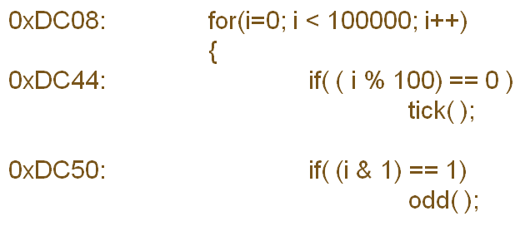
One-Bit Branch Predictor: Performance
DC08: TTTTTTTTTTT ... TTTTTTTTTTNTTTTTTTTT …
100,000 iterations
NT
How often is branch outcome != previous outcome?
2 / 100,000
TN
99.998%
Prediction
Rate
DC44: TTTTT ... TNTTTTT … TNTTTTT …
2 / 100
98.0%
DC50: TNTNTNTNTNTNTNTNTNTNTNTNTNTNT …
2 / 2
0.0%
Each anomaly in a stable pattern results in two mispredictions per loop
Notes:
T -> taken N->not taken

Slide 13
Two Bits are Better Than One
Predict NT
Predict T
Transition on T outcome
2
3
Transition on NT outcome
0
1
0
1
FSM for Last-Outcome
Prediction
FSM for 2bC
(2-bit Counter)

Slide 14
Performance
Checkmark: predict right
Crossmark: predict wrong
Only 1 Misprediction per N branches now!
DC08: 99.999% DC44: 99.0%
1bC:
Initial Training/Warm-up
0
1
1
1
1
…
1
1
0
1
1
…
T
T
T
T
T
T
N
T
T
T
✗
✓
✓
✓
✓
✓
✗
✗
✓
✓
2bC:
0
1
2
3
3
…
3
3
2
3
3
…
T
T
T
T
T
T
N
T
T
T
✗
✗
✓
✓
✓
✓
✗
✓
✓
✓
2
3
0
1
FSM for 2bC
(2-bit Counter)
Notes:
1bc -> 1 bit predictor , T -> actual outcome of branch taken , N->actual outcome of branch not taken, 0 -> wrong prediction , 1-> correct prediction
2bc (2bit counter) -> 0->1 transition on taken, 1->2 transition on taken(t), finally stays at 3 … , (green -> follow taken arrow(t), red-> follow not taken(n) )

Slide 15
Performance: How about DC50?
DC50: N T N T N T …
2
3
3
2
3
2
3
2
N
T
N
T
N
T
✗
✓
✗
✓
✗
✓
0
1
2-bit for DC50?
Always predict T
Miss-prediction rate: 50%
FSM for 2bC
(2-bit Counter)
Notes:
Initially is misprediction, because N is not taken , but state is 3, (observe here 2 , 3 are green so T is tick(\/) here but * is wrong for these states)

Slide 16
Importance of Branches
98% → 99%
Who cares?
Actually, it’s 2% misprediction rate → 1%
Half as many mispredictions!
So what?
If misp rate equals 50%, and 1 in 5 insts is a branch, then number of useful instructions that we can fetch is:
5*(1 + ½ + (½)² + (½)³ + … ) = 10
If we halve the miss rate down to 25%:
5*(1 + ¾ + (¾)² + (¾)³ + … ) = 20
Halving the miss rate doubles the number of useful instructions that we can try to extract ILP from

Slide 17
Still Not Good Enough
These are good
We can live with these
This is bad!

Slide 18
The case of Branch at 0xdc50?
DC50: NTNTNT …
Both 1bc and 2bc don’t do well (50% at best)
But it’s still obviously predictable
Why?: It has a repeating pattern: (NT)*
Patterns are common? (TTNTN)*
Key idea: Remember patterns!
(NT)* has two patterns:
NT → N
TN → T
Let’s remember both patterns!
Implementation: Having more pred. per branch instruction
Previously, only one predictor (one PHT entry) per branch
Notes:
Assume, for example, that a conditional jump is taken every third time. The branch sequence is 001001001... In this case, entry number 00 in the pattern history table will go to state "strongly taken", indicating that after two zeroes comes a one. Entry number 01 will go to state "strongly not taken", indicating that after 01 comes a 0. The same is the

Slide 19
Using Two-Level Predictor
A (m, n) two-level branch predictor:
PHT: Pattern-history table
PHT Index: Branch PC + shift register (BHR)
PHT has 2^m predictors, each of n-bit
Different patterns are now handled separately!
For one target PC, two patterns (NT)* and (TN)* remembered
By different 2-bit predictors!
Branch PC
Index
f
T/N
2^m
n
BHR
PHT
Notes:
Assume, for example, that a conditional jump is taken every third time. The branch sequence is 001001001... In this case, entry number 00 in the pattern history table will go to state "strongly taken", indicating that after two zeroes comes a one. Entry number 01 will go to state "strongly not taken", indicating that after 01 comes a 0. The same is the

Slide 20
0xDC50 with two-level predictor
DC50:
3
3
2
3
1
3
3
…
0
N
T
N
T
N
T
N
T
N
T
✗
✓
✗
✓
✓
✓
✓
✓
Index
2
3
DC50
f
NT:
1
2
3
m
TN:
0
1
3
n
NT/TN
BHR
PHT

Slide 21
Further Improve: Interplay between branches?
Example: related branch conditions
p = findNode(foo);
if ( p is parent )
do something;
do other stuff; /* may contain more branches */
if ( p is a child )
do something else;
A:
Outcome of second
branch is always
opposite of the first
branch
B:

Slide 22
Other Global Correlations
Testing same/similar conditions
code might test for NULL before a function call, and the function might test for NULL again
in some cases it may be faster to recompute a condition rather than save a previous computation in memory and re-load it
partial correlations: one branch could test for cond₁, and another branch could test for cond₁ && cond₂ (if cond₁ is false, then the second branch can be predicted as false)
multiple correlations: one branch tests cond₁, a second tests cond₂, and a third tests cond₁ ⊕ cond₂ (which can always be predicted if the first two branches are known).

Slide 23
Global/Local Predictor
Local predictor
What is the predicted direction of Branch A given the outcomes of previous instances of Branch A?
Each PHT entry recording the last n outcomes of the branch
Global predictor
What is the predicted direction of Branch Z given the outcomes of all* previous branches A, B, …, X and Y?
Each PHT entry recording the outcomes of preceding n branches

Slide 24
Global/Local predictor implementation
BHR: recent outcomes
Global: one entry (by Intel)
Local: multi-entries, one per branch
Index
Branch PC
f
T/N
m
n
BHR
PHT

Slide 25
Direction Prediction by Tournament Predictor

Slide 26
Tournament Predictors
No predictor is clearly the best
Different branches exhibit different behaviors
Some “constant”, some global, some local
Idea: Let’s have a meta-predictor to predict which predictor will do a better job? ☺

Slide 27
Tournament Hybrid Predictors
Pred₀
Pred₁
Selector
table of 2-/3-bit counters
Final Prediction
Pred₀ | Pred₁ | Meta Update
✗ | ✗ | ---
✗ | ✓ | Inc
✓ | ✗ | Dec
✓ | ✓ | ---
If meta-counter MSB = 0,
use pred₀ else use pred₁

Slide 28
Common Combinations
Global history + Local history
“Easy” branches + global history
2bC and gshare
Short history + long history
Many types of behaviors, many combinations

Slide 29
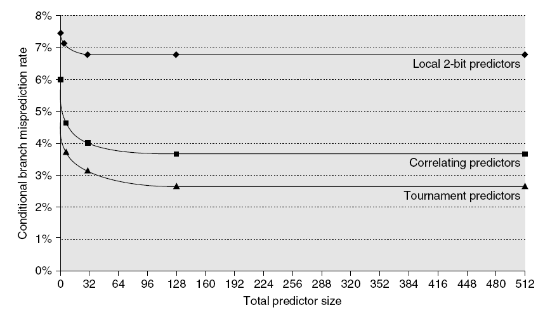
Branch Prediction Performance
Branch predictor performance

Slide 30
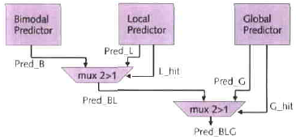
Examples
Alpha 21264 (RISC): Tournament predictor
Combines local and global history components with a meta-predictor
Pentium M:
Hybrid: uses tag-based selection mechanism
Local component for loops
It accurately predicts branches of form (T^{k}N)*

Slide 31
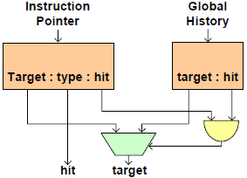
Pentium-M (cont’d)
Special target prediction for indirect branches
common in object-oriented code (vtables)
assumes correlation with global history

Slide 32
Branch Target Prediction

Slide 33
Target Address Prediction
To maintain pipeline, target addr. needs known right after IF
For direct branch, target only known after ID; too late
For indirect branch, target known after EX/MEM stage; way too late
So, we need a quick-and-dirty predictor for the target addr.
 | CC1 | CC2 | CC3 | CC4 | CC5 | CC6
CALL foo | IF | ID | EX | MEM | WB
foo |  | IF | ID | EX | MEM | WB

Slide 34
Branch Target Buffer for CALL/JMP
BTB indexed by instruction address
We don’t even know if it is a branch!
If address matches a BTB entry, it is predicted to be a branch
BTB entry tells whether it is taken (direction) and where it goes if taken
BTB takes only the instruction address, so while we fetch one instruction in the IF stage we are predicting where to fetch the next one from
Direction prediction can be factored out into separate table

Slide 35
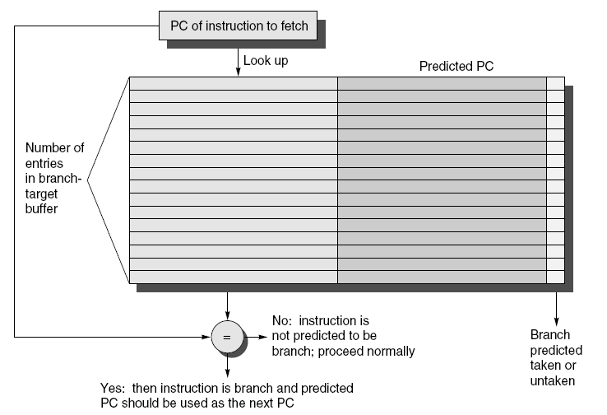
Branch Target Buffer

Slide 36
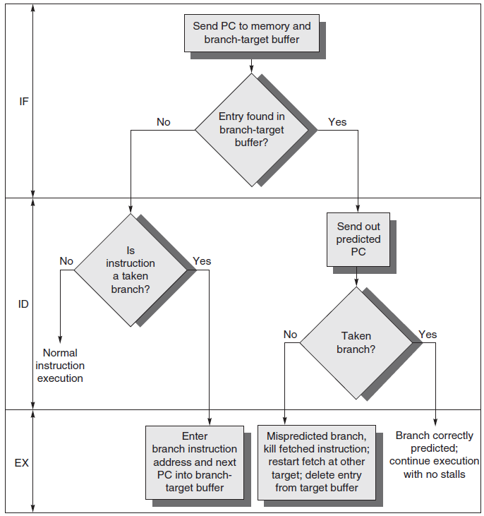
BTB with Conditional Branch
Situation
The pipeline for instruction predicted to run after a taken branch

Slide 37
Return Address Stack (RAS) for RET
Function returns are frequent, yet
Address is difficult to compute (have to wait until EX stage done to know it)
Address difficult to predict with BTB (function can be called from multiple places)
But return address is actually easy to predict
It is the address after the last call instruction that we haven’t returned from yet
Hence the Return Address Stack
Notes:
return address stacks are also very simple: they're fixed size stacks of return addresses.
to use a return address stack, we push pc+4 onto the stack when we execute a procedure call instruction. this pushes the return address of the call instruction onto the stack - when the call is finished, it will return to pc+4 of the procedure call instruction. when we execute a return instruction, we pop an address off the stack, and predict that the return instruction will return to the popped address.
since return instructions almost always return to the last procedure call instruction, return address stacks are highly accurate.
remember that return address stacks only generate predictions for return instructions. they don't help at all for procedure call instructions [we use the btb to predict calls].

Slide 38
Return Address Stack (RAS)
Call pushes return address into the RAS
When a return instruction decoded, pop the predicted return address from RAS
Accurate prediction even w/ small RAS

Slide 39
Conclusion and reading lists
Dynamic branch direction prediction
2-bit predictor (Textbook C.2)
Correlating predictor
Textbook 3.3
http://en.wikipedia.org/wiki/Branch_predictor#Global_branch_prediction
Tournament predictor (Textbook 3.3)
Branch target prediction (Textbook 3.9)
Ack: Prof. Milos’s slides

