Slide 1
CIS 655/CSE 661 - Advanced Computer Architecture
Multi-issue processor and SIMD (2.5)
Dr. Yuzhe (Richard) Tang
Textbook: 3.7, 3.9, 3.12, 4

Slide 2
Multi-issue processor

Slide 3
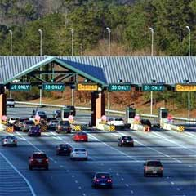
Example: Toll Booth
Caravanning on a trip, must stay in
order to prevent losing anyone
D
C
B
A
When we get to the toll, everyone gets
in the same lane to stay in order
This works… but it’s slow. Everyone has to
wait for D to get through the toll booth
Go through two at a time
(in parallel)
Lane 1
Lane 2
You Didn’t
See That…
Before Toll Booth
After Toll Booth

Slide 4
Multi-issue processor
To achieve CPI < 1
Multiple functional units: adder, multiplier, FP units, mem-access, etc
Can issue/complete multiple instructions per clock
Superscalar processor
Varying number of instrs to issue per clock
Static scheduled superscalar: In-order EX
Dynamic scheduled superscalar: Out-of-order EX

Slide 5
VLIW Processors
VLIW processor:
Fixed number of instrs to issue per clock
In-order EX: static scheduled
Package multiple operations into one instruction
Example VLIW processor:
One integer instruction (or branch)
Two independent floating-point operations
Two independent memory references
Enough parallelism in code to fill available slots

Slide 6
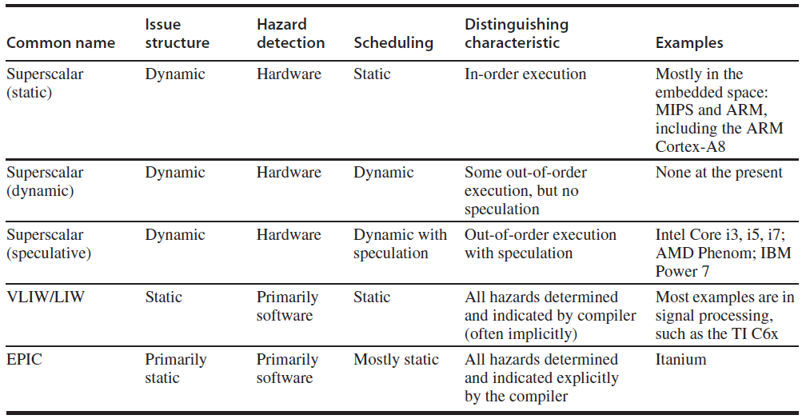
Multi-issue processor: Towards CPI < 1

Slide 7
Speculation: HW vs SW
HW speculation: pros
Runtime behavior is unpredictable at compile time
Disambiguate memory reference
Branch predictions
No bookkeeping code
Required by ambitious SW speculation
SW speculation: pros
Have global view: be able to see further in code seq.
Less complexity in HW

Slide 8
High-Bandwidth Instruction Stream
It needs to deliver a high-bandwidth instruction stream.
4-8 instruction per cycle.
Fetch (IF) efficiently:
Fetching branches: BTB, RAS
Advanced speculation

Slide 9
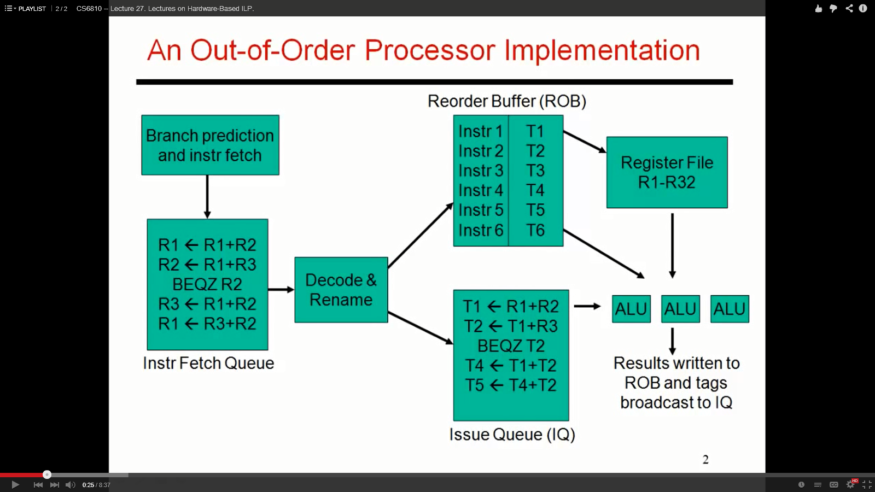
Register Renaming with ROB
Extra RF used to rename register
Avoid hazards by naming dep.: WAW/WAR
Simple heuristic: always rename it!
Ack: Prof. Rajeev Balasubramonian

Slide 10
HW Multithreading

Slide 11
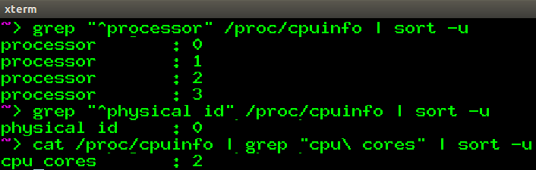
HW multithreading: Concept
HW multithreading for a single processor
Different from multi-processing
Different from SW threads
HW multi-threading
Demo: Hyper-threading by Intel
virtual core ids (Hw Threads)
physical processor ids
# physical cores per processors
Notes:
There is one package of CPU (physical ID), two cores(hardware level), 4 HW threads => each core has 2 HW threads
HW thread is single pipeline

Slide 12
HW multithreading: Pros
Multithreading share resources
Increase of threads will not increase HW resources
Thus, HW multithreading can hide stalls due to cache misses and memory accesses.

Slide 13
HW multithreading: Cons
Still there are private states per thread
Private thread state: PC, register files, renaming tables, page tables (if running dedicated program)
Private states need to be saved/loaded every-time there is a switch between threads.

Slide 14
Scheduling: How to switch threads
CMT: coarse-grained multi-threading
Switch whenever the current thread has a (long) stall
☹: need to flush pipeline upon thread switch (branch pred.)
FMT: fine-grained multi-threading
Switch every clock cycle
Scheduling in round-robin and to non-stalled threads.
☺: be able to handle both long and short stalls
☺: no empty cycles (i.e. all slots are empty on that cycle)
☹: longer latency for non-stalling threads (more switches)
Notes:
Because CMT issues instruction from a single thread, upon switching it may need to flush all instructions in progress in the current pipeline. In other words, not every time it can switch, but only when all instructions in the current pipeline finishes!!!

Slide 15
Scheduling: How to switch threads
SMT: Simultaneous multi-threading
A variant of FMT on multi-issue, dynamic scheduled processor.
Reg renaming and dynamic scheduling allows multiple independent threads to execute
In essence, SMT converts TLP into ILP
SMT is called Hyper-threading in Intel processors

Slide 16
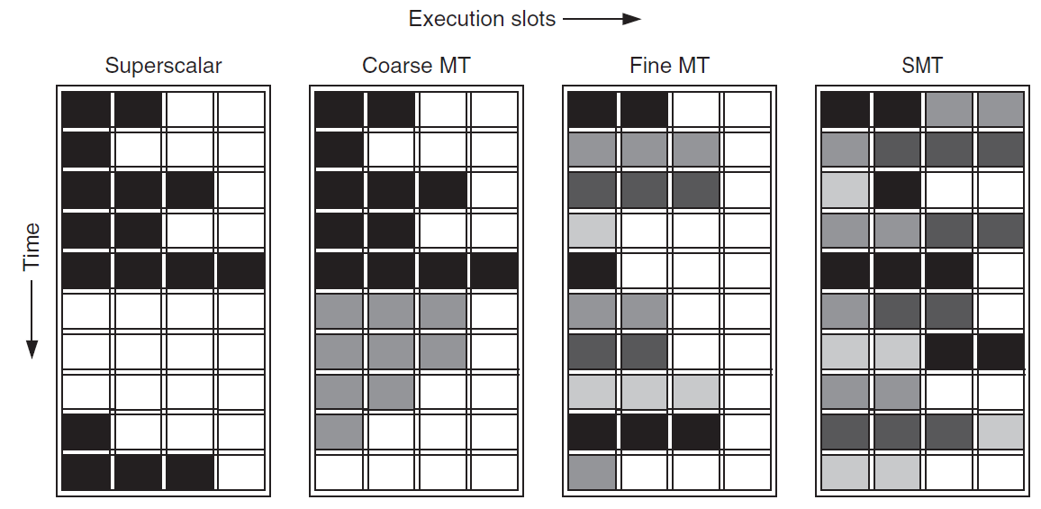
Multithreading
C program
Partitioned assembly code
T1
T1
T2
T1
T2
T3
T4
Stall!
Stall on T1
Notes:
X axis is referring to different functional units

Slide 17
DLP in Vector, SIMD, GPU

Slide 18
Introduction
Introduction
SIMD architectures can exploit significant data-level parallelism for:
matrix-oriented scientific computing
media-oriented image and sound processors
SIMD is more energy efficient than MIMD
Only needs to fetch one instruction per data operation
Makes SIMD attractive for personal mobile devices
SIMD allows programmer to continue to think sequentially

Slide 19
SIMD Parallelism
Introduction
Three SIMD variations
Vector architectures: many pipelined ops
SIMD extensions: simu. data parallel ops, media app.,
Graphics Processor Units (GPUs): display, massive number of small threads.
For x86 processors:
Expect two additional cores per chip per year
SIMD width to double every four years
Potential speedup from SIMD to be twice that from MIMD!
Intel AVX-128, AVX-256, etc

Slide 20
Vector Architectures
Vector Architectures
Basic idea:
Read sets of data elements into “vector registers”
Operate on those registers
Disperse the results back into memory
Registers are controlled by compiler
Used to hide memory latency
Leverage memory bandwidth

Slide 21
Sparse Data by Scatter-Gather
Vector Architectures
Scatter-and-gather supports moving
Between compressed and normal representations.
Between index and expanded data forms.
Consider the case of sparse vectors (A[] is indexed by another vector):
for (i = 0; i < n; i=i+1)
A[K[i]] = A[K[i]] + C[M[i]];
Use index vector:
LV Vk, Rk ;load K
LVI Va, (Ra+Vk) ;load A[K[]]
LV Vm, Rm ;load M
LVI Vc, (Rc+Vm) ;load C[M[]]
ADDVV.D Va, Va, Vc ;add them
SVI (Ra+Vk), Va ;store A[K[]]
sparse
dense
Gather: from sparse to dense form
Scatter: from dense to sparse form
Notes:
LV Vk Rk: Rk is regular register storing address of K[0], while Vk is a vector register of n elements

Slide 22
SIMD Extensions
Media applications operate on data types narrower than the native 32-bit word.
Example: 8 bit for each color (GRB)
Limitations, compared to vector instructions:
Fixed number of operands encoded in op code
No sophisticated addressing modes (scatter-gather)
SIMD Instruction Set Extensions for Multimedia

Slide 23
SIMD Implementations
Implementations:
Intel MMX (1996)
MMX-64: Eight 8-bit integer ops or four 16-bit integer ops
Streaming SIMD Extensions (SSE) (1999)
SSE-128: Eight 16-bit integer ops, Four 32-bit integer/fp ops or two 64-bit integer/fp ops
Advanced Vector Extensions (2010)
AVX-256: Four 64-bit integer/fp ops
AVX-512 (2013)
Operands must be consecutive and aligned memory locations
SIMD Instruction Set Extensions for Multimedia

Slide 24
Graphical Processing Units
Graphical Processing Units
Given the hardware invested to do graphics well, how to improve performance of a wider range of applications?
Basic idea:
Heterogeneous execution model
CPU is the host, GPU is the device
Develop a C-like programming language for GPU
Unify all forms of GPU parallelism as CUDA thread
Programming model is “Single Instruction Multiple Thread”

Slide 25
NVIDIA GPU Architecture
Graphical Processing Units
Similarities to vector machines:
Works well with data-level parallel problems
Scatter-gather transfers
Large register files
Differences:
No scalar processor
Uses multithreading to hide memory latency
Has many functional units, as opposed to a few deeply pipelined units like a vector processor

Slide 26
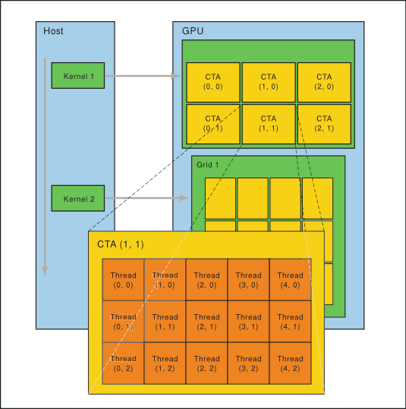
Threads and Blocks
Graphical Processing Units
A thread is associated with each data element
Threads are organized into blocks
Blocks are organized into a grid
Notes:
R(registers) - > threads(T) -> Block(B) -> G(GPU) i.e., set of regsiters form thread

Slide 27
Example
Graphical Processing Units
Multiply two vectors of length 8192
Code that works over all elements is the grid
Thread blocks break this down into manageable sizes
512 threads per block
SIMD instruction executes 32 elements at a time
Thus grid size = 16 blocks
Block is analogous to a strip-mined vector loop with vector length of 32
Block is assigned to a multithreaded SIMD processor by the thread block scheduler
Current-generation GPUs (Fermi) have 7-15 multithreaded SIMD processors

Slide 28
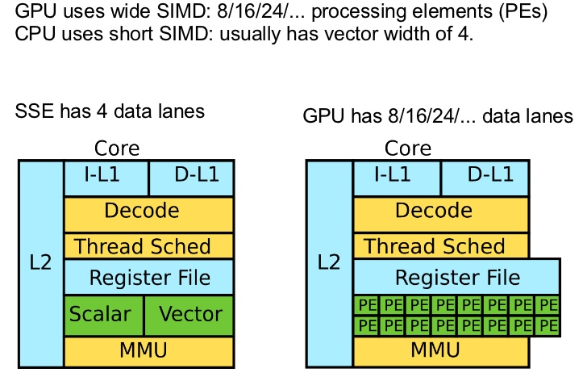
SIMD/GPU Hardware Model
Threads of SIMD instructions
Each has its own PC
Thread scheduler uses scoreboard to dispatch
GPU HW, not OS, handles thread management
No data dependencies between threads!
Keeps track of up to 48 threads of SIMD instructions
Hides memory latency
Within each SIMD processor:
32 SIMD lanes
Wide and shallow compared to vector CPU
Graphical Processing Units

Slide 29
SIMD/GPU : Example
Graphical Processing Units
NVIDIA GPU has 32,768 registers
Divided into lanes
There’re 16 physical SIMD lanes, each of 2048 registers
Each SIMD thread accesses one lane, with up to:
64 vector registers of 32 32-bit elements
32 vector registers of 32 64-bit elements

Slide 30
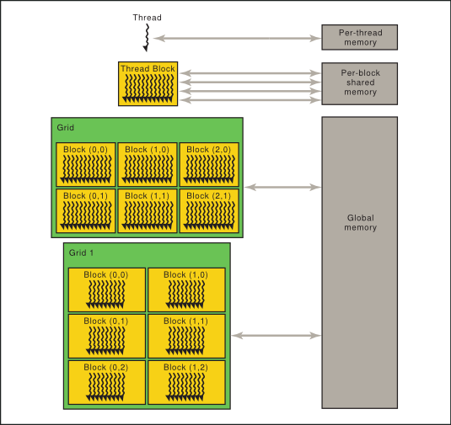
NVIDIA GPU Memory Structures
Private memory: SIMD Lane, off-chip DRAM
Contains stack frame, private variables, etc
Local memory: multithreaded SIMD processor
Shared by SIMD lanes / threads within a block
Shared GPU memory:
Host CPU can read and write GPU memory
Graphical Processing Units

Slide 31
Conclusion and reading lists
Multi-issue processors (Textbook 3.7, 3.9)
Multi-threading (Textbook 3.12)
DLP in Vector, SIMD, GPU (Textbook 4)

