Slide 1
CIS 655/CSE 661 - Advanced Computer Architecture
Virtual Memory (3.3)
Dr. Yuzhe (Richard) Tang
Textbook: B.4, B.5, 2.4

Slide 2
Virtual Memory

Slide 3
Views of Memory
Real machines have different memory sizes
640MB? A few GB?
(An average laptop: 2GB)
Programmer doesn’t want to be bothered
Do you think, “oh, this computer only has 128MB so I’ll write my code this way…”
What happens if you run on a different machine?

Slide 4
Programmer’s View
Example 32-bit memory layout
Segments
Independent of the actual memory there is
You don’t need to buy a machine with 4GB memory to run programs requiring 4GB space.
Kernel
0-2GB
Text
Data
Heap
Stack
4GB
A.K.A. Virtual Addresses
Notes:
Text seg. store program code
Data seg. store data
Heap stores global data
Stack stores local variable.

Slide 5
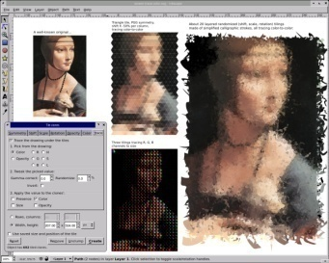

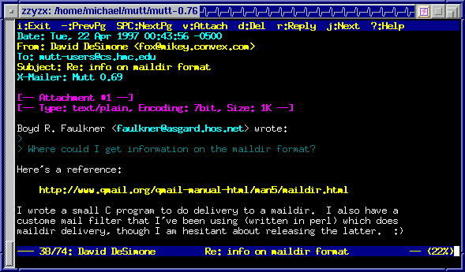
Programmer’s View (2)
Multi-programming:
Each process runs in an exclusive addr. space.
Context switches btwn processes at any time
Isolation btwn different addr. spaces
Kernel
Text
Data
Kernel
Kernel
Heap
Stack
Text
Text
Data
Data
Heap
Heap
Stack
Stack
Notes:
Text seg. store program code
Data seg. store data
Heap stores global data
Stack stores local variable.

Slide 6
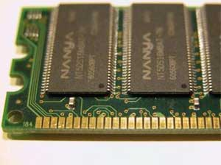
CPU’s View
At some point, the CPU is going to have to load-from/store-to memory… all it has to know is the real, A.K.A. physical memory
The physical space
is often not equal to 4GB
Multiple virt. spaces but only one physical memory.
And physical space is almost never
4GB per process

Slide 7
Connecting virt./phys. memories: Pages
Divide memory into pages
Pages are nothing more than fixed sized and aligned regions of memory
Typical size: 4KB/page (but not always)
0-4095
Page 0
4096-8191
Page 1
8192-12287
Page 2
12288-16383
Page 3
…

Slide 8
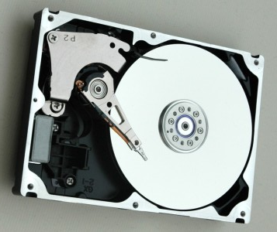
Page Table
Map from virtual addresses to physical locations
Physical
Addresses
0K
4K
0K
8K
4K
Page Table implements
this V→P mapping
12K
8K
16K
12K
20K
24K
Entry includes permissions (e.g., read-only)
28K
Virtual
Addresses
“Physical Location” may
include hard-disk

Slide 9

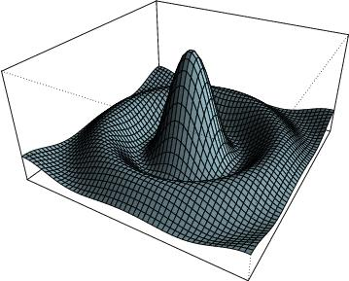
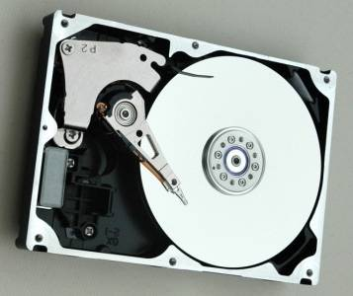
Multiple Page Tables
Physical Memory
0K
4K
0K
8K
4K
12K
8K
16K
12K
20K
24K
28K
0K
4K
8K
12K

Slide 10
Address Translation Mechanism
Instructions
(CPU/$)
0xFC51908B
Virtual Address
Virtual Page Number
Page Offset
Main
Memory
Page
Table
Physical
Address
0xFC519
0x00152
0x0015208B

Slide 11
Page Table Internals: Simple PT
Flat organization
One entry per page
Entry contains physical page number (PPN) or indicates page is on disk or invalid
Also meta-data (e.g., permissions, dirtiness, etc.)
One entry per page

Slide 12
Simple Page Table Size?
Assume:
32-bit address space for process
4KB page
Page table entry: 8 bytes
Page table size?
Notes:
print

Slide 13
Simple Page Table Size?
Assume:
32-bit address space for process
4KB page
Page table entry: 8 bytes
Page table size?
8 * 2³² / 4 * 1024
= 2²³ = 8MB
What if the program only uses 4MB of memory?
What if the page size is 1MB?
What if 64-bit address space?
Notes:
2^32 words . Each word stores a byte of information.

Slide 14
Multi-Level Page Tables
Virtual Page Number
Level 1
Level 2
Page Offset
X
Physical Page Number
Unused addr. space will not have level-2 page table

Slide 15
Multi-Level Page Table Size?
Assume:
32-bit address space for process, 4KB page
1st level uses 8 bits of indexing, 2nd level uses 12 bits
Page table entry: 8 bytes
First-level page table size?
Size? 8 * 2⁸ = 2¹¹ = 2KB
2⁸ entries also mean one L1 can point to up to 2⁸ L2 PTs
Second-level page table size?
8 * 2¹² = 2¹⁵ = 32KB
2¹² entries also mean one L2 can point to 2¹²=4096 pages
What if the program only uses 4MB of memory?
4MB can fit in one second-level PT (4MB=1000 pages < 4000 pages)
It will need 1 L1 and 1 L2 page tables.
Total page-table size: 2KB + 1 * 32KB=34KB
Notes:
Print, and failed before! need your attention!

Slide 16
Multi-Level Page Table Size?
Assume:
32-bit address space for process, 4KB page
1st level uses 5 bits of indexing, 2nd uses 6 bits, 3rd uses 9 bits
Page table entry: 8 bytes
First-level page table size?
8 * 2⁵ = 2⁸ = 256bytes
2⁵ entries also mean one L1 can point to up to 2⁵ L2 PTs
Second-level page table size?
8 * 2⁶ = 2⁹ = 512bytes
2⁶ entries also mean one L2 can point to 2⁶ L3 PTs
Third-level page table size?
8 * 2⁹ = 2¹² = 4KB
2⁹ entries also mean one L3 can point to 2⁹ pages = 2MB
What if the program only uses 4MB of memory?
It will need 1 L1, 1 L2 and 2 L3 page tables.
Total page-table size: 256 + 1 * 512 + 2 * 4KB < 9KB
Notes:
print

Slide 17
Choosing a Page Size
Small pages result in larger page table
Small page leads to less fragmentation
Big page likely to have more bytes unused
Large pages allow efficient transfer to/from disk
vs. many small transfers
Like downloading from Internet

Slide 18
TLB

Slide 19
Page Table’s Impact on Performance
Every load/store needs to access memory twice!
“LD R1 0xFC51908B”
First mem. access: translating 0xFC51908B to 0x0015208B
This could be more than one memory access (Why?)
Second mem. access: load data at 0x0015208B from physical mem.
Even worse, every IF (instruction fetch) requires translation of the PC!
Idea: cache the page table!

Slide 20
TLB: Cached Page Translations
TLB: a cache storing address translations
TLB = Translation Look-aside Buffer
Physical
Addresses
0K
0K
4K
4K
8K
8K
12K
12K
16K
20K
24K
28K
Virtual
Addresses
0
20
VPN 8
4
4
12
X
8
16
PPN 16

Slide 21
What if there is a TLB miss?
Option 1: Hardware TLB miss handling (x86)
Hardware register keeps page table location
Hardware knows how to read page table
Note: can be complex, e.g. if hierarchical page table
TLB miss stalls instruction until translation found
Option 2: Software TLB miss handling
Raise exception on TLB miss
Software TLB miss handler in OS
Finds translation (can use any page table structure)
Writes translation into TLB (need special privileged instruction for this)
Retry instruction (hopefully now a TLB hit)

Slide 22
TLB Design: Yet Another Cache
Used to be fully-associative
Any mapping can be kept in any TLB entry
Check all entries on each access
For low latency, this means few entries
However, each entry is for a whole page
Ex. 32-entry TLB, 4KB page… how big of working set while avoiding TLB misses?
If many misses:
Increase TLB size (latency problems)
Increase page size (fragmenation problems)

Slide 23
TLB Design: Yet Another Cache
Programs getting bigger
Larger working set → more pages active → need for TLB to remember more mappings
New processors include larger, but set-associative TLBs
Mapping can go into a specific part of the TLB
Use lowest bits of VPN to determine where it can go
Some also include multi-level TLBs (L1/L2)
If we don’t find mapping in L1, check L2, then memory
L1 small for speed, L2 larger to improve hit rate

Slide 24
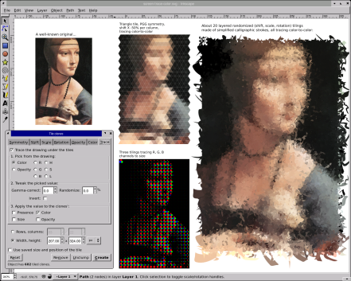
Process Changes
After context switch TLB content no longer valid!
Add process ID to translation
Only flush parts of TLB when recycling PIDs
0
4
20
PID:0
VPN:8
1
0
32
1
12
36
0
8
28
PPN: 28
PID:1
VPN:8
0
0
16
0
12
8
1
8
44
PPN: 44
1
4
52

Slide 25
Conclusion and reading lists
Virtual memory: B.4, B.5, 2.4
Memory protection: 2.4
Virtual machine: 2.5
Ack: Prof. Milos’s slides
Copyright © 2012, Elsevier Inc. All rights reserved.

