Slide 1
CIS 655/CSE 661 - Advanced Computer Architecture
Cache (3.2)
Dr. Yuzhe (Richard) Tang
Textbook: 2.1, 2.2, B.1, B.2, B.3

Slide 2
Cache: What and Why

Slide 3
Memory hierarchy
Memory hierarchy
Entire address space into the largest, slowest memory
Incrementally smaller and faster memories, each containing a subset of the memory below it
Fast memory technology is more expensive per bit than slower memory
Working:
Data is not found in the higher-level storage, a miss occurs.
Fetch data from lower level in hierarchy, incurring a higher latency reference
Why it works:
Temporal and spatial locality ensures that nearly all references can be found in smaller memories

Slide 4
Memory/storage hierarchy
Capacity +/Speed -
Motherboard
Disk
10TB/10ms
SRAM Cache
IO bus
Main Memory
10GB/100ns
Memory bus
Row buffer
Chip
1MB/20ns
L3 Cache
L2 Cache
256 KB/10ns
ITLB
Instruction Cache
Data Cache
DTLB
64 KB/1ns
Register File
1000 bytes/100ps(10⁻¹² sec)
CPU core
Bypass Network
Speed +/ Capacity -
Translation lookaside buffer

Slide 5
Why Cache?
Memory latency is long!
60-100ns not uncommon
It’s too long, from CPU’s perspective:
2GHz CPU → 0.5ns / cycle
100ns memory → 200 CPU cycles (idling wo/ cache)!
Memory wall: memory latency is improved slower than CPU speed!

Slide 6
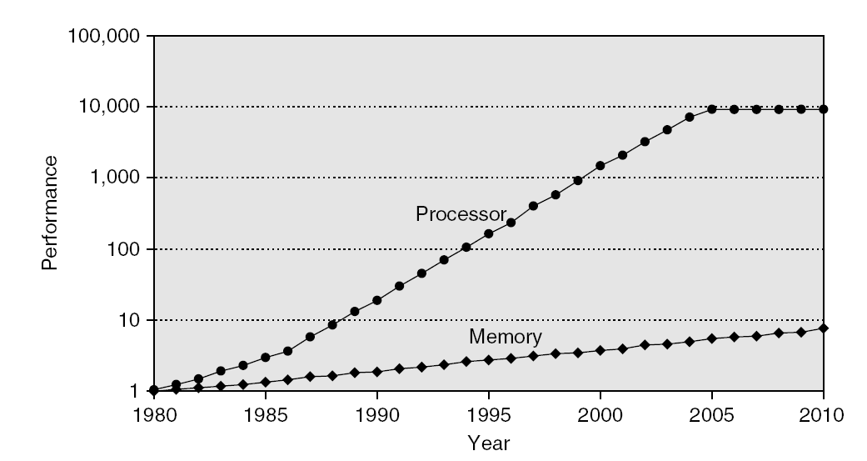
Why Cache?(2) CPU-mem perf. gap
Introduction

Slide 7
Why Cache?(3)
Multi-core processors calls for higher memory bandwidth
Required mem bandwidth increases with # core
Example: Intel Core i7 can generate two references per core per clock
Four cores and 3.2 GHz clock
25.6 billion 64-bit data references/second +
12.8 billion 128-bit instruction references
= 409.6 GB/s!
DRAM bandwidth is only 6% of this (25 GB/s)
Cache is needed!

Slide 8
Cache basics

Slide 9
Cache: Optimizing memory access
Fast (but small) memory close to processor
Data granularity
Word: finest granularity memory data is addressed
32 bits
Block: the granularity data is transferred from memory
between 4096 bytes and 32KB
When a word referenced
If in cache, use cache instead of memory
If not in cache, bring entire block (of words) into cache

Slide 10
Cache structure
Cache consists of block-sized lines
A line of multiple words
Line size typically power of two: 16-128 bytes
Example
Assume block size is 256=2⁸ bytes
Lowest eight bits determine offset within block
Read data at address A=0x7fffa3f4
Word address: | Line address | Offset
7 f f f a 3
f 4

Slide 11
Cache design
Important decisions
Placement: where in the cache can a block go?
Replacement: what to kick out to make room in cache?
Write policy: What do we do about stores?

Slide 12
1) Cache placement
Introduction
Placement:
How to map memory block to cache line?
Direct map => a block to only one line
Associative
Fully associative => a block to all lines
N-way set associative:
N-way set: a group of N lines
=> one block to a set of N lines
N = 1 => Direct-map
N = C (total # cache lines) => Fully associative

Slide 13
Direct Mapped Cache
To which line can it go? (3 bits)
Which part of cache block?
Word address: | Tag | Index | Offset
101
Cache Line #
0
1
2
3
4
5
6
7
Cache has 8 lines, need 3 bits that tell us which line to go

Slide 14
2-Way Set Associative Cache
To which line can it go? (2 bits)
Which part of cache block?
Address: | Tag | Index | Offset
10
Need 2 bits to tell us to which of the 4 sets to go
Cache Line #
0
1
2
3
4
5
6
7
Set 0
Cache has 8 lines, a block can go to one of two lines, so we have 4 sets of 2 lines each
Set 1
Set 2
Set 3

Slide 15
Fully Associative Cache
Which part of cache block?
Address: | Tag | Offset
No bits needed to tell us where it can go
Cache Line #
0
1
2
3
4
5
6
7
Block can go anywhere!

Slide 16
2) Cache replacement
Need a free line to insert new block (for set-associative cache)
Which block should we kick out?
Several strategies
Random (randomly selected line)
FIFO (line that has been in cache the longest)
LRU (least recently used line)
LRU Approximations: NMRU

Slide 17
Implementing LRU
Have LRU counter for each line in a set
When line accessed (cache hit)
Get old value X of its counter
Set its counter to max value
For every other line in the set
If counter larger than X, decrement it
When replacement needed (cache miss)
Select line whose counter is 0

Slide 18
LRU Counter Example
Line
Set
A
0
B
1
C
2
D
3
A
A
3
B
0
C
1
D
2
D
A
2
B
0
C
1
D
3
C
A
1
B
0
C
3
D
2
A
A
3
B
0
C
2
D
1
E
A
2
E
3
C
1
D
0
C
A
1
E
2
C
3
D
0
B
A
0
E
1
C
2
B
3
Line X accessed (hit)
-Set counter to max
-Decrease all others larger than X
Line Y replaced (miss)
-Find line X with 0

Slide 19
Approximating LRU
LRU is pretty complicated (esp. for many ways)
Access and possibly update all counters in a set on every access (not just replacement)
Need something simpler and faster
But still close to LRU
NMRU – Not Most Recently Used
The entire set has one MRU pointer
Points to last-accessed line in the set
Replacement: Randomly select a non-MRU line
In previous example: Choose any line not with counter 3.

Slide 20
3) Write policy
Do we allocate cache lines on a write?
Write-allocate
A write miss brings block into cache
No-write-allocate
A write miss leaves cache as it was
Do we update memory on writes?
Write-through
Immediately update lower-level memory
Write-back
Only update lower levels of hierarchy when an updated block is replaced

Slide 21
Write-Back caches: Implementation
Need a Dirty bit for each line
A dirty line has more recent data than memory
Line starts as clean (not dirty)
Line becomes dirty on first write to it
Memory not updated yet, cache has the only up-to-date copy of data for a dirty line
Replacing a dirty line
Must write data back to memory (write-back)

Slide 22
Optimizing Cache Performance
Notes:
Average memory access time = hit-time + (miss-rate*miss-penalty)

Slide 23
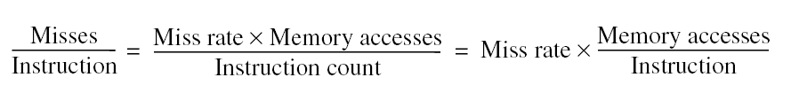
Cache Perf. Metrics
Miss rate
Fraction of cache access that results in a miss
Hit rate = 1 – miss rate
Miss per instruction
Average memory access time (AMAT)

Slide 24
Cache perf. metrics: Implications
Latency: AMAT = hit time + miss rate * miss penalty
Reduce hit time
Reduce miss penalty
Reduce miss rate
Bandwidth
Improve cache-access bandwidth

Slide 25
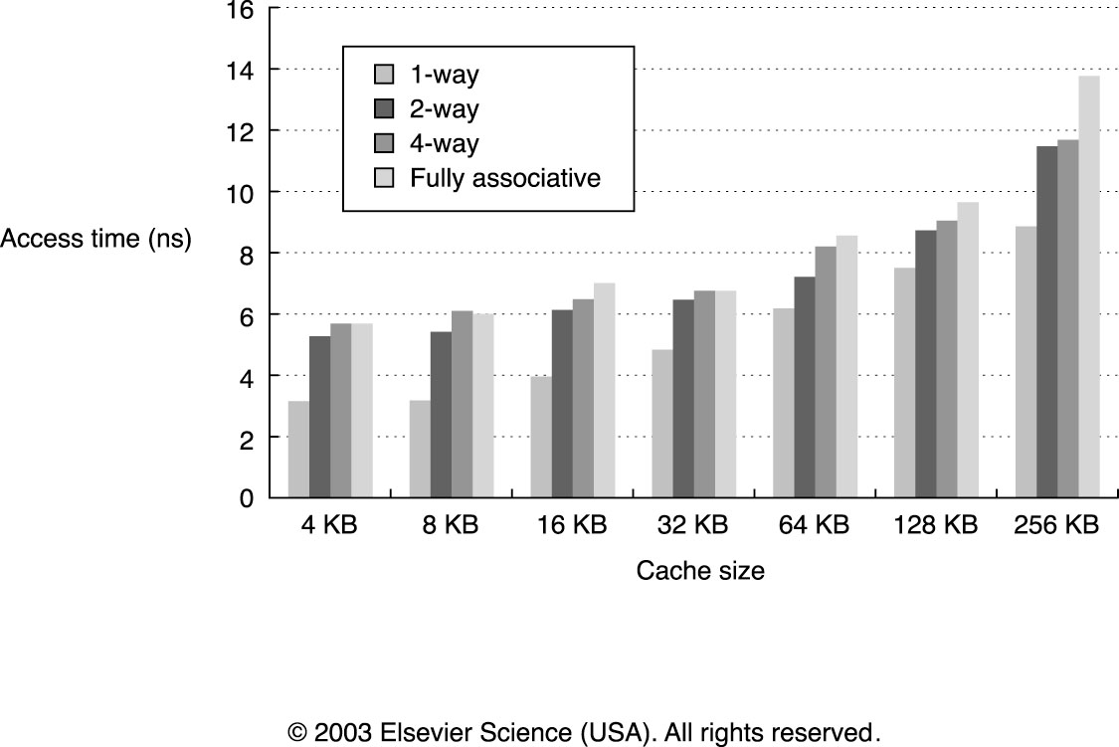
Reducing Hit Time (1)
Small & Simple Caches are faster

Slide 26
Small & simple caches
Advanced Optimizations
Why?
Critical timing path:
Compute the memory address with tag,
(Cache indexing) Select set based on index,
(Tag comparison) Comparing tags to distinguish cached lines in the same set
Direct-mapped caches: tag compare and data transmission are done at the same time (speculative data transmission)
Lower associativity reduces power because fewer cache lines are accessed
Used in first-level cache (L1)

Slide 27
Reducing Hit Time (2)
Pipelined design of caches
Improves bandwidth, but not latency
Essential for L1 caches at high frequency
Even small caches have 2-3 cycle latency at N GHz
Pentium: 1 cycle, Pentium Pro – Pentium III: 2 cycles, Pentium 4 – Core i7: 4 cycles
Also used in many L2 caches
Way Prediction
Speeds up set-associative caches
Predict which of N ways has our data, fast access as direct-mapped cache
If mispredicted, access again as set-assoc cache
Avoid address translation
Address translation handled by TLB
Remove TLB access from the hit path.

Slide 28
Avoid address translation
Virtual/physical address
Virtual memory per user/process, used for isolated address spaces
Virtual memory mapped to physical memory or disk
Instr. uses virtual address, need to be translated into physical address in runtime to locate actual data on physical memory
Page table: store the mapping from virt addr. to phys. addr.
TLB: a cache for page-table data
Key design
Cache line address: using virtual/physical address

Slide 29
Physically addressed cache
Which address do we use to access cache?
Line address: | Tag | Index
Physical
Physical
Physical
Address
TLB
Cache
Data
Virtual
Address
Cache
Tags
Hit?
If TLB hit, no need to
do page table lookup
from memory
Note: data cache
accessed by physical
addresses now
Cache permissions
as well

Slide 30
PAPT Cache
Previous slide showed Physically-Addressed Physically-Tagged cache
Sometimes called PIPT (I=Indexed)
Con: TLB lookup and cache access serialized
Caches already take > 1 cycle

Slide 31
Virtually Addressed Cache
Line address: | Tag | Index
Virtual
Virtual
Cache
Data
(VIVT: vitually
indexed,
virtually tagged)
Virtual
Address
Physical
Address
Pro: latency – no need to check TLB
Con: Must flush cache on process change
Same VA in different processes maps to different data
Con #3: Aliasing Problem
Several virtual pages can map to same physical page!
-> Duplicated cache lines
Cache index and offset can only bits from page offset not from the page number (big page size can help here)
TLB
Cache
Tags
On Cache
Miss
To L2
Hit?
Con #2: How enforce page-level permissions?
(Page is physical, while cache data is virtually indexed)

Slide 32
Virtually Indexed Physically Tagged
Cache
Data
Virtual
Address
Line address: | Tag | Index
Pro: latency – TLB parallelized
Pro: don’t need to flush $ on process swap
Con: Aliasing still limits cache indexing (can only use bits not from the VPN/PPN)
Cache
Tags
Physical
Virtual
Physical Tag
=
Hit?
TLB
Physical Address

Slide 33
Conclusion and reading lists
Cache: Textbook 2.1, 2.2, B.1, B.2, B.3
Ack: Prof. Milos’s slides

