Slide 1
CIS 655/CSE 661 - Advanced Computer Architecture
Cache Optimizations (3.3)
Dr. Yuzhe (Richard) Tang
Textbook: 2.2

Slide 2
From the last class
AMAT: average memory access time
Cache optimization techniques
Reducing hit time
Reducing miss penalty
Reducing miss rate

Slide 3
Reducing Cache Miss Rate

Slide 4
Causes of Cache Misses
Introduction
Causes of misses (3Cs)
Compulsory
First reference to a block
Due to the first-time access
Capacity
Blocks discarded and later retrieved
Due to limited capacity
Conflict:
Different memory references refer to the same cache locations (e.g. the same line in direct mapped cache)
Due to limited associativity

Slide 5
Reducing miss rate (1)
Introduction
“Larger cache”:
☺ Reduce rate of capacity misses
☹ Increases hit time
☹ Increases power consumption
“Higher associativity”:
☺ Reduce rate of conflict misses
☹ Increases hit time
☹ Increases power consumption
Notes:
What could affect miss rate?: capacity, associativity

Slide 6
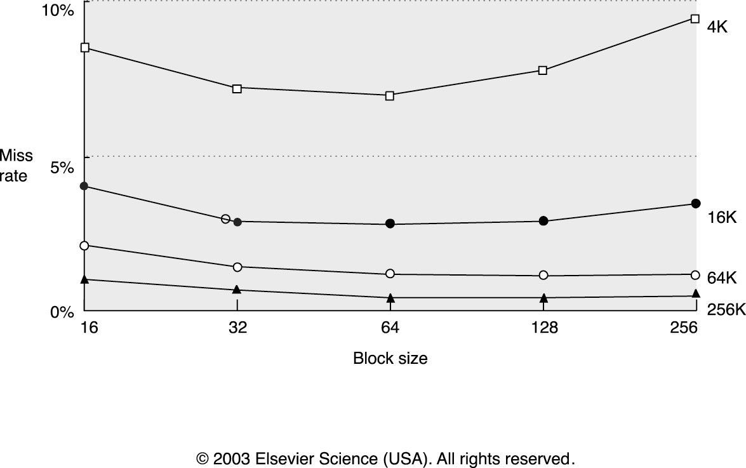
Reducing Cache Miss Rate (2)
Larger block size:
☺ Reduce compulsory misses
Helpful if there is more spatial locality
☹ Increases capacity and conflict misses
☹ Increases miss penalty

Slide 7
Reducing miss rates (3)
Compiler based technology
Improve locality
Ideal: Memory data will not be reloaded into cache.
Techniques
Loop interchange
Cache blocking
Prefetch

Slide 8
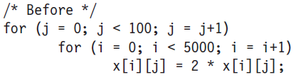
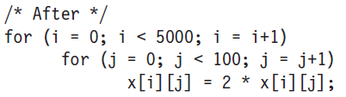
Loop Interchange
Loop interchange
Swap nested loops to access memory in sequential order
Example:
X[i][j] in row-major order: Last index changes first
x[i][j] and x[i+1][j] are 100 elements apart
x[i][j] and x[i][j+1] are next to each other
Notes:
Print it out!

Slide 9
Blocking
Loop interchange works for array accessed either by row or column.
What about matrix multiplication?
Featuring hybrid access: sometime accessed by row and other times by column
Blocked algorithm
Instead of accessing entire rows or columns, it subdivides matrices into blocks
Maximize computations on block data already in cache.

Slide 10
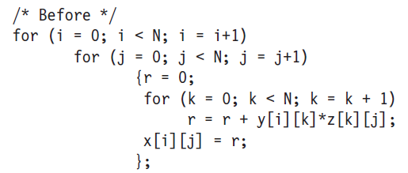
Example: Matrix Multiplication
Complexity: O(N³)
Memory references: 2N³+N²=N² (2N+1)

Slide 11
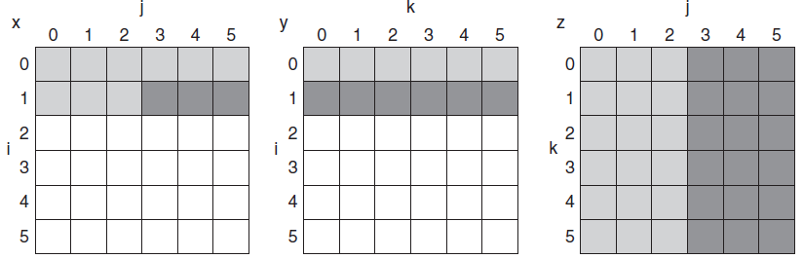
Matrix Multi. with Cache
Access pattern (per-matrix)
Temporal locality:
Accessed at loop 3,9,15…
Spatial locality:
Access by column
0
3
6
9
12
15
=
X

Slide 12
Matrix Multi. with Cache
How to calculate the three elements
Per-matrix access pattern
Is it cache friendly?
X = Y * Z

Slide 13
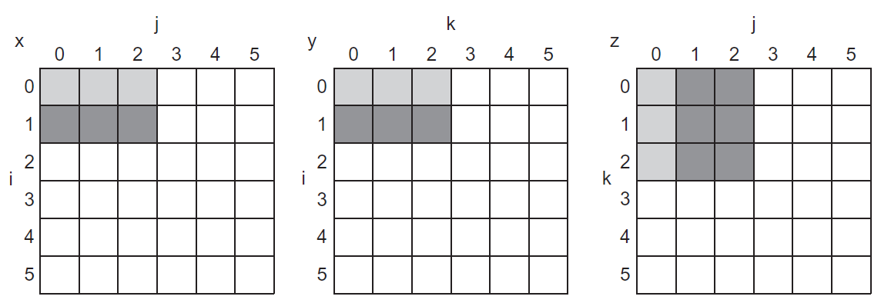
Blocked Matrix Multi.
Blocked matrix multiplication
Y1*Z2
Z2
X1
Y2*Z4
X2
Y1
Y2
=
X
X3
X4
Z4

Slide 14
Blocked M.M.: Why It Works?
Blocked matrix multiplication
Unblocked matrix multiplication
Y1*Z2
Y1
Y2
Z2
Y2*Z4
X1
=
X
Z4
Assumption
Cache capacity is 18 cells
Cache uses LRU
=
X
Notes:
Assume cache capacity is of 18 cells
Cache is using LRU
Print it out !

Slide 15
Blocked M.M.: Why It Works?
Assumption
Cache capacity is 18 cells
Cache uses LRU
Blocked matrix multiplication
X₂ = Y₁*Z₂+Y₂*Z₄
X = Y * Z
Notes:
Assume cache capacity is of 18 cells
Cache is using LRU
Print it out !

Slide 16
Blocked M.M.: Why It Works?
Assumption
Cache capacity is 18 cells
Cache uses LRU
Matrix multiplication with no blocking
X = Y * Z
Notes:
Assume cache capacity is of 18 cells
Cache is using LRU
Print it out !

Slide 17
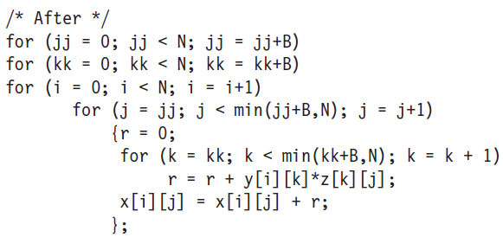
Blocked M.M.: Why It Works?
With blocking (Block size: B)
Total cache misses:
2N³/B + N² (=2B²*(N/B)³ + B*N/B*N)
Without blocking: 2N³ + N² (worst case)
N/B
No repeated memory access: 2B²
N/B
N=N/B*B
Notes:
Why 2B*N/B*N/B*N?
Because in loop i, N= N/B * B; when it is within step B, it will not incur any cache misses; but when out of B, it will incur new miss. The assumption here is that B is chosen such that those two “green” rectangles can fit into cache.
B*N/B*N is that x[i][j] is not changed by N2, but affected by kk or k.
B*N/B*N is write miss to output matrix
While 2N^3/B +N^2 is read-miss to two input matrix

Slide 18
Prefetching
Start fetching block earlier
Overlap miss latency with work before miss
L1
L2
Memory
Load
Total Load-to-Use Latency
Data
May cause resource
contention due to
extra cache/memory
activity
Prefetch
Load
Data
Much improved Load-to-Use Latency
Somewhat improved Latency

Slide 19
Prefetching
Predict future misses and get data into cache
If access does happen, we have a hit now (or a partial miss, if data is on the way)
If access does not happen, cache pollution (replaced other data with junk we don’t need)
To avoid pollution, prefetch buffers
Pollution a big problem for small caches
Have a small separate buffer for prefetches
When we do access it, put data in cache
If we don’t access it, cache not polluted

Slide 20
Software Prefetching
Two flavors: register prefetch and cache prefetch
Each flavor can be faulting or non-faulting
Non-faulting: prefetch can’t cause exceptions if address bad
Faulting register prefetch is binding
It is a normal load, address must be OK, uses register
Non-faulting cache prefetch is non-binding
If address bad, becomes a NOP
Does not affect register state
Has more overhead (load still there), ISA change (prefetch instruction), complicates cache (prefetches and loads different)

Slide 21
Software Prefetching
Reordering can
mess up your
code
A
R1 = [R2]
R0 = [R2]
A
A
R1 = R1- 1
R1 = R1- 1
B
C
B
C
B
C
R1 = [R2]
R3 = R1+4
R1 = [R2]
R3 = R1+4
R3 = R1+4
Hopefully the load miss
is serviced by the time
we get to the consumer
Using a prefetch instruction
(or load to $zero) can help
to avoid problems with
data dependencies
(Cache missing
instruction in red)

Slide 22
Hardware Prefetching
Fetch two blocks on miss (include next sequential block)
Hardware monitors miss traffic to memory
Memory
Depending on prefetch
algorithm/miss patterns,
prefetcher injects
additional memory
requests
CPU
HW
Prefetcher
Cannot be overly aggressive
since prefetches may contend
for memory bandwidth, and
may pollute the cache (evict
other useful cache lines)

Slide 23
Compiler based technology
How to optimize cache-aware memory accesses?
How to be aware of hierarchical caches?
How to automatically optimize access (regardless cache sizes)?
…

Slide 24
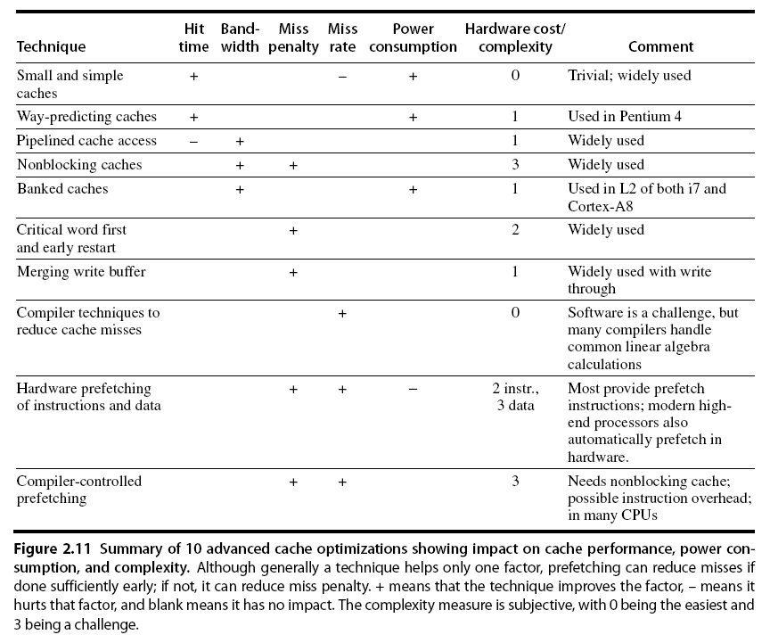
Summary
Advanced Optimizations

Slide 25
Pop quiz (March 8)
What are three factors in cache performance?
How will a larger block affect the three factors (fixed sized cache)?
What are the approaches to improve program locality?

Slide 28
Cache and address translation

Slide 29
Avoid address translation in cache hit path
Virtual/physical address
Virtual memory per user/process, used for isolated address spaces
Virtual memory mapped to physical memory or disk
Instr. uses virtual address, need to be translated into physical address in runtime to locate actual data on physical memory
Page table: store the mapping from virt addr. to phys. addr.
TLB: a cache for page-table data
Key design
Cache line address: using virtual/physical address

Slide 30
Physically addressed cache
Which address do we use to access cache?
Line address: | Tag | Index
Physical
Physical
Physical
Address
TLB
Cache
Data
Virtual
Address
Cache
Tags
Hit?
If TLB hit, no need to
do page table lookup
from memory
Note: data cache
accessed by physical
addresses now
Cache permissions
as well

Slide 31
PAPT Cache
Previous slide showed Physically-Addressed Physically-Tagged cache
Sometimes called PIPT (I=Indexed)
Con: TLB lookup and cache access serialized
Caches already take > 1 cycle

Slide 32
Virtually Addressed Cache
Line address: | Tag | Index
Virtual
Virtual
Cache
Data
(VIVT: vitually
indexed,
virtually tagged)
Virtual
Address
Physical
Address
Pro: latency – no need to check TLB
Con: Must flush cache on process change
Same VA in different processes maps to different data
Con #3: Aliasing Problem
Several virtual pages can map to same physical page!
-> Duplicated cache lines
Cache index and offset can only bits from page offset not from the page number (big page size can help here)
TLB
Cache
Tags
On Cache
Miss
To L2
Hit?
Con #2: How enforce page-level permissions?
(Page is physical, while cache data is virtually indexed)

Slide 33
Virtually Indexed Physically Tagged
Cache
Data
Virtual
Address
Line address: | Tag | Index
Pro: latency – TLB parallelized
Pro: don’t need to flush $ on process swap
Con: Aliasing still limits cache indexing (can only use bits not from the VPN/PPN)
Cache
Tags
Physical
Virtual
Physical Tag
=
Hit?
TLB
Physical Address

Slide 34
Conclusion and reading lists
Cache: Textbook 2.1, 2.2, B.1, B.2, B.3
Ack: Prof. Milos’s slides

