Slide 1
CIS 655/CSE 661 - Advanced Computer Architecture
Cache Optimizations (3.3)
Dr. Yuzhe (Richard) Tang
Textbook: 2.2

Slide 2
From the last class
AMAT: average memory access time
Cache optimization techniques
Reducing hit time
Reducing miss rate
Reducing miss penalty

Slide 3
Reducing Cache Miss Rate

Slide 4
Causes of Cache Misses
Introduction
Causes of misses (3Cs)
Compulsory
First reference to a block
Due to the first-time access
Capacity
Blocks discarded and later retrieved
Due to limited capacity
Conflict:
Different memory references refer to the same cache locations (e.g. the same line in direct mapped cache)
Due to limited associativity
Notes:
Conflict cache miss -> two addresses mapped to same cache.
Check for conflict in Fully associated mapping ->( no conflict why?)

Slide 5
Reducing miss rate (1)
Introduction
“Larger cache”:
☺ Reduce rate of capacity misses
☹ Increases hit time
☹ Increases power consumption
“Higher associativity”:
☺ Reduce rate of conflict misses
☹ Increases hit time
☹ Increases power consumption
Notes:
What could affect miss rate?: capacity, associativity

Slide 6
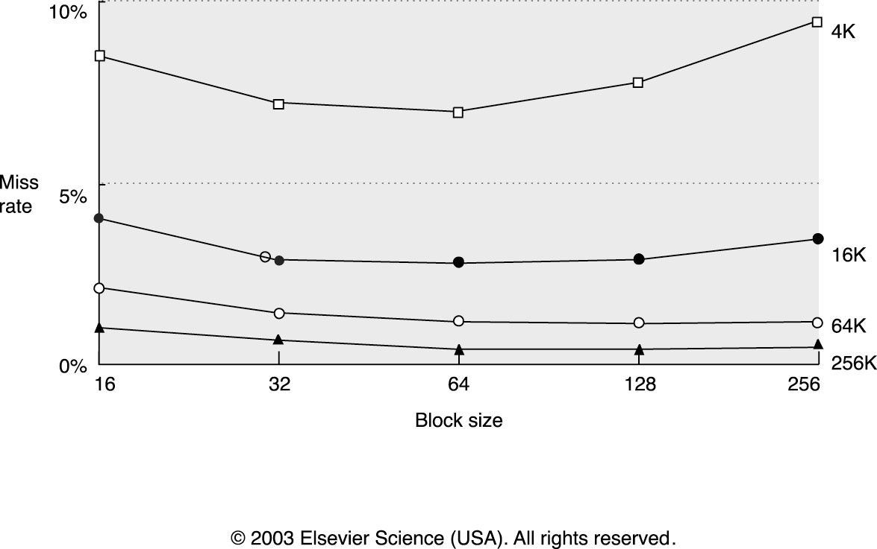
Reducing Cache Miss Rate (2)
Larger block size:
☺ Reduce compulsory misses
Helpful if there is more spatial locality
☹ Increases capacity and conflict misses
☹ Increases miss penalty

Slide 7
Reducing miss rates (3)
Compiler based technology
Improve locality
Ideal: Memory data will not be reloaded into cache.
Techniques
Loop interchange
Cache blocking
Prefetch

Slide 8
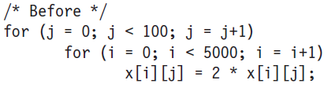
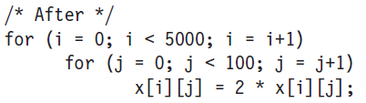
Loop Interchange
Loop interchange
Swap nested loops to access memory in sequential order
Example:
X[i][j] in row-major order: Last index changes first
x[i][j] and x[i+1][j] are 100 elements apart
x[i][j] and x[i][j+1] are next to each other
Notes:
Print it out!

Slide 9
Blocking
Loop interchange works for array accessed either by row or column.
What about matrix multiplication?
Featuring hybrid access: sometime accessed by row and other times by column
Blocked algorithm
Instead of accessing entire rows or columns, it subdivides matrices into blocks
Maximize computations on block data already in cache.

Slide 10
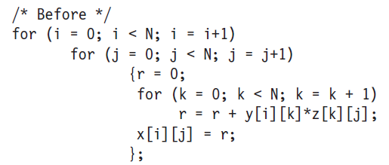
Example: Matrix Multiplication
Complexity: O(N³)
Memory references: 2N³+N²=N² (2N+1)
Notes:
3N^2 cache misses = miss rate best
2N^3 + N^2 = cache misses worst
for(j = j + b) (N/B blocks)
{
for(k = k + b) (N/B blocks)
{
For(i++) =➔ for(i++) to N
{ {
for (j++) for(j++; j < B)
{ {
for (k++) for(k++ ; k < B)
{ {
number of memory references = (N/B)^2* B^2 * N = O(N^3)
#ref : (N/B)^2 * N * B + 2* (N/B)^2 * N * B^2 = N^3/B + 2N^3 => we access memory for y,z matrices for B^2 , we have N/B such blocks

Slide 11
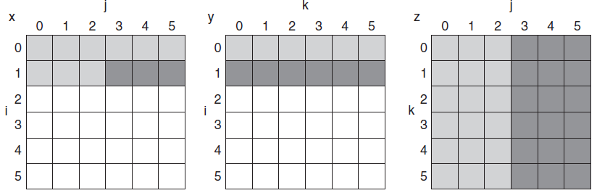
Matrix Multi. with Cache
Access pattern (per-matrix)
Temporal locality:
Accessed at loop 3,9,15…
Spatial locality:
Access by column
0
3
6
9
12
15
=
X

Slide 12
Matrix Multi. with Cache
How to calculate the three elements
Per-matrix access pattern
Is it cache friendly?
X = Y * Z
Notes:
Its not very cache friendly

Slide 13
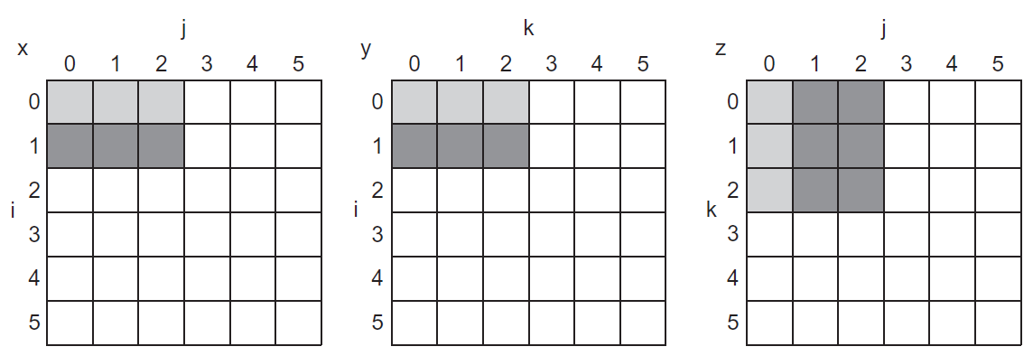
Blocked Matrix Multi.
Blocked matrix multiplication
Y1*Z2
Z2
X1
Y2*Z4
X2
Y1
Y2
=
X
X3
X4
Z4

Slide 14
Blocked M.M.: Why It Works?
Blocked matrix multiplication
Unblocked matrix multiplication
Y1*Z2
Y1
Y2
Z2
Y2*Z4
X1
=
X
Z4
Assumption
Cache capacity is 18 cells
Cache uses LRU
=
X
Notes:
Assume cache capacity is of 18 cells
Cache is using LRU
Print it out !

Slide 15
Blocked M.M.: Why It Works?
Assumption
Cache capacity is 18 cells
Cache uses LRU
Blocked matrix multiplication
X₂ = Y₁*Z₂+Y₂*Z₄
X = Y * Z
Notes:
Assume cache capacity is of 18 cells
Cache is using LRU
Print it out !

Slide 16
Blocked M.M.: Why It Works?
Assumption
Cache capacity is 18 cells
Cache uses LRU
Matrix multiplication with no blocking
X = Y * Z
Notes:
Assume cache capacity is of 18 cells
Cache is using LRU
Print it out !

Slide 17
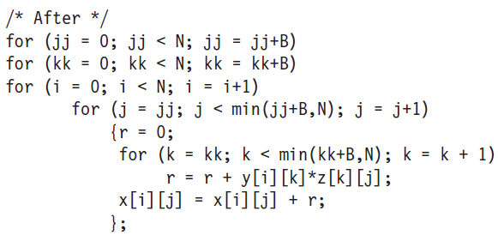
Blocked M.M.: Why It Works?
With blocking (Block size: B)
Total cache misses:
2N³/B + N² (=2B²*(N/B)³ + B*N/B*N)
Without blocking: 2N³ + N² (worst case)
N/B
No repeated memory access: 2B²
N/B
N=N/B*B
Notes:
Why 2B*N/B*N/B*N?
Because in loop i, N= N/B * B; when it is within step B, it will not incur any cache misses; but when out of B, it will incur new miss. The assumption here is that B is chosen such that those two “green” rectangles can fit into cache.
B*N/B*N is that x[i][j] is not changed by N2, but affected by kk or k.
B*N/B*N is write miss to output matrix
While 2N^3/B +N^2 is read-miss to two input matrix

Slide 18
Prefetching
Start fetching block earlier
Overlap miss latency with work before miss
L1
L2
Memory
Load
Total Load-to-Use Latency
Data
May cause resource
contention due to
extra cache/memory
activity
Prefetch
Load
Data
Much improved Load-to-Use Latency
Somewhat improved Latency

Slide 19
Prefetching
Predict future misses and get data into cache
If access does happen, we have a hit now (or a partial miss, if data is on the way)
If access does not happen, cache pollution (replaced other data with junk we don’t need)
To avoid pollution, prefetch buffers
Pollution a big problem for small caches
Have a small separate buffer for prefetches
When we do access it, put data in cache
If we don’t access it, cache not polluted

Slide 20
Software Prefetching
Two flavors: register prefetch and cache prefetch
Each flavor can be faulting or non-faulting
Non-faulting: prefetch can’t cause exceptions if address bad
Faulting register prefetch is binding
It is a normal load, address must be OK, uses register
Non-faulting cache prefetch is non-binding
If address bad, becomes a NOP
Does not affect register state
Has more overhead (load still there), ISA change (prefetch instruction), complicates cache (prefetches and loads different)

Slide 21
Software Prefetching
Reordering can
mess up your
code
A
R1 = [R2]
R0 = [R2]
A
A
R1 = R1- 1
R1 = R1- 1
B
C
B
C
B
C
R1 = [R2]
R3 = R1+4
R1 = [R2]
R3 = R1+4
R3 = R1+4
Hopefully the load miss
is serviced by the time
we get to the consumer
Using a prefetch instruction
(or load to $zero) can help
to avoid problems with
data dependencies
(Cache missing
instruction in red)

Slide 22
Hardware Prefetching
Fetch two blocks on miss (include next sequential block)
Hardware monitors miss traffic to memory
Memory
Depending on prefetch
algorithm/miss patterns,
prefetcher injects
additional memory
requests
CPU
HW
Prefetcher
Cannot be overly aggressive
since prefetches may contend
for memory bandwidth, and
may pollute the cache (evict
other useful cache lines)

Slide 23
Compiler based technology
How to optimize cache-aware memory accesses?
How to be aware of hierarchical caches?
How to automatically optimize access (regardless cache sizes)?
…

Slide 24
Reducing Cache Miss Penalty

Slide 25
Reducing Cache Miss Penalty (1)
Multilevel caches
Very fast, small Level 1 (L1) cache
Fast, not so small Level 2 (L2) cache
May also have slower, large L3 cache, etc.
Why does this help?
Miss in L1 cache can hit in L2 cache, etc.
AMAT = HitTime_{L1}+MissRate_{L1}MissPenalty_{L1}
MissPenalty_{L1}= HitTime_{L2}+MissRate_{L2}MissPenalty_{L2}
MissPenalty_{L2}= HitTime_{L3}+MissRate_{L3}MissPenalty_{L3}

Slide 26
Multi-Level Caches
Memory latency = 100 cycles
16KB L1 cache, 3 cycle latency, 85% hit rate
Use two levels of caching
Smaller 8KB cache: 1 cycle latency, 75% hit rate
Larger 128KB cache: 6 cycle latency, 60% hit rate
One level caching: 3+0.15*100=18
Two level caching: 1+0.25*(6+0.4*100) =12.5

Slide 27
Multi-Level Caches (2)
Global vs. Local Miss Rate
Global L2 Miss Rate # of L2 Misses / # of All Memory Refs
Local Miss Rate # of L2 Misses / # of L1 Misses (only L1 misses actually get to the L2 cache)
Exclusion Property
If block is in L1 cache, it is never in L2 cache
Saves some L2 space
Inclusion Property
If block A is in L1 cache, it must also be in L2 cache

Slide 28
Reducing Cache Miss Penalty (2)
Critical word first
Why: Give requested word to loads before entire block arrive
Request missed word from memory first
Send it to the processor ASA it arrives
Early restart
Why: Block transfer takes time (narrow bus)
Request words in normal order
Send missed word to the processor ASA it arrives
Notes:
Print it out!
Both are in some way of pipelining

Slide 29
Reducing Cache Miss Penalty (3)
Increase Load Miss Priority
Loads can have dependent instructions
If a load misses and a store needs to go to memory, let the load miss go first
Need a write buffer to remember stores
Merging Write Buffer
If multiple write misses to the same block, combine them in the write buffer
When storing to a block that is already pending in the write buffer, update write buffer
Use block-write instead of many small writes

Slide 30
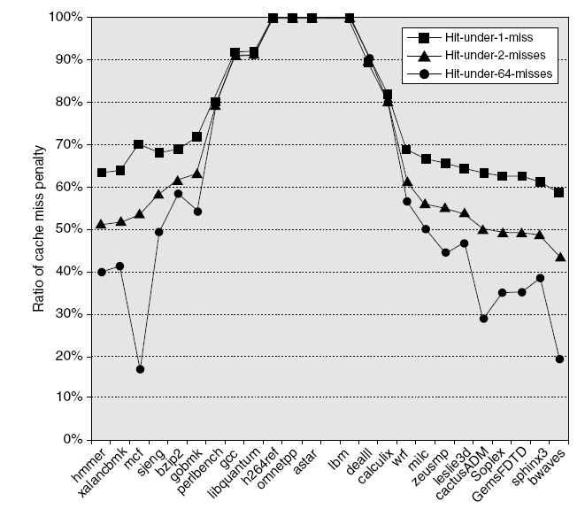
Non-blocking Caches
Non-blocking caches
A blocking cache services one access at a time
While miss serviced, other accesses blocked (wait)
Non-blocking caches remove this limitation
While miss serviced, can process other requests
Allow hits before previous misses complete
“Hit under miss”
“Hit under multiple miss”
Advanced Optimizations
Notes:
Penalty to concurrent loads/stores

Slide 31
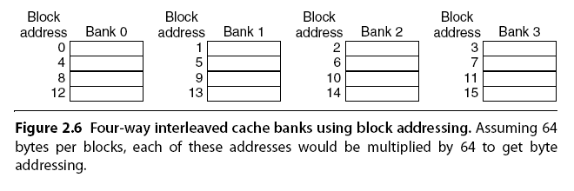
Multibanked Caches
Organize cache as independent banks to support simultaneous access
ARM Cortex-A8 supports 1-4 banks for L2
Intel i7 supports 4 banks for L1 and 8 banks for L2
Interleave banks according to block address
Advanced Optimizations

Slide 32
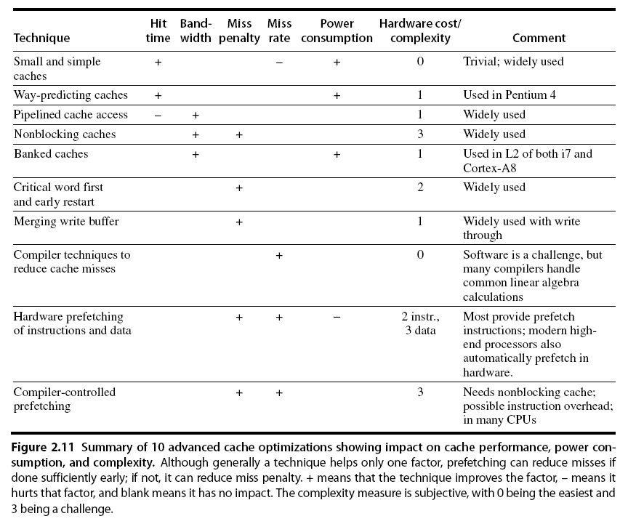
Summary
Advanced Optimizations
Notes:
Simple cache is direct mapped cache
Instead of broadcast to all lines in the set , send to only one line – way-predict caches
Pipelined cache access => multiple concurrent requests, to improve throughout,
Pop Quiz
Three factors in cache performance?
Hit time, miss rate, miss penalty
Larger block affect three factors (fixe sized cache)
Cache hit time (assume direct mapped cache) -> small time to lookup because smaller lines in block size
Miss penalty – time needed to transfer bloc from RAM to cache. Larger the block miss penality tend to be longer.
Approaches to improve program locality?
Cache Miss rate – three kinds – composite, complete and conflict?
Composite miss rate will be smaller for large block size – reason being large block implies more data in the cache. (assume program exhibits spatial locality)
Capacity – no effect size is fixed
Conflict – depends on structure and placement of cache.
If direct mapped cache – more conflicts . If only one line in cache always a conflict => larger the block is more likely for conflict cache miss
Loop interchange, code cache block to improve program locality.

