Slide 1
CIS 655/CSE 661 - Advanced Computer Architecture
Maintaining Cache Coherence (4.2)
Dr. Yuzhe (Richard) Tang

Slide 2
Maintaining Cache Coherence
Hardware schemes
Shared Caches
Trivially enforces coherence
Not scalable (L1 cache quickly becomes a bottleneck)
Snooping
Needs a broadcast network (like a bus) to enforce coherence
Each cache that has a block tracks its sharing state on its own
Directory
Can enforce coherence even with a point-to-point network
A block has just one place where its full sharing state is kept

Slide 3
Snooping by MSI

Slide 4
Snooping
Typical for bus-based multiprocessors
Bus serialization maintains coherence property 3
Two flavors:
Write-update (write broadcast)
A write to shared data is broadcast to update all copies
All subsequent reads will return the new written value (property 2)
All see the writes in the order of broadcasts One bus == one order seen by all (property 3)
Write-invalidate
Write to shared data forces invalidation of all other cached copies
Subsequent reads miss and fetch new value (property 2)
Writes ordered by invalidations on the bus (property 3)
Notes:
Write-update: read optimized
Write-invalidate: write optimized

Slide 5
Update vs. Invalidate
A burst of writes by a processor to one addr
Update: each sends an update
Invalidate: possibly only the first invalidation is sent
Writes to different words of a block
Update: update sent for each word
Invalidate: possibly only the first invalidation is sent
Producer-consumer communication latency
Update: producer sends an update, consumer reads new value from its cache
Invalidate: producer invalidates consumer’s copy, consumer’s read misses and has to request the memory block
Which is better depends on application
But write-invalidate is simpler and implemented in most MP-capable processors today

Slide 6
MSI: A Write-Invalidate Snoopy Protocol
State of block B in cache C can be
Invalid: B is not cached in C
To read or write, must make a request on the bus
Modified: B is dirty in C
C has the block, no other cache has the block, and C must update memory when it displaces B
Can read or write B without going to the bus
Shared: B is clean in C
C has the block, other caches have the block, and C need not update memory when it displaces B
Can read B without going to bus
To write, must send an upgrade request to the bus

Slide 7
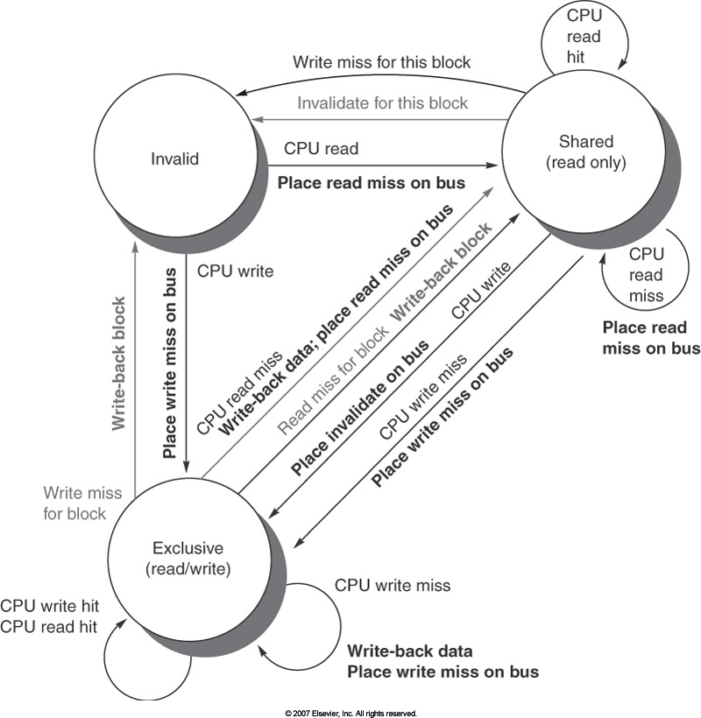
MSI Snoopy Protocol
Also called “modified”

Slide 8
MSI Example
Main Memory
A’
A
CPU₀
cache
CPU₁
cache
CPU₂
cache
CPU₃
cache
→ I
A: S
→S
→ I
A’: M
A: S
A: M
→A’:S
Read A
Read A
Timeline
Write A, A’
Read A

Slide 9
Cache-To-Cache Transfers: Impl.
The case of the last step (in the prev. slide)
CPU3 has block B in M state
CPU0 wants to read B, puts a RdReq on bus
Latest data, A’, need to be transferred from CPU3 to CPU0
But how?
Solution 1: abort/retry
CPU3 cancels CPU0’s request, issues a write back
CPU0 later retries RdReq and gets data from memory
Too slow (two memory latencies to move data from CPU3 to CPU0)
Solution 2: intervention
CPU3 indicates it will supply the data (“intervention” bus signal)
Memory sees that, does not supply data, and waits for CPU3’s data
CPU3 starts sending the data on the bus, memory is updated
CPU0 snoops the transfer during the write-back and gets the block

Slide 10
Cache-To-Cache Transfers: Arbitration
Intervention works if a cache has data in M state
Nobody else has correct data, clear who responds
What if a cache has requested data in S state
Multiple others may have the data, who should supply it?
Solution 1: let memory supply the data
Solution 2: whoever wins arbitration supplies the data
Notes:
Solution 3: A separate state similar to S that indicates there are maybe others who have the block in S state, but if anybody asks for the data we should supply it

Slide 11
MSI Example
Main Memory
CPU₀
cache
CPU₁
cache
CPU₂
cache
CPU₃
cache

Slide 12
Conclusion and reading lists
Multiprocessing: 5.1
Cache coherency: 5.2
Ack: Prof. Milos’s slides
Copyright © 2012, Elsevier Inc. All rights reserved.

Slide 13
MESI Protocol
New state: Exclusive
Data is valid and clean (like in S state)
But this is the only cached copy (like in M state)
Benefit: bandwidth reduction
Favor writes on exclusive over shared reads.

Slide 14
MESI: Improving Write-after-read
Main Memory
A
CPU₀
cache
CPU₁
cache
CPU₂
cache
CPU₃
cache
→M
A: E
Read A
Timeline
Write A, A’

Slide 15
MESI: Extra Read Overhead
Main Memory
A
CPU₀
cache
CPU₁
cache
CPU₂
cache
CPU₃
cache
→S
A: E
A: S
Read A
Read A
Timeline

Slide 16
Detecting Other Sharers
Problem
CPU2 wants to read A, puts RdReq on bus, receives data
How does CPU2 know if its B should be in S or E state?
Solution: “Share” bus signal
Always 0, except when somebody pulls it to 1
This is called “hardwired OR”
When CPU0 snoops CPU2’s request, it pulls “Share” to 1
CPU2 goes to S if “Share” is 1, to E if “Share” is 0

Slide 17
MOESI: Delayed write-back
M: Modified
I have the only copy, and it’s dirty (memory is stale)
O: Owned
I have the most up-to-date copy, others may have copies, too, but I am responsible for supplying data and for updating memory
E: Exclusive
I have the only copy, but it’s clean
S: Shared
Multiple copies, all clean (memory is up-to-date)
I: Invalid
In practice,
MOESI is used in AMD Opteron.
MESI is used in Intel i7.

Slide 18
MSI Example
Main Memory
A’
A
CPU₀
cache
CPU₁
cache
CPU₂
cache
CPU₃
cache
→S
A’: M
A’:S
A: M
Write A, A’
Read A
CPU₀ read M state:
Change M to S on CPU₃
Update memory
Memory supply data with state S to CPU₀
Expensive!
Timeline

Slide 19
MOESI Example
Main Memory
A
CPU₀
cache
CPU₁
cache
CPU₂
cache
CPU₃
cache
A’: M
→O
A’:S
A: M
Write A, A’
Read A
CPU₀ read M state:
Change M to O on CPU₃ !NO memory update
CPU₃ supplies data on state S to CPU₀
Timeline

Slide 20
Summarizing MSI,MESI,MOESI
Write optimized
Read optimized
Write invalidate
Write update
MOESI
MESI
MSI

Slide 21
Coherence Cache Miss & False Sharing

Slide 22
Shared Memory Performance
Another “C” for cache misses
Still have Compulsory, Capacity, Conflict
Now have Coherence, too
What is Coherence miss?
Scenarios:
Write to a cache line not in M state
Read cache line in I state
Overhead: communication thru bus
Load data from bus (memory/remote cache)
Invalidation signals to remote cache lines

Slide 23
Coherence misses: Write non-M state
Main Memory
A
CPU₀
cache
CPU₁
cache
CPU₂
cache
CPU₃
cache
→ I
A: S
→ I
A’: M
A: S
A: M
Read A
Coherence miss!
Read A
Timeline
CPU₃ write to non-M state: Write miss
load data with state M on CPU₃
Send invalidation signals on bus
CPU₀ update S to I
CPU₂ update S to I
Write A, A’

Slide 24
Coherence misses: Read I state
Main Memory
A’
A
CPU₀
cache
CPU₁
cache
CPU₂
cache
CPU₃
cache
→ I
A: S
→S
→ I
A’: M
A: S
A: M
→A’:S
Read A
Coherence miss!
Read A
Timeline
CPU₀ read I state: Read miss
CPU₃ update state M to O/S
(Write dirty data back to memory)
CPU₀ read data from mem/CPU₃
Write A, A’
Read A

Slide 25
Coherence cache misses
Two sources:
True sharing
Different processors access the same data
False sharing
Different processors access different data,
But they happen to be in the same block

Slide 26
Coherence miss: False sharing
Main Memory
A’
A
CPU₀
cache
CPU₁
cache
CPU₂
cache
CPU₃
cache
→ I
A: S
→S
→ I
A’: M
A: S
A: M
→A’:S
Read A.x1
Coherence miss!
Coherence miss!
Read A.x1
Timeline
Write A.x2
Read A.x1
Coherence misses if A.x1 and A.x2 are in same cache line (A)!

Slide 27
Coherence miss: False sharing
Main Memory
A
B
CPU₀
cache
CPU₁
cache
CPU₂
cache
CPU₃
cache
A: S
A: S
B: M
Read A.x1
NO Coherence miss!
NO Coherence miss!
Read A.x1
Timeline
Write B.x2
Read A.x1
Coherence misses are eliminated if A.x1 and B.x2 are in diff. cache lines (A and B)

Slide 28
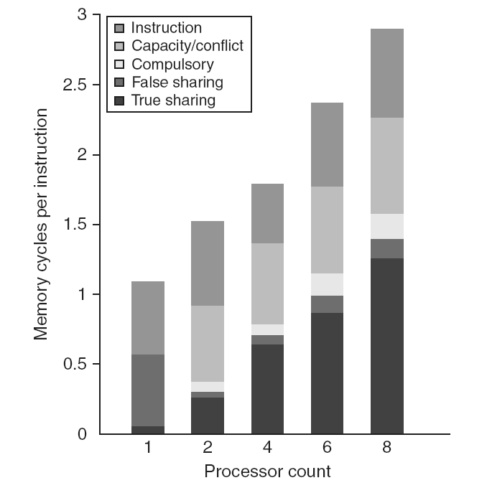
Performance Study: Commercial Workload
Benchmark study setup:
On four-processor shared-memory multiprocessor
Three typical workloads
OLTP: TPC-C
Decision-support systems: TPC-D
Web index search
False sharing increases
True sharing increases with # of processors.
Notes:
The more processors there are (meaning more CPUs/processes/etc), the more likely it results in sharing…

Slide 29
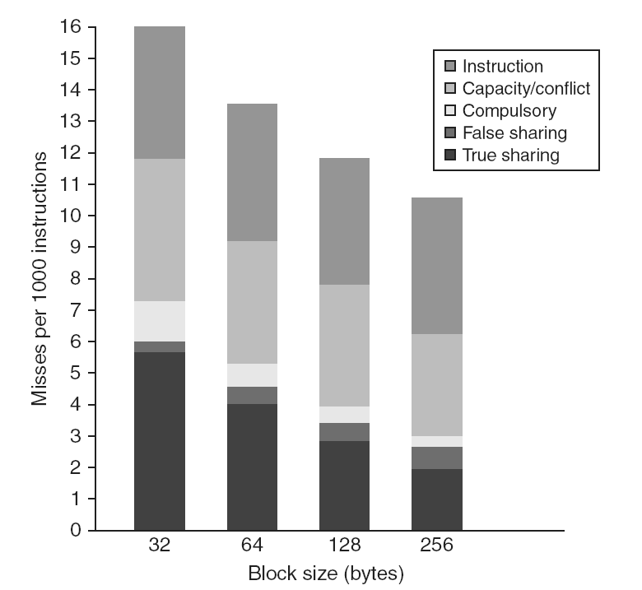
Performance Study: Commercial Workload
False sharing increases!
True sharing decreases
Notes:
True sharing misses decrease because “additional data brought in with each cache miss is accessed before the block is replaced, due to spatial locality.” the bigger a block is, the more likely that a word is brought into local CPU before being accessed (thus no miss) caused by another word accessed in the same block.
For true sharing coherence miss specifically, the increased block size will allow one processors to access more data upon each cache miss.

Slide 30
Directory-based coherence

Slide 31
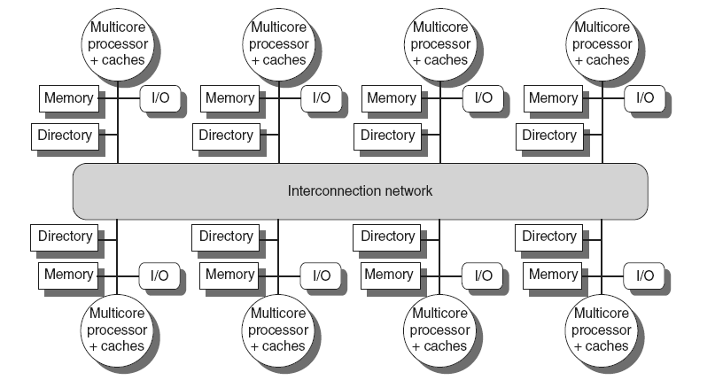
Directory-Based Coherence
Typically in distributed shared memory
Works for any point-to-point network, not just bus
Decide who gets to write when without broadcasts
For every local memory block, local directory has an entry
Directory entry indicates
Who has cached copies of the block
In what state do they have the block

Slide 32
Basic Directory Scheme
Each entry for a local mem block
One dirty bit (1 if there is a dirty cached copy)
A presence vector of #CPU bits
Each element bit is for one CPU node, tells wether it has a cached copy
All misses sent to block’s home
Known by mem address (in DSM)
Directory performs needed coherence actions
Eventually, directory responds with data

Slide 33
Read Miss
Processor CPUk has a read miss on block B, sends request to home node of the block
Directory controller
Finds entry for B, checks D bit
If D=0
Read memory and send data back, set P[k]
If D=1
Request block from processor whose P bit is 1
When block arrives, update memory, clear D bit, send block to Pk and set P[k]

Slide 34
Distributed MSI Example
Read X
Write X
Read X
CPU₀
cache
CPU₁
cache
CPU₂
cache
CPU₃
cache
→ I
→ I
X: S
X: M
X: S
Dist.Memory₀
Dist.Memory₁
Dist.Memory₂
Dist.Memory₃
X
dir
0
1
1
1
0
0
1
0
Mem
X
Interconnection Network

Slide 35
Directory Operation
Network controller connected to each bus
A proxy for remote caches and memories
Requests for remote addresses forwarded to home, responses from home placed on the bus
Requests from home placed on the bus, cache responses sent back to home node
Each cache still has its own coherence state
Directory is there just to avoid broadcasts and order accesses to each location
Simplest scheme: If access A1 to block B still not fully processed by directory when A2 arrives, A2 waits in a queue until A1 is done

Slide 36
Distributed MSI Example
CPU₀
cache
CPU₁
cache
CPU₂
cache
CPU₃
cache
Dist.Memory₀
Dist.Memory₁
Dist.Memory₂
Dist.Memory₃
dir
mem
X
Interconnection Network

Slide 37
Conclusion and reading lists
MSI(continued): 5.2
Performance in SMP: 5.3
Directory-based coherence: 5.4
Ack: Prof. Milos’s slides
Copyright © 2012, Elsevier Inc. All rights reserved.

