Slide 1
CIS 655/CSE 661 - Advanced Computer Architecture
Storage (5.1)
Dr. Yuzhe (Richard) Tang

Slide 2
Storage Systems
I/O performance (bandwidth, latency)
Bandwidth improving, but not as fast as CPU
Latency improving very slowly
Consequently, by Amdahl’s Law: fraction of time spent on I/O increasing
Other factors just as important
Reliability, Availability, Dependability
Storage devices very diverse
Magnetic disks, tapes, CDs, DVDs, flash
Different advantages/disadvantages and uses

Slide 3
Storage Devices

Slide 4
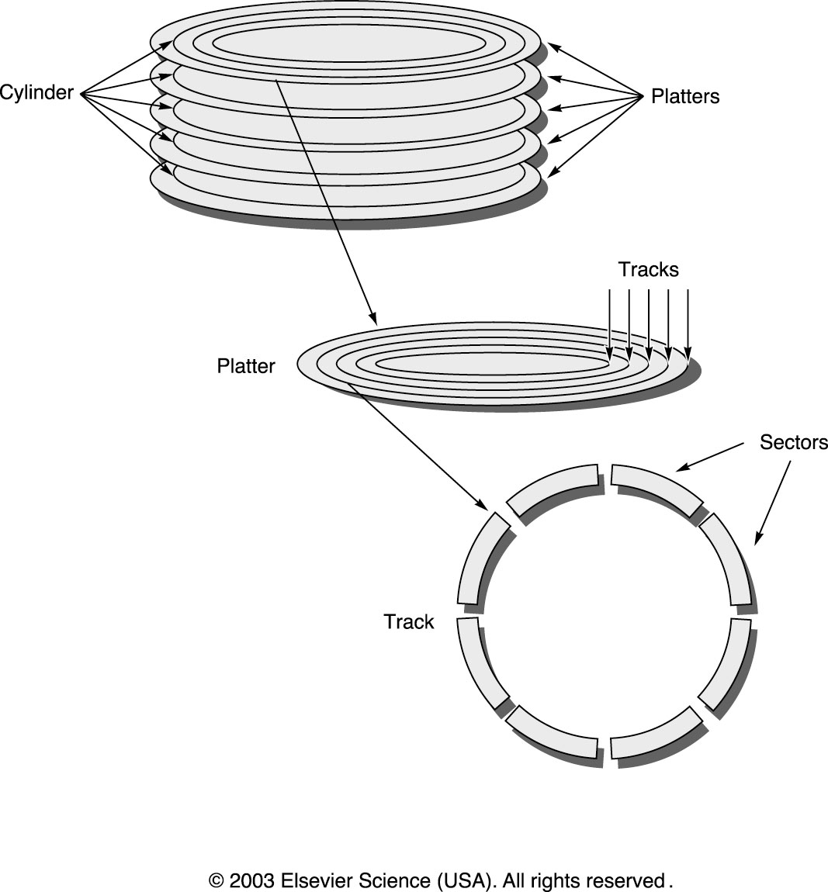
Magnetic Disks

Slide 5
Magnetic Disks
Good: cheap ($/MB), fairly reliable
Primary storage, memory swapping
Bad: Can only read/write an entire sector
Can not be directly addressed as main memory
Disk access time
Queuing delay
Wait until disk gets to do this operation
Seek time
Head moves to correct track
Rotational latency
Correct sector must get under the head
Data transfer time and controller time

Slide 6
Trends for Magnetic Disks
Capacity: doubles in approx. one year
Average seek time
5-12ms, very slow improvement
Average rotational latency (1/2 full rotation)
5,000 RPM to 10,000 RPM to 15,000 RPM
Improves slowly, not easy (reliability, noise)
Data transfer rate
Improves at an OK rate
New interfaces, more data per track

Slide 7
Optical Disks
Improvement limited by standards
CD and DVD capacity fixed over years
Technology actually improves, but it takes time for it to make it into new standards
Physically small, Replaceable
Good for backups and carrying around

Slide 8
Magnetic Tapes
Very long access latency
Must rewind tape to correct place for read/write
Very cheap
It’s just miles of tape!
Used for backup (secondary storage)
Large capacity & Replaceable
Performance tolerable for linear/sequential access (e.g., writing backups)
Dying out
Low volume, so cost decreases slower than disks
Cheaper to use disks now

Slide 9
Using RAM for Storage
Disks are about 100 times cheaper ($/MB)
DRAM is about 100,000 faster (latency)
Solid-State Disks
Was a DRAM and a battery
Much faster than disk, more reliable
Expensive (not very good for archives and such)
Now: Flash memory
Much faster than disks, but slower than DRAM
Very low power consumption
Smaller capacity than disks (GB vs. TB)
Can only write 1,000,000 many times

Slide 10
Hybrid Magnetic-Flash
Magnetic is cheap, huge capacity
Power-hungry (always spinning)
Slow (must move heads)
Need large buffer to improve access scheduling
Sensitive to impact while spinning
Flash is fast but small capacity
Fast, power-efficient, no moving parts
Idea: have both
Buffer writes on flash (use flash as cache for writes)
Can spin down magnetic drive, spin up occasionally to write “dirty” blocks

Slide 11
Storage IO

Slide 12
Buses for I/O
Traditionally, two kinds of busses
CPU-Memory bus (fast, short)
I/O bus (can be slower and longer)
Now: mezzanine buses (PCI)
Pretty fast and relatively short
Can connect fast devices directly
Can connect to longer, slower I/O busses
Data transfers over a bus: transactions
Notes:
Mezzanine: me-zer-nin

Slide 13
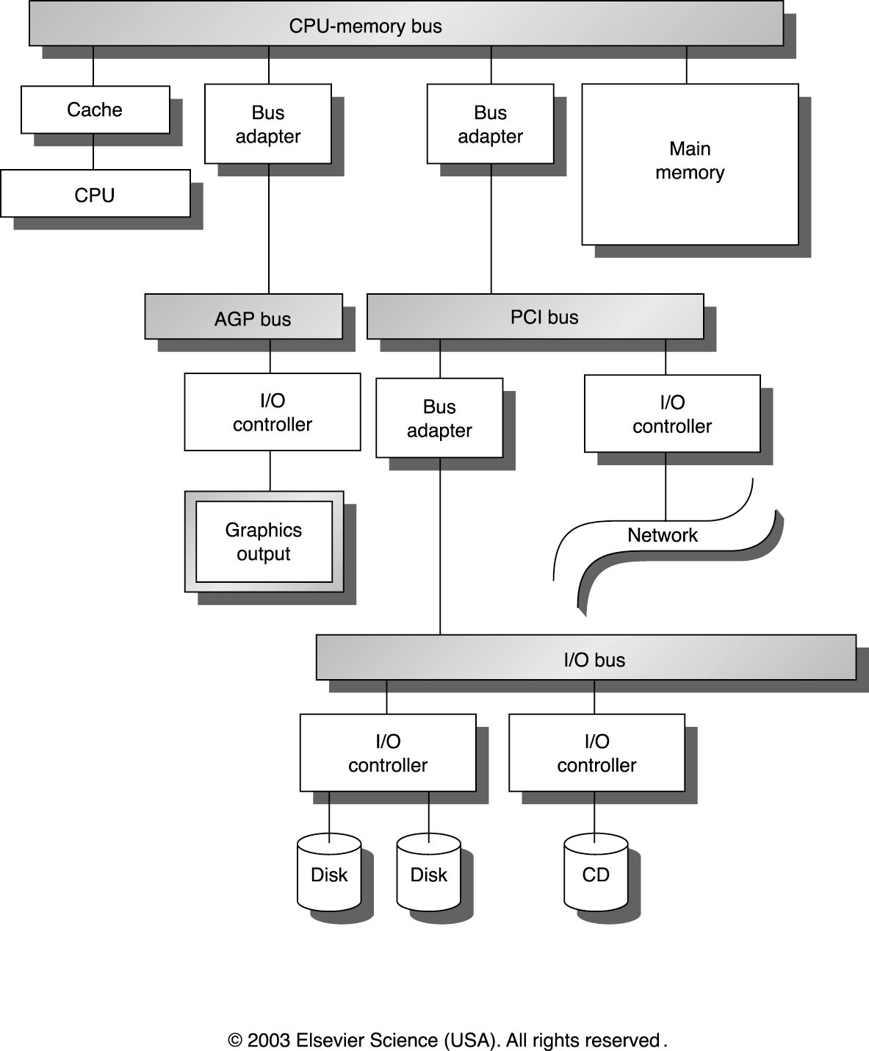
Buses in a System
Notes:
Pci express

Slide 14
How does read() works?

Slide 15
Bus Design Decisions
Split transactions
Traditionally, bus stays occupied between request and response on a read
Now, get bus, send request, free bus (when response ready, get bus, send response, free bus)
Bus mastering
Which devices can initiate transfers on the bus
CPU can always be the master
But we can also allow other devices to be masters
With multiple masters, need arbitration

Slide 16
Interface to access IO devices
Application-level IO:
What is usually written in your program
Provided by language runtime (e.g. libc)
Example: Standard I/O (stdio.h) by C
Printf, scanf, fopen …
System-level IO:
Directly by system calls
Example: POSIX syscalls: open, close, read/write, state
Allow you to access raw data on disk (e.g. inode)
CPU-device IO:
Device driver’s view
App
Libc
OS
Device driver
Memory
IO Device

Slide 17
CPU-Device Interface (Device driver’s view)
CPU
Devices accessible to CPU thru device registers (data/control)
These registers can be either
Memory mapped IO
Some physical memory addresses map to I/O device registers (inside the IO device)
Read/write through LS/ST
Most RISC processors support only this kind of I/O mapping
Port mapped IO:
In a separate I/O address space: dedicated IO pin or bus
Read/write through special IN/OUT instrs
Used in x86, but even in x86 PCs some I/O is memory mapped
Phy. memory address space
Physical Memory
Disk
NI
Notes:
http://en.wikipedia.org/wiki/Memory-mapped_I/O
IO device register represents IO device!

Slide 18
CPU-Device Interface
CPU
Devices can be very slow
When given some data, a device may take a long time to become ready to receive the data
Usually we have a Done bit in status register
Checking the Done bit
Polling: test the Done bit in a loop
Interrupt: interrupt CPU when Done bit becomes 1
Interrupts if I/O events infrequent or if device is slow
Each interrupt has some OS and HW overhead
Polling better for devices that are done quickly
Even then, buffering data in the device lets us use interrupts
Interrupt-driven I/O used today in most systems
Phy. memory address space
Physical Memory
Disk
NI

Slide 19
IO Performance

Slide 20
IO performance
Metrics
Throughput, or bandwidth in context of IO
Response time, or latency in context of IO
Trade-off btwn throughput and response time
Improving throughput favors non-empty queue
Improving latency favors empty queue

Slide 21
Throughput versus response time

Slide 22
SPEC File Server Benchmarks
x
With 168 15k RPM 72GB disks

Slide 23
Dependability

Slide 24
Recap: Reliability and Availability
System can be in one of two states
Service Accomplishment
Service Interruption
Reliability
Measure of continuous service accomplishment
Typically, Mean Time To Failure (MTTF)
Availability
Service accomplishment as a fraction of overall time
Also looks at Mean Time To Repair (MTTR)
MTTR is the average duration of service interruption
Availability=MTTF/(MTTF+MTTR)
MTTR
MTTF
Failure
Restorations
MTBF
Time-line

Slide 25
Dependability
Quality of delivered service that justifies us relying on the system to provide that service
Delivered service is the actual behavior
Each module has an ideal specified behavior
Faults, Errors, Failures
Failure: actual deviates from specified behavior
Error: defect that results in failure
Fault: cause of error
Notes:
Reliability : external metrics
depende

Slide 26
Failure Example
A programming mistake is a fault
An add function that works fine, except when we try 5+3, in which case it returns 7 instead of 8
It is a latent error until activated
An activated fault becomes effective error
We call our add and it returns 7 for 5+3
Failure when error results in deviation in behavior
E.g. we schedule a meeting for the 7th instead of 8th
An effective error need not result in a failure (if we never use the result of this add, no failure)
Notes:
Latent error: hidden error

Slide 27
Faults Classified by Cause
Hardware Faults
Hardware devices fail to perform as designed
Design Faults
Faults in software and some faults in HW
E.g. the Pentium FDIV bug was a design fault
Operation Faults
Operator and user mistakes
Environmental Faults
Fire, power failure, sabotage, etc.
Notes:
Pentium FDIV bug is one of the most infamous bugs by Intel. It is a bug in Intel Pentium FPU; for some calculation, it can not produce correct result beyond 4 digits.

Slide 28
Faults Classified by Duration
Transient Faults
Last for a limited time and are not recurring
An alpha particle can flip a bit in memory but usually does not damage the memory HW
Intermittent Faults
Last for a limited time but are recurring
E.g. overclocked system works fine for a while, but then crashes… then we reboot it and it does it again
Permanent Faults
Do not get corrected when time passes
E.g. the processor has a large round hole in it because we wanted to see what’s inside…
Notes:
Alpha particle is a radiation particle that may change the status of memory bits.

Slide 29
Improving Reliability
Fault Avoidance:
Prevent occurrence of faults by better HW construction
Fault Tolerance
Prevent faults from becoming failures
Typically done through redundancy
Error Removal
Removing latent errors by verification
Error Forecasting
Estimate presence, creation, and consequences of errors

