Slide 1
CIS 655/CSE 661 - Advanced Computer Architecture
RAID (5.2)
Dr. Yuzhe (Richard) Tang

Slide 2
Recap: Reliability and Availability
System can be in one of two states
Service Accomplishment
Service Interruption
Reliability
Measure of continuous service accomplishment
Typically, Mean Time To Failure (MTTF)
Availability
Service accomplishment as a fraction of overall time
Also looks at Mean Time To Repair (MTTR)
MTTR is the average duration of service interruption
Availability=MTTF/(MTTF+MTTR)
MTTR
MTTF
Failure
Restorations
MTBF
Time-line

Slide 3
Redundant Array of Inexpensive Disks

Slide 4
Disk Fault Tolerance with RAID
Redundant Array of Inexpensive Disks
Several smaller disks play a role of one big disk
Can improve performance
Data spread among multiple disks
Accesses to different disks go in parallel
Can improve reliability
Data can be kept with some redundancy
And reliability is a more important issue in RAID than in one disk…
Inexpensive

Slide 5
RAID 0
Data striping used to improve performance
Data striping is about partitioning logically sequential data, such as a file, so that consecutive “stripes” are stored on different physical storage devices.
Disk load balanced, which improves
Throughput: all disks can work in parallel
Latency: less queuing delay – a queue for each disk
No Redundancy
Reliability is actually lower than a single disk (if any disk in array fails, we have a problem)

Slide 6
RAID 0 Reliability
P - probability that a drive will die during one hour
For a single drive, MTTF = 1/P hours
For RAID 0 with two drives:
Probability that both drives survive an hour: (1-P) (1-P)
Probability of failure: 1-(1-P)²
MTTF is 1/(1-(1-P)²)
Say P=0.01, MTTF is
100 hours for single drive
50.25 hours for 2-drive RAID-0
25.38 hours for 4-drive RAID-0
Notes:
Pr[A AND B]=Pr[A]*Pr[B]=(1-P)(1-P)
P[^A OR ^B]=1-Pr[A AND B]=1-(1-P)^2

Slide 7
RAID 1
Disk mirroring [replication]
Disks paired up, keep identical data
A write must update copies on both disks
A read can read any of the two copies
Improved performance and reliability
Can do more reads per unit time
If one disk fails, its mirror still has the data
If we have more than 2 disks (e.g. 8 disks)
“Striped mirrors” (RAID 1+0)
Pair disks for mirroring, striping across the 4 pairs
“Mirrored stripes” (RAID 0+1)
Do striping using 4 disks, then mirror that using the other 4

Slide 8
RAID 1 Reliability
P - probability that a drive will die during one hour
For a single drive, MTTF = 1/P hours
For RAID 1 with two drives:
Probability that both drives fail during one hour: P²
MTTF is 1/P²
Say P=0.01, MTTF is
100 hours for single drive
10,000 hours for 2-drive RAID-1
100,000,000 hours for 4-drive RAID-0
Notes:
P[^A AND ^B]=Pr[^A]*Pr[*B]=P^2

Slide 9
RAID 2/3/4
Idea of error-correcting code (ECC)
Example: parity by XOR
1,0,0,1, s
s=1 XOR 0 XOR 0 XOR 1
RAID 2: memory style ECC
RAID 3: bit-interleaved parity
RAID 4: Block-interleaved parity

Slide 10
RAID 4
Block-interleaved parity
One disk is a parity disk, keeps parity blocks
Parity block at position X is the parity for all blocks whose position is X on any of the data disks
A read accesses only the data disk where the data is
A write must update the data block and its parity block
Can recover from an error on any one disk
Use parity and other data disks to restore lost data
Note that with N disks we have N-1 data disks and only one parity disk, but can still recover when one disk fails
But write performance worse than with one disk (all writes must read and then write the parity disk)

Slide 11
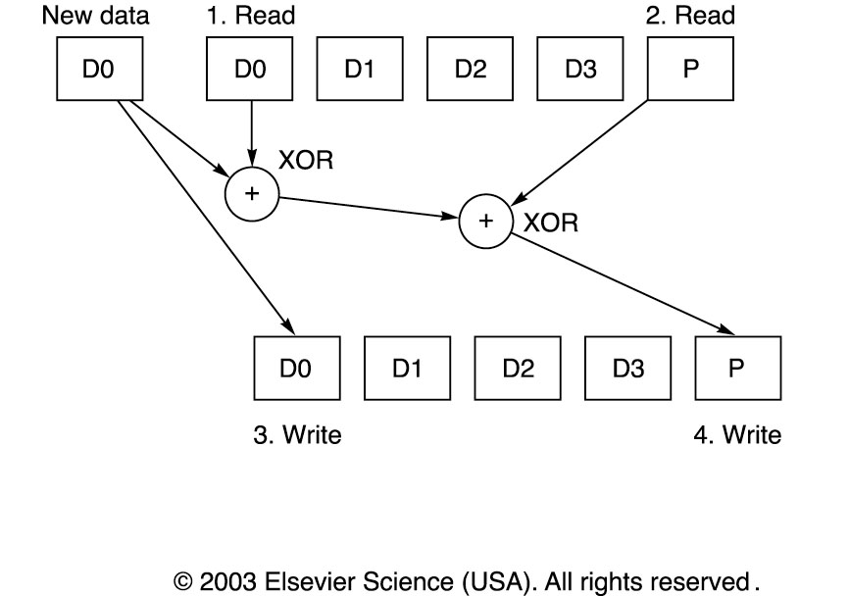
RAID 4 Parity Update

Slide 12
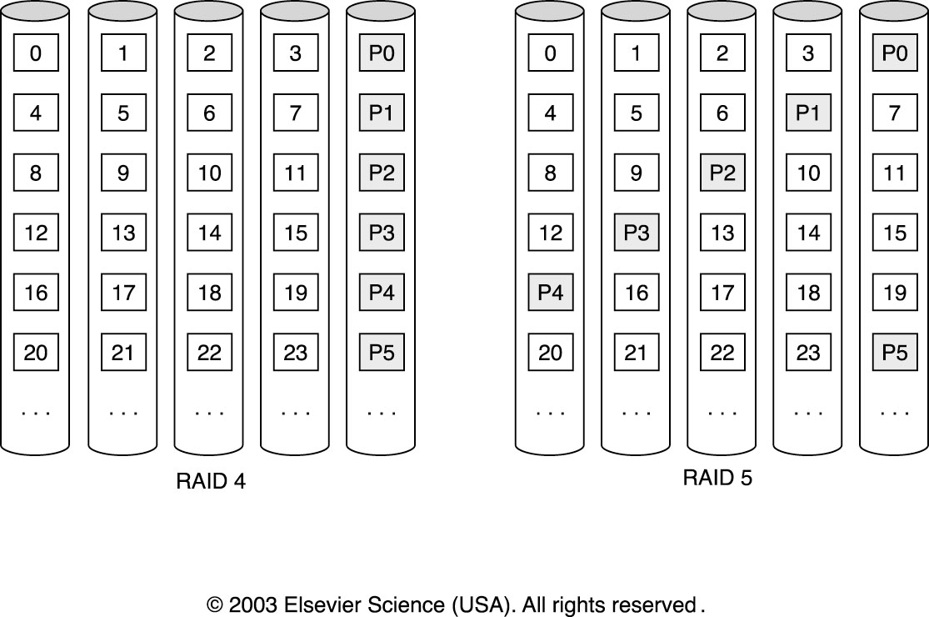
RAID 5
Distributed block-interleaved parity
Like RAID 4, but parity blocks distributed to all disks
Read accesses only the data disk where the data is
A write must update the data block and its parity block
But now all disks share the parity update load
Notes:
The write to parity disk drive is not evenly distirbuted. No load balancing.
In RAID5 there is distribution of parity bits among all five drives.

Slide 13
RAID 5 Reliability
P - probability that a drive will die during one hour
For a single drive, MTTF = 1/P hours
For RAID 5 (and RAID 4) with 4 drives:
Probability that none of the four drives fails: (1-P)⁴
Probability that exactly one drive fails: 4*P* (1-P)³
Probability that 2 or more drives fail:
1- [(1-P)⁴+4*P* (1-P)³]
Say P=0.01, MTTF is
100 hours for single drive
10,000 hours for 2-drive RAID-5 (same as RAID-1)
1,689 hours for 4-drive RAID-5

Slide 14
RAID 6
Two different (P and Q) check blocks
Each protection group has
N-2 data blocks
One parity block
Another check block (not the same as parity)
Can recover when two disks are lost
Think of P as the sum and Q as the product of D blocks
If two blocks are missing, solve equations to get both back
More space overhead (only N-2 of N are data)
More write overhead (must update both P and Q)
P and Q still distributed like in RAID 5

Slide 15
Dependability

Slide 16
Dependability: from Failure to Fault
Quality of delivered service that justifies us relying on the system to provide that service
Delivered service is the actual behavior
Each module has an ideal specified behavior
Faults, Errors, Failures
Failure: actual deviates from specified behavior (effect)
Error: defect that results in failure
Fault: cause of error
Notes:
Reliability : external metrics
depende

Slide 17
Failure Example
A programming mistake is a fault
An add function that works fine, except when we try 5+3, in which case it returns 7 instead of 8
It is a latent error until activated
An activated fault becomes effective error
We call our add and it returns 7 for 5+3
Failure when error results in deviation in behavior
E.g. we schedule a meeting for the 7th instead of 8th
An effective error need not result in a failure (if we never use the result of this add, no failure)
Notes:
Latent error: hidden error

Slide 18
Faults Classified by Cause
Hardware Faults
Hardware devices fail to perform as designed
Design Faults
Faults in software and some faults in HW
E.g. the Pentium FDIV bug was a design fault
Operation Faults
Operator and user mistakes
Environmental Faults
Fire, power failure, sabotage, etc.
Notes:
Pentium FDIV bug is one of the most infamous bugs by Intel. It is a bug in Intel Pentium FPU; for some calculation, it can not produce correct result beyond 4 digits.

Slide 19
Faults Classified by Duration
Transient Faults
Last for a limited time and are not recurring
An alpha particle can flip a bit in memory but usually does not damage the memory HW
Intermittent Faults
Last for a limited time but are recurring
E.g. overclocked system works fine for a while, but then crashes… then we reboot it and it does it again
Permanent Faults
Do not get corrected when time passes
E.g. the processor has a large round hole in it because we wanted to see what’s inside…
Notes:
Alpha particle is a radiation particle that may change the status of memory bits.

Slide 20
Improving Reliability
Fault Avoidance:
Prevent occurrence of faults by better HW construction
Fault Tolerance
Prevent faults from becoming failures
Typically done through redundancy
Error Removal
Removing latent errors by verification
Error Forecasting
Estimate presence, creation, and consequences of errors

Slide 21
References
Appendix D: Storage Systems
Online link: http://booksite.elsevier.com/9780123838728/references/appendix_d.pdf

