Slide 1
Log-structured storage systems (5.3)

Slide 2
1. Basic Approach for Storage
Keep everything in order and in place
Updates:
Reads
0
1
2
3
4
5
3
5
D
C
G
A
B
E
F
W
0
1
2
3
4
5
D
C
G
A
B
E
F
W

Slide 3
What is the problem?
Data writes incur random disk access
Position “3” can be in any place
Random access causes expensive disk seeks.
Disk traffic benchmark is dominated by small writes
Larger memory sizes mean larger caches
Caches will capture most read accesses
Cloud/big-data workloads feature high write rate
Micro-blogging, etc
Office and engineering workloads dominated by accesses to small files
Need to optimize small random writes.
Eliminate disk seeks.. How?
Notes:
Many random disk accesses
File creation and deletion times dominated by directory and i-node updates
I-nodes stored apart from data blocks
synchronous writes to update directories and i-nodes
Required for consistency

Slide 4
2. Log-structured file system
Write all updates to disk sequentially in a log-like structure
Batch many small random writes into one big write (large sequential transfers)
Use memory as write buffer
0
1
2
3
4
5
6
7
0,D
1,C
2,G
3,A
4,B
5,E
3,F
5,W

Slide 5
Main advantages
Write w. fewer seeks by batching and logging
Faster recovery after a crash
Log ordered by time
All blocks that were recently written are at the tail end of log
No need to check whole file system for inconsistencies
Like UNIX and Windows 95/98 do

Slide 6
Read Performance Issue
Log is the only structure on disk
LFS’s log contains both i-nodes and data blocks
All files share the same log
How to read?
Indexing can help but still need to scan
Originally in BSD Linux, later Journaling file systems: Ext3, Ext4
Imap: i-node map
0,D
1,C
2,G
3,A
4,B
5,E
3,F
5,W
Notes:
inode is per file
Imap will include entries, each entry for one inode/file

Slide 7
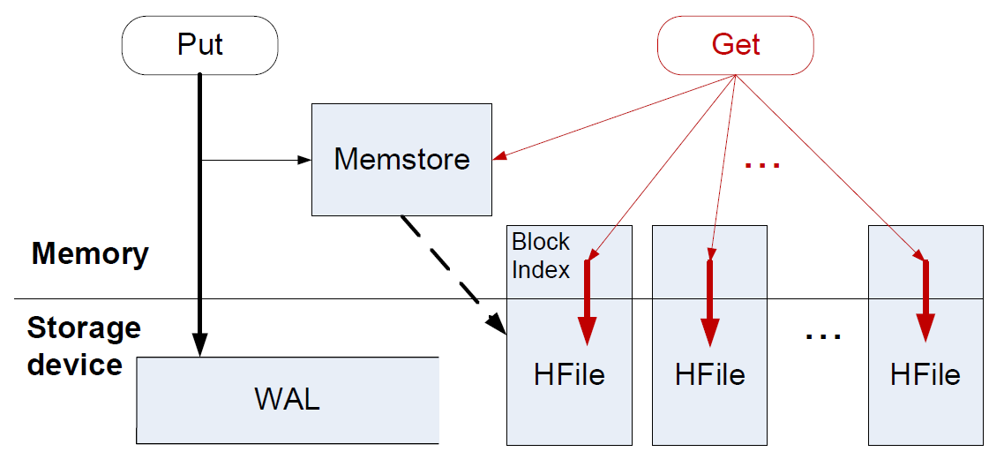
3. Log-structured merge tree
Data is key-ordered within files, time-ordered across files
Write path
Flush
Read path
Multiple on-disk files
0
1
2
3
4
5
0,D
1,C
2,G
3,A
4,B
5,E
0
1
2
3
4
5
0,S
2,X
3,F
5,W
7,E
10,D

Slide 8
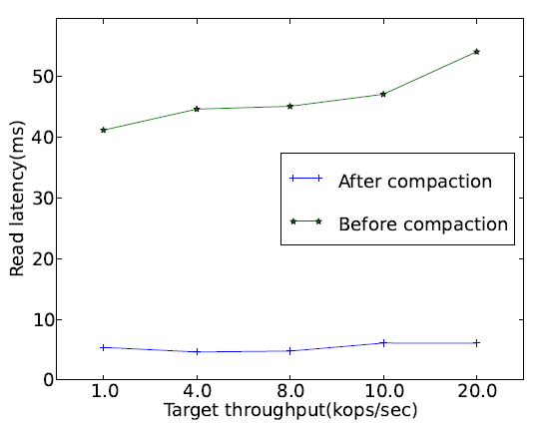
Compaction
What if there are too many files?
Merge all files into one: merge-sort
An offline batch process
Read performance is improved afterwards
Notes:
Here we can see the performance study regarding get performance before versus after compaction.
First Compaction is an offline batch process for storage reorganization and garbage collection in NoSQL stores.
From this perf study on this version of HBase, we can see that get is much faster after compaction versus before. The brief reason is that after compaction, multiple ondisk files are merged into one and Get only needs to read one file.

Slide 9
Adoption and Performance
LSM tree is widely adopted by “big-data” stores
Google’s Big-Table family (Hbase, LevelDB, …), SQLite4
MySQL updates in-place
BF. Cooper, etc. Benchmarking Cloud Serving Systems with YCSB Socc 2011

Slide 10
References
LSM tree:
'Neil, Patrick E.; Cheng, Edward; Gawlick, Dieter; O'Neil, Elizabeth (June 1996). "The log-structured merge-tree (LSM-tree)". Acta Informatica 33 (4): 351–385. doi:10.1007/s002360050048.

