Slide 1
Pop quiz
What mechanism is used to store the mapping between virtual and physical address spaces?
What mechanism is used to store the mapping between physical address and disk sector spaces?
What mechanism is to transfer data from disk to memory without going through CPU?
Name one condition that triggers page-fault.

Slide 2
IO Performance

Slide 3
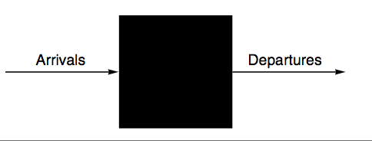
IO performance
Performance model 1: black-box
Little’s law:
Mean number of tasks in system = Arrival rate × Mean response time
Performance model 2
Queue in front of server
Queue serves as a buffer before server
Queuing theory

Slide 4
IO performance
Metrics
Throughput, or bandwidth in context of IO
Maximal arrive rate it can sustain.
Response time, or latency in context of IO
Trade-off btwn throughput and response time
Improving throughput favors non-empty queue
Improving latency favors empty queue

Slide 5
Throughput versus response time

Slide 6
SPEC File Server Benchmarks
x
With 168 15k RPM 72GB disks

Slide 7
CIS 655/CSE 661 - Advanced Computer Architecture
Interconnect (5.3)
Dr. Yuzhe (Richard) Tang

Slide 8
Networks

Slide 9
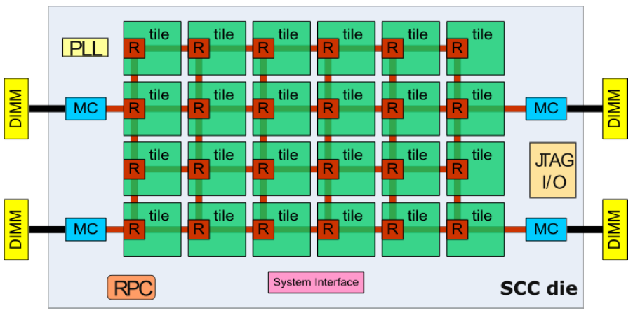
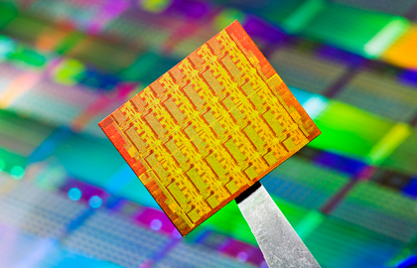
Example 1: On-chip network (ONC)
Many-core: Single-chip cloud computer (SCC)
48 cores with 2D mesh network
24 two-core tiles, 4 memory controllers
Can address totally 64 GB
Has to use 2D mesh to fit into 2D chip

Slide 10
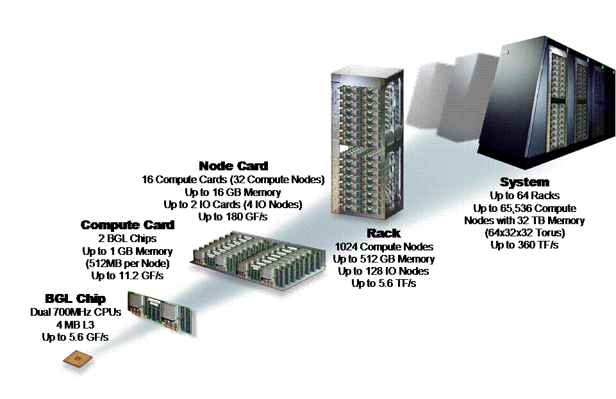
Example 2: Storage area network
IBM Blue gene: super-computer
(was) number one in the top500 HPC list
2,500 square feet
65,536 dual-processor nodes and 1,024 I/O nodes
3D torus network: 32*32*64 (=64K)
Node Card
16 compute, 0-2 I/O cards
Compute Card
2 chips
Chip (node)
2 processors
System
64 Racks
Rack
32 Node cards
© Timothy Mark Pinkston, José Duato

Slide 11
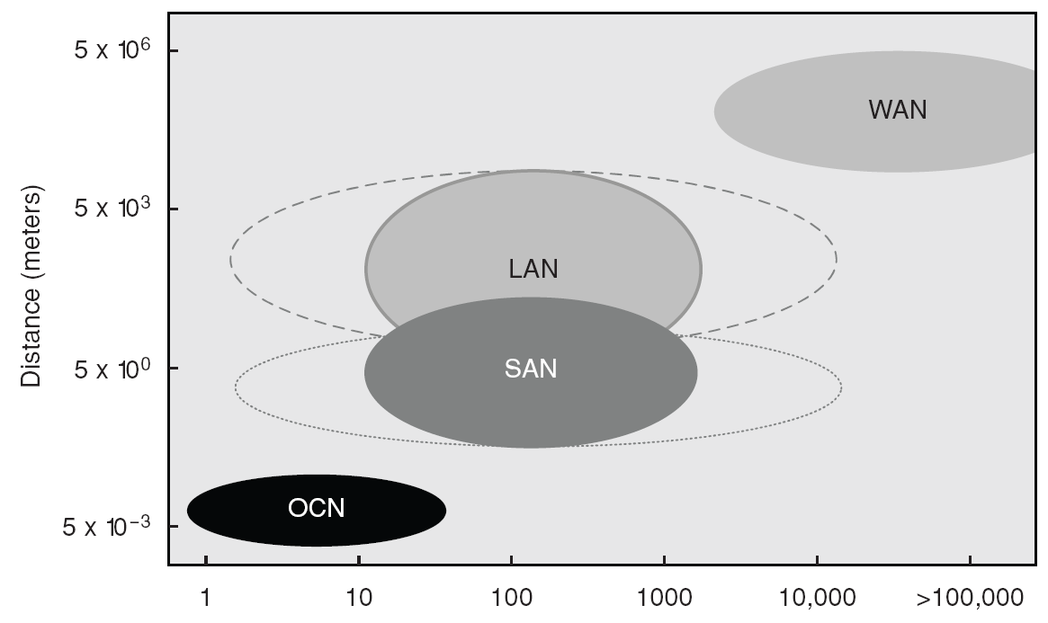
Network Classifications
On-chip Networks (OCNs)
Sometimes called network-on-chip (NoC)
System/Storage-area Networks (SANs)
For multi-processor/multi-computer systems, and server-I/O connections
Local Area Networks (LANs)
100’s-1000’s of nodes; typically up to a few km of distance; usually Ethernet up to 10Gbps
Wide Area Networks (WANs)
Also called long-haul networks; global-scale; e.g., ATM (asynchronous transfer mode)
nodes

Slide 12
Example 2: System/storage area net.
InfiniBand
Industry-wide defacto networking standard
Can be used for both inter-processor communication or server I/O
Switch-based technology
Flexible in topology, arbitration and routing.
Programmable routing table
User level communication:
Send/receive
RDMA: remotely DMA (redirect memory access) data into the receiver’s memory

Slide 13
Network interface

Slide 14
Network Interface Functions
Network functions
Composing messages
Packetization
TCP offload, OS bypassing
Flow control
Data transportation
End Node
End Node
End Node
End Node
Device
Device
Device
Device
…
SW Interface
SW Interface
SW Interface
SW Interface
HW Interface
HW Interface
HW Interface
HW Interface
…
Link
Link
Link
Link
Interconnection Network
…
Notes:
Network media
Electronics: copper
Optics: e.g. long-distance communication

Slide 15
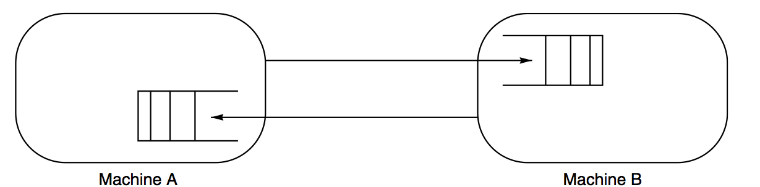
Interconnecting Two Devices
Two devices via dedicated link
Communication Protocol
Typical steps followed by the sender:
System call by application
Copies the data into OS and/or network interface memory
Packetizes the message, Prepares headers and trailers of packets
Checksum is computed and added to header/trailer
Timer is started and the network interface sends the packets
processor
memory
ni
ni
memory
processor
proc/mem bus
user
space
IO bus or proc/mem bus
IO bus or proc/mem bus
user
space
proc/mem bus
register
file
Interconnection
network
register
file
FIFO
FIFO
system
space
system
space
packet
user writes
data in
memory
system call
sends
1 copy
pipelined
transfer
e.g., DMA
© Timothy Mark Pinkston, José Duato

Slide 16
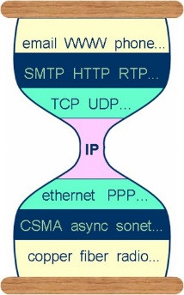
Network Interface Functions
Interface Functions
Composing & processing messages:
e.g. adding headers
Packetization
for IP
header
trailer
Dest
Information
Type
message payload
checksum
header
trailer
Dest
Info
Msg
ID
Seq.
#
Type
packet payload
checksum
00 = request
01 = reply
10 = request acknowledge
11 = reply acknowledge

Slide 17
Interconnecting Two Devices
Communication Protocol
Typical steps followed by the receiver:
NI allocates received packets into its memory or OS memory
Checksum is computed and compared for each packet
If checksum matches, NI sends back an ACK packet
Once all packets are correctly received
The message is reassembled and copied to user's address space
The corresponding application is signalled (via polling or interrupt)
processor
memory
ni
ni
memory
processor
proc/mem bus
user
space
IO bus or proc/mem bus
IO bus or proc/mem bus
user
space
proc/mem bus
register
file
Interconnection
network
register
file
FIFO
FIFO
system
space
system
space
packet
pipelined
reception
e.g., DMA
interrupt
2 copy
data
ready
© Timothy Mark Pinkston, José Duato

Slide 18
Interconnecting Two Devices
Communication Protocol
Additional steps at the sender side:
ACK received: the copy is released and timer is cancelled
Timer expires before receiving an ACK: packet is resent and the timer is started
processor
memory
ni
ni
memory
processor
register
file
user
space
user
space
register
file
Interconnection
network
pkt
FIFO
FIFO
system
space
system
space
ACK
© Timothy Mark Pinkston, José Duato

Slide 19
Interconnecting Two Devices
Communication Protocol
OS-bypassing (zero-copy or user-level protocols)
Direct allocation for DMA transfer to/from memory/NI buffers
Application directly reads/writes from/to these locations
Memory-to-memory copies are avoided, protection by OS
processor
memory
ni
ni
memory
processor
proc/mem bus
user
space
IO bus or proc/mem bus
IO bus or proc/mem bus
user
space
proc/mem bus
register
file
Interconnection
network
register
file
FIFO
FIFO
system
space
system
space
packet
user copies
data into pinned
user space
system call send.
pipelined transfer
e.g., DMA
Pipelined
peception
e.g., DMA
interrupt:
data ready
© Timothy Mark Pinkston, José Duato

Slide 20
Interconnecting Two Devices
Communication Protocol
OS-bypassing (zero-copy or user-level protocols)
Direct allocation for DMA transfer to/from memory/NI buffers
Application directly reads/writes from/to these locations
Memory-to-memory copies are avoided, protection by OS
Is it possible to take out register to memory/buffer copy?
processor
memory
ni
ni
memory
processor
proc/mem bus
user
space
IO bus or proc/mem bus
IO bus or proc/mem bus
user
space
proc/mem bus
register
file
Interconnection
network
register
file
FIFO
FIFO
system
space
system
space
packet
© Timothy Mark Pinkston, José Duato

Slide 21
Interconnecting Two Devices
Communication Protocol
OS-bypassing (zero-copy or user-level protocols)
Direct allocation of system or network interface memory/buffers
Application directly reads/writes from/to these locations
Memory-to-memory copies are avoided, protection by OS
Is it possible to take out register to memory/buffer copy?
NI buffer is associated with (or replaced by) register mapping
processor
ni
ni
processor
proc/mem bus
proc/mem bus
register
file
Interconnection
network
register
file
FIFO
FIFO
packet
Pipelined transfer
© Timothy Mark Pinkston, José Duato

Slide 22
Extra Network Interface Functions
Network functions
TCP offload from host CPU to NIC processors
Works for SAN, LAN and WAN.
Flow control:
Prevent sending packets faster than can be processed by receivers
Strategy: receiver notifies sender to stop now & resume later
Transport over physical layer
Express the packets in signal and physically transport signal
Memory
host interface
internal interconnect
to/from
network
DMA
NIC
processor
FIFO
Network
interface
DMA
NIC

Slide 23
Blackbox view of the network
Black-box model of interconnection network
Deliver packets from one node to another
About packets not messages
Not about network stack: App-level protocols
What happens internally?
processor
ni
ni
processor
proc/mem bus
proc/mem bus
register
file
Interconnection
network
register
file
FIFO
FIFO
packet
Pipelined transfer

Slide 24
Internal Network Design
More than 2 devices:
Paths need to be shared → how?
Topology: network structure
“What paths are possible for a packet?”
Shared- or switched-media
Routing:
”Which of the possible paths are valid for packets?”
Outcome: Determine a path from source to destination
Routing info in packet header
Arbitration:
“When are paths available for packets?”
Outcome: One winner to advance to the next step (by switching), several losers to buffer
Flow control: avoids buffer overflow
Switching:
“How are paths allocated to packets?”

Slide 25
Network Structure

Slide 26
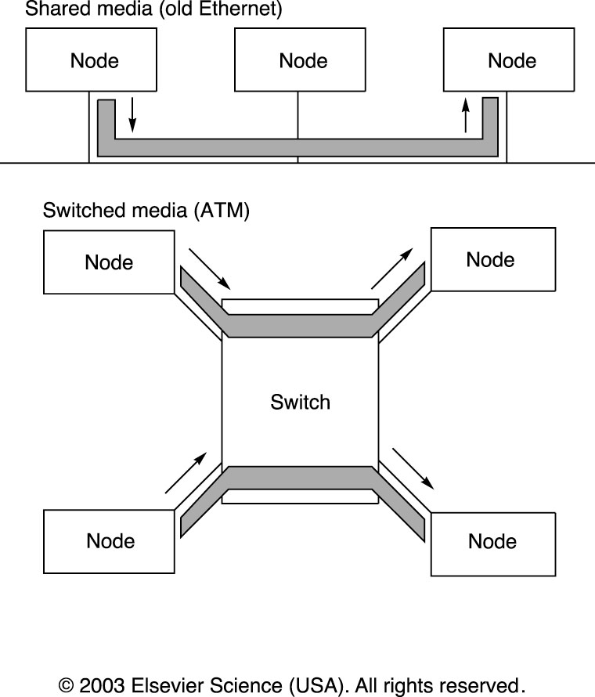
Interconnection networks: Shared media
Traditionally just used a bus (or shared media)

Slide 27
Shared Media Networks
Need arbitration to decide who gets to talk
Arbitration can be centralized or distributed
Distributed arbitration
(Centralized not used much in practice)
Check, if media not used now, start sending
if another also sending (collision detection)
If collision, wait for a while and retry
“For a while” is random (otherwise collisions repeat forever)
Exponential back-off to avoid wasting bandwidth on collisions
Not scalable

Slide 28
Interconnection Networks: Switched
Large-scale systems:
Massive MP systems (many-core), for instance:
Intel’s Single-chip Cloud computer
HPC (top500 computers)
The Internet
Switched networks
Notes:
ATM: Asynchronous Transfer Mode

Slide 29
Switched Networks
Switching: allocating path to packets
From the input port/buffer to the output
Switching overheads but no time wasted on arbitration
Multiple transfers can be in progress
If they use different links, of course
Circuit or Packet Switching
Circuit-level switching: per end-to-end connection
Reserves links for a connection (e.g., phone network)
Packet-level switching: each packet routed separately
Links used only when data transferred (e.g., Internet Protocol)

Slide 30
Switch Technology
What do we want in a switch
Many input and output links
Usually number of input and output links the same
Low contention inside the switch
Best if there is none (only external links cause contention)
Short switching delay

Slide 31
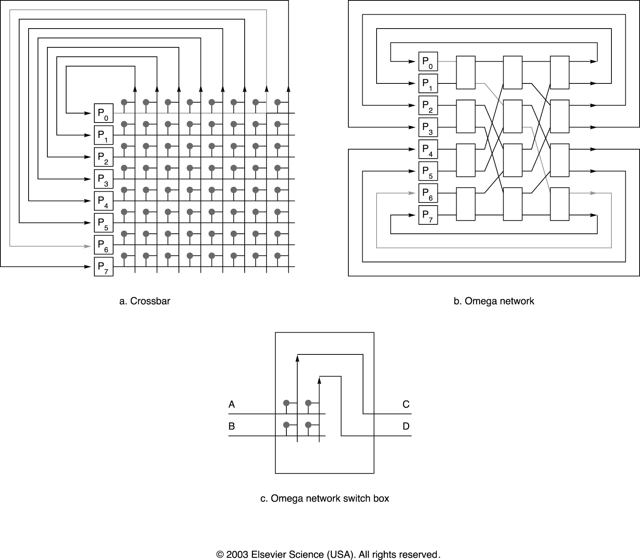
Crossbar Switch
Crossbar
Very low switching delay, no internal contention
Complexity grows as square of number of links
Can not have too many links (e.g., up to 64 in and 64 out)

Slide 32
Omega Network
Omega Network
Build switches with more ports using small crossbars
Lower complexity per link, but longer delay and more contention

Slide 33
Connecting switches: Network Topology
Mesh
Torus

Slide 34
Connecting Switches: Network Topology
Hypercube

Slide 35
Network Topology: Metrics
What do we want in a network topology
Many nodes, high bandwidth, low contention, low latency
Low latency: few switches along any route
For each (src, dest) pair, we choose shortest route
Longest such route over all (src,dst) pairs: network diameter
We want networks with small diameter!
Low contention: high aggregate bandwidth
Divide network into two groups, each with half the nodes
Total bandwidth between groups is bisection bandwidth
Actually, we use the minimum over all such bisections
Low switch complexity: higher switch speeds
Want low in-/out-degree for node

Slide 36
Example Topologies (Chain)
Diameter
Average Distance
Bisection Bandwidth
Max degree
Notes:
Diameter: 4
Average distance: 2 =(1*4+2*3+3*2+4*1) / (1+2+3+4)
Bisection bandwidth: 1
Max degree: 2

Slide 37
Example Topologies (Ring)
Diameter
Average Distance
Bisection Bandwidth
Max degree
Notes:
Diameter: 2
Average distance: 1.5=(1+2+2+1) / 4 (symmetry)
Bisection bandwidth: 2
Max degree: 2

Slide 38
Example Topologies (2D Grid/Mesh)
Diameter
Average Distance
Bisection Bandwidth
Max degree
Notes:
Diameter: 4
Average distance: 2
Bisection bandwidth: 4
Max degree: 4

Slide 39
Different Topologies, Different Uses
Chain networks
2D mesh networks: on-chip interconnects
Hyper-cube networks: SAN

Slide 40
Example Topologies (2D Torus)
Diameter
Average Distance
Bisection Bandwidth
Max degree

Slide 41
Example Topologies (Hyper-Cube)
Diameter
Average Distance
Bisection Bandwidth
Max degree

Slide 42
Routing

Slide 43
Routing
Shared media has trivial routing (broadcast)
In switched media we can have
Source-based (source specifies route)
Virtual circuits (end-to-end route created)
When connection made, set up route
Switches forward packets along the route
Destination-based (source specifies destination)
Switches must route packet toward destination
Also can be classified into
Deterministic (one unique route from a source to a destination)
Adaptive (different routes can be used)

Slide 44
Routing Methods for Switches
Store-and-Forward
Switch receives entire packet, then forwards it
If error occurs when forwarding, switch can re-send
Timeline
0
1
2
3
H
B
B
B
T
H
B
B
B
T
Channel
H
B
B
B
T

Slide 45
Wormhole routing
Packet consists of flits (a few bytes each)
Each flit is the amount of data can be transferred in one clock cycle
First flit contains header w/ destination address
Switch gets header, decides where to forward
Other flits (without header) forwarded as they arrive
Between flits, it does not allow other package to cut in.
Looks like packet worming through network
If an error occurs along the way, sender must resend
No switch has the entire packet to re-send it
0
1
2
3
H
B
B
B
T
Channel
H
B
B
B
T
H
B
B
B
T
0 1 2 3 4 5 6 7 8 9 10 11 12 13 14
Cycle

Slide 46
Flow control in wormhole routing
Each network link starts/terminates in a buffer in the switch port.
Flow control: resource allocations in the buffer
Wormhole routing: per-flit allocation
Allocate one flit-sized buffer upon arrival of one flit
What if the link is busy (dest. buffer being full) in the middle of a transfer?
How to deal with the rest of flits in the packet?
Wormhole has to stop the tail when head stops
Now each flit along the way blocks a link
One busy link creates other busy links => traffic jam

Slide 47
Cut-Through Routing
Cut-through routing:
Allocate dest. buffer per packet
Before the header is transferred, make sure there is enough space for the packet.
Handling busy links
If outgoing link busy, receive and buffer incoming flits
The buffered flits stay there until link becomes free
When link free, the flits start worming out of the switch
Need packet-sized buffer space in each switch
Wormhole Routing switch needs to buffer only one flit

Slide 48
Routing: Network Latency
Switch Delay
Time from incoming to outgoing link in a switch
Switches
Number of switches along the way
Transfer time
Time to send the packet through a link
Store-and-Forward end-to-end transfer time
(Switches*SwitchDelay)+(TransferTime*(Switches+1))
Wormhole end-to-end transfer time
(Switches*SwitchDelay) + TransferTime
Much better if there are many switches along the way

Slide 49
S&F vs. Wormhole
Assume network with 7 switches on route to send a message. 16 bytes messages, 4 byte headers, 0.25 μs switch latency, transfer rate of 20MB/s
Packet size:
Time to transfer over one link:
S&F Time: (#Sw * Sw-delay) + ((#Sw +1) + transfer_time)
Wormhole Time: (#Sw * Sw-delay) + transfer_time

Slide 50
References
Appendix F:
Online link: http://booksite.elsevier.com/9780123838728/references/appendix_f.pdf
Copyright © 2012, Elsevier Inc. All rights reserved.

