Slide 1

Communication and Data Handling Subsystem Design
Presenter Name(s) Go Here

Slide 2
CDH Overview - 1
• Payload
– Processor: ATMega 128 ( As Central Processing Unit of the Carrier; sensing, processing, transmitting, storing telemetry data)
– Memory: Atmel0736 (For storing telemetry data onboard for backup in case of communication failure)
– Radio Transceiver: XBEE-PRO® 900HP Transceiver (For transmitting data to ground station once every 2 seconds)
– Antenna : A24-HABUF-P5i (2.1dBi)

Slide 3
CDH Overview - 2
• Ground Station
– Radio Transceiver: XBEE-PRO® 900HP Transceiver (For receiving data from the carrier once every 2 seconds)
– XBEE USB Explorer
– Antenna : A24-HABUF-P5i (2.1dBI)
– Intel Core i3 Processor Laptop.

Slide 4
CDH Changes Since PDR
Calculation for memory consumption is explained.
Method for activation of transmission is updated.
Format for data packet is explained.

Slide 5
CDH Requirements – 1 (Container)
ID | Requirement | Rationale | Parent | Priority | VM
 |  |  |  |  | A | I | T | D
CDH01 | Transmit GPS Data Stream | Descent Telemetry packet (transmitted every 2 seconds) | SYS -08 CD-01 | HIGH |  |  | x | x
CDH02 | Transmit Altitude in meters | Descent Telemetry packet (transmitted every 2 seconds) | SYS-08 CD-01 | HIGH |  |  | x | x
CDH03 | Transmit Air Temperature in Celsius | Descent Telemetry packet (transmitted every 2 seconds) | SYS-08 CD-01 | HIGH |  |  | x | X
CDH04 | Transmit Battery Voltage in Volts | Descent Telemetry packet (transmitted every 2 seconds) | SYS-08 CD-01 | HIGH | x |  | x | x
CDH05 | Terminate Telemetry | Terminate Telemetry within 5 minutes of landing. | SYS-08,09 CD-01 | HIGH | x |  | x | x
CDH06 | Store Telemetry Data | For Post Processing in case of Communication Failure | SYS-11 | LOW
Presenter: Name goes here

Slide 6
CDH Requirements – 2 (Ground Station)
ID | Requirement | Rationale | Parent | Priority | VM
 |  |  |  |  | A | I | T | D
CDH09 | Receive GPS Data Stream | Descent Telemetry packet Receive every 2S | CD01 | HIGH |  |  | x | x
CDH10 | Receive Altitude in meters | Descent Telemetry packet (received every 2 seconds) | CD01 | HIGH |  |  | x | x
CDH11 | Receive Air Temperature in Celsius | Descent Telemetry packet (received every 2 seconds) | CD01 | HIGH |  |  | x | X
CDH12 | Receive Battery Voltage in Volts | Descent Telemetry packet (received every 2 seconds) | CD01 | HIGH | x |  | x | x
CDH13 | Plot telemetry data In real time | Ret real time feel for what is happening. | CD01 | HIGH | x |  | x | x
Presenter: Name goes here

Slide 7
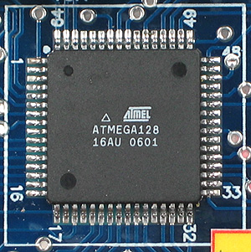
Processor Selection
Carrier: AtMega 128
Maximum Clock Frequency 16 MHz (external)
Data Interfaces:
USART: 2 (One for Transceiver and
one for GPS)
SPI: 1(For memory)
ADC PORTS: 8 channels(one each
for battery voltage, temperature sensor and pressure
sensor)
On chip Flash Memory: 128 Kb
SRAM / EEPROM: 4 Kb
Supply Voltage: 4.5V – 5V

Slide 8
Memory Selection
If 2 minutes of Total Telemetry(carrier) time is sampled every 2 seconds,
(((2(min) x 60) sec) x (50 bytes)) / 2 sec =3000 bytes
- 50 bytes is the size of one packet.
If acceleration data is calculated at 100 samples/sec, assuming the time for which pressure sensor is activated is 3secs,
(3 x 100 x 2) bytes = 600 bytes
- Atmel Memory Chip :
- 8 MB, SPI Mode, Chip Select available.
- Cheap and readily available.

Slide 9
Antenna Selection
Antenna Selected : A09 – HASM – 675
Technology : Half Wave Dipole Articulated Antenna
Frequency : 915 MHz (902 MHz – 928 MHz)
Gain : 2.1 dBi
Power Rating : 1 W
Mass : Will be calculated after procurement. Estimated to be within limits.

Slide 10
Radio Configuration
Fixed baud rate of 57600 bps , channel 0 in Receive mode for query wait
Transceiver programmed for API control Mode
The system in API mode set at fixed baud rate and channel transmits and receives through a 3 byte MAC address which will be hard coded on the EEPROM.
NET ID = “1300”(as per guidelines)
Transmit when asked for a query, through UDR buffer
Presenter: Name goes here

Slide 11
Telemetry Format
Characters | Definition | Size(Bytes)
cc. | State | 2
hhmmss | Data time tag in hours, minutes and seconds | 8
Hhmmss | Mission Time | 8
N | Start of latitude data | 1
AA.aaa | Payload latitude | 9
W | Start of longitude data | 1
BB.bbbb | Payload longitude | 10
hh.hh.. | Payload GPS altitude | 3
Ab | Number of satellites tracked in decimal | 2
pp. | Pressure Sensor Sampled Data | 2
tt. | Air temperature ( 1 degree resolution) | 2
vv. | Battery voltage | 2
States
BOOT
TEST_MODE
LAUNCH_PAD
ASCENT
PARA
CANSAT
IMPACT
BUZZER
Data will be sent every 2 seconds at baud rate of 57600 bps.
Data Format :
CANSAT | <TEAM_ID> | <MISSION_TIME> | <GPS_TIME> | <GPS_LAT> | <GPS_LONG> | <GPS_ALT> | <GPS_SAT> | <ALT_SENSOR> | <TEMP> | <BAT_V> | <STATE>
Example : ‘CANSAT,1300,7200137,161229,3723.2475N,12158.3146W,3120.3,7,3109.4,29,8.4,’
TIME _MISSION ,TIME_GPS, LATITUDE, LONGITUDE,ALTITUDE,SATELLITES,BAROMETRIC ALTITUDE,AIR TEMP., B VOLT
Presenter: Name goes here

Slide 12
Activation of Telemetry Transmissions
As soon as FSW boots, the sampling of sensor will start immediately and data will be stored on chip memory.
GCS will transmit a byte which when received by FSW imply the start of telemetry and after that every packet formed will be transmitted to GCS as well as stored on board memory.
Presenter: Name goes here

Slide 13
Locator Device and Labeling
The locator will be activated by the FSW upon impact and deactivated manually after recovery.
Model Selected : MAS803Q
Rated Voltage : 6V DC
Max Power Consumption : 780mW at rated voltage
Audible Volume : 105dB at height > 10cm, 80dB required
Activation Trigger : Switch on buzzer by making control pin high as soon as impact takes place.
Deactivation : Manual switch provided for deactivation

Slide 14
Flight Software Design
Presenter Name(s) Go Here

Slide 15
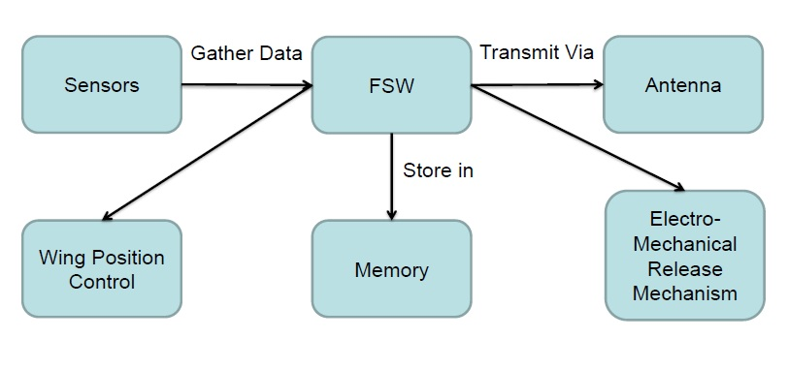
FSW Overview - 1
The FSW will work in a Microcontroller(ATMega128). Its basic structure will be as follows.
Presenter: Name goes here

Slide 16
FSW Overview - 2
The FSW will collect data from all the sensors and store it onto the on-board memory. It will also transmit the collected data via XBEE.
It will also initialize the Electromechanical Mechanism used to release the Payload from the container at the height of 400 meters.
Complete FSW will be developed in C with an AVR GCC environment. All C programs are compiled and dumped as HEX codes in ATMEL microcontrollers which forms the embedded platform of our Payload. We have chosen this platform because we are familiar with it as it is a part of our curriculum.
Presenter: Name goes here

Slide 17
FSW Changes Since PDR
Software development plan is updated.
Sampling rates are corrected.
State diagram is updated with release state included.

Slide 18
FSW(Payload) Requirements
ID | Requirement | Rationale | Parent | Priority | VM
 |  |  |  |  | A | I | T | D
FSC01 | Collection of Sensor data in processor and formation of packet | Reception of data values from sensors and analysis in firmware to produce data packets | CD01 | HIGH | x |  | x | x
FSC02 | Data packet to be sent to RF Transceiver via USART. | Packet sent for Transmission to Relay | CD01 | HIGH |  |  | x | x
FSC03 | Packets sent also stored as Data backup. | Packet also sent to memory for Data-packet backup. | CD01 CD04 CD06 | LOW |  |  |  | x
FSC04 | Control the Release mechanism of the lander | So that the lander can be released at height of 400 meters | CD03 | LOW | x |  | x | x
Presenter: Name goes here

Slide 19
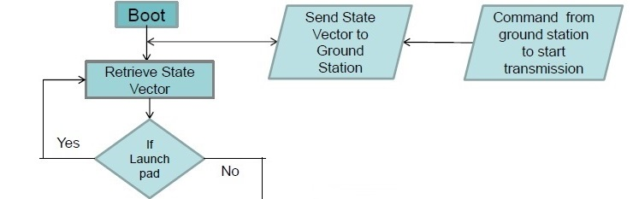
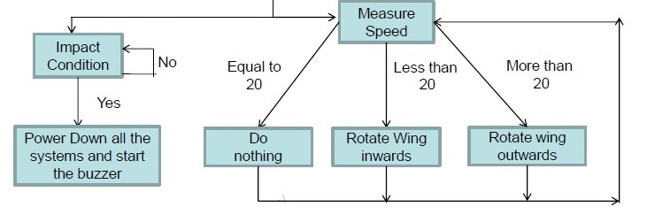
Payload FSW Flow Diagram
Check if altitude 400m
No
Yes
Release Container
Presenter: Name goes here

Slide 20
Payload FSW State Diagram
Boot
Activate sensors and check that sensors are responding
if every sensor is working fine
Test-Mode
Make FSW send few packets to GCS to verify functionality
When acknowledgement from GCS is received
Launch-Pad
Store collected data and store it on chip memory placed on board
And start telemetry after receiving command from GCS.
As soon as there is increase in altitude value
Ascent
Continue collecting data and transmit to GCS every 2sec.
At altitude of 600 meter or change in acceleration
PARA
While continuing telemetry see if payload descended 400m of height and then detach parachute
At 400mtr
CANSAT
Continue telemetry and check if payload is 3sec from impact at which point pressure sensor is activated.
At altitude of 0 meter
Impact
As soon as there is sudden change in impact sensor start buzzer and terminate telemetry..
After activating buzzer and terminating telemetry
Buzzer
..wait till buzzer is switched manually.
Presenter: Name goes here

Slide 21
Payload FSW Explanaitions
All the sensors except impact sensor will be sampled every 2 seconds.
Impact sensor will be sampled at 100 samples/sec.
FSW will release the Payload from container at altitude of 400m.
On receiving command from ground station FSW will transmit telemetry data every 2 seconds.
In case of FSW reset, FSW will retrieve the last packet stored from memory and analyze the change in altitude and acceleration data with the packet that it will calculate on resuming functioning and decide if the state is same or changed during reset , if changed it will be updated accordingly.
Presenter: Name goes here

Slide 22
Software Development Plan - 1
Overview of Plan:
We have divided FSW in sub-parts to check each function of FSW separately.
Work Done:
Getting data from sensors via ADC is being done.
Interfacing microcontroller via UART is done.
XBEE are configured in API mode and tested on XCT-U software.
Further Work:
Interfacing GPS via UART and testing ( 1week)
Transmitting via XBEE through microcontroller by UART interface and testing(1 week)
Formation of packets and storing on board memory chip and testing(1 week)
Integration of FSW(2 weeks)
Testing of FSW(1 week).
Presenter: Name goes here

Slide 23
Software Development Plan - 2
Prototyping And Prototyping Environments :
For prototyping of gathering of values from sensors, C with an AVR GCC environment is used.
For testing the communication between XBEE modules XCT-U is used. However, in final FSW XBEE will be interfaced directly to microcontroller by UART.
Every subpart mentioned in development sequence will be tested separately and integrated FSW will be tested with various test cases.
Development Sequence :
Sampling and getting ADC values of all sensors.
Interfacing with GPS and receive required data from GPS.
Storing data packets on chip-memory unit.
Sending the packet every 2 seconds via XBEE module to GCS.
Integration of all these subparts of FSW.
Presenter: Name goes here

Slide 24
Software Development Plan - 3
Progress since PDR :
Codes for getting values from sensors except GPS are already being written and tested.
XBEEs are being configured and tested in XCT-U environment.
UART interface is being tested in a way that microcontroller is able to send and receive data via UART cable.
Presenter: Name goes here

Slide 25
Ground Control System (GCS) Design
Presenter Name(s) Go Here

Slide 26
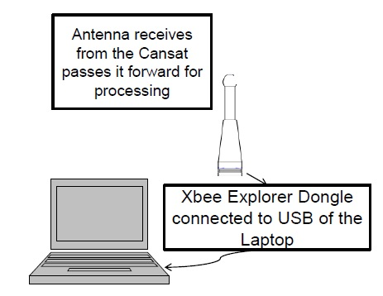
GCS Overview
GCS uses the data received to populate various tables and plot graphs. The software clearly indicates the phases of flight, i.e. pre-launch, moving upwards, deployment, coming down, landed etc.

Slide 27
GCS Requirements
ID | Requirement | Rationale | Priority | Parent | Children | VM
 |  |  |  |  |  | A | I | T | D
GCS01 | Antenna placement : Antenna must point upward, towards the Payload | For better signal reception. | Medium | None | GCS02 GCS03 |  |  | X
GCS02 | Computational requirements : Data is received at 0.5 Hz. | Computational speed is not a big issue. (Assuming GCS laptop has a reasonably fast processor) | Low | GCS01 | None |  |  | X
GCS03 | Power Requirement : Should be able to receive and display data for about 3 hrs. | GCS has to be ready always for the communication. Not a big issue as ample power is available. | Medium | GCS01 | GCS05 |  |  | X
GCS04 | Analysis Software requirements : Should support Java, C/C++. | To be able to run analysis software. | High | None | None |  | X | X
GCS05 | Mission operations : Includes the detection of various phases by the GCS | To be able to distinguish between various states of flight. | Medium | GCS03 | None |  |  | X
Presenter: Name goes here

Slide 28
GCS Antenna Selection
The selection criteria and placement is elaborated in the diagram below.
Cansat Antenna
Maximum Antenna Range
700 m
ɵ
GCS Antenna
3.5 m
Inconsiderable Horizontal Drift.
Note: Diagram is not to scale.
Ground level

Slide 29
Packet Storage
csv file stores the packet data in the following format.
Example log file looks like:
# 7200137,161229,3180.1245N,09880.7486W,1970.3,7,1961.4,29,8.8
# 7202137161231,3180.2463N,09880.7481W,1905.6,7,1895.1,29,8.4
………………………………………………………………………….
…………………………………………………………………………...
# 12600378,3180.1408N,09880.7388W,400.1,9,396.5,36,8.1
# 12602378,3180.1408N,09880.7388W,37.4,9,393.2,35,8.1
The first column gives mission time(in millisec ) ,second column gives GPS time (hhmmss), third column gives GPS latitude, fourth GPS longitude , fifth GPS altitude(in feet) , sixth no. of satellites, seventh Altitude sensor value(in feet) , Eighth temperature (in ºC), finally voltage value(in volts)

Slide 30
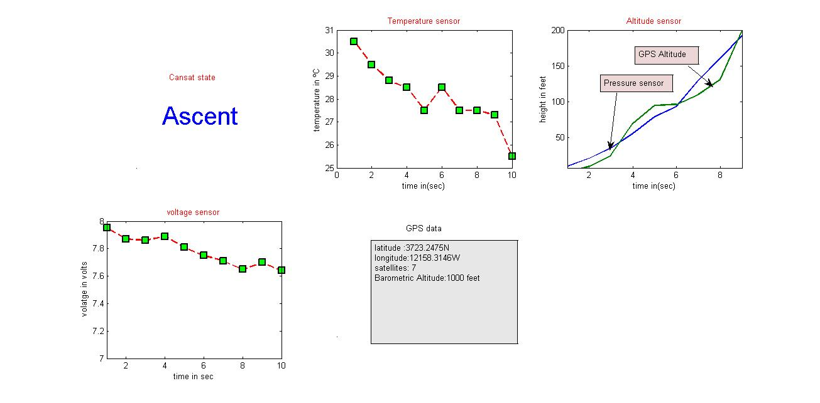
GCS Software – 1 (Real – Time plot – screen shot )

Slide 31
GCS Software - 2
Complete GCS software will be designed in Matlab .
Real Time Plotting Software Design :
Get new packet every 2 seconds
Store the values in CSV file
Parse it and retrieve values
Update plot and info to be displayed
Data Archiving And Retrieval :
When we run GCS we will open a blank CSV file then after receiving every packet we write values in specified order separated by comma.
Data will be received through XBEE which will be connected to laptop via USB cable.

Slide 32
GCS Software - 3
Command Software And Interface :
To send a command via GCS to FSW for start of telemetry following steps are performed
1. Open a COM port using MATLAB to which XBEE is connected.
2. Write the byte which signifies start of telemetry.
Progress Since PDR :
Reading and writing data bytes from/in XBEE via COM port is tested.
Plotting and storing data is also tested although the data for plotting was artificially generated.

