Slide 1

Cansat 2013 PDR Outline
Team Name : Frequency
Team Number : 1300

Slide 2
Presentation Outline
1. About The Team
1.1 Team Composition [5]
1.2 Internal Organization [6]
1.3 Acronyms [7]
2. System Overview - Presenter : Abhishek Bhatia
2.1 Mission Summary [9]
2.2 System Requirement [10-12]
2.3 System Level Cansat Configuration [13-14]
2.4 System Concept of Operations [15-20]
2.5 Physical Layout of Cansat [21-23]
2.6 Launch Vehicle Compatibility [24]
3. Sensor Systems Design - Presenter : Varun Ramchandani
3.1 Sensor Subsystem Overview [26]
3.2 Sensor Subsystem Requirements [27]
3.3 Carrier GPS Sensor Selection [28]
3.4 Carrier Non-GPS Altitude Sensor Selection [29]
3.5 Carrier Air Temperature Sensor Selection [30]
3.6 Lander Pressure Sensor Selection [31]
3.7 Lander Impact Force Sensor [32]
4. Descent Control Design - Presenter : Prahal Ghai
4.1 Descent Control Overview [34]
4.2 Descent Control Requirements [35]
4.3 Carrier Descent Control Strategy [36]
4.4 Lander Descent Control Strategy [37]
4.5 Descent Rate Estimates [38-39]
4.6 Lander Detachment Strategy [40-41]
Presenter: Palash Jain

Slide 3
Presentation Outline
5. Mechanical Systems Design - Presenter : Ramakrishna Vedantam S
5.1 Mechanical Systems Overview [43]
5.2 Mechanical Systems Requirement [44]
5.3 Egg Protection Mechanisms [45-46]
5.4 Carrier – Lander Interface [47]
5.5 Mechanical Layout of Components [48]
5.6 Estimated Mass Budget [49]
6. Communication and Data Handling Subsystem Design - Presenter : Jasmeet Singh
6.1 CDH Overview [51-52]
6.2 CDH Requirements [53-55]
6.3 Processor Selection [56-57]
6.4 Memory Selection [58]
6.5 Carrier Antenna Selection [59]
6.6 Communication Configuration [60]
6.7 Carrier Telemetry Format [61]
6.8 Autonomous Termination of Transmissions [62]
6.9 Locator Device Selection [63]
7. Electrical Power System Design - Presenter : Neeraj Pradhan
7.1 EPS Overview [65 ]
7.2 EPS Requirements [66-68]
7.3 Carrier Electrical Block Diagram [69]
7.4 Carrier Electrical Block Diagram [70]
7.5 Power Budget [72-74]
7.6 Power Source Selection [75]
7.7 Battery Voltage Measurement [76]
7.8 EPS Testing Overview [77]

Slide 4
Presentation Outline
8. Flight Software Design - Presenter : Nikhil Soni
8.1 FSW Overview [79-81]
8.2 FSW Requirements [82-83]
8.3 Software Flow Diagram [84-87]
9. Ground Control System Design - Presenter : Palash Jain
9.1 GCS Overview [89]
9.2 GCS Requirements [90]
9.3 Antenna Selection [91]
10. Cansat Integration and Test - Presenter : Palash Jain
10.1 Integration of Cansat Subsystem [93]
10.2 Tests Performed [94-96]
10.3 Tests to be Performed [97]
11. Mission Operation and Analysis - Presenter : Roopak Dubey
11.1 Overview of Mission Sequence of Events [99]
11.2 Lander Landing Coordinate Prediction [100]
11.3 Cansat Location and Recover [101]
Management - Presenter : Roopak Dubey
1 Cansat Budget – Hardware [103]
12.2 Cansat Budget – Other Costs [104]
12.3 Program Schedule [105-106]
12.4 Mechanical Team Schedule [107-108]
14. Conclusions [109]

Slide 5
Team Organization
No. | Name | Year of study | Position | Contact details
1 | Syed Tabish Abbas | 3rd yr | Team Leader Electronics Team lead | syed.abbas@students.iiit.ac.in
2 | Rakesh N R | 3rd yr | Alternate Team Leader Mechanical Team Lead | rakesh.r@students.iiit.ac.in
3 | Rahul Gupta | 3rd yr | Member, Mechanical Team | rahul.g@students.iiit.ac.in
4 | Siddharth Singh | 3rd yr | Member, Mechanical Structure Team | siddharth.singh@students.iiit.ac.in
5 | Gauresh Patil | 3rd yr | Member, Electronics Team | gauresh.patil@students.iiit.ac.in
6 | Shashank Wadhva | 3rd yr | Member, Mechanical Structure Team | wadhwa.lekhraj@students.iiit.ac.in
7 | Kunth Jain | 3rd yr | Member, Electronics Team | kunth.jain@students.iiit.ac.in
8 | Jashwanth Reddy | 3nd yr | Member, Mechanical Structure Team | @students.iiit.ac.in
9 | Akshat Khandelwal | 2nd yr | Member, Mechanical Structure Team | prahal.ghai@students.iiit.ac.in
10 | Priya Bansal | 2nd yr | Member, Mechanical Structure Team | priya.bansal@students.iiit.ac.in

Slide 6
Internal Organization
Team Mentor
Jim Yen
Electronics Design
Team
Lead : Syed Tabish
Members : Siddharth Singh
Kunth Jain
Rahul Gupta
Akshat Khandelwal
Faculty Advisor
Dr. K Madhava
Krishna
Team Leader
Syed Tabish
Mechanical Structure
Team
Lead : Rakesh N R
Members : Gauresh Patil
Shashank Wadhva
Jashwanth Reddy
Priya Bansal
Alternate Team Leader
Rakesh N R
Presenter: Name goes here

Slide 7
Acronyms
M Mission
S Sensor
MS Mechanical System
DCS Descent Control System
CDH Command and Data Handling
EPS Electrical and Power system
FSW Flight Software
GCS Ground control station
A/D Analog or Digital
adc Analog digital converter
clk Clock
cpu Central processing unit
eeprom Electrically Erasable Programmable Read-Only Memory
Fcc Federal communications commission
g Acceleration due to gravity
ghz Giga hertz
gps Global positioning system
Hz Hertz
ism Industrial, scientific and medical
kbps Kilobytes per second
km Kilometer
mhz Mega hertz
NiMH Nickel metal hydride
rf Radio frequency
spi Serial peripheral interface
sram Static random access memory
USART Universal synchronous asynchronous receiver/transmitter
USD US Dollar
INR Indian Rupees
Presenter: Name goes here

Slide 8
Systems Overview
Presenter :

Slide 9
Mission Summary
Mission:
The mission of 2013 Cansat competition is Sensor Delivery System.
Objectives:
To carry the hen’s egg intact for the entire duration from launch to landing.
To control the descent of the Container and maintain its speed to less than 20 m/s.
The Container should hold the Cansat till deployment and after the Container reaches 400m after deployment, it should deploy the Cansat containing the egg.
To control the descent of the Cansat after its deployment from the Container at the descend speed of 20 +/- 1 m/s.
To send the telemetry data to a central ground station.
Optional Objective:
To measure the force of impact of the Cansat with the ground and store the data on-board which can later be downloaded.
Presenter: Abhishek Bhatia

Slide 10
System Requirements
ID | Requirement | Rationale | Priority | Parent(s) | Children | VM
 |  |  |  |  |  | A | I | T | D
SYS-01 | Total mass of the Entire system will be 700 +/- 10gms excluding the egg | There is always a finite limit of the mass that can be put into space | HIGH |  | MS01 DCS02 |  | X | X
SYS-02 | Container will fit in a cylindrical envelope of 130mm diameter and 250 mm in length | Payload structure dimensions are influenced by launch vehicle characteristics | HIGH |  | MS02,03 DCS 04 |  | X
SYS-03 | There will be no protrusions until Container deployment from rocket payload | Payload structure dimensions are influenced by launch vehicle characteristics | HIGH |  | DCS-01,02,03 |  | X
SYS-04 | Container will descent with rate of less than 20m/s and Cansat at rate of 20 +/- 1m/s | So that does not get drifted away by wind safe landing speed | HIGH |  | DCS- 01,02,03,04 | X |  | X | X
Presenter: Abhishek Bhatia

Slide 11
System Requirements
ID | Requirement | Rationale | Priority | Parent(s) | Children | VM
 |  |  |  |  |  | A | I | T | D
SYS-05 | GCS will have external power control with confirmation from Cansat power state | To avoid Battery consumption when idle and to not to tamper the Cansat while operating. | LOW |  |  |  | X |  | X
SYS-06 | Total cost of the Cansat will not exceed $1000 | Every well managed systems has constraint, to have uniformity | MEDIUM |  |  |  | X
SYS-07 | During descent Cansat will send its position along with house keeping telemetry | To track the health of the Cansat | HIGH |  | S01 MS05 CDH 01,02 |  |  | X | X
Presenter: Abhishek Bhatia

Slide 12
System Requirements
ID | Requirement | Rationale | Priority | Parent(s) | Children | VM
 |  |  |  |  |  | A | I | T | D
SYS-08 | Cansat will stop transmitting telemeter upon landing and it will calculate the impact force with the ground as requirement of additional objective. | To measure the impact force on the Cansat so as to estimate the amount of maximum force that the Lander can sustain in order to save the egg. | LOW |  | S01 MS05 CDH05 |  |  | X | X
SYS-09 | Container and Cansat should be recovered safely. | To avoid damage to cansat structure and components so that it functions properly after landing. | HIGH |  |  |  |  |  | X
SYS-10 | Team will provide all saved telemetered data transmitted by the Cansat. | As a part of Post Flight Review so as to analyze the telemetered data. | MEDIUM |  | CDH06,07,08 |  |  |  | X
Presenter: Abhishek Bhatia

Slide 13
System Level Cansat Configuration Trade & Selection
Choice of aluminum over steel: aluminum was chosen over steel keeping in mind the mass constraints.
Earlier the container containing the egg was kept at top of the lander and the electronics was at the bottom as we felt that the impulse of the ground will be more on the egg if the container containing the egg was at the bottom of the lander, but then this idea was rejected due to antenna constraints.
Presenter: Abhishek Bhatia

Slide 14
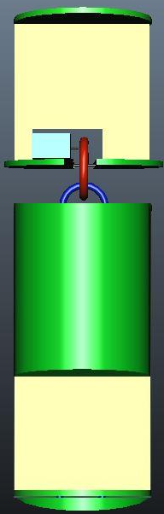
System Level Cansat Configuration Trade & Selection
The other cansat system which we considered but was rejected due to the below mentioned reason:
The height of carrier frame is 8 cm, but the length of antenna that we are using for the communication purpose in carrier section is 17.5 cm. The given picture shows the physical layout that we wanted to use earlier, i.e. egg container at the top of lander . But to use this structure we would have had to penetrate the egg container to accommodate the antenna, which is not preferable because then the protection of egg would be under risk. So we inverted the lander configuration as the electronics section is moved at the top and the egg container at the bottom to accommodate the carrier antenna.
Carrier Circuitry
Egg Container
Electronics Circuit Board
Presenter: Abhishek Bhatia

Slide 15

System Concept of Operations
Cansat rests in the payload section of the rocket
Team developed Ground Control Station
Presenter: Abhishek Bhatia

Slide 16

System Concept of Operations
Cansat rests on its parachute still inside the parachute. The nose cone parachute rests at the bottom of the Cansat.
Ground Control Station
Presenter: Abhishek Bhatia

Slide 17
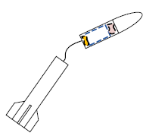
System Concept of Operations
Ejection charge separates payload section from rocket around approx height of 1100m.
Ground Control Station
Presenter: Abhishek Bhatia

Slide 18
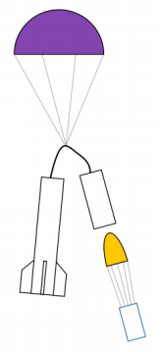
System Concept of Operations
Front section tips over and the cansat falls out of the payload section. The Cansat Carrier parachute inflates over the cansat. This cansat consists of both Carrier and the Lander right now.
Ground Control Station receives and visualizes Descent Data Packets
Cansat starts sending Descent Data Packets as soon as the parachute inflates.
Presenter: Abhishek Bhatia

Slide 19
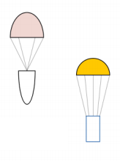


System Concept of Operations
The Cansat, Nose cone and rocket descend under parachutes. The carrier and lander separate at 500m above ground.
Cansat carrier will communicate with the GCS
Ground Control Station receives and visualizes Descent Data Packets
Cansat Lander will detatch from the carrier at 500 mts above the ground.
Presenter: Abhishek Bhatia

Slide 20

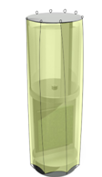
System Concept of Operations
The Cansat, Nose cone and rocket descend under parachutes. The carrier and lander separate at 500m above ground.
Cansat carrier will communicate with the GCS
Ground Control Station receives and visualizes Descent Data Packets
Cansat Lander will measure the ground impact force after landing.
Presenter: Abhishek Bhatia

Slide 21
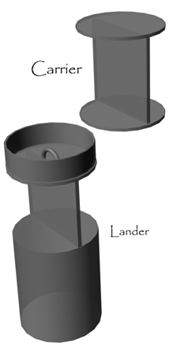
Physical Layout
Presenter: Abhishek Bhatia

Slide 22
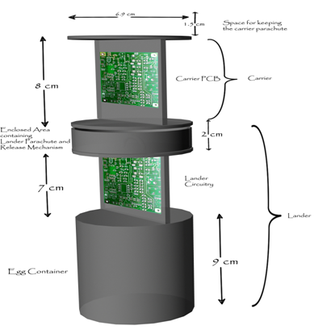
Physical Layout
6.9 cm
1.5 cm
Space for carrier parahcute
Carrier PCB
Carrier
Enclosed area containing detachment mechanism
Lander PCB
Lander
Egg Container
Presenter: Abhishek Bhatia

Slide 23
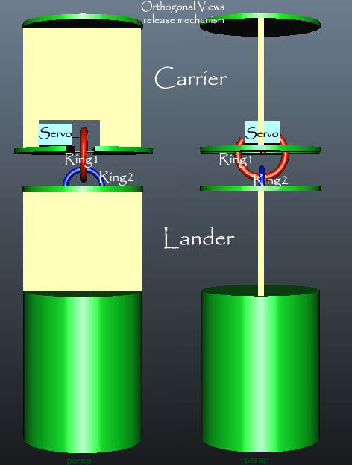
Physical Layout
A small Servo Motor controls the detachment of lander from carrier. Motor is controlled by the microcontroller, which uses GPS and pressure sensor data to decide when to detach the lander.
Presenter: Abhishek Bhatia

Slide 24
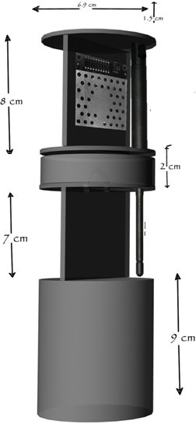
Launch Vehicle Compatibility
Cansat structure is designed strictly keeping in mind the size and weight restrictions.
maximum diameter of the cansat is 6.9 cm which is 0.3 cm less than the payload section diameter, hence facilitates smooth deployment.
Height of the cansat is 1.5+8+2+7+9=27.5 cm. Thus is well under the given limit of 27.9 cm, ensuring that cansat will not protrude out of the payload section.
No electronic/mechanical control is employed to push the cansat out of payload and is assumed that once the rocket dismantles it will automatically slip out of the payload bay.
Presenter: Abhishek Bhatia

Slide 25
Sensor Subsystem Design
Presenter : Varun Ramchandani

Slide 26
Sensor Subsystem Overview
Accelerometer
( Free Scale Semi-conductors MMA7260Q )
Pressure Sensor- Altitude
(Motorola MPX6115a)
GPS sensor
( SIRF -StarIIIGSC3f/LPx-7989)
Microcontroller
Temperature Sensor
( LM35)
Battery voltage sensing
Presenter: Varun Ramchandani

Slide 27
Sensor Subsystem Requirements
ID | Requirement | Rationale | Parent | Children | Priority | VM
 |  |  |  |  |  | A | I | T | D
S01 | Measurement of barometric altitude | It is a requirement for descent telemetry | SYS -08,09 |  | HIGH | x |  | x | x
S02 | Measurement of air temperature. | It is a requirement for descent telemetry | SYS -08,09 | - | HIGH |  |  | x | x
S03 | Measurement of Battery Voltage. | Requirement for Descent Telemetry and Housekeeping Data | SYS-08,09 | - | HIGH |  |  | x
S04 | GPS Location data | Descent Telemetry and determination of Landing | SYS-08,09 | - | HIGH | x |  | x | x
S05 | Acceleration Sensor | Various events such as ejecting, mapping of motion and operational objective of landing data. | SYS – 08,09 | - | MEDIUM | x |  | x | x
S06 | Audio Beacon | It is required to retrieve the Cansat after it has landed. |  | - | MEDIUM
Presenter: Varun Ramchandani

Slide 28
Carrier GPS Trade & Selection
Manufacturer | Model | Dimensions | Accuracy | Mass | Power/voltage
SiRF | StarIII GSC3f/LPx-7989 | Length:27mm, Width: 23mm | 5m | 10g | 75mw/3.3v
Garmin | OEM GPS 15H-W | Length:30mm, Width: 30mm | 4m | 15g | 85mw/8-40v
Global Sat | EM-406 | Length:30mm, Width: 30mm | 3m | 23g | 70mw/4.5v
GS3f GPS sensor is selected because it has much more accuracy than other sensors, also it weighs less and uses less power which are other critical parameters for the selection of GPS sensor.
SiRF GSC3f GPS Sensor
Presenter: Varun Ramchandani

Slide 29
Carrier Non-GPS Altitude Sensor Trade & Selection
Manufacturer | Model | Accuracy | Mass | Power/voltage | Dimensions | A/D
Motorola | MPX6115a | +-1.5% | 25g | 0.5ma/5v | 16.6 * 7.2mm | A
Omega | PX302 | 0.3% | 131g | 97ma/10v | 28.6 * 81.7mm | A
Vaisala | PTB210 | +-0.25hpa | 110g | 55ma/6v | 120mm * 30mm | D
MPX6115a Non-GPS Altitude Sensor is selected because it weighs less, consumes less power and is smaller than other two sensors in race.
MPX6115a Non-GPS Altitude Sensor
Presenter: Varun Ramchandani

Slide 30
Carrier Air Temperature Trade & Selection
Product | Type | Operates in region | Accuracy
FM 75 | Digital | 0 – 100 degrees | +-1degree Celsius
LM 35 | Analog | 0 – 100 degrees | +- 0.5 degree Celsius
This temperature sensor is selected to fulfill the need of our mission because of it’s more accuracy than FM75, low cost and easy availability.
Other fact about using this sensor is that it is very simple to use it rather than using a digital temperature sensor which on other hand is expensive and not easily available.
LM 35
Presenter: Varun Ramchandani

Slide 31
Lander Pressure Sensor Trade & Selection
MPX6115a will act as lander pressure sensor.
Barometric pressure changes with respect to altitude and temperature
The relation between analog pressure and voltage in analog sensors is almost linear and is most of the times provided by the manufacturer
Pressure from Voltage :
P = 22.222 * V + 10.556 – (22.222*EF)
Height from Pressure :
MPX6115a Pressure Sensor
Presenter: Varun Ramchandani

Slide 32
Lander Impact Force Sensor Trade & Selection
Model | Dimensions | Voltage/current Normal mode | Current Power saving mode | Range | Accuracy | Sensitivity Due to temp | A/D
Analog devices ADXL345 | 15mm*25mm | 3.3V/145uA | 0.1uA | ±16g | ±1% | ±0.01%/°C | D
Free Scale Semi-conductors MMA7260Q | 25mm*25mm | 3.3V/500uA | 3uA | ± 6g | ±5% | ±0.03%/°C | A
The MMA7260Q was selected because it is analog and also is very much comparable to the other in all aspects.
The ADXL345 is digital and needs to be interfaced using SPI/I2C which will are already used up by other sensors and is thus not selected.
Presenter: Varun Ramchandani

Slide 33
Descent Control Design
Presenter : Prahal Ghai

Slide 34
Descent Control Overview
The Descent control system will be achieved through the use of parachutes of appropriate size 20cm for carrier and 25 cm for lander and design keeping in mind the aerodynamics of the fall.
Proper design and right choice of materials will be the backbone of the Descent Control System, as it is not an electronically controlled one extreme care and precision needs to be involved in design taking care of all possibilities.
Both Carrier and Lander sections will have separate parachute structures of appropriate sizes to achieve the required constant descent speeds of ~ 4m/s and 5.5m/s respectively.
While the Cansat is in the payload section , the parachutes will be closed such as to occupy an allotted space.
After deployment from the rocket airflow will cause the parachute of the carrier to inflate and the rate of descent will be controlled by the parachute.
At the time of separation, air flow will cause the parachutes of the lander to open but their positioning will ensure a tangle free separation.
The spill hole at the top(3cm radius) will ensure continuous air flow through the parachute, thereby stabilizing it and ensuring descent at required speeds.
All calculations have been shown in the descent rate estimation slide.
Presenter: Prahal Ghai

Slide 35
Descent Control Requirements
ID | Requirement | Rationale | Parent | Children | Priority | VM
 |  |  |  |  |  | A | I | T | D
DCS01 | carrier and lander chutes occupy their allotted space, whatever be the orientation of the payload. | to ensure a tangle free separation, and proper fitting while in payload. | SYS – 04 |  | HIGH
DCS02 | carrier chute size such that descent rate ~4m/s | Competition requirement | SYS- 01,04 |  | HIGH
DCS03 | Lander chute size such that descent rate ~5.5m/s | Competition requirement | SYS- 04 |  | HIGH |  |  | X
DCS04 | Materials used to be light and flexible. | To minimize mass and volume requirements. | SYS- 02 |  | MEDIUM
DCS05 | The descent control system shall not use any flammable or pyrotechnic device. | Safety. |  |  | MEDIUM
Presenter: Prahal Ghai

Slide 36
Carrier Descent Control Strategy Trade and Selection
Strategy selection
Strategy | Pros | Cons
Use of streamers | Used by us the last time, complete knowledge of the mechanics and aerodynamics involved, reliable. | Achievement of speeds as low as 4m\s difficult
Use of parachute | Easy to design and attain required speed, low space requirement. | Drift(can be countered by a spill hole, affects area)
Material selection for parachute design
Silk- thin, light and easy to fold but expensive and not as elastic as nylon
Rip stop Nylon cloth - Due to property to block air , easy availability and good elasticity.
Strings to control shape : Nylon strings – High strength , easy to use and light.
Presenter: Prahal Ghai

Slide 37
Lander Descent Control Strategy Trade and Selection
Strategy selection
Strategy | Pros | Cons
Use of streamers | Used by us the last time, complete knowledge of the mechanics and aerodynamics involved, reliable. | Achievement of speeds as low as 5.5m\s difficult
Use of parachute | Easy to design and attain required speed, low space requirement. | Drift(can be countered by a spill hole, affects area)
Material selection for parachute design
Silk- thin, light and easy to fold but expensive and not as elastic as nylon
Rip stop Nylon cloth - Due to property to block air , easy availability and good elasticity.
Strings to control shape : Nylon strings – High strength , easy to use and light weight.
Presenter: Prahal Ghai

Slide 38
Descent Rate Estimates
As both our carrier and lander are working on a parachute based descent mechanism, the size of the parachutes is fixed by calculation from the following relation.
r = sqrt( (2 m g) / (π p C_{d} v²) )
where,
π = 3.14159265359
ρ = 1.146 kg/m³ (density of air at 35 °C ) C_{d} =1.5 (drag coefficient of the chute for a hemisphere chute)
v =terminal velocity achieved (from mission required)
r = radius of the chute
g = acceleration due to gravity
Presenter: Prahal Ghai

Slide 39
Descent Rate Estimates
RESULTS
C_{d} will not be 1.5 as parachute will not be completely hemispherical.
Introduction of spill hole stabilizes the cansat by allowing air to flow but increases the rate of descent hence, maximum radius of parachutes is being preferred
The radius of the spill hole(3cm) has been finalized by some tests performed from a height of ~50m and some extrapolation such that it will work well at a height of ~1500m as well.
Before separation both the carrier and lander will be supported by the carrier parachute, mass m will be(212+323) is 535gm the descent velocity will be 6.5 m/s
Component | Mass | Velocity | Radius(before spill hole consideration ) | Final radius(after spill hole, C_{d} consideration)
Carrier | 212gm | 3 to 5 m/s | 17 to 28cm | 28 cm
Lander | 273gm | 4.5 to 6.5m/s | 15 to 23cm | 25cm
Presenter: Prahal Ghai

Slide 40
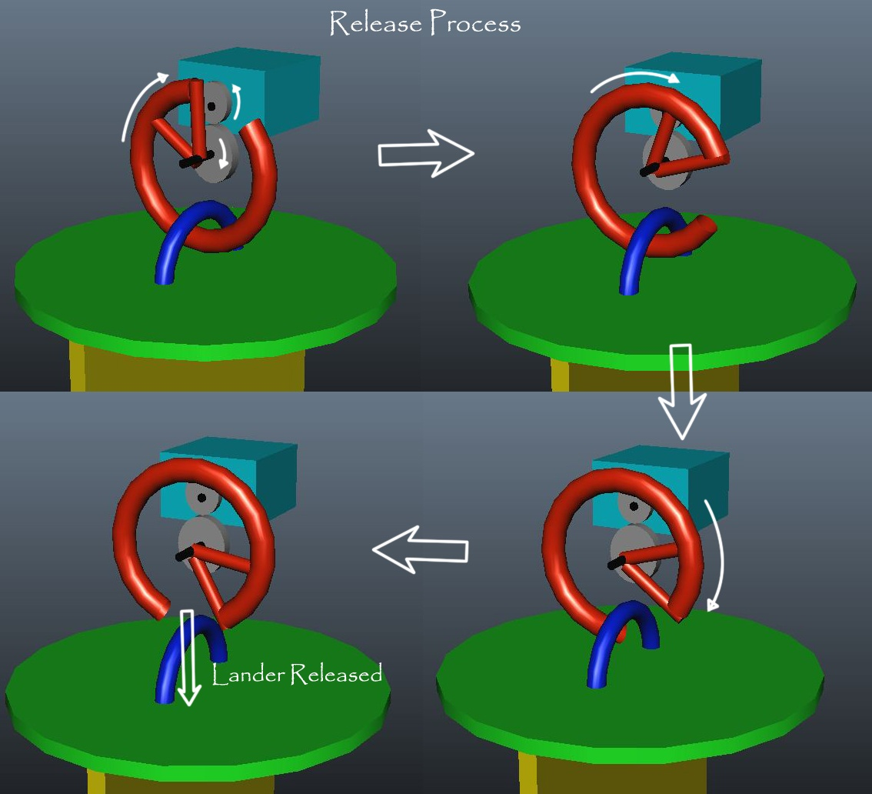
Lander detachment strategy

Slide 41
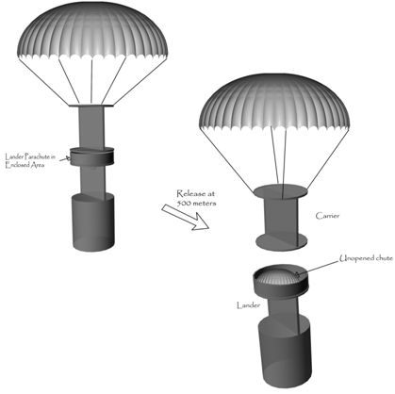
Lander detachment strategy
The image below shows position of the parachutes at different times during the flight.
Lander carrier interface
Release at 500m
Carrier
Unopened chute of lander
Lander
Presenter: Prahal Ghai

Slide 42
Mechanical Subsystem Design
Ramakrishna Vedantam S

Slide 43
Mechanical Subsystem Overview
Presenter: Ramakrishna Vedantam
The major components of the cansat are the egg carrier or container, the carrier circuit , the lander circuit and the sensor arrangement.
The egg container has the lander circuit placed on it. This is covered by folded lander parachute. A hook holds the carrier and the lander together. The release mechanism and the carrier circuitry complete the arrangement.
The entire body skeleton is made of aluminium.
Sensors are placed appropriately so as to achieve optimum space and functional efficiency.
Carrier and lander are interfaced using a motor-hook system.

Slide 44
Mechanical System Requirements
ID | Requirement | Rationale | Parent | Priority | VM
 |  |  |  |  | A | I | T | D
MS01 | Total mass of the Cansat will not be more than 500gms excluding egg | There is always a finite limit of the mass that can be put into space | SYS -01 | HIGH |  | x | x
MS02 | Cansat will fit in a cylindrical envelope of 72mm diameter and 279 mm in length | Payload structure dimensions are influenced by launch vehicle characteristics | SYS -02 | HIGH |  | x
MS03 | There will be no protrusions until Cansat deployment from rocket payload | Payload structure dimensions are influenced by launch vehicle characteristics | SYS -02 | HIGH |  | x
MS04 | Cansat and egg placed inside should be recovered safely. | Structure should be able to withstand vibration shocks and protect the egg from breaking. |  | HIGH |  |  | x | x
MS05 | Placement of GPS Antenna , Transceiver Antenna | Placement of Sensors and Antennas have to be appropriate for proper Transmission and Reception | SYS-08,09 | MEDIUM |  |  | x | x
MS06 | Ensure smooth detachment of the lander and the carrier at a height of 500m.
Presenter: Ramakrishna Vedantam

Slide 45
Egg Protection Trade and Selection
Egg is best protected in the following conditions -
An Aluminum container is used for carrying the egg. The rationale of using aluminum is as follows:
The container is stuffed with polystyrene balls with egg in the middle.
Sponge and paper cushions were also considered but rejected based on test observations (Refer : Egg drop test In Integrated test section).
Polystyrene balls provide the required cushioning to protect the egg. Polystyrene balls are inexpensive, light weight and easily available
Material | Density (gms/cc) | Tensile strength (GPa) | Cost per square meter | Availability
Aluminum | 2.7 | 90 | 59.74 $ | Easily available
Carbon Fiber | 1.75 | 3.5 | 651 $ | Facility not yet identified
Steel | 7.9 | 1.3 | 52.31 $ | Difficult
Presenter: Ramakrishna Vedantam

Slide 46
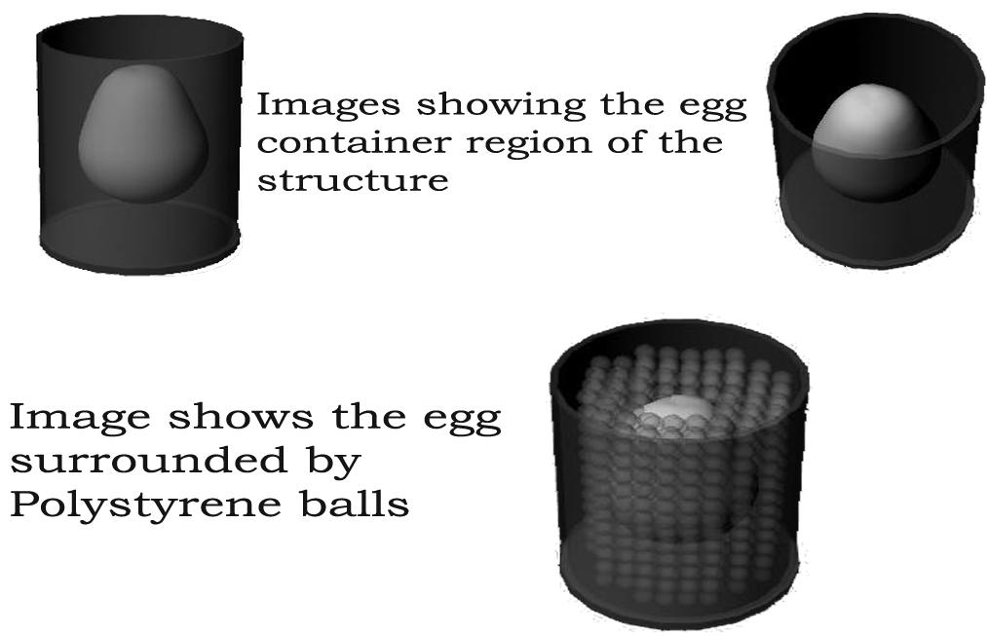
Egg Protection Trade and selection
Presenter: Ramakrishna Vedantam

Slide 47
Carrier-Lander Interface
Presenter: Ramakrishna Vedantam
The lander will be connected to
the carrier via a hook oriented
horizontally. The hook will be
moved using the servo when
the release sequence is
to be performed.
The release of the hook results
in the opening of lander
parachute.

Slide 48
Mechanical Layout of Components Trade & Selection
The Battery and the rest of the electronics have been placed on opposite sides in both carrier and lander to ensure that center of mass remains near the center of the structure for proper balance.
The motor-hook arrangement is placed at the center of the CanSat cross-section for smooth release.
The egg container is placed at the bottom , on top of it is the lander electronic section and above it, interfaced using motor – hook mechanism is carrier.
Presenter: Ramakrishna Vedantam

Slide 49
Estimated Mass Budget
Carrier | Weight (gm)
mass of skeleton (carrier) | 52
mass of pcb(including microcontroller, temp.sensor) | 23
total mass of electronics | 84
battery | 53
parachute | 20
total carrier mass | 232
Lander | Weight(gm)
mass of lander skeleton | 140
mass of electronics | 25
Parachute | 30
Egg and cushioning | 55
Battery | 53
Total Lander mass | 303
Total Mass | 535
Total mass (excluding egg) | 485
Presenter: Ramakrishna Vedantam

Slide 50
Communication and Data Handling Subsystem Design
Presenter : Jasmeet Singh

Slide 51
CDH Overview-1
Carrier
Processor: AtMega 128 ( As Central Processing Unit of the Carrier; sensing, processing, transmitting, storing telemetry data)
Memory: Atmel0736 (For storing telemetry data onboard for backup in case of communication failure)
Radio Transceiver: Laird AC4790 Transceiver (For transmitting data to ground station once every 2 seconds)
Antennae: S467XX-915S (2.0dBI)
Presenter: Jasmeet Singh

Slide 52
CDH Overview-2
Lander
Processor: AtMega 128 (As Central Processing Unit of the Lander; sensing, processing, storing sensor data;
Memory: Atmel0736 (For storing telemetry data onboard the lander for post processing)
Ground Station
Processor: AtMega 128 ( For receiving and decoding received telemetry data from carrier)
Radio Transceiver: Laird AC4790 Transceiver (For receiving data from the carrier once every 2 seconds)
Antennae: S467XX-915S (2.0dBI)
Presenter: Jasmeet Singh

Slide 53
CDH Requirements-1 (CARRIER)
ID | Requirement | Rationale | Parent | Priority | VM
 |  |  |  |  | A | I | T | D
CDH01 | Transmit GPS Data Stream | Descent Telemetry packet (transmitted every 2 seconds) | SYS -08 CD-01 | HIGH |  |  | x | x
CDH02 | Transmit Altitude in meters | Descent Telemetry packet (transmitted every 2 seconds) | SYS-08 CD-01 | HIGH |  |  | x | x
CDH03 | Transmit Air Temperature in Celsius | Descent Telemetry packet (transmitted every 2 seconds) | SYS-08 CD-01 | HIGH |  |  | x | X
CDH04 | Transmit Battery Voltage in Volts | Descent Telemetry packet (transmitted every 2 seconds) | SYS-08 CD-01 | HIGH | x |  | x | x
CDH05 | Terminate Telemetry | Terminate Telemetry within 5 minutes of landing. | SYS-08,09 CD-01 | HIGH | x |  | x | x
CDH06 | Store Telemetry Data | For Post Processing in case of Communication Failure | SYS-11 | LOW
Presenter: Jasmeet Singh

Slide 54
CDH Requirements-2 (LANDER)
ID | Requirement | Rationale | Parent | Priority | VM
 |  |  |  |  | A | I | T | D
CDH06 | Store Lander Altitude Measured | Descent Telemetry packet (stored every 2 seconds) | SYS-11 | HIGH |  |  | x | x
CDH07 | Store Lander Battery Voltage | Descent Telemetry packet (stored every 2 seconds) | SYS-11 | HIGH |  |  | x | x
CDH08 | Storing the Impact Force | Impact Force (Stored when lander hits the ground) | BONUS | HIGH
CDH09 | Send stored descent telemetry to Ground Control | For post-processing following retrieval of Lander | SYS-11 | HIGH |  |  | x | X
Presenter: Jasmeet Singh

Slide 55
CDH Requirements-3 (GROUND STATION)
ID | Requirement | Rationale | Parent | Priority | VM
 |  |  |  |  | A | I | T | D
CDH09 | Receive GPS Data Stream | Descent Telemetry packet Receive every 2S | CD01 | HIGH |  |  | x | x
CDH10 | Receive Altitude in meters | Descent Telemetry packet (received every 2 seconds) | CD01 | HIGH |  |  | x | x
CDH11 | Receive Air Temperature in Celsius | Descent Telemetry packet (received every 2 seconds) | CD01 | HIGH |  |  | x | X
CDH12 | Receive Battery Voltage in Volts | Descent Telemetry packet (received every 2 seconds) | CD01 | HIGH | x |  | x | x
CDH13 | Terminate Telemetry | Terminate Telemetry within 5 minutes of landing. | CD01 | HIGH | x |  | x | x
Presenter: Jasmeet Singh

Slide 56
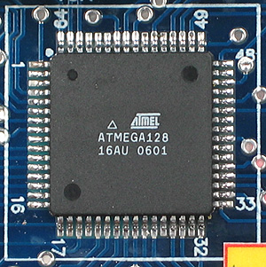
Processor : Trade & Selection-1
Carrier: AtMega 128
Maximum Clock Frequency 16 MHz (external)
Data Interfaces:
USART: 2 (One for Transceiver and
one for GPS)
SPI: 1(For memory)
ADC PORTS: 8 channels(one each
for battery voltage, temperature sensor and pressure
Sensor)
On chip Flash Memory: 128 Kb
SRAM / EEPROM: 4 Kb
Supply Voltage: 4.5V – 5V
Presenter: Jasmeet Singh

Slide 57
Processor : Trade & Selection-2
Lander: AtMega 128 (Will save design time to design another PCB, so carrier PCB will work for lander too, Other controllers were considered but not much different in cost and other factors was observed so this was selected due to its high functionality)
Maximum Clock Frequency 16 MHz (external)
Data Interfaces:
SPI: For memory
PORTS: 8 channels(one each for Battery voltage, accelerometer and pressure sensor)
On chip Flash Memory: 128 Kb
SRAM / EEPROM: 4 Kb
Supply Voltage: 4.5V – 5V
Presenter: Jasmeet Singh

Slide 58
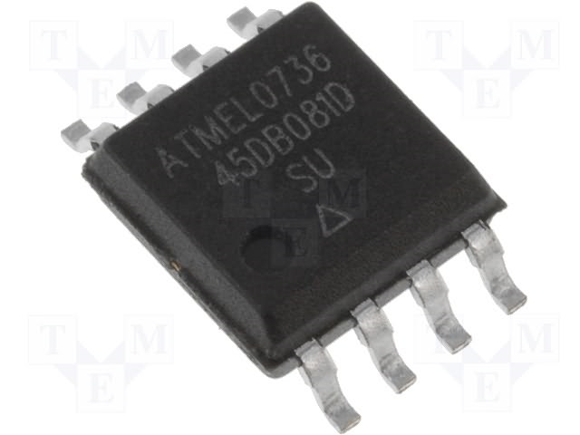
Memory : Trade & Selection
If 5 minutes of Descent Telemetry(carrier) sampled at 2 seconds
5* 60 * ( 50 bytes ) / 2 ~= 7.5 Kb
For lander, 5 minutes of height and battery voltage data sampled at 2 seconds:
5* 60 * ( 10 bytes ) / 2 ~= 7.5 Kb
If Acceleration Data is calculated with 100 samples per second :
5 * 60 *100 ~= 30 Kb
Totally it adds up to at least 7.5 Kb
for carrier and 31.5 kb for lander.
The same memory chip is used for both
Lander and carrier.
Atmel Memory chip
8 MB, SPI Mode, Chip Select Available
Presenter: Jasmeet Singh

Slide 59
Carrier Antenna Trade & Selection
The Antenna had to be matching for the range of 900 – 928 MHz ( 900 MHz ISM)
Have preferably an MMCX connector against SMA,BNC or TNC .
High Decibel Gain
VWSR less than 2.0 : 1
Half Wave Dipole and Omni Directional
Antenna Chosen: S467XX-915S (2.0dBI)
Presenter: Jasmeet Singh

Slide 60
Communications Configuration
Fixed baud rate of 57600 bps , channel 0 in Receive mode for query wait
Transceiver programmed for API control Mode
The system in API mode set at fixed baud rate and channel transmits and receives through a 3 byte MAC address which can either be hard coded on the EEPROM or sent dynamically.
Transmit when asked for a query, through UDR buffer
Presenter: Jasmeet Singh

Slide 61
Carrier Telemetry Format
Data sent every 2 seconds with baud rate of 57600 bps.
Data Format: Data Format will be finalized in CDR
Characters | Definition
hhmmss | Data time tag in hours , minutes and seconds
AA.aaaa | Cansat latitude
N | Start of latitude data
BB.bbbb | Cansat Longitude
W | Start of longitude data
hh.hh.. | Cansat GPS altitude
Ab | Number of satellites tracked in decimal
hh.hh.. | Altitude via non GPS sensor(meters)
tt | Air temperature ( 1 degree resolution)
vv.vv.. | Battery voltage
Presenter: Jasmeet Singh

Slide 62
Autonomous Termination of Transmissions
To terminate telemetry:
This will be done via a check in the loop which compares the altitude from GPS data to altitude from several previous data packets. If the altitude remains same for a certain amount of time, we conclude that the carrier has landed and that its time to stop sending the telemetry.
The GCS will recognize the end of telemetry by the special custom occurrence of 99 satellites tracked in the last incoming data packet.
Presenter: Jasmeet Singh

Slide 63
Locator Device Trade & Selection
We are not yet decided on the exact locator device which we will be using, but a list of locator devices considered so far is –
The problem with both of them is that one high power consuming and the other is not available easily. We are searching for other options.
Locator device will be controlled using microcontroller, but will aslo have an external switch, thus will enable us to switch it off upon recovery.
Both carrier and lander shall have same locator device.
Name | Size | Power consumption | Cost | Availability
CMS0341KLX | 3.4cm x3.4cmx1.5cm | 20 W | 7 $ | Easily available
JS-666 | 0.8cm*3cm*3.8cm | 0.5W | 10$ | Facility not yet identified
Presenter: Jasmeet Singh

Slide 64
Electrical Power Subsystem Design
Presenter : Neeraj Pradhan

Slide 65
EPS Overview
Design Considerations
All the power and electrical requirements are met.
Voltage Regulation
Level-shifting and voltage regulations for using two different voltage regulators each corresponding to 5v and 3.3v.
Power Monitoring
Done by additional hardware
Presenter: Neeraj Pradhan

Slide 66
EPS Requirements For Cansat System
ID | Requirement | Rationale | Parent | Priority | VM
 |  |  |  |  | A | I | T | D
EP01 | Voltage Requirement (5V, 3.3V) | 5V required for MicroController and Pressure, Temperature Sensor, Servo. 3.3V for Memory, GPS and Transceiver. |  | MEDIUM |  |  | x | x
EP02 | Battery Requirement (9V) | To be able to provide adequate power for the whole period of flight. | EP01 | MEDIUM |  | x
EP03 | Measurement Accuracy and Resolution (0.008V) | Voltage has to be measured and stored. |  | MEDIUM |  | x
Presenter: Neeraj Pradhan

Slide 67
EPS Requirements For Carrier
ID | Requirement | Rationale | Parent | Priority | VM
 |  |  |  |  | A | I | T | D
EP01 | Voltage Requirement (5V, 3.3V) | 5V required for MicroController and Pressure, Temperature Sensor, Servo. 3.3V for Memory, GPS and Transceiver. | ----- | MEDIUM |  |  | x | x
EP02 | Battery Requirement (9V) | To be able to provide adequate power for the whole period of flight. | EP01 | MEDIUM |  | x
EP03 | Measurement Accuracy and Resolution (0.008V) | Voltage has to be measured and stored. | ----- | MEDIUM |  | x
Presenter: Neeraj Pradhan

Slide 68
EPS Requirements For Lander
ID | Requirement | Rationale | Parent | Priority | VM
 |  |  |  |  | A | I | T | D
EP01 | Voltage Requirement (5V, 3.3V) | 5V required for MicroController and Pressure, Temperature Sensor. 3.3V for Memory. | ----- | MEDIUM |  |  | x | x
EP02 | Battery Requirement (9V) | To be able to provide adequate power for the whole period of flight. | EP01 | MEDIUM |  | x
EP03 | Measurement Accuracy and Resolution (0.008V) | Voltage has to be measured and stored. | ----- | MEDIUM |  | x
Presenter: Neeraj Pradhan

Slide 69
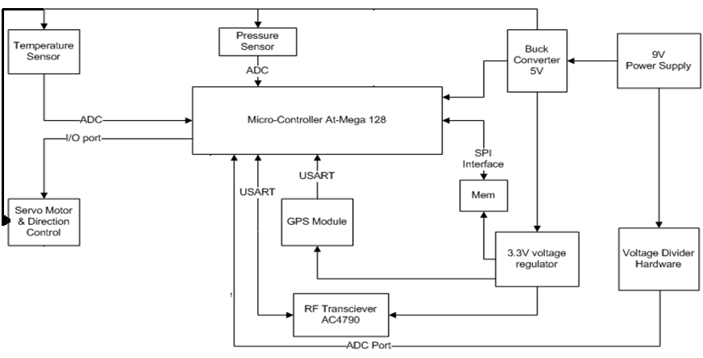
Carrier Electrical Block Diagram
External Power Switch will be present to control the power flow in the system. Battery
Voltage will be read using microcontroller.
Presenter: Neeraj Pradhan

Slide 70
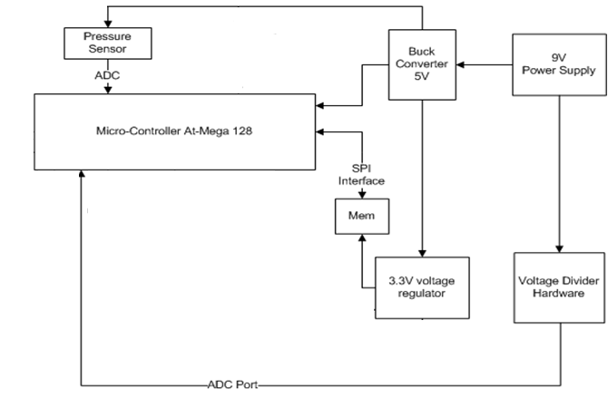
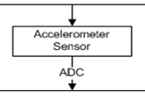
Lander Electrical Block Diagram
External Power Switch will be present to control the power flow in the system. Battery
Voltage will be read using microcontroller.
Presenter: Neeraj Pradhan

Slide 71
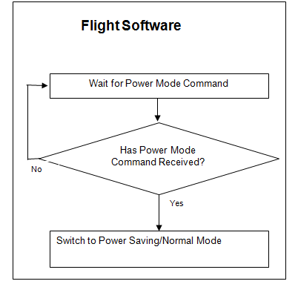
External Power Control without disassembling CANSAT
Idle Mode: In this mode of the processor would disable the CPU and the MEMORY by switching off the clk_cpu and clk_flash but the USART, ADC and SPI keep working which would save power.
Power down Mode: In this mode we
can switch off the ADC clock and the USART
locks to save power.
Simple LED indication of power on/off
status with an external push button may be
added
Presenter: Neeraj Pradhan

Slide 72
Carrier Power Budget
Device | Average Power consumption (Watts) | Voltage | Average Current | Usage in 3.5hrs
GPS | 72.64mW | 3.3v | 22.7 ma | 100%
Pressure Sensor | 2.5mW | 5v | 0.5ma | 100%
Temperature Sensor | 5mW | 5v | 1ma | 100%
Transceiver RF | 0.214 W | 3.3v | 65ma | 100%
Microcontroller | 0.11 W | 5v | 28ma | 100%
Flash memory | 71.5mW | 5v | 14.3ma | 100%
Buck Convertor 5v |  |  | 92% eff
Buck converter 3.3v |  |  | 90% eff
Voltage divider H |  |  | Negligible
Servo Motor |  | 5v |  | One Time
Presenter: Neeraj Pradhan

Slide 73
Lander Power Budget
Device | Average Power consumption (Watts) | Voltage | Average Current | Usage in 3.5hrs
Pressure Sensor | 2.5mW | 5v | 0.5ma | 100%
Microcontroller | 0.11 W | 5v | 28ma | 100%
Flash memory | 71.5mW | 5v | 14.3ma | 100%
Buck Convertor 5v |  |  | 92% eff
Buck converter 3.3v |  |  | 90% eff
Voltage divider H |  |  | Negligible
Presenter: Neeraj Pradhan

Slide 74
Total Power Budget
Total Power used by main components is 475.64mWh(Carrier) and 184mWh(Lander).
Voltage loss of 90% efficiency in 3.3v and 92% in 5v for Buck Convertors
Battery life: 3.85 hours (approx )
Presenter: Neeraj Pradhan

Slide 75
Power Source Trade & Selection
Name | Voltage/Power | Type | Mass
6F22 Heavy duty | 9v / 500mah | Alkaline | 45g
UBP 001 | 3.7v/1800mah | Lithium Ion | 41g
Dura Cell | 9.6v/ 230mah | Ni Mh | 47g
We are using Dura Cell for both Carrier and Lander as it is most easily available and
Highly efficient for the purposes required.
Although we are thinking of switching to CR2430 Lithium Button Rechargeable Cells for Lander.
Presenter: Neeraj Pradhan

Slide 76
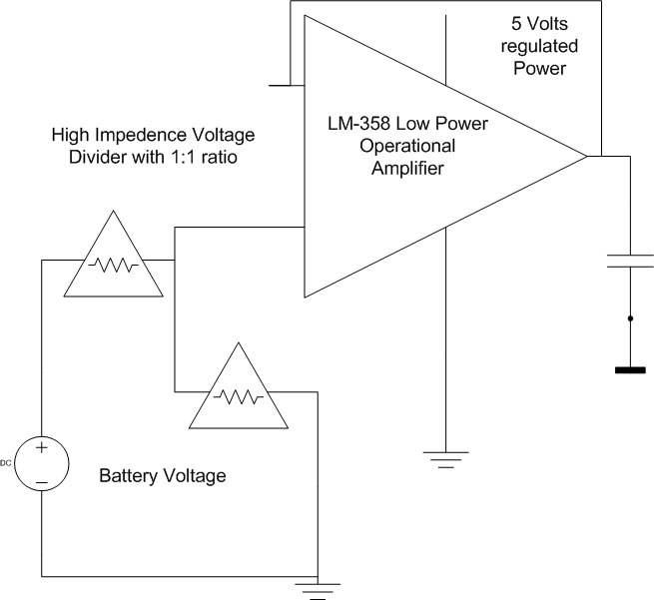
Battery Voltage Measurement Trade & Selection
Battery Voltage is measured by giving a high impedance voltage divider with outsourcing and then interfaced to the ADC port.
We use the same circuit for both Lander and Carrier.
Presenter: Neeraj Pradhan

Slide 77
EPS Testing Overviews
Power
Regulation
Testing of Buck Converter based Regulators 1 week post PDR
Lab Power Testing
1 week prior to CDR
On Field Power Testing
Post CDR
Presenter: Neeraj Pradhan

Slide 78
Flight Software Design
Nikhil Soni

Slide 79
FSW Overview
The FSW will work in a Microcontroller(Atmega128). There will be separate FSW’s for the lander and the carrier. Its basic structure will be as follows:
gather transmit via
data
initiate at 500m
store in
Sensors
FSW( for Carrier)
Antenna
Memory
Electro-Mechanical Release Mechanism
Presenter: Nikhil Soni

Slide 80
Basic Structure: FSW for Lander
Sensors
Gathers data
FSW( for Lander)
Stores into
Memory
Presenter: Nikhil Soni

Slide 81
FSW Overview
The FSW for the carrier will collect data from all the sensors and store it onto the onboard memory. It will also transmit the collected data via the Antenna.
It will also initialize the Electromechanical Mechanism used to release the lander from the carrier at the height of 500 meters.
The FSW for the lander will collect data from the altitude sensor and the impact sensor and store it onto the onboard memory so as to be analyzed later.
Complete FSW will be developed in C with an AVR GCC environment. All C programs are compiled and dumped as HEX codes in ATMEL microcontrollers which forms the embedded platform of our CANSAT. We have chosen this platform because we are familiar with it as it is a part of our curriculum.
Presenter: Nikhil Soni

Slide 82
FSW (Carrier) Requirements
ID | Requirement | Rationale | Parent | Priority | VM
 |  |  |  |  | A | I | T | D
FSC01 | Collection of Sensor data in processor and formation of packet | Reception of data values from sensors and analysis in firmware to produce data packets | CD01 | HIGH | x |  | x | x
FSC02 | Data packet to be sent to RF Transceiver via USART. | Packet sent for Transmission to Relay | CD01 | HIGH |  |  | x | x
FSC03 | Packets sent also stored as Data backup. | Packet also sent to memory for Data-packet backup. | CD01 CD04 CD06 | LOW |  |  |  | x
FSC04 | Control the Release mechanism of the lander | So that the lander can be released at height of 500 meters | CD03 | LOW | x |  | x | x
Presenter: Nikhil Soni

Slide 83
FSW (Lander) Requirements
ID | Requirement | Rationale | Parent | Priority | VM
 |  |  |  |  | A | I | T | D
FSL01 | Collection of Sensor data in processor and formation of packet | Reception of data values from sensors and analysis in firmware to store heights and impact force | CD01 | HIGH | x |  | x | x
FSL02 | Packets stored as onboard memory. | Data can be retrieved from memory for later analysis. | CD01 CD04 CD06 | LOW |  |  |  | x
Presenter: Nikhil Soni

Slide 84
Software (Carrier) flow diagram(High Level)
Start
Collect Pressure Value, Temperature Value, Battery Voltage Value
Collect Latitude & Longitude Values, Altitude and Number of Satellites Tracked.
No
Yes
Check altitude repetition condition for termination
Exit
Is CANSAT height == 500m ?
No
Prepare Data Packet and Transmit to GCS
Yes
Initiate Lander releasing mechanism
Store Backup Data in Assigned Memory
s
Presenter: Nikhil Soni

Slide 85
Sensors
Pressure Sensor:
Interfaced via ADC
sampled at 50kHz
Temperature Sensor:
Interfaced via ADC
sampled at 50kHz.
Battery Voltage Sensor:
Interfaced via ADC
sampled at 50kHz.
GPS:
Interfaced via USART at 4800bps
sampled at 1Hz.
Memory : Memory chip is interfaced via SPI
A total of 7.5 KB of data is stored for a flight time of 5 minutes.(Calculation of
memory consumed is shown in CDH
Presenter: Nikhil Soni

Slide 86
Software (Lander) flow diagram(High Level)
Start
Collect Pressure Value, Accelerometer X,Y,Z values, Battery voltage
Convert Pressure value to Height , Find net force on the lander by superposition of X,Y and Z values of acceleration
Store Data packet in Assigned Memory
s
Presenter: Nikhil Soni

Slide 87
Sensors
Pressure Sensor:
Interfaced via ADC
sampled at 50kHz
Battery Voltage Sensor:
Interfaced via ADC
sampled at 50kHz.
Accelerometer X,Y and Z:
Interfaced via ADC( 3 ADC ports)
sampled at 100Hz.
Memory : Memory chip is interfaced via SPI
A total of 90 KB of accelerometer data is stored for a flight time of 5 minutes.
A total of 1.5 KB of sensor data is stored for a flight time of 5 minutes.
Presenter: Nikhil Soni

Slide 88
Ground Control System Design
Presenter : Palash Jain

Slide 89

GCS Overview
Antenna receives from the cansat carrier and passes it forward for processing
Microcontroller interface connected to USB of the Laptop
GCS uses the data received to populate various tables and plot graphs. The software clearly indicates the phases of flight, i.e. pre-launch, moving upwards, deployment, coming down, landed etc..
Presenter: Palash Jain

Slide 90
GCS Requirements
ID | Requirement | Rationale | Priority | Parent | Children | VM
 |  |  |  |  |  | A | I | T | D
GCS01 | Antenna placement : Antenna must point upward, towards the cansat | For better signal reception. | Medium | None | GCS02 GCS03 |  |  | X
GCS02 | Computational requirements : Data is received at 0.5 Hz. | Computational speed is not a big issue. (Assuming GCS laptop has a reasonably fast processor) | Low | GCS01 | None |  |  | X
GCS03 | Power Requirement : Should be able to receive and display data for about 4 hrs. | GCS has to be ready always for the communication. Not a big issue as ample power is available. | Medium | GCS01 | GCS05 |  |  | X
GCS04 | Analysis Software requirements : Should support Java, C/C++. | To be able to run analysis software. | High | None | None |  | X | X
GCS05 | Mission operations : Includes the detection of various phases by the GCS | To be able to distinguish between various states of flight. | Medium | GCS03 | None |  |  | X
Presenter: Palash Jain

Slide 91
GCS Antenna Trade & Selection
Name | Range | Gain | Radiation Direction | Mass
Antenova B58124 | 1 Km | 1.8dB | Omni | 2g
S467XX-915S | 5 Km | 2.0dB | Omni | 21g
The first one is small easy to accommodate and light weight, but lacks in providing the required range hence communication fails, which is an extremely important objective of the cansat mission. Thus we select the one which gives us the required range.
Presenter: Palash Jain

Slide 92
CanSat Integration and Test
Presenter : Palash Jain

Slide 93
Integration of CANSAT subsystems
Integration of Carrier and Lander
We used a servo motor to control a hook that holds the Lander and the Carrier.
Integrations in Carrier
EPS, SS, CDHS and DC
On one side frame there will be the PCB while on the other side there will be the battery. They both will be attached to the base frame structure and the power supply to the PCB will be provided by this battery source.
Integrations in Lander
EPS and SS
Just like Carrier the Lander will also have PCB and battery source on either side of the frame but it will also have the egg container. Above this container only, the PCB and battery source will be kept.
Presenter: Palash Jain

Slide 94
Tests Performed
Sensor Testing
The sensor are same as we us we used in last year. They all are tested and are working fine.
The sensors are :-
Temperature Sensor (LM35)
Pressure Sensor (MPX6115A)
Accelerometer (MMA7260Q)
GPS Sensor (GSC3) is also used. We are facing little difficulties with the last year’s GPS. It is currently under test and will be procured soon if it doesn’t work.
Presenter: Palash Jain

Slide 95
Tests Performed
Mechanical Testing
Egg drop tests (To decide the cushioning material and parachute size)
Evaluated under free fall and windy conditions - worst case analysis.
Trial | Outer case | Inner filling | Drop Height (feets) | Velocity at Ground Level (metres/second) V = √(2gh) | Results
1 | Coke Can | Sponge | 10 | 7.75 | FAIL
2 | Aluminum container | Paper Cushion | 10 | 7.75 | PASS
3 | Aluminum container | Sponge + Paper Cushion | 20 | 11 | PASS
4 | Aluminum container | Sponge + Paper Cushion | 40 | 15.5 | FAIL
6 | Aluminum container | Sponge + thermacol balls | 20 | 11 | PASS
7 | Aluminum container | Sponge + polystyrene balls | 40 | 15.5 | Pass
8 | Aluminum container | Sponge + polystyrene balls | 60 | 19 | Pass
Presenter: Palash Jain

Slide 96
Tests Performed
Electronics Testing
Objective :- Verification of the working of Motor-Hook
The detachment of Lander and Carrier with the help of a microcontroller and servo motor(as explained earlier) is the main motive of the test.
The Lander and Carrier are getting detached at various angles tested by manually tilting the structure.
They are also getting detached at an angle of 90degree.
Presenter: Palash Jain

Slide 97
Tests to be Performed
Communication Testing
Flight Software Testing
Detachment Testing during Flight
Lander Position Estimation Testing
Final Structure Testing
Presenter: Palash Jain

Slide 98
Mission Operations & Analysis
Presenter : Roopak Dubey

Slide 99
Overview of Mission Sequence of Events
•Preliminary launch-day sequence of events
–Arrive at the Launch site will in-time
–Locate a workspace for the team
–Layout the team’s equipment and put up the team’s banner
–Collect the launch time schedule
–Assemble the CANSAT carrier and lander for final check
–Setup GCS
–Verify communication between CANSAT and GCS
–Collect and place the Egg in its container
–Proceed to place the CANSAT in the payload section of the rocket
–Post Launch – run all the GCS operations
–On successful landing of CANSAT, proceed for recovery
–Pack up and leave the Launch site
Presenter: Roopak Dubey

Slide 100
Lander Landing Coordinate Prediction
DCS will keep track of GPS readings during descent.
The sensor data will be taken after each 2 seconds. This timing is done by the onboard controller.
After detachment the co-ordinates of Lander will be predicted on the basis of GPS readings at the carrier.
After some Readings Trajectory of the Lander can be estimated.
The DCS will be enabled as soon as Cansat will come out of Rocket.
It keeps track of height using GPS.
At 500 Meter height Lander and Carrier detach with DCS on Carrier tracking co-ordinates of Lander.
Further Trajectory can be estimated by extrapolation.
CANSAT
Reading is taken
every 2 secs
Lander
Carrier
Presenter: Roopak Dubey

Slide 101
Cansat Location and Recover
Lander Recovery
The co-ordinates of lander will be estimated by FSW in the carrier that will help us to find the exact location of Lander on the ground. The exact method for determination of lander location is under construction. However a heuristic approach based upon GPS data is as follows :
We store the position of cansat before separation of carrier and lander in the memory at every 2 sec interval.. This will depict the trajectory of the cansat as it falls. This can be extrapolated taking into consideration local wind effect as altitude decreases to predict the trajectory and final position of lander.
The Lander will have a shiny parachute after detachment from carrier. That parachute will be helpful in spotting the lander from a far distance.
Carrier Recovery
A buzzer will be there on carrier and it start beeping as soon as Carrier will hit the ground this will help in recovery of carrier.
Shiny and colorful parachute will help in spotting the carrier from far distances.
Telemetry data received by the GCS towards the end (when the cansat has landed) will also be used to discover the location of the carrier.
Presenter: Roopak Dubey

Slide 102
Management
Presenter : Roopak Dubey

Slide 103
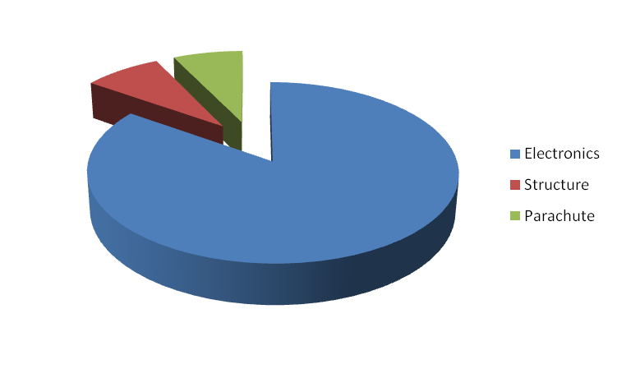
Cansat Budget – Hardware
Component | Quantity | Unit Price (in USD) | Cost (in USD)
Atmega128 microcontroller | 2 | 6.8 | 13.6
Temperature Sensor | 1 | 0.7 | 0.7
Accelerometer | 1 | 20 | 20
Battery | 2 | 10 | 20
Mini Servo Motor | 1 | 5 | 5
Circuit Fabrication | 2 | 10 | 10(original) + 2(Replicate)
GPS Equipment | 1 | 108 | 108
Electronics system |  |  | 71.3
Structure material and Fabrication |  | 60 | 60
Rip-Stop Nylon | 3 | 18 | 54
Miscellaneous |  | 20 | 20
Margin | 15% | 41.3 | 41.3
Total |  |  | 350.7
Presenter: Roopak Dubey

Slide 104
Cansat Budget – Other Costs
Component | Cost (in USD)
Ground Control Station | 1140$ (for laptop and AC4790 + antenna)
Test facilities and equipment | 20$ till now
Rentals | Nil
Travel | 40$
Total | 1200 $
Any external financial support for the project is not yet available.
Presenter: Roopak Dubey

Slide 105
Program Schedule
Electronics Team
Task | Scheduled Dates (dd/mm/yy) |  | Actual Dates (dd/mm/yy) |  | Reasons for not completing
1. Recognition of Tasks | 1/1/11 | 7/1/11 | 1/1/11 | 7/1/11
2. Allocation and Division of Tasks | 8/1/11 | 10/1/11 | 8/1/11 | 10/1/11
3. Identification of Systems and System Architecture | 11/1/11 | 15/1/11 | 11/1/11 | 15/1/11
4. Testing of Available components from previous year | 15/1/11 | 27/1/11 | 15/1/11 | 24/1/11
5. PDR Report and Presentation | 27/1/11 | 31/1/11 | 21/1/11 | 31/1/11
6. Hardware Procurement Begins | 1/2/11 | 15/2/11
7. Basic System Integration | 15/2/11 | 15/3/11
8. Work on Image Sensing and Orientation | 15/3/11 | 25/3/11
Presenter: Roopak Dubey

Slide 106
Program Schedule(contd.)
Electronics Team
Task | Scheduled Dates |  | Actual Dates |  | Reasons for not completing
9. CDR PPT and PDF | 25/3/11 | 29/3/11
10. Accelerometer Interfacing | 1/4/11 | 10/4/11
11. Flight Software Development | 11/4/11 | 25/4/11
12. Testing of Prototype | 25/4/11 | 5/5/11
13. Fabrication of Final PCB | 6/5/11 | 15/5/11
14. Field Testing of Hardware with System | 16/5/11 | 5/6/11
15. Flight Operations Preparation | 6/6/11 | 11/6/11
Presenter: Roopak Dubey

Slide 107
Mechanical Team Schedule
Mechanical and Descent Control Team
Task | Scheduled Dates |  | Actual Dates |  | Reasons
1. Recognition of Tasks | 1/1/11 | 15/1/11 | 1/1/11 | 15/1/11
2. Egg Canopy Design | 16/1/11 | 20/1/11 | 16/1/11 | 20/1/11
3. Egg Landing Test on Materials | 20/1/11 | 25/1/11 | 23/1/11 | 25/1/11
4. Mechanical Structure Design | 25/1/11 | 27/1/11 | 25/1/11 | 27/1/11
5. PDR report and presentation | 27/1/11 | 31/1/11 | 27/1/11 | 31/1/11
Presenter: Roopak Dubey

Slide 108
Mechanical Team Schedule(contd.)
Mechanical and Descent Control Team
Task | Scheduled Dates |  | Actual Dates |  | Reasons
6. Descent Control Hardware | 1/2/11 | 15/2/11
7. Designing Descent Control | 16/2/11 | 25/2/11
8. Integrating Descent Control with Egg Canopy | 25/2/11 | 5/3/11
9. Testing of Structure for operation | 5/3/11 | 15/3/11
10. Make necessary changes in descent or Egg mechanism | 15/3/11 | 15/4/11
11. Testing with Changes | 15/4/11 | 1/5/11
12. Fabrication of Final Structure | 1/5/11 | 10/5/11
13. Testing with integrated Hardware | 10/5/11 | 25/5/11
Presenter: Roopak Dubey

Slide 109
Conclusions
Accomplishments :
Detachment mechanism finalized.
Physical structure layout finalized.
Sensors and components are decided (except locator device).
Descent mechanism decided and parachutes are ready.
Sensors tested.
Yet to be done :
PCB design and locator device is yet to be finalized.
Physical structure needs to be prepared.
FSW code has to be written.
GCS code has to be written.
We are ready for the next stage which is - Implementation of the subsystems
according to the conclusions we’ve reached upon.
Presenter: Roopak Dubey

Slide 110
THANK YOU
THANK YOU
THANK YOU

