Slide 1
A simple prior free model for non-rigid structure from motion
Authors:
Yuchao Dai HongDong Li Mingyi He
Jashwanth - 201030068
CVPR 2012

Slide 2
About:
This paper proposes a simple prior free method for solving non rigid structure from Motion factorization problems.
This paper doesnot assume any extra prior knowledge except a low rank constraint hence is prior free.
This paper is free from constraints like non rigid shape bases , coefficients , camera motion(may be smooth or rapidly changing ) etc…

Slide 3
PRIOR WORK IN THE AREA
Tomasi – Kanade Factorization:
P feature points over F frames in an image stream.
Image coordinates are (u_{fp} , v_{fp} ) where f = 1,2,…..F and p = 1,2,………..P.
u₁₁ u₁₂ …… u_{1p}
u₂₁ …………..
W= ………………
v₁₁..................v_{1p}
……………...
v_{f1}………......v_{fp}
Mean is subtracted from each entity -> registered rank matrix

Slide 4
I₁
I₂
.
.
.
J₁
J₂
.
.
J_{f}
S = S₁……S_{p}
W = RS
Here R is rotation matrix and S is shape matrix.
Rank of noise less W = 3!!!
SVD :: W’ = U’V’D’ where R’ = U’V’ and S’ = D’.
But R=R’Q and S = Q⁻¹ S’ are also solutions.
To find Q metric constraints i1^{T}QQ^{t} i1 = 1 and i1^{t}QQ^{t} i2 = 0 .
R =

Slide 5
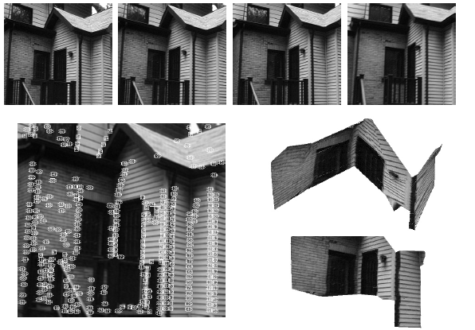

Slide 6
Bregler’s work
Recover 3-D non-rigid shape models from image sequences.
3D shape is a linear combination of set of basis.
This algorithm tackles the problem without use of prior model
and multi-view etc…
We describe the shape of the non-rigid object as key frame basis set s1,s2,…sk. Each key frame is 3*P dimensional.
The required shape is linear combination of basis set.

Slide 7
S₁
S₂
.
.
.
S_{K}
l¹₁R¹ ………………..l¹_{k}R¹
…………………………………..
l^{N}₁ R¹……………….l^{N}_{k} R¹
W =
X
= πB

Slide 8
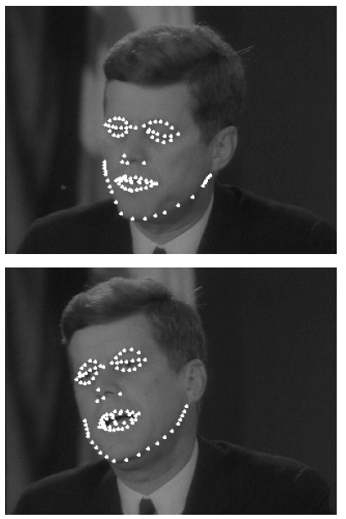
Track the eyes brows , upper and lower eye lids , 5 nose points , outer and inner boundary of the lips and chin contour using appearance based 2D tracking technique.

Slide 9
Paper’s work
According to xio et.al one cannot recover non-rigid shapes and shapes coefficients uniquely.
But Akhter et al. proves that although ambiguity in shape basis is inherent
3D shape can be recovered uniquely without ambiguity.
Here also S(shape matrix) is linear combination of shape basis .
W = πB = πGG⁻¹B where G is Euclidean corrective matrix.
Orthonormal constraints are imposed to recover Q_{k} = G_{k} G_{K}^{T} by
π_{2i-1} * Qk * π_{2i-1}^{T} = π_{2i} * Qk * π_{2i}^{T}
π_{2i} * Qk * π_{2i-1}^{T} = 0

Slide 10
Main Theorem
All solutions of Qk form a linear subspace of dimension (2k² - k ).
Intersection theorem:
Avec(Qk) = 0 ∩ Qk > 0 ∩ rank(Qk) = 3.This is converted to nuclear norm rank minimisation problem – standard SDP .

Slide 11
Similarly estimate S by rank minimization problem.
W = RS
Rank(S) <= 3*k
Gives S = RŦW . (RŦ is pseudo inverse of R)

Slide 12
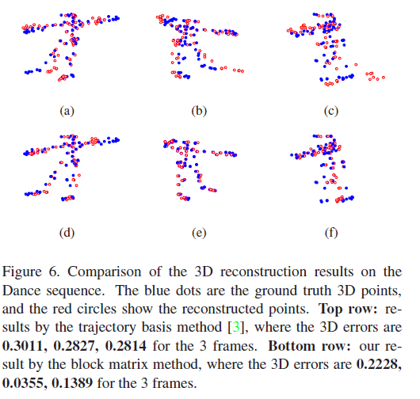
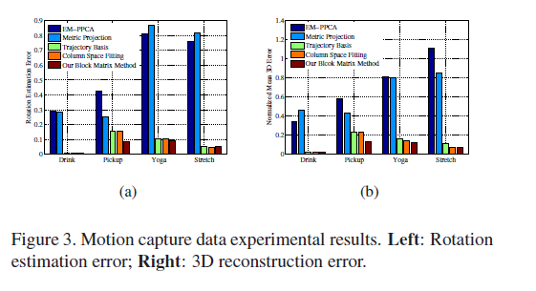
Experimental Results

Slide 13
THANK YOU

