Slide 1
Computer systems Organization
Memory Hierarchies -- Spring 2010 -- IIIT-H -- Suresh Purini

Slide 2
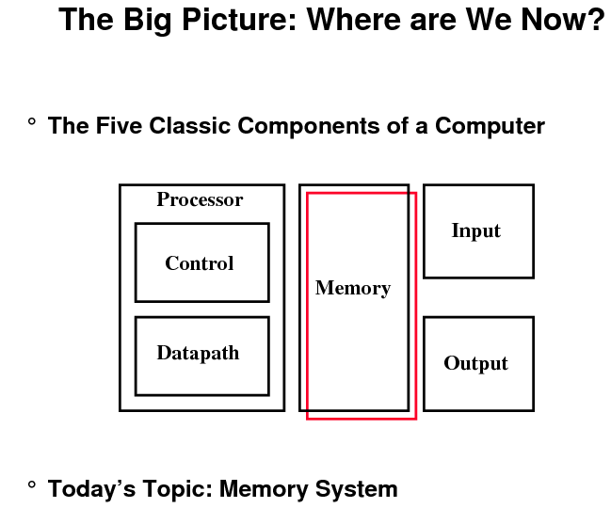
Source: Dave Patterson

Slide 3
Desired Features for Memory
Memory should be
Large – So that programs with huge memory footprint can be executed.
Fast – Why?
However, in real world these two are contradictory requirements!

Slide 4
Random Access Memory (RAM)
Main Memory – DRAM
Cache – SRAM
Main memory can be logically viewed as an array of bytes
In RAMs, time taken to access any byte of memory is exactly same.
Compare this against Disks, Magnetic Tapes, CD-Rom
Technologies for RAM
Static RAM (SRAM)
Low density, high power, expensive, fast
Static: content will last “forever”
Dynamic RAM (DRAM)
High density, low power, cheap, slow
Dynamic: need to be “refreshed” regularly

Slide 5
Random Access Memory (RAM) Technology
Why do computer designers need to know about RAM technology?
Processor performance is usually limited by memory bandwidth
As IC densities increase, lots of memory will fit on processor chip
Tailor on-chip memory to specific needs
Instruction cache
Data cache
Write buffer
What makes RAM different from a bunch of flip-flops?
Density: RAM is much more denser

Slide 6
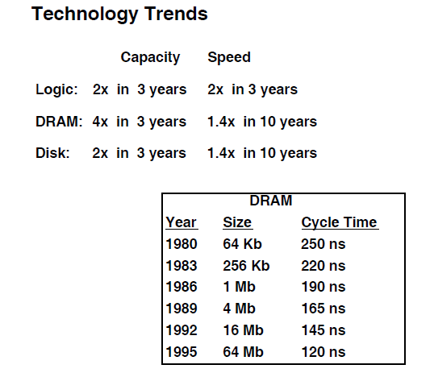

Slide 7
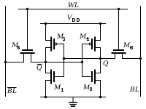
Static RAM
Low density, high power, expensive, fast
Static: content will last “forever”
SRAM stores each bit in a bistable memory cell
Each cell is implemented with a six transistor circuit
The above circuit can stay in one of two possible states indefinitely (as long as the circuit is powered)

Slide 8
Dynamic RAM (DRAM)
DRAM stores each bit as a charge on a capacitor.
DRAM storage can be made very dense
DRAM cell will lose its charge within a time period of around 10 to 100 milliseconds
Memory system should be periodically refreshed by reading every bit of memory and writing it back
High density, low power, cheap, slow
Dynamic: need to be “refreshed” regularly

Slide 9
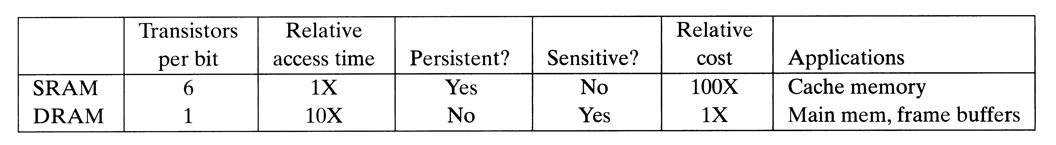
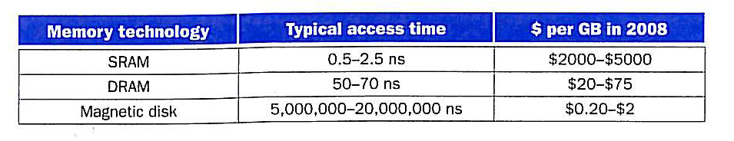
SRAM vs DRAM

Slide 10
The Illusion of Fast and Large Memories
SRAMs – For small but fast Cache Memories
DRAMs – For large but slow Main Memories
Design Goal for Memory Hierarchy: Give the illusion of large and fast memory
Key Idea: Exploit temporal and spatial locality of the programs to achieve the illusion.

Slide 11
Principle of Locality of Reference
The Principle of Locality:
Program access a relatively small portion of the address space at any instant of time.
Two Different Types of Locality:
Temporal Locality (Locality in Time): If an item is referenced, it will tend to be referenced again soon.
Spatial Locality (Locality in Space): If an item is referenced, items whose addresses are close by tend to be referenced soon.

Slide 12
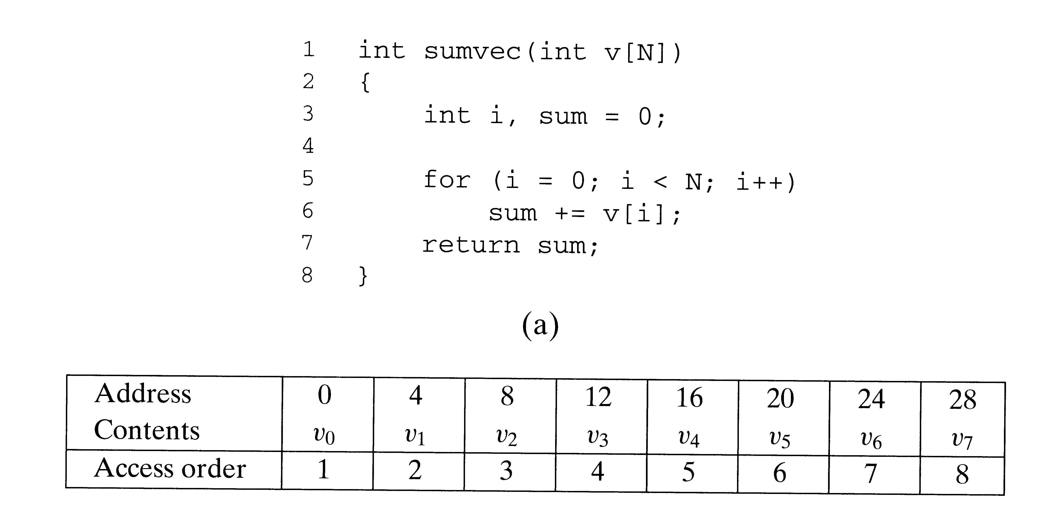
Principle of Locality
Function sumvec exhibits
Good temporal locality w.r.t variable sum
Good spatial locality w.r.t variable v (Stride-1 reference pattern)
Spatial locality decreases for Stride-k reference patterns as k increases
Hey how about locality of instruction fetches?
Loops exhibit good temporal and spatial locality
N = 8

Slide 13
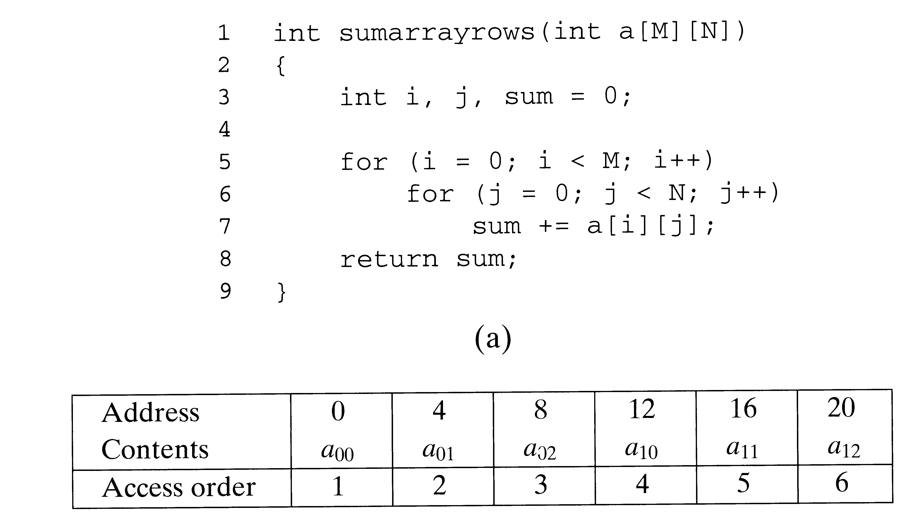
Principle of Locality
Does the function sumarrayrows exhibit good spatial locality?
What is the Stride for the array variable a?
M = 2
N = 3

Slide 14
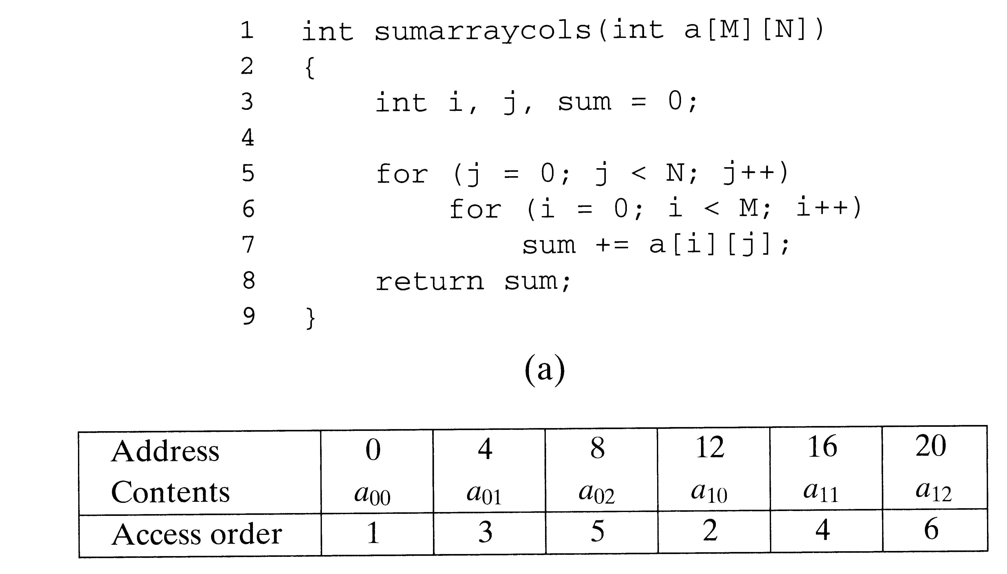
Principle of Locality
Does the function sumarraycolumns exhibit good spatial locality?
What is the Stride for the array variable a?
M = 2
N = 3

Slide 15
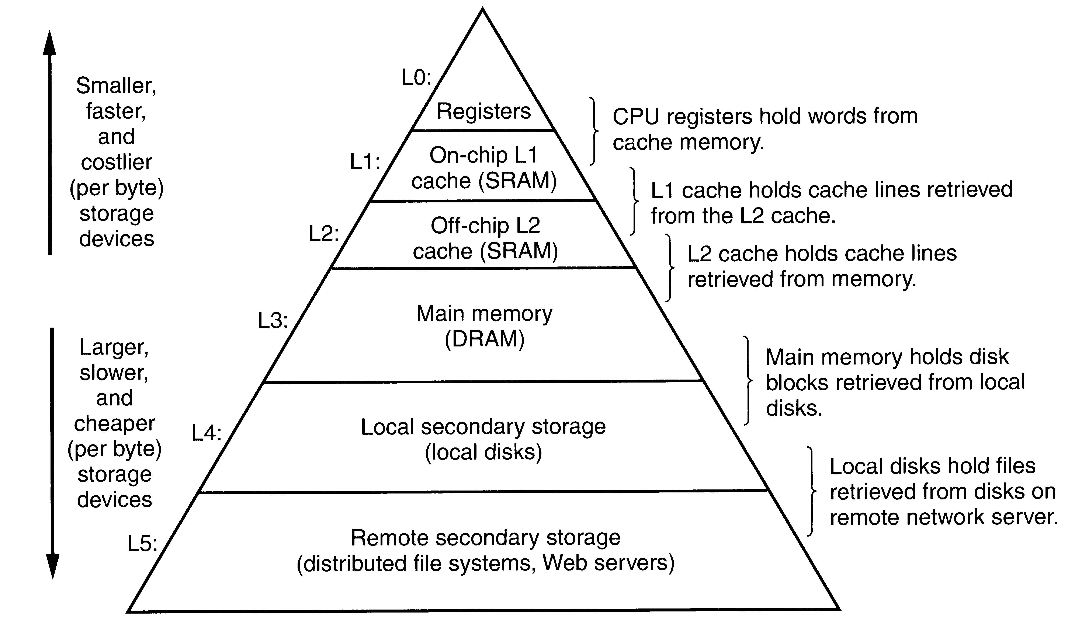
Memory Hierarchy

Slide 16
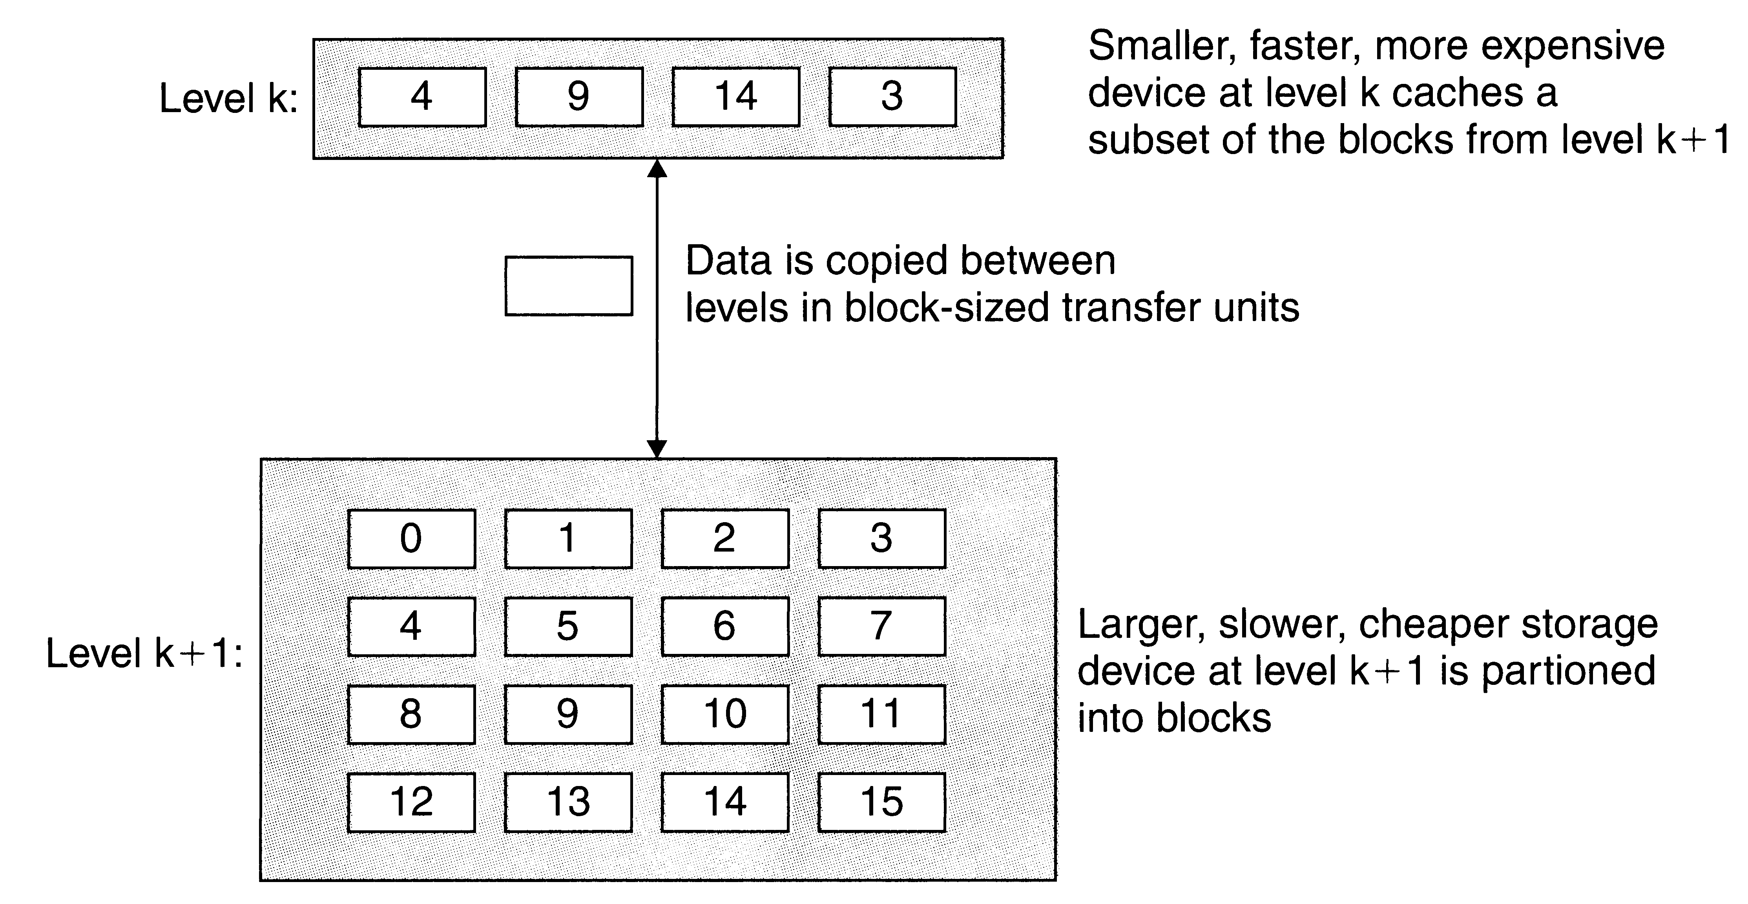
Basic Principle of Caching in the Memory Hierarchy
Focus of this lecture:
Level k: on-chip cache memory (SRAM)
Level k+1: Main memory (DRAM)

Slide 17
What is a Cache Hit and Cache Miss?
Let us say
Cache size – 128 bytes (2⁷ bytes)
Cache line/block size – 32 bytes
Main Memory 512 bytes (2⁹ bytes)
Main memory is also logically divided into 2⁴ blocks each of size 32 bytes
When the processor accesses a word of memory
Cache hit: If the block containing the word is available in the Cache
Cache Miss: If the block containing the word is not available in Cache
Question: How to search the cache for the block containing the word of memory the processor is accessing?

Slide 18
What happens on a Cache Miss?
The block containing the word of memory has to be fetched into the cache.
We may have to overwrite an existing block if the cache is already full. This is called replacing or evicting the block.
Question: Which block should we evict? (Cache’s Replacement policy)
Random replacement policy, Least Recently Used (LRU) replacement policy, FIFO, Least Frequently Used (LFU), ….

Slide 19
Main Memory = 16 32-byte blocks
Cache = 4 32-byte blocks
Direct-Mapped Cache Organization
Block No | Main Memory
0000
0001
0010
0011
0100
0101
0110
0111
1000
1001
1010
1011
1100
1101
1110
1111
Cache Structure
Index | Valid Bit | Tag | Data
00 | N
01 | N
10 | N
11 | N
Memory Address
Tag | Index | Byte Offset
Block K of memory is mapped to the block K mod 4 of cache.

Slide 20
Direct Mapped Cache Organization
What is the Hit rate for the following loop assuming the cache is initially empty? Assume the array A is allocated memory starting at address 0. Also assume the variable sum is located in a register.
Hit Rate: Percentage of memory references served from the cache
Miss Rate: 1 – Hit Rate
for( i = 0; i < 128; ++i)
sum = sum + A[i] ;
Three types of Cache Misses
Compulsory or Cold Start Misses
Conflict Miss
Capacity Miss

Slide 21
Conflict Misses and Direct Mapped Cache Organization
What is the Hit rate for the following loop assuming the cache is initially empty? Assume the array A is allocated memory starting at address 0. Also assume the variable sum is located in a register.
for( i = 0; i < 128; i = i + 32)
sum = sum + A[i] ;
for( i = 0; i < 128; i = i + 32)
A[i] = ~A[i] ;
Hmm! Unnecessary Cache Misses in the second for loop. Conflict Misses? How can we solve this problem.

Slide 22
Conflict Misses and Direct Mapped Cache Organization
What is the Hit rate for the following loop assuming the cache is initially empty? Assume array x is allocated memory starting at address 0x0 and array y is allocated memory starting at address 0b010000000.
Variables sum and i are located in registers
float dotprod(int x[8], int y[8])
{
int sum = 0, i ;
for( i = 0; i < 8; ++i )
sum = sum + x[i] * y[i] ;
return sum;
}

Slide 23
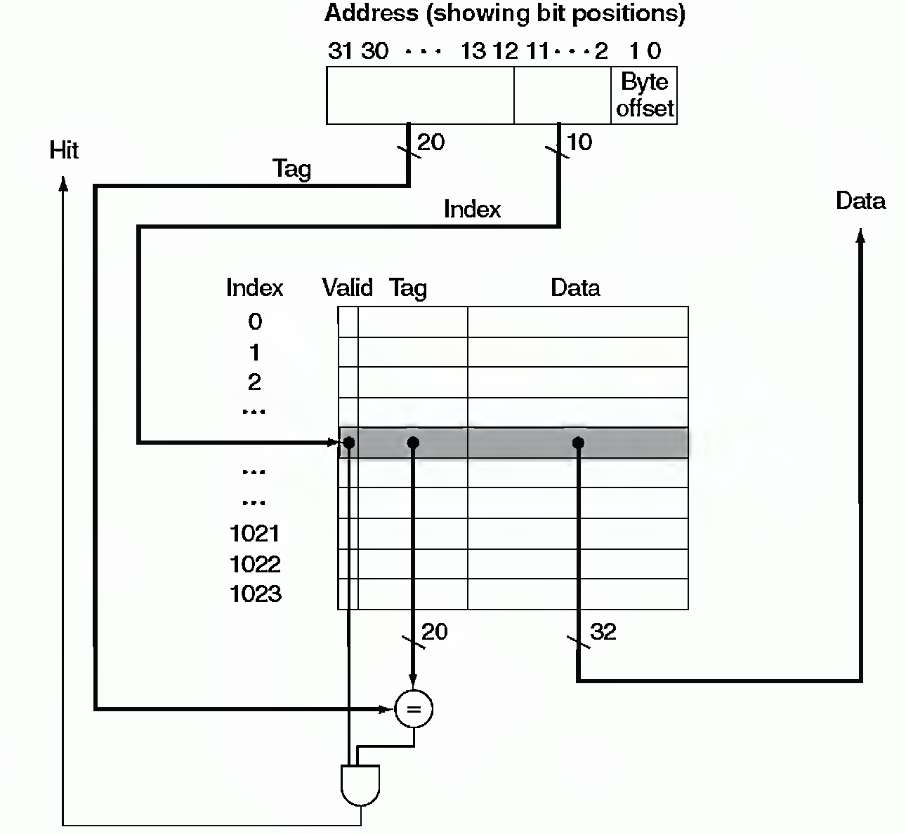
Direct Mapped Cache Organization
By looking at this picture can you guess ….
Memory size
Block size
No of blocks in main memory
How many distinct main memory blocks can map to the same cache block?

Slide 24
Main Memory = 16 32-byte blocks
Cache = 4 32-byte blocks
Fully Associative Cache Organization
Block No | Main Memory
0000
0001
0010
0011
0100
0101
0110
0111
1000
1001
1010
1011
1100
1101
1110
1111
Cache Structure
Valid Bit | Tag | Data
N
N
N
N
Memory Address
Tag | Byte Offset
Block K of memory can be placed anywhere in Cache.

Slide 25
Conflict Misses and Fully Associative Cache Organization
What is the Hit rate for the following loop assuming the cache is initially empty? Assume the array A is allocated memory starting at address 0. Also assume the variable sum is located in a register.
for( i = 0; i < 128; i = i + 32)
sum = sum + A[i] ;
for( i = 0; i < 128; i = i + 32)
A[i] = ~A[i] ;
No Conflict Misses at all!
In Real Life: It is extremely expensive to build fast Tag Lookup hardware.

Slide 26
Fully Associative Cache Organization
What is the Hit rate for the following loop assuming the cache is initially empty? Assume array x is allocated memory starting at address 0x0 and array y is allocated memory starting at address 0x010000000.
Variables sum and i are located in registers
float dotprod(int x[8], int y[8])
{
int sum = 0, i ;
for( i = 0; i < 8; ++i )
sum = sum + x[i] * y[i] ;
return sum;
}

Slide 27
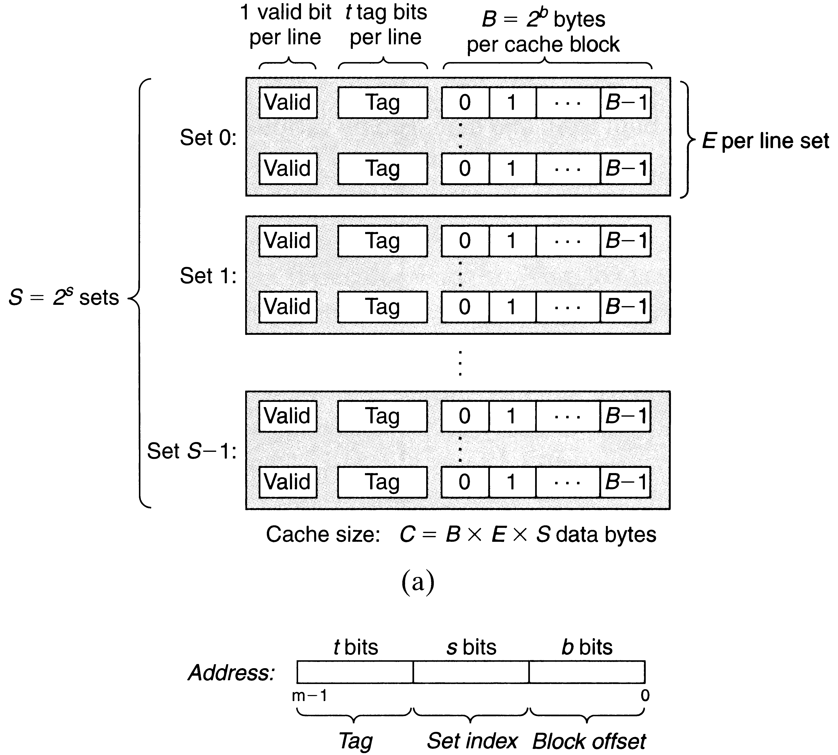
Set Associative Cache Organization

Slide 28
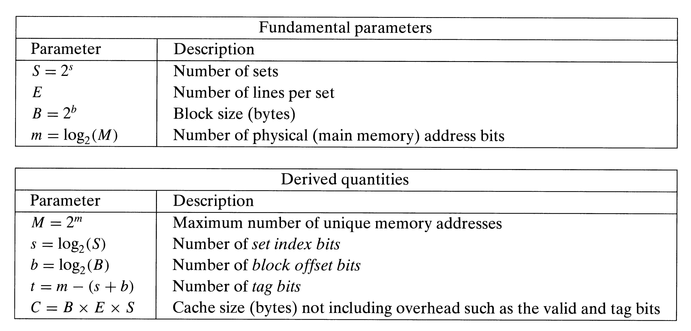
Set Associative Cache Organization

Slide 29
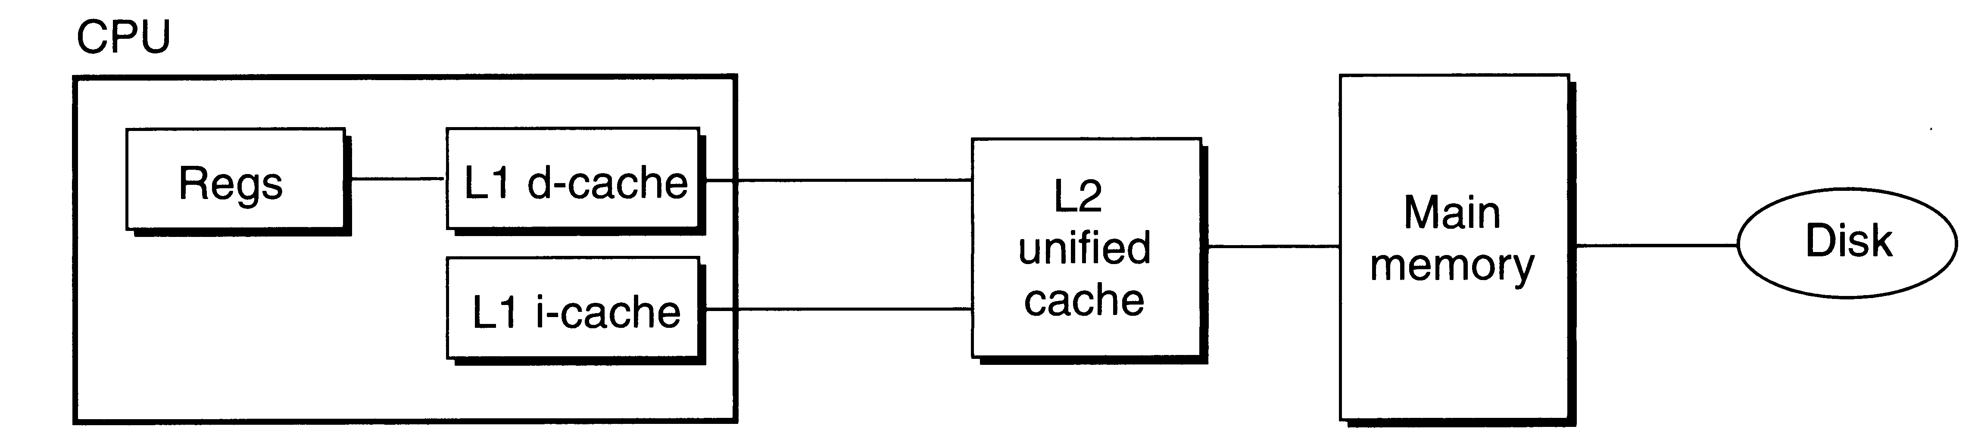
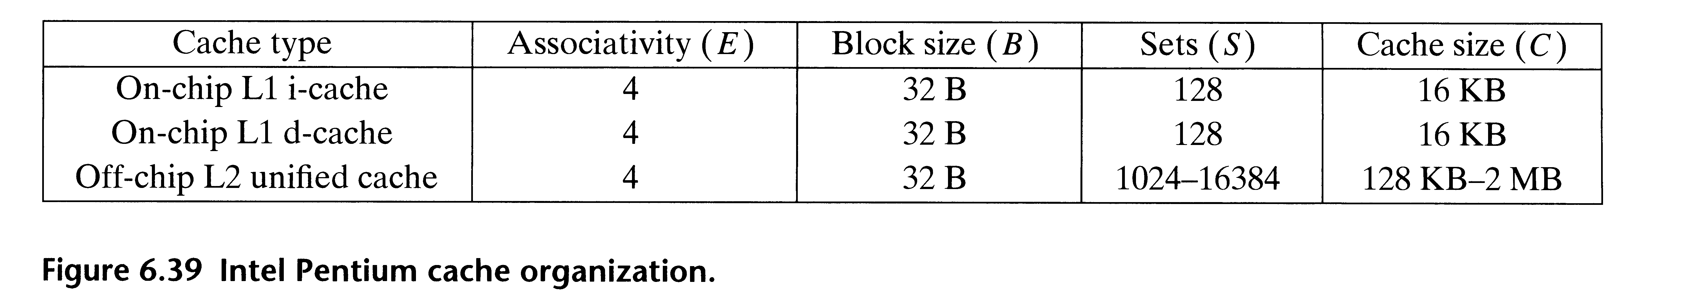
Typical Multi-Level Cache Organization

Slide 30
Average Memory Access Time
Average Memory Access Time =
Cache Memory Access Time * Hit Ratio + (1 – Hit Ratio)* Miss Penalty
Miss Penalty: (roughly) Time taken to access the main memory block and put it in the cache.

Slide 31
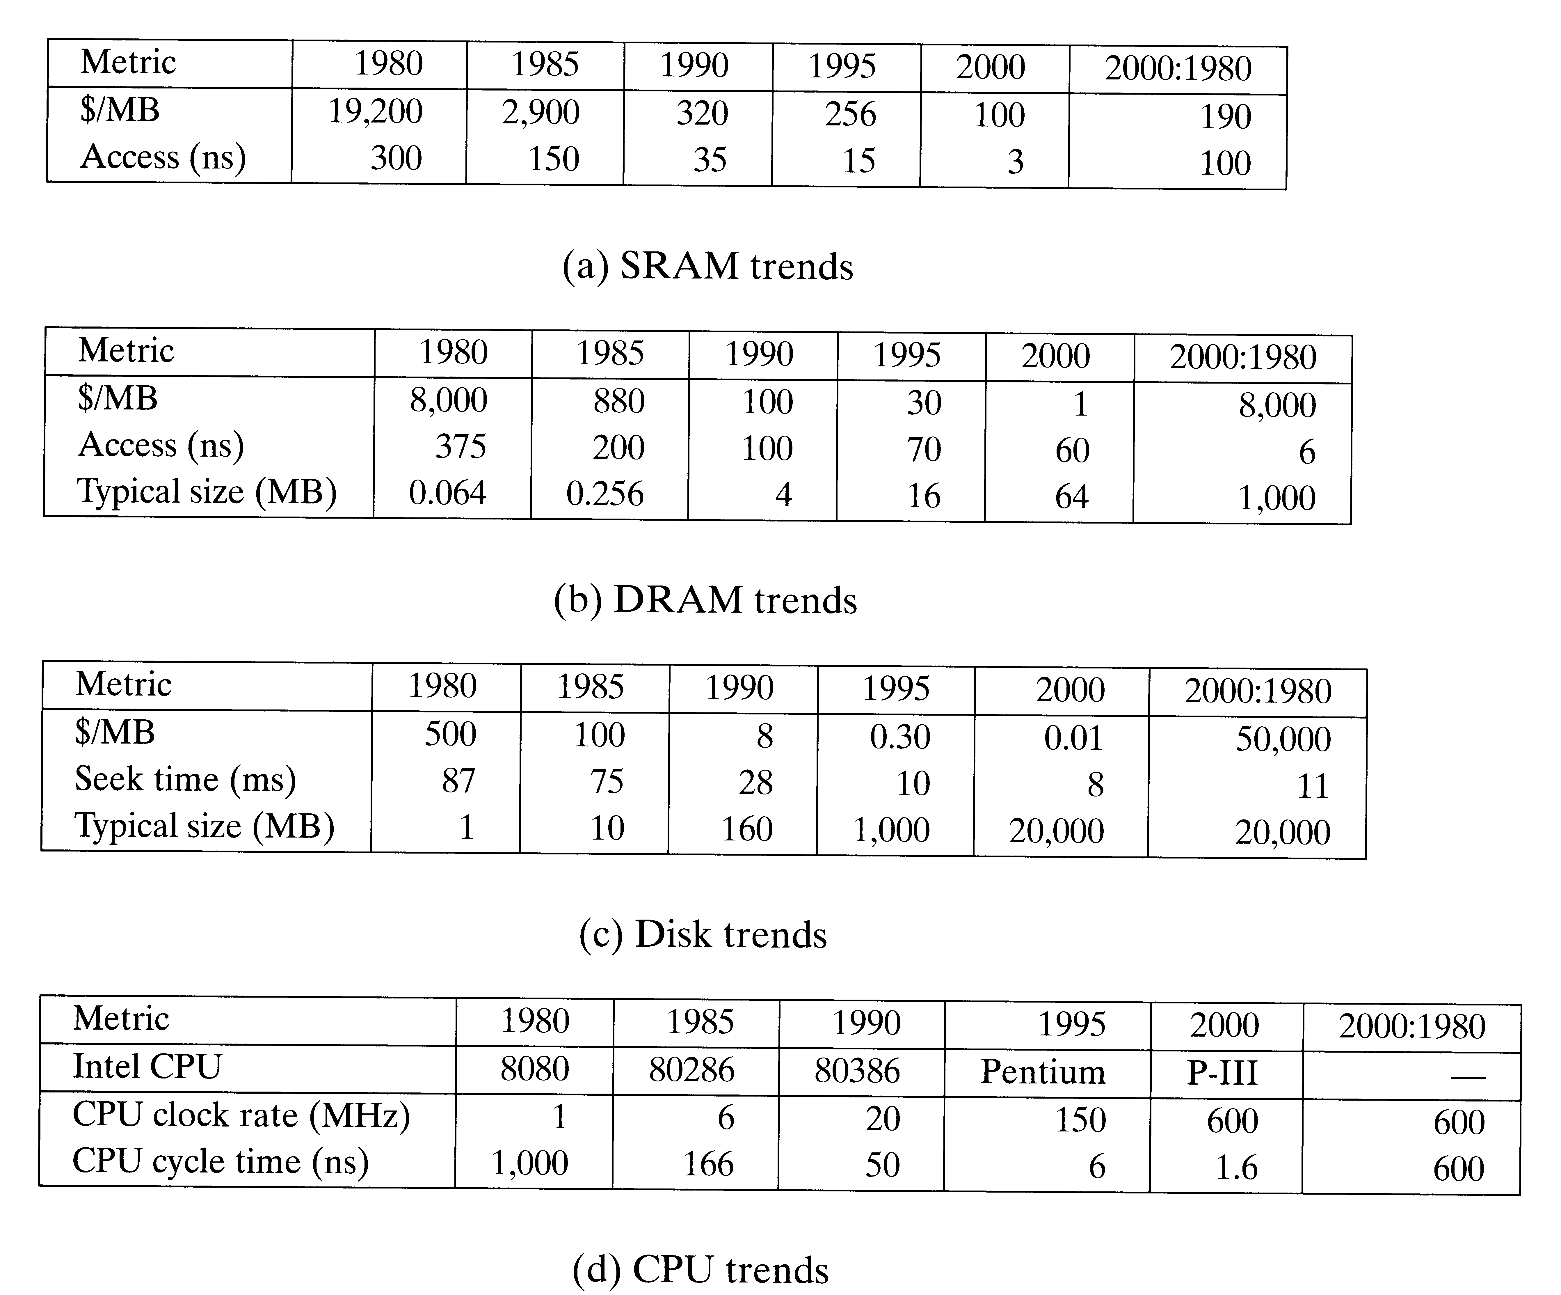
Memory Wall
Technology Trends

Slide 32
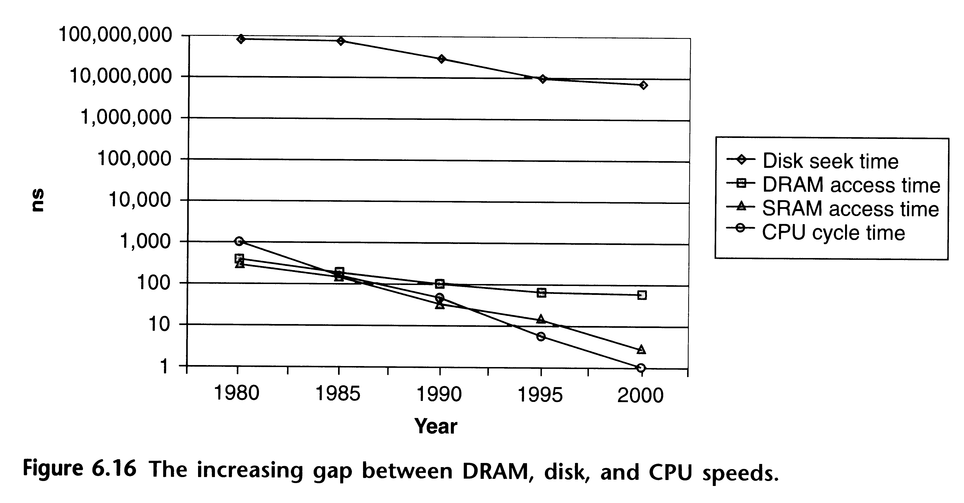
Memory Wall

