Slide 1
Computer systems Organization
Input/Output -- Spring 2010 -- IIIT-H -- Suresh Purini

Slide 2
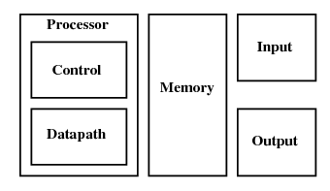
The Big Picture: Where are we now?
Input and Output

Slide 3
High level view of connections between various modules in a computer system
S
Y
S
T
E
M
B
U
S
Keyboard
Controller
Keyboard
Memory
Graphics
Controller
Monitor
CPU
Hard Disk
Controller
Hard Disk
Printer
Controller
Printer

Slide 4
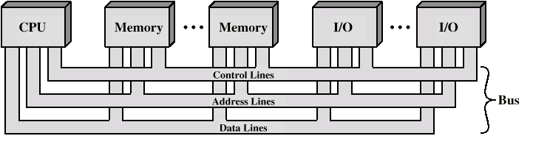
System Bus Consists of:
Address lines
Data lines
Control lines
Typical Control Lines:
Memory write
Memory read
I/O write
Bus grant
Interrupt request
Interrupt ACK
Clock
I/O read
Transfer ACK
Bus request

Slide 5
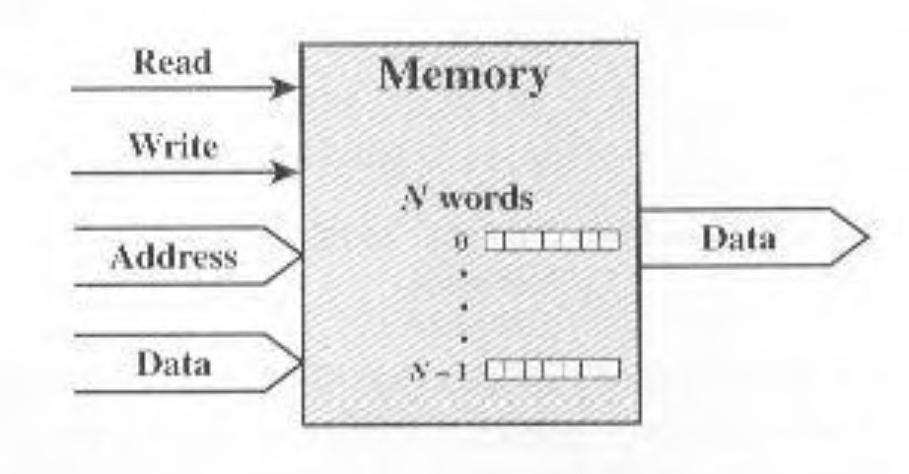
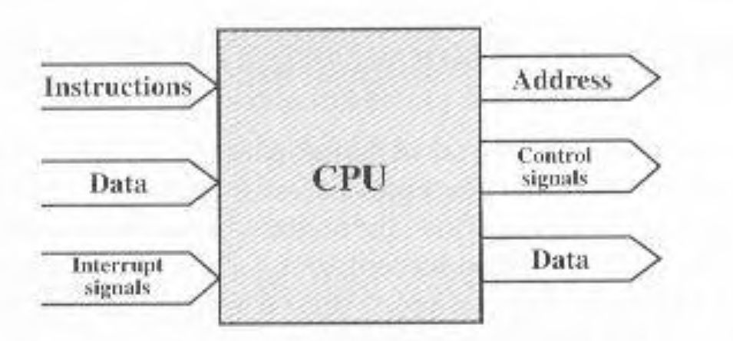
Typical Signal Lines for Memory and CPU

Slide 6
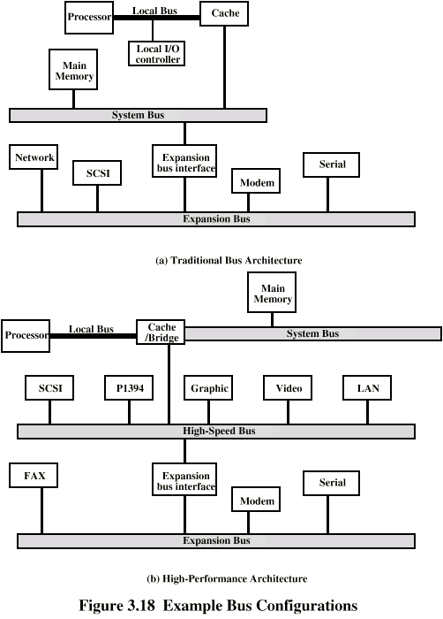
Traditional Bus Architecture

Slide 7
Another Possible Bus Architecture

Slide 8
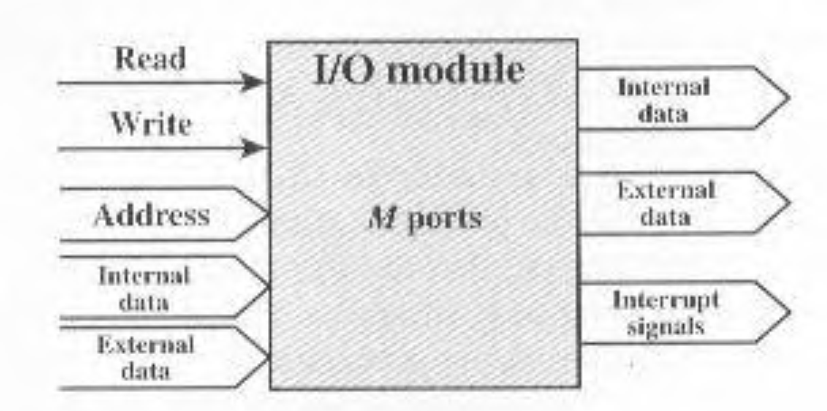
Typical Signal Lines for I/O Modules (Device Controllers)
Data
Device
Controller
Data
Memory
Address
Device
Control
Control
CPU
Status
Interrupt

Slide 9
Typical Signal Lines for I/O Modules (Device Controllers)
We need a device drive which knows how to interface with the Device Controller
Data
Device
Controller
Data
Memory
Address
Device
Control
Control
CPU
Status
Interrupt

Slide 10
Floppy Disk Controller
Floppy disk
Controller
FDD 0
FDD 1
Control Signal | Action by the device
Drive Select | FDD gets logically connected
Head Select | FDD selects either the top or bottom head
Direction | Indicate the direction of head movement (inward or outward)
Step | Move one track
…………….. | ………
Status Signal | Action by the device
Track 0 | Read/write head is positioned over the track 0
Write Protect | FDD is write protected
Ready | FDD is ready for operation
…………….. | ………

Slide 11
Types of Data Transfer
Bus interconnection should support the folllowing types of transfer:
Memory to processors
Processor to memory
I/O to processor
Processor to I/O
I/O to or from memory (Direct Memory Access – DMA)

Slide 12
Elements of Bus Design: Bus Type
Dedicated
Separate data & address lines
Multiplexed
Shared lines
Address valid or data valid control line
Advantage - fewer lines
Disadvantages
More complex control
Ultimate performance

Slide 13
Elements of Bus Design: Method of Arbitration
More than one module controlling the bus
e.g. CPU and DMA controller
Only one module may control bus at one time
Arbitration may be Centralised (Bus Controller) or Distributed

Slide 14
Elements of Bus Design: Timing
Co-ordination of events on bus
Synchronous
Events determined by clock signals
Control Bus includes clock line
A single 1-0 is a bus cycle
All devices can read clock line
Usually sync on leading edge
Usually a single cycle for an event
Asynchronous

Slide 15
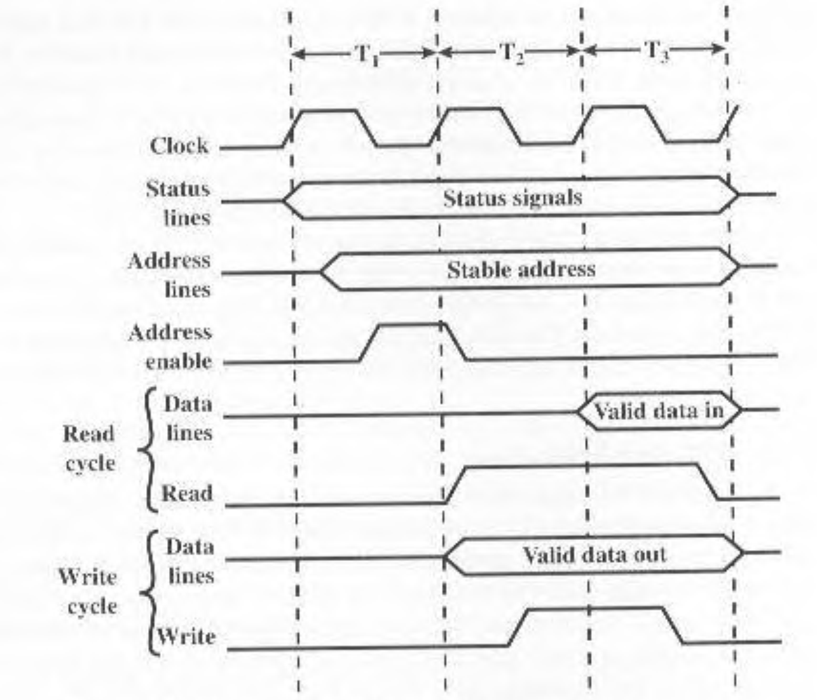
Timing of Synchronous Bus Operations
Important Remark: Bus clock and Processor clock are different.

Slide 16
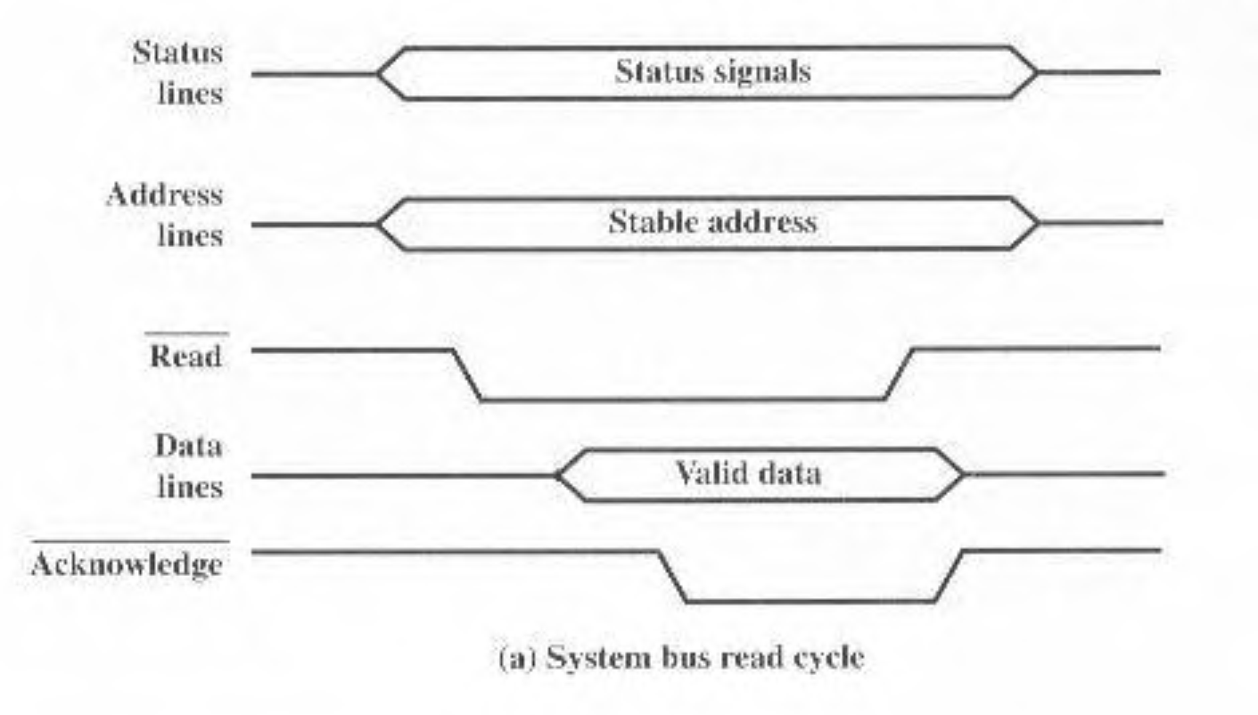
Timing of Asynchronous Bus Operations

Slide 17
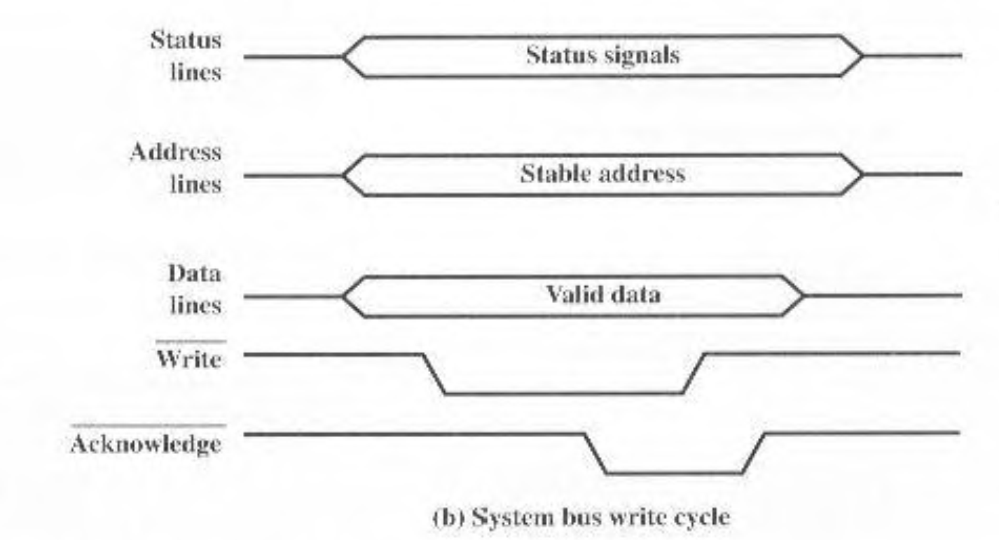
Timing of Asynchronous Bus Operations

Slide 18
Various Bus Protocols
Industry Standard Architecture – ISA (1982)
Extended Industry Standard Architecture – EISA
Vesa Local Bus – VL Bus
Peripheral Component Interconnect – PCI (Early 1990s)

Slide 19
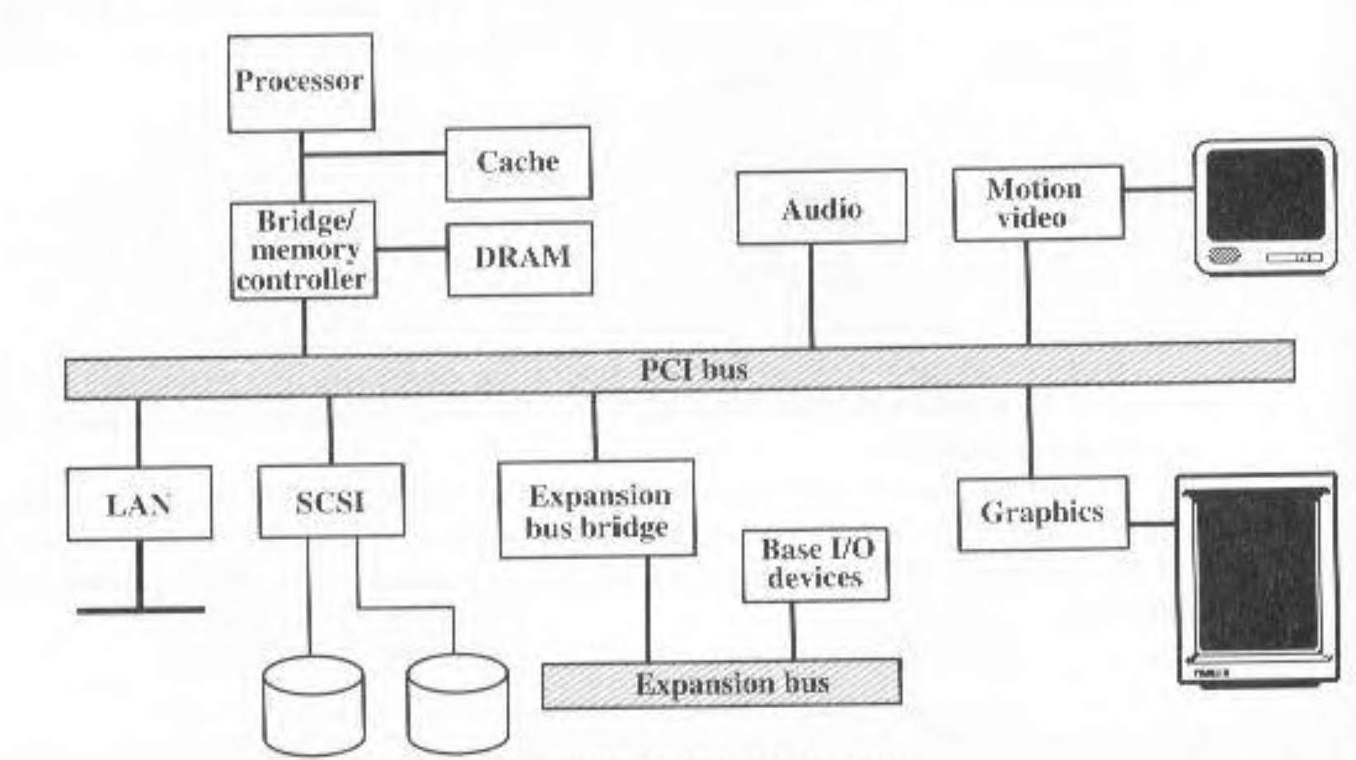
Typical Desktop System

