Slide 1
Computer systems Organization
ACK: Some of these slides are based on Stallings
Input/Output -- Spring 2010 -- IIIT-H -- Suresh Purini

Slide 2
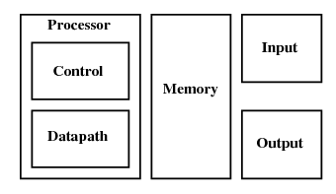
The Big Picture: Where are we now?
Input and Output

Slide 3
High level view of connections between various modules in a computer system
S
Y
S
T
E
M
B
U
S
Keyboard
Controller
Keyboard
Memory
Graphics
Controller
Monitor
CPU
Hard Disk
Controller
Hard Disk
Printer
Controller
Printer

Slide 4
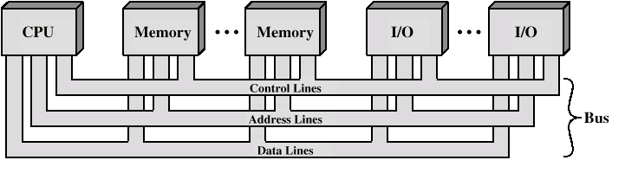
System Bus Consists of:
Address lines
Data lines
Control lines
Typical Control Lines:
Memory write
Memory read
I/O write
Bus grant
Interrupt request
Interrupt ACK
Clock
I/O read
Transfer ACK
Bus request

Slide 5
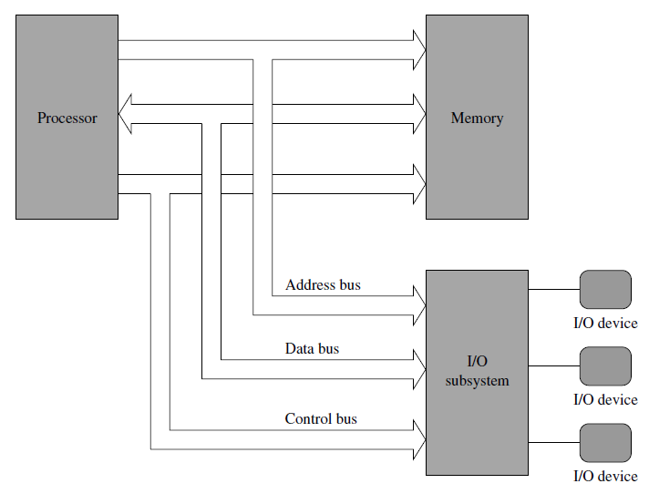
Basic Components of a Computer and their Interconnection

Slide 6
Input/Output Problems
Wide variety of peripherals
Delivering different amounts of data
At different speeds
In different formats
All slower than CPU and RAM
Need I/O modules (with their Device Drivers and the corresponding Operating System support)

Slide 7
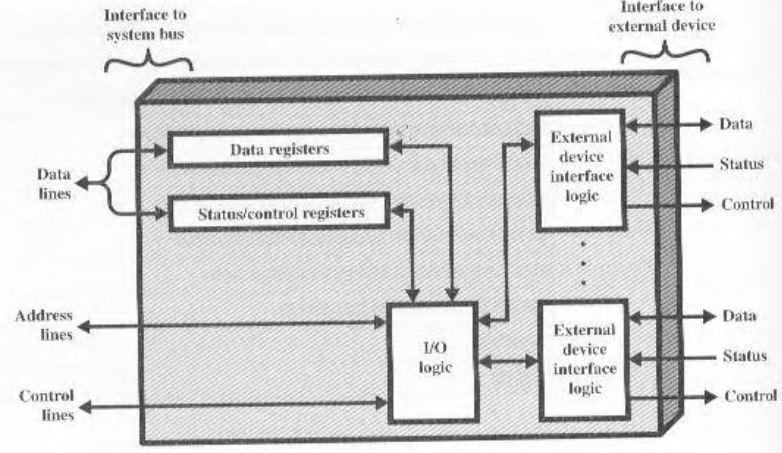
I/O Device Interface
Interface to CPU and Memory
Interface to one or more peripherals

Slide 8
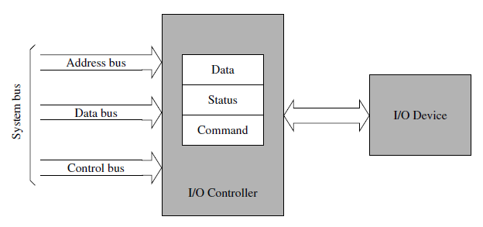
I/O Device Interface
Interface to CPU and Memory
Interface to one or more peripherals

Slide 9
I/O Module Functions
Control & Timing
CPU Communication
Device Communication
Data Buffering
Error Detection

Slide 10
I/O Steps
CPU checks I/O module device status
I/O module returns status
If ready, CPU requests data transfer
I/O module gets data from device
I/O module transfers data to CPU
Variations for output, DMA, etc.

Slide 11
I/O Decisions
Hide or reveal device properties to CPU
Support multiple or single device
Control device functions or leave for CPU

Slide 12
Input Output Techniques
Programmed I/O
Interrupt driven
Direct Memory Access (DMA)

Slide 13
Programmed I/O
CPU has direct control over I/O
Sensing status
Read/write commands
Transferring data
CPU waits for I/O module to complete operation
Wastes CPU time

Slide 14
Programmed I/O - detail
CPU requests I/O operation
I/O module performs operation
I/O module sets status bits
CPU checks status bits periodically
I/O module does not inform CPU directly
I/O module does not interrupt CPU
CPU may wait or come back later

Slide 15
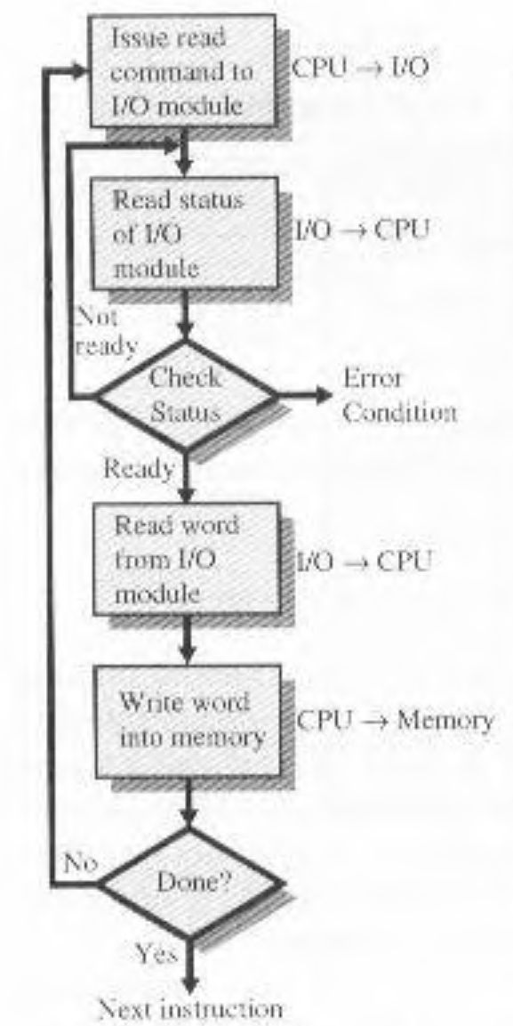
Programmed I/O

Slide 16
I/O Mapping
Memory mapped I/O
Devices and memory share an address space
I/O looks just like memory read/write
No special commands for I/O
Large selection of memory access commands available
Isolated I/O (I/O Mapped I/O)
Separate address spaces
Need I/O or memory select lines
Special commands for I/O
Limited set

Slide 17
Interrupt Driven I/O
Overcomes CPU waiting
No repeated CPU checking of device
I/O module interrupts when ready

Slide 18
Interrupt Driven I/O Basic Operation
CPU issues read command
I/O module gets data from peripheral whilst CPU does other work
I/O module interrupts CPU
CPU requests data
I/O module transfers data

Slide 19
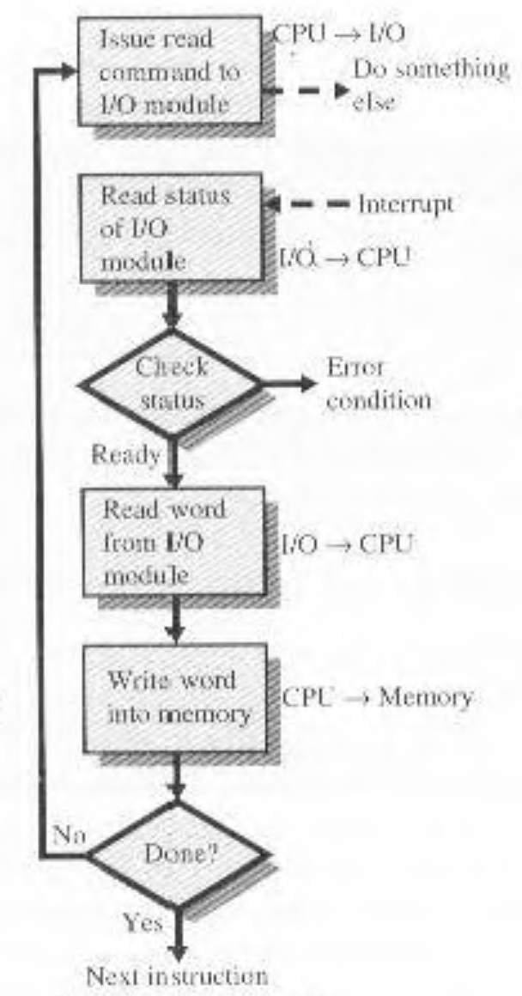
Interrupt Driven I/O

Slide 20
CPU Viewpoint
Issue read command
Do other work
Check for interrupt at end of each instruction cycle
If interrupted:-
Save context (registers)
Process interrupt
Fetch data & store

Slide 21
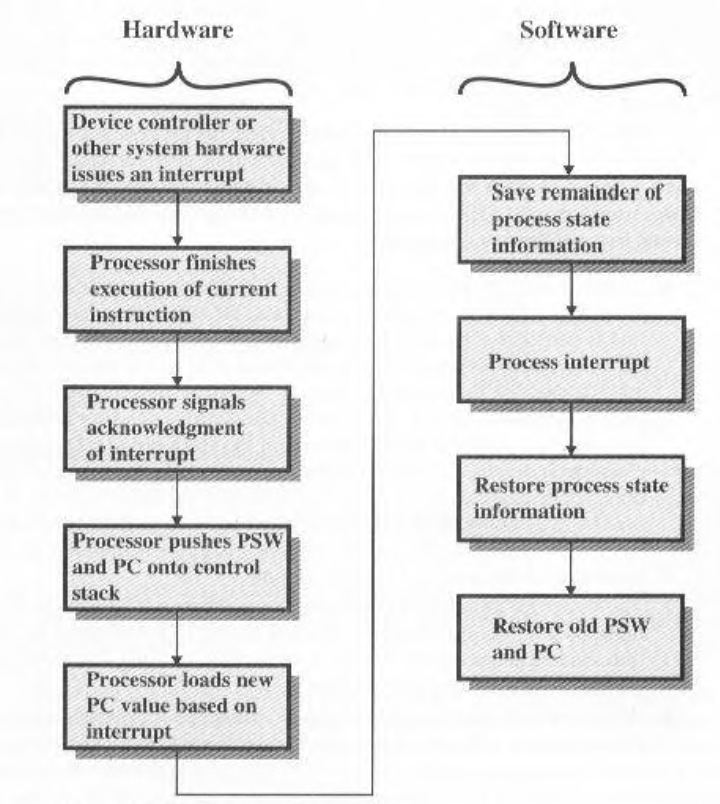
Interrupt Processing

Slide 22
Design Issues
How do you identify the module issuing the interrupt?
How do you deal with multiple interrupts?
i.e. an interrupt handler being interrupted

Slide 23
Identifying Interrupting Module
Different line for each module
PC
Limits number of devices
Software poll
CPU asks each module in turn
Slow

Slide 24
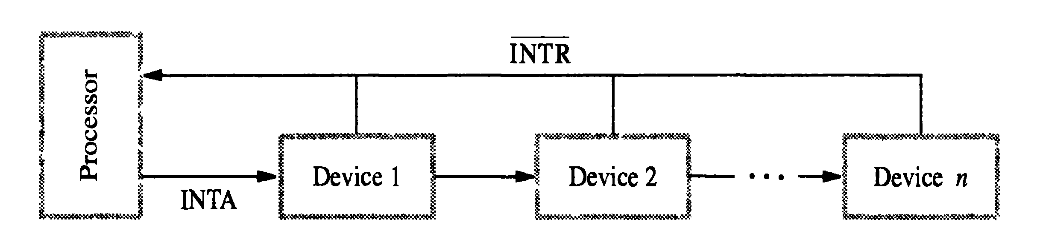
Identifying Interrupting Module
Daisy Chain or Hardware poll
Interrupt Acknowledge sent down a chain
Module responsible places vector on bus
CPU uses vector to identify handler routi
ne
Bus Master
Module must claim the bus before it can raise interrupt

Slide 25
Multiple Interrupts
Each interrupt line has a priority
Higher priority lines can interrupt lower priority lines
If bus mastering only current master can interrupt

Slide 26
Example
80x86 has one interrupt line
8086 based systems use one 8259A interrupt controller
8259A has 8 interrupt lines

Slide 27
Sequence of Events
8259A accepts interrupts
8259A determines priority
8259A signals 8086 (raises INTR line)
CPU Acknowledges
8259A puts correct vector on data bus
CPU processes interrupt

Slide 28
PC Interrupt Layout
8259A
8086
IRQ0
IRQ1
IRQ2
IRQ3
INTR
IRQ4
IRQ5
IRQ6
IRQ7

Slide 29
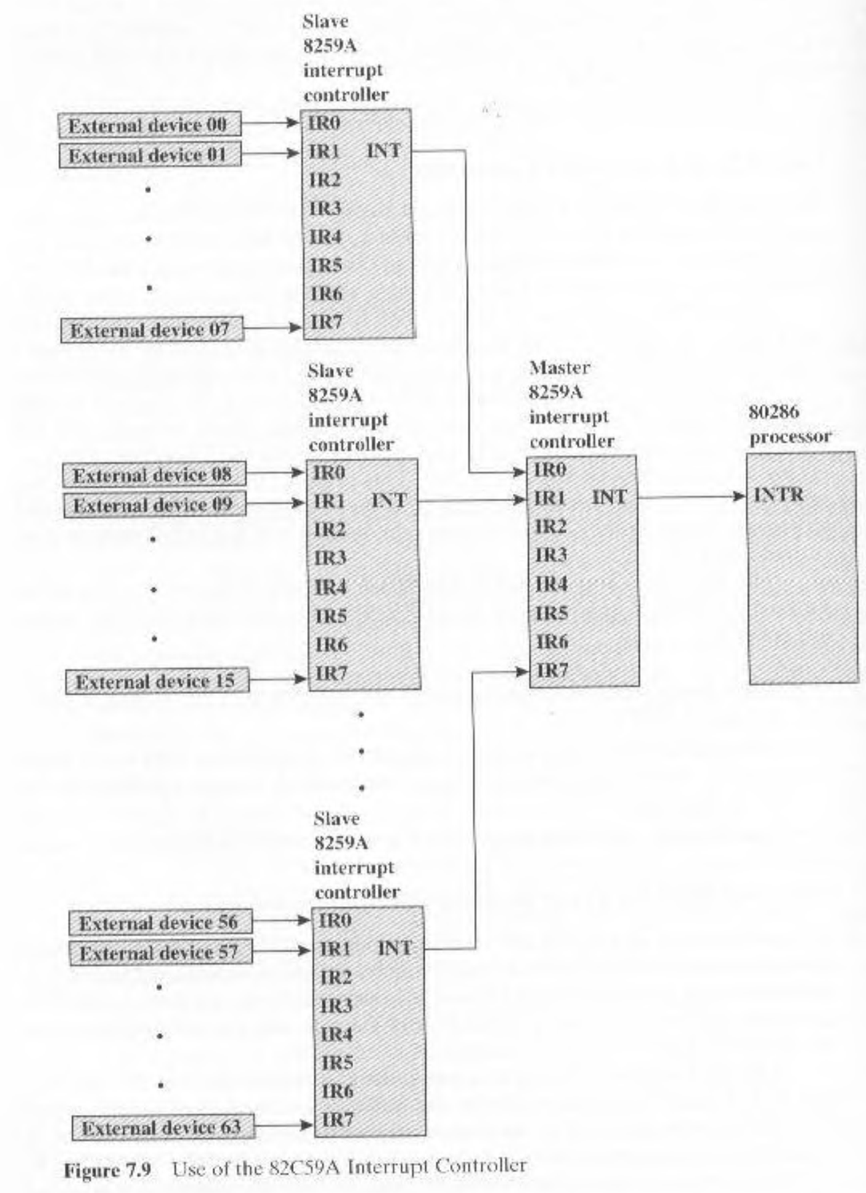

Slide 30
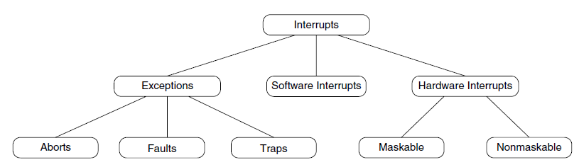
Taxonomy of Interrupts in Pentium
Software Interrupts are Synchronous Events whereas Hardware Interrupts are Asynchronous Events.

Slide 31
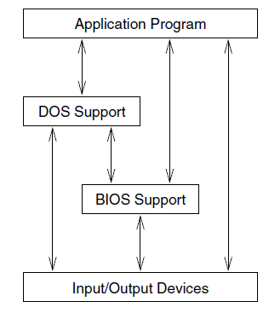
Interacting with I/O Devices: MS-Dos on an x86 Machine

Slide 32
Pentium Modes
Real Mode
Protected Mode

Slide 33
Pentium

Slide 34
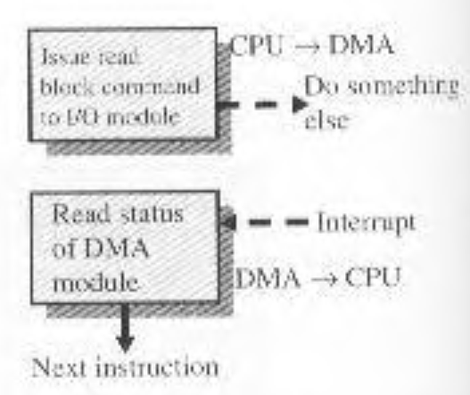
Direct Memory Access

Slide 35
I/O Techniques Summary
 | No Interrupts | Use of Interrupts
I/O-to-memory Transfer through Processor | Programmed I/O | Interrupt-driven I/O
Direct I/O-to-memory transfer |  | Direct Memory Access

