Slide 1
Another Variation
Consider the following setting.
Imagine creating a system for a billion records.
  Like the Unique ID project.
The system should enable search/insert/delete and other dictionary operations.
What kind of data structures should we use?
Data Structures Week 7

Slide 2
Another Variation
Imagine using the height balanced search trees, i.e. AVL trees.
For n = 10⁹ records, the AVL tree will have about 1.4 log₂ n ~ 40 levels.
Each record may take up to a KB of space.
However, the entire tree may not fit in the memory of a computer.
  Need secondary storage such as disk to hold the tree.
That is pretty reasonable. However, has a few problems.
Data Structures Week 7

Slide 3
Another Variation
However, has to understand the way the memory system interacts with the computer.
A typical memory system has at least two levels in the hierarchy.
  A main memory
  A cache
The reason for this is that main memory access times are much higher than the processor speeds.
  A cache can help reduce the memory latency.
Pages, a unit of memory, are moved back and forth.
Data Structures Week 7

Slide 4
Another Variation
Pages are brought into the cache sometimes on demand and sometimes prefetched.
Paging not good for pointer based data structures.
Data Structures Week 7

Slide 5
Another Variation
In a binary search tree, nodes may belong to various pages in memory.
Though the tree has only ~40 levels, the actual number of disk accesses may be high enough to slow down the process.
Let us see if we can modify the structure so as to reduce the number of disk accesses.
Data Structures Week 7

Slide 6
The B+ Tree
62
Instead of a binary tree, imagine a k-ary search tree.
The k subtrees of a node shall be k-ary trees so that the values in tree T_{i} are between T_{i-1} and T_{i+1}.
  Generalizes a binary search tree.
Data Structures Week 7

Slide 7
B+ Tree
Is that the best way to organize a k-ary tree?
The above translates to :
Does not help a cache as the references can be in different pages.
struct karynode
{
int data
struct karynode*[k];
};
Data Structures Week 7

Slide 8
B+ Tree
Another problem is that the definition allows for many of the children to be non-existent
So, may not fully benefit from a k-ary structure.
  Need rules to improve occupancy.
Data Structures Week 7

Slide 9
B+ Tree
p1
v1
p2
v2
v_{k-1}
p_{k}
Another way to organize a node is as shown.
Data Structures Week 7

Slide 10
Advantages
A disk access can bring in a node and up to k-1 values along with it.
Reduces the number of disk accesses.
Still, the same rules with respect to searchability.
Data Structures Week 7

Slide 11
B+ Tree Occupancy Conditions
The root of the tree is either a leaf node or has at least 2 children and at most M − 1 keys and M pointers.
Pointer i in any non-leaf node points to the smallest value in the i + 1st child of the node.
Each non-leaf node has at least ⌈M/2⌉ and at most M − 1 children.
Each leaf node contains at least ⌈L/2⌉ keys and at most L keys.
Data Structures Week 7

Slide 12
B+ Tree Occupancy Conditions
All leaf nodes are at the same level of the tree and are arranged in sorted order of keys.
All data items are stored at the leaf nodes.
Data Structures Week 7

Slide 13
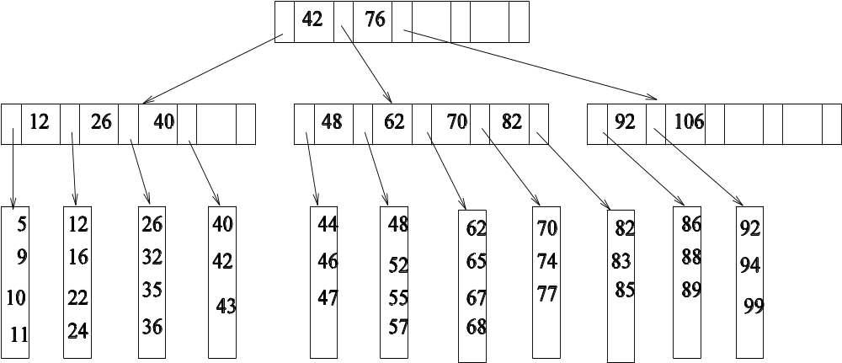
B+ Tree Example with M = L = 5
132
147
155
Data Structures Week 7

Slide 14
How to Choose M and L
For choosing L, notice that leaf nodes store only records.
The basic idea behind the present approach is to place lot of useful information in each disk page.
So, if each record is for R Bytes, and a page is of size P Bytes, then we require that each page has L = P/R records.
Similar considerations apply to choose M.
Data Structures Week 7

Slide 15
Choosing M
A page of P Bytes should contain one non-leaf node.
Each non-leaf node has at most M − 1 keys and M pointers.
If each pointer takes 4 B and each key takes about K bytes, then the total storage for a non-leaf node is K(M − 1) + 4M Bytes.
So, we should choose M so that K(M − 1) + 4M = P.
Data Structures Week 7

Slide 16
Operations on the B+ Tree
Search is by far the easiest.
Proceed as in a binary search tree with suitable modifications.
Data Structures Week 7

Slide 17
Insert in a B+ Tree
Apart from the search invariant, we need to maintain the occupancy invariants.
So, have to be careful when a node is already full and cannot accommodate a new item.
Consider when a leaf node is full, (L = 3).
25
29
35
insert x = 32
Data Structures Week 7

Slide 18
Insert in a B+ Tree
The idea is to “split” the leaf node into two.
Copy the old contents and the new item into two leaf nodes.
Add these as children on their parent.
Notice that each new leaf node has at least L/2 records.
25
29
32
35
insert x = 32
Data Structures Week 7

Slide 19
Insert in a B+ Tree
25
29
32
35
insert x = 32
The parent is also likely to be full.
So, split the parent too, redistribute the values.
Add them as two children to its parent.
  The new internal nodes shall satisfy the occupancy rules.
The above may continue till we reach the root.
Data Structures Week 7

Slide 20
Insert in B+ Tree
What if the root is also full?
Then split the root node itself.
The new root will have two children.
  Recall the occupancy rule with respect to the root.
Data Structures Week 7

Slide 21
Delete from B+ Tree
What could go wrong with respect to occupancy?
A leaf node may have less than L/2 records.
Then have to merge with other leaf nodes.
  Borrow records from other leaf nodes.
  Redistribute contents.
Can happen that an internal node may violate occupancy rules.
  Merge internal nodes.
Can continue till the root.
Data Structures Week 7

Slide 22
B+ Tree
Operations takes only O(log_{M} n) time and disk accesses.
Data Structures Week 7

