Slide 1
Probabilistic Robotics
Bayes Filter Implementations
Gaussian filters

Slide 2
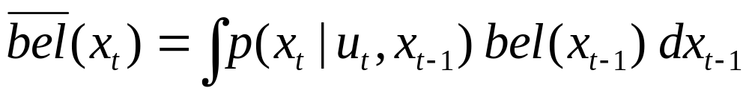
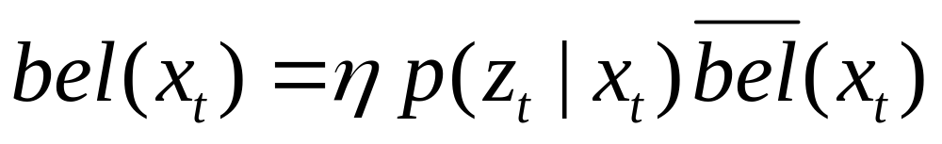
Bayes Filter Reminder
Prediction
Correction

Slide 3
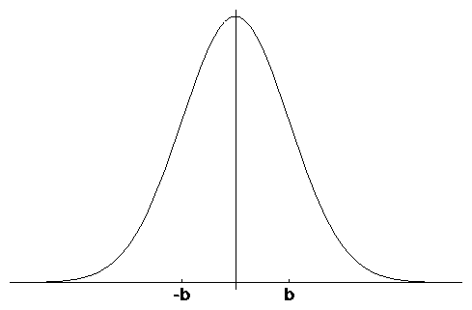
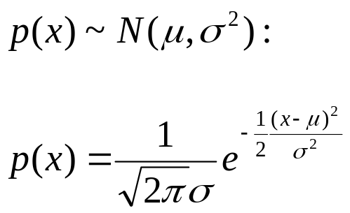
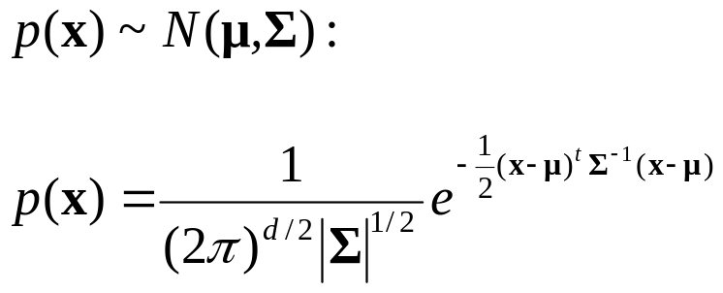
Gaussians
μ
Univariate
-σ
σ
μ
Multivariate

Slide 4
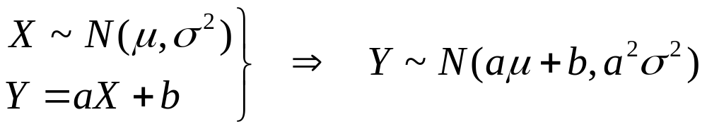
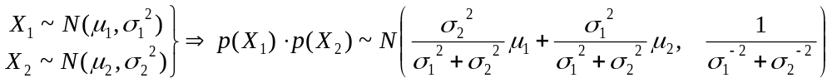
Properties of Gaussians

Slide 5
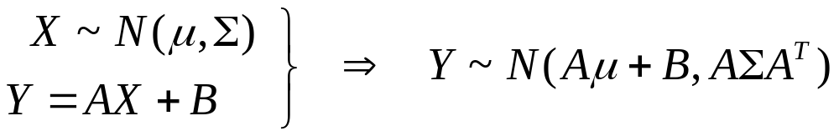
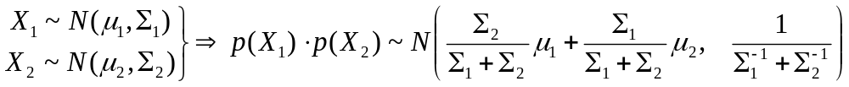
Multivariate Gaussians
We stay in the “Gaussian world” as long as we start with Gaussians and perform only linear transformations.

Slide 6
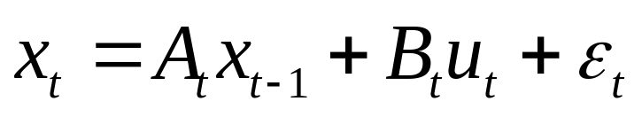
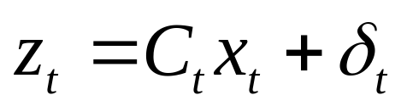
Discrete Kalman Filter
Estimates the state x of a discrete-time controlled process that is governed by the linear stochastic difference equation
with a measurement

Slide 7
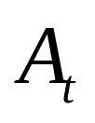
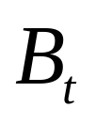
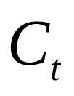


Components of a Kalman Filter
Matrix (nxn) that describes how the state evolves from t to t-1 without controls or noise.
Matrix (nxl) that describes how the control u_{t} changes the state from t to t-1.
Matrix (kxn) that describes how to map the state x_{t} to an observation z_{t}.
Random variables representing the process and measurement noise that are assumed to be independent and normally distributed with covariance R_{t} and Q_{t} respectively.

Slide 8
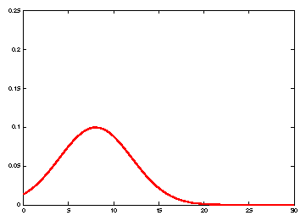
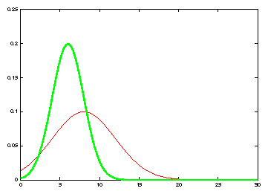
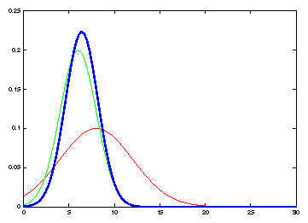
Kalman Filter Updates in 1D

Slide 9
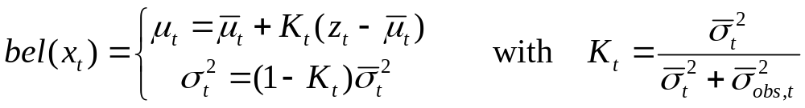
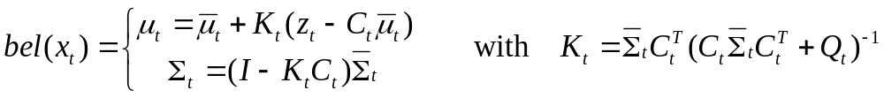
Kalman Filter Updates in 1D

Slide 10
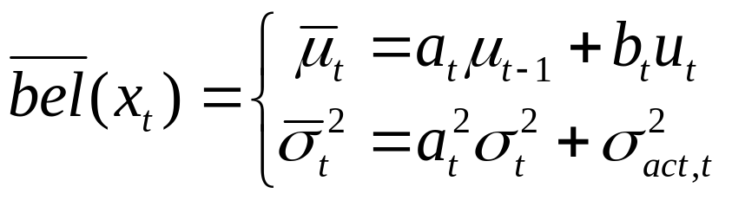
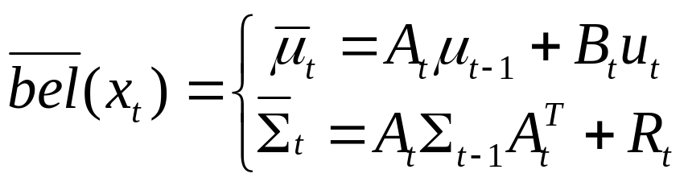
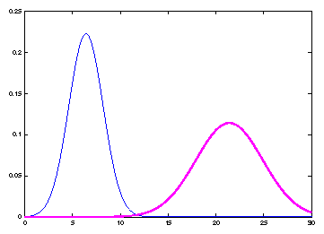
Kalman Filter Updates in 1D

Slide 11
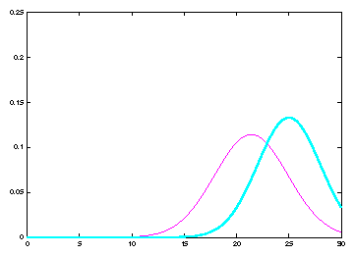
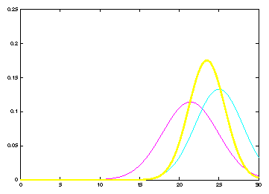
Kalman Filter Updates

Slide 12
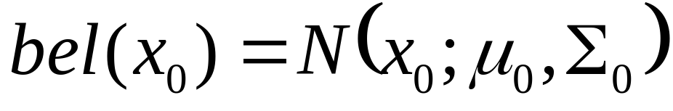
Linear Gaussian Systems: Initialization
Initial belief is normally distributed:

Slide 13
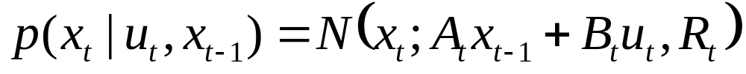
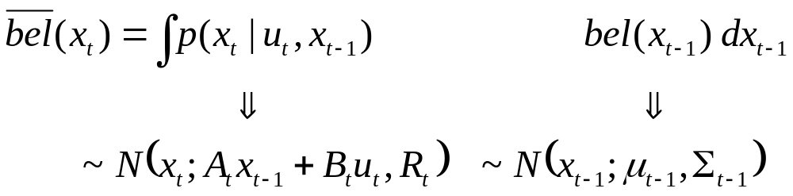
Linear Gaussian Systems: Dynamics
Dynamics are linear function of state and control plus additive noise:

Slide 14
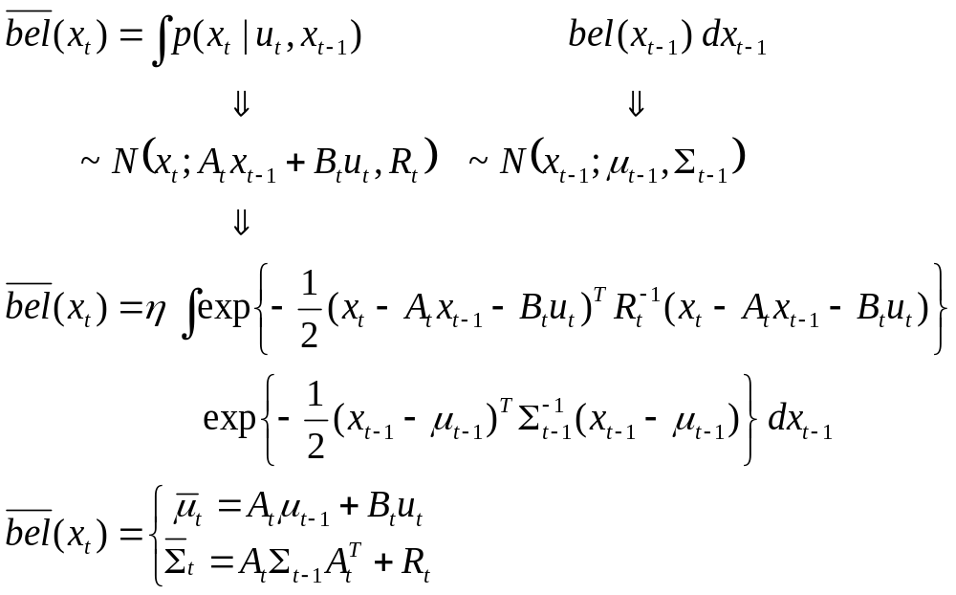
Linear Gaussian Systems: Dynamics
Notes:
This equation can be derived by just looking at the linear function of a Gaussian (ax+bu) and a convolution of two Gaussians

Slide 15
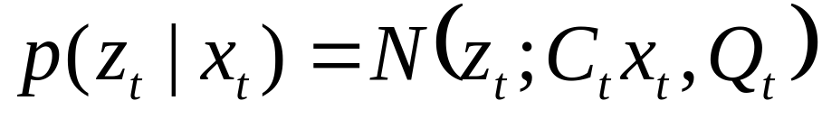
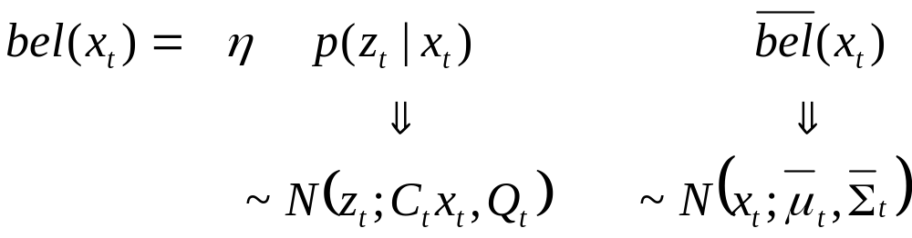
Linear Gaussian Systems: Observations
Observations are linear function of state plus additive noise:

Slide 16
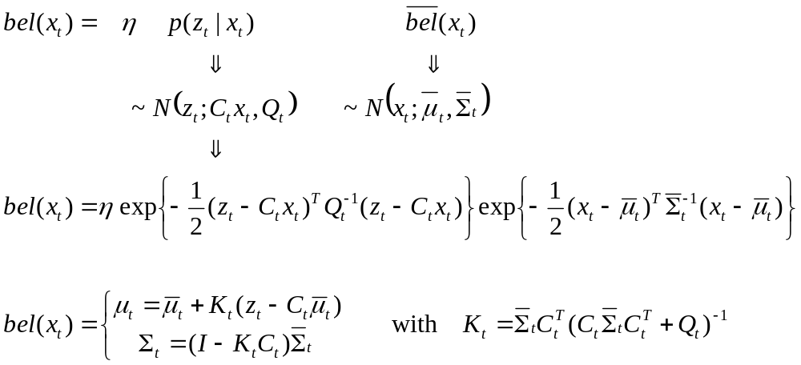
Linear Gaussian Systems: Observations
Notes:
Just the multiplication of two Gaussians (ignore c matrix to make it easier
To derive mean, multiply K = sigma / sigma * q into the equation, expand the left mean by sigma + q / sigma + q
To derive variance, same approach: expand left sigma with sigma + q / sigma + q

Slide 17
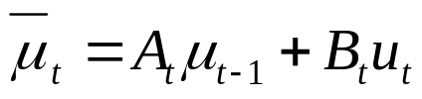
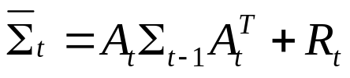
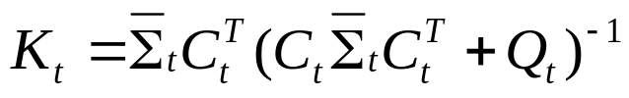
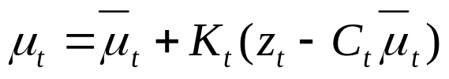
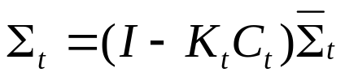
Kalman Filter Algorithm
Algorithm Kalman_filter( μ_{t-1}, Σ_{t-1}, u_{t}, z_{t}):
Prediction:
Correction:
Return μ_{t}, Σ_{t}

Slide 18
The Prediction-Correction-Cycle
Prediction

Slide 19


The Prediction-Correction-Cycle
Correction

Slide 20
The Prediction-Correction-Cycle
Prediction
Correction

Slide 21
Kalman Filter Summary
Highly efficient: Polynomial in measurement dimensionality k and state dimensionality n:
O(k^{2.376} + n²)
Optimal for linear Gaussian systems!
Most robotics systems are nonlinear!

Slide 22
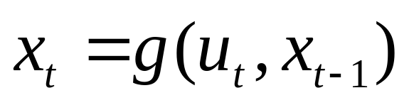
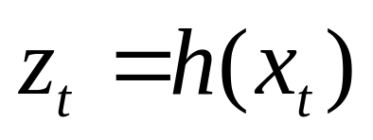
Nonlinear Dynamic Systems
Most realistic robotic problems involve nonlinear functions

Slide 23
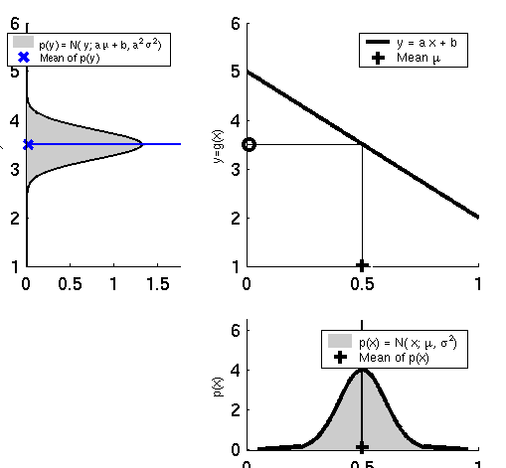
Linearity Assumption Revisited

Slide 24
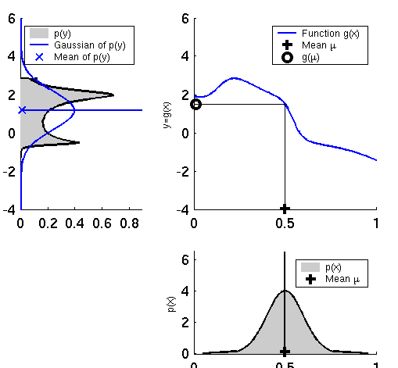
Non-linear Function

Slide 25
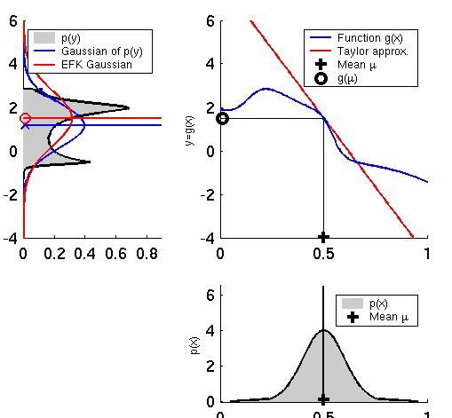
EKF Linearization (1)

Slide 26
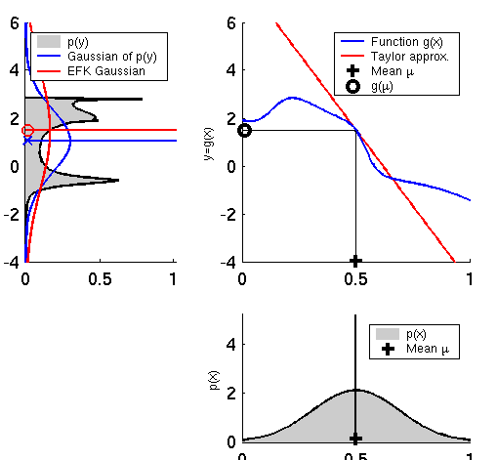
EKF Linearization (2)

Slide 27
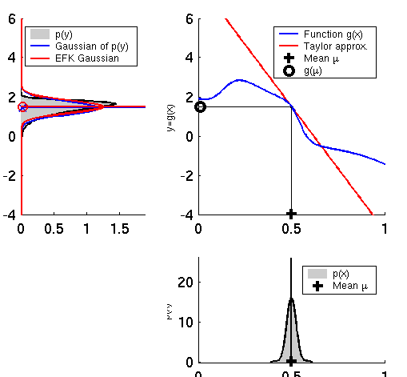
EKF Linearization (3)

Slide 28
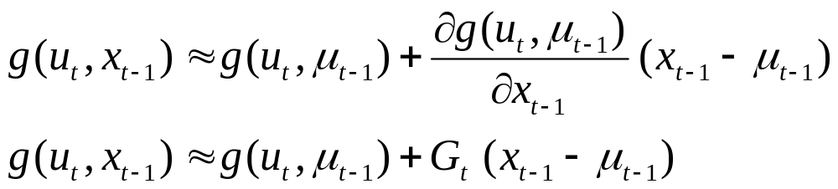
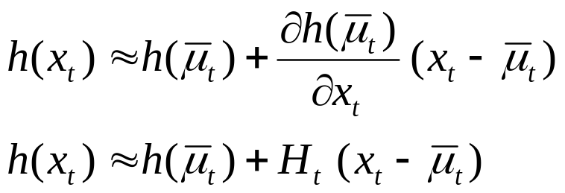
EKF Linearization: First Order Taylor Series Expansion
Prediction:
Correction:

Slide 29

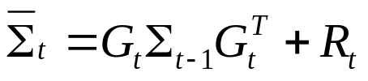
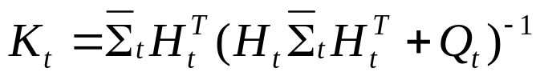

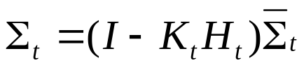
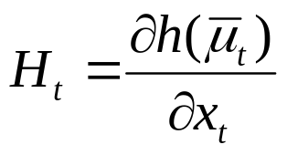
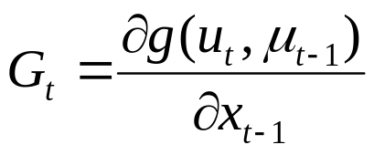
EKF Algorithm
Extended_Kalman_filter( μ_{t-1}, Σ_{t-1}, u_{t}, z_{t}):
Prediction:
Correction:
Return μ_{t}, Σ_{t}

Slide 30
Localization
“Using sensory information to locate the robot in its environment is the most fundamental problem to providing a mobile robot with autonomous capabilities.” [Cox ’91]
Given
  Map of the environment.
  Sequence of sensor measurements.
Wanted
  Estimate of the robot’s position.
Problem classes
  Position tracking
  Global localization
  Kidnapped robot problem (recovery)

Slide 31

Landmark-based Localization

Slide 32




EKF_localization ( μ_{t-1}, Σ_{t-1}, u_{t}, z_{t}, m):
Prediction:
Jacobian of g w.r.t location
Jacobian of g w.r.t control
Motion noise
Predicted mean
Predicted covariance

Slide 33







EKF_localization ( μ_{t-1}, Σ_{t-1}, u_{t}, z_{t}, m):
Correction:
Predicted measurement mean
Jacobian of h w.r.t location
Pred. measurement covariance
Kalman gain
Updated mean
Updated covariance

Slide 34




EKF Prediction Step

Slide 35




EKF Observation Prediction Step

Slide 36


EKF Correction Step

Slide 37


Estimation Sequence (1)

Slide 38


Estimation Sequence (2)

Slide 39

Comparison to GroundTruth

Slide 40
EKF Summary
Highly efficient: Polynomial in measurement dimensionality k and state dimensionality n:
O(k^{2.376} + n²)
Not optimal!
Can diverge if nonlinearities are large!
Works surprisingly well even when all assumptions are violated!

Slide 41


Linearization via Unscented Transform
EKF
UKF

Slide 42


UKF Sigma-Point Estimate (2)
EKF
UKF

Slide 43


UKF Sigma-Point Estimate (3)
EKF
UKF

Slide 44



Unscented Transform
Sigma points Weights
Pass sigma points through nonlinear function
Recover mean and covariance

Slide 45






UKF_localization ( μ_{t-1}, Σ_{t-1}, u_{t}, z_{t}, m):
Prediction:
Motion noise
Measurement noise
Augmented state mean
Augmented covariance
Sigma points
Prediction of sigma points
Predicted mean
Predicted covariance

Slide 46







UKF_localization ( μ_{t-1}, Σ_{t-1}, u_{t}, z_{t}, m):
Correction:
Measurement sigma points
Predicted measurement mean
Pred. measurement covariance
Cross-covariance
Kalman gain
Updated mean
Updated covariance

Slide 47
EKF_localization ( μ_{t-1}, Σ_{t-1}, u_{t}, z_{t}, m):
Correction:
Predicted measurement mean
Jacobian of h w.r.t location
Pred. measurement covariance
Kalman gain
Updated mean
Updated covariance
Notes:
Sigma – k h sigma = sigma – k s k

Slide 48




UKF Prediction Step

Slide 49




UKF Observation Prediction Step

Slide 50


UKF Correction Step

Slide 51
EKF Correction Step

Slide 52

Estimation Sequence
EKF PF UKF

Slide 53
Estimation Sequence
EKF UKF

Slide 54


Prediction Quality
EKF UKF

Slide 55
UKF Summary
Highly efficient: Same complexity as EKF, with a constant factor slower in typical practical applications
Better linearization than EKF: Accurate in first two terms of Taylor expansion (EKF only first term)
Derivative-free: No Jacobians needed
Still not optimal!

Slide 56

Kalman Filter-based System
[Arras et al. 98]:
  Laser range-finder and vision
  High precision (<1cm accuracy)
[Courtesy of Kai Arras]

Slide 57




Multi- hypothesis
Tracking

Slide 58
Localization With MHT
Belief is represented by multiple hypotheses
Each hypothesis is tracked by a Kalman filter
Additional problems:
  Data association: Which observation corresponds to which hypothesis?
  Hypothesis management: When to add / delete hypotheses?
Huge body of literature on target tracking, motion correspondence etc.

Slide 59



MHT: Implemented System (1)
Hypotheses are extracted from LRF scans
Each hypothesis has probability of being the correct one:
Hypothesis probability is computed using Bayes’ rule
Hypotheses with low probability are deleted.
New candidates are extracted from LRF scans.
[Jensfelt et al. ’00]

Slide 60


MHT: Implemented System (2)
Courtesy of P. Jensfelt and S. Kristensen

Slide 61


MHT: Implemented System (3)
Example run
# hypotheses
P(H_{best})
Map and trajectory
#hypotheses vs. time
Courtesy of P. Jensfelt and S. Kristensen

