Slide 1
Quantum Information And Computing
Quantum Entropy

Slide 2
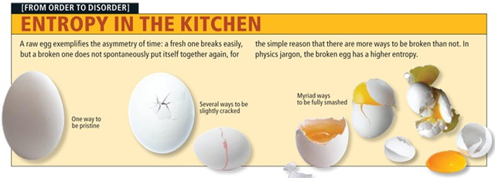

Slide 3
Thermodynamic
ds = dq/T
Statistical
degrees of
freedom
Information
H = -∑ pi log(pi)

Slide 4
Shannon Encoding Theorem
Shannon Entropy | Data Compression Encoding bits Degress of Freedom

Slide 5

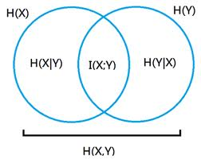
Concavity:
f(px + (1 − p)y) ≥ pf(x) + (1 − p)f(y).
Relativity:
Conditional entropy:
H(x || y ) ≥ 0
H(x/y) = H(x,y) – H(y)
Mutual Entropy:
H(x:y) = H(x) – H(x/y)

Slide 6

Quantum Entropy:
Density Operators
ρ ≡ ∑ pi |ψi˃ <ψi|
Pure state
Mixed state – Ensemble
Trace

Slide 7
S(ρ) = -tr(ρ log ρ)
S(ρ) = -∑ λ log λ
Conditional Entropy
Mutual Entropy
S(B/A) < 0 ?
Purification?

Slide 8
Schmidt Decomposition!!
Sub-Additive:
Triangle Law:
Concavity:

