Slide 2
Prediction of impact on GDP and Unemployment due to Covid-19
Presented by
Jashwanth Reddy Baggari - jbaggari@kent.edu
Nikhil Velakurthy- nvelakur@kent.edu
Jyothi Vasamsetty- jvasamse@kent.edu

Slide 3
Introduction
Forecasting has been one of the most successful statistical methods for detecting and analyzing patterns and predicting future events, allowing for early and mitigating action.
To determine the unemployment rate across the globe, due to COVID-19 pandemic.
We evaluate the spread under the economy’s effect using machine learning algorithms with linear regression models.

Slide 4
Milestone
Data collection
Data cleaning and integrating the libraries in Jupiter notebook.
Implementing Machine learning algorithms.
Training the algorithms with dataset.
Results.

Slide 5
Potential Customers
Policymakers, economists, business leaders, and researchers who are interested in understanding the economic effects of the pandemic.
End Users
Researchers may use these predictions to study the impact of COVID-19 on the economy and to develop new economic models and theories.

Slide 6
Dataset:
We have collected our dataset from the Kaggle source“Impact of Covid-19 Pandemic on the global economy”.
https://www.kaggle.com/code/sathianpong/covid19-economic-effect-on-unemployment

Slide 7
Literature Review
Kumari, Rajani, Sandeep Kumar, Ramesh Chandra Poonia, Vijander Singh, Linesh Raja, Vaibhav Bhatnagar, and Pankaj Agarwal. "Analysis and predictions of spread, recovery, and death caused by COVID-19 in India." Big Data Mining and Analytics 4, no. 2 (2021): 65-75.
Mohan, S., Abugabah, A., Kumar Singh, S., Kashif Bashir, A. and Sanzogni, L., 2022. An approach to forecast impact of Covid‐19 using supervised machine learning model. Software: Practice and Experience, 52(4), pp.824-840.

Slide 8
Project Background

Slide 9
Tools
Python
Jupyter Notebook
Seaborn
Numpy
Matplotlib
Aws SageMaker
Excel

Slide 10
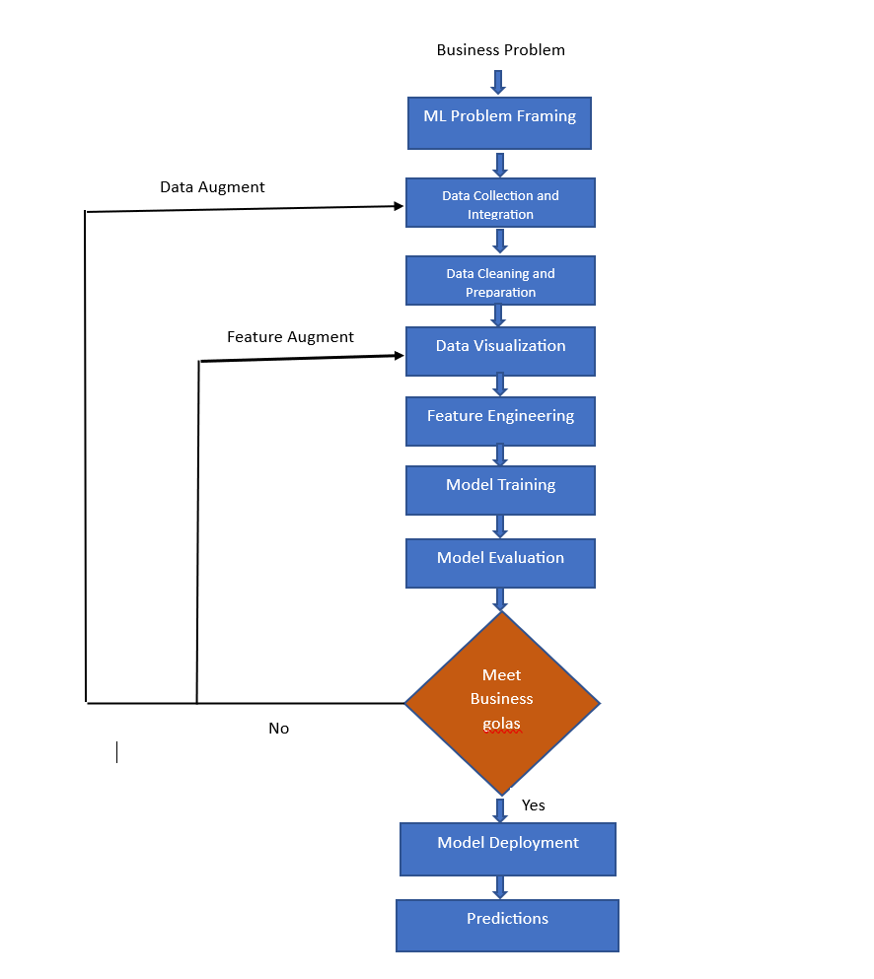
Flow Chart

Slide 11
Machine Learning Algorithms
Linear Regression:
The link between two or more variables can be modeled using this straightforward but efficient algorithm. It might be applied to forecast how Covid-19 cases and associated policy actions will affect GDP and unemployment rates.
Random Forest:
An ensemble technique mixes different decision trees to increase the precision of predictions. By considering a number of variables associated to Covid-19 instances and relevant policy actions, it could be utilized to produce projections of GDP and unemployment rates that are more accurate.

Slide 12
XGBoost :
A class of group machine learning methods known as gradient boosting can be applied to classification or regression predictive modeling issues. Decision tree models are used to build clusters. In order to repair the prediction mistakes caused by earlier models, trees are added one at a time to the ensemble and fitted. Boosting is a term used to describe this kind of batch machine learning model.
Decision Tree :
A decision tree creates tree-like models for classification or regression. It incrementally develops an associated decision tree while segmenting a dataset into smaller and smaller sections. The outcome is a tree containing leaf nodes and decision nodes.
Support Vector Machines (SVM) :
By identifying the ideal decision border between data points, this approach can be applied to both classification and regression issues. It might be used to find the model that fits the data the best and forecasts how Covid-19 would affect GDP and unemployment rates

Slide 13
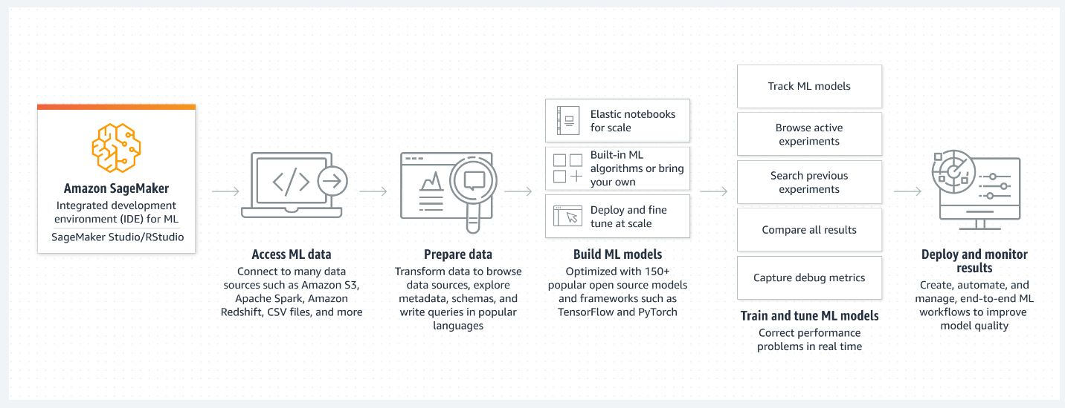
Cloud Deployment

Slide 14
THANK YOU

