Slide 2
Prediction of impact on GDP and Unemployment due to Covid-19
Presented by - Team 8
Jashwanth Reddy Baggari - jbaggari@kent.edu
Nikhil Velakurthy- nvelakur@kent.edu
Jyothi Vasamsetty- jvasamse@kent.edu

Slide 3
Overview
Introduction
Potential Customers & End Users
Tools Utilized
Literature Review
Data Cleaning
Data Analysis
Methods Implemented
Results

Slide 4
MILESTONE 1

Slide 5
Introduction
Forecasting has been one of the most successful statistical methods for detecting and analyzing patterns and predicting future events, allowing for early and mitigating action.
To determine the GDP across the globe, due to COVID-19 pandemic.
We evaluate the spread under the economy’s effect using machine learning algorithms.

Slide 6
Potential Customers
Policymakers, economists, business leaders, and researchers who are interested in understanding the economic effects of the pandemic.
End Users
Researchers may use these predictions to study the impact of COVID-19 on the economy and to develop new economic models and theories.

Slide 7
Tools and Libraries
Python
Jupyter Notebook
Numpy
Seaborn
Matplotlib
Sklearn
plotly
Excel

Slide 8
Literature Review
Kumari, Rajani, Sandeep Kumar, Ramesh Chandra Poonia, Vijander Singh, Linesh Raja, Vaibhav Bhatnagar, and Pankaj Agarwal. "Analysis and predictions of spread, recovery, and death caused by COVID-19 in India." Big Data Mining and Analytics 4, no. 2 (2021): 65-75.
Mohan, S., Abugabah, A., Kumar Singh, S., Kashif Bashir, A. and Sanzogni, L., 2022. An approach to forecast impact of Covid‐19 using supervised machine learning model. Software: Practice and Experience, 52(4), pp.824-840.

Slide 9
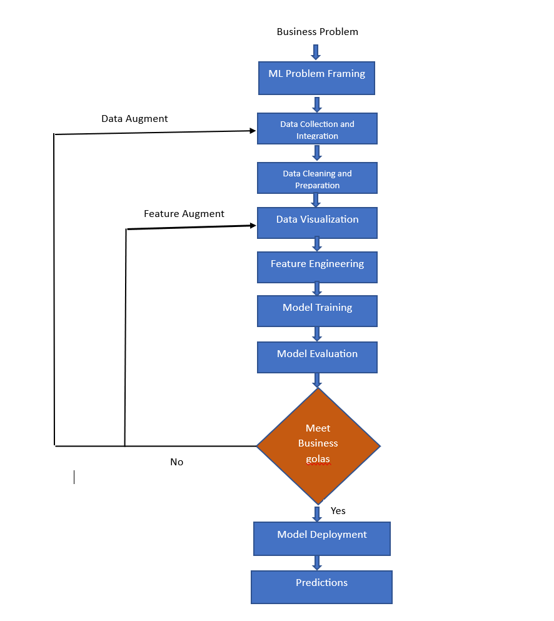
Flow Chart

Slide 10
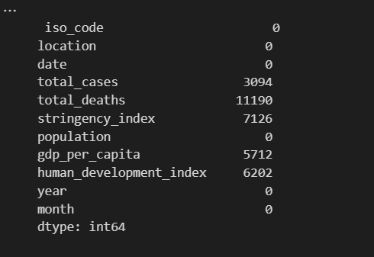
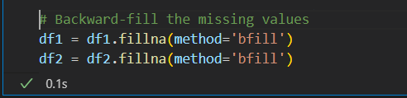
Data cleaning
As per the analysis most of the missing values are in total cases and in total deaths columns
With the help of time series analysis, we found that the deaths are almost similar to the previous day deaths , so we have used backward fill method to fill all the missing values

Slide 11
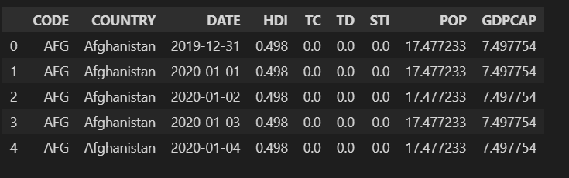
DATA SET
Source: Kaggle website
https://www.kaggle.com/code/sathianpong/covid19-economic-effect-on-unemployment
Datasets:
Training Dataset
— 40334 samples of data (80%)
— 8 unique features
Test Dataset
— 10083 samples (20%)
— 8 unique features

Slide 12
Data Features
ISO_CODE: Country code in short form.
Location: Country name.
Date: The date on which the total deaths and other values are recorded.
Total_cases: Number of cases recorded.
Total_deaths: Number of deaths recorded.

Slide 13
stringency_index : The stringency index is a composite metric based on nine reaction indicators, such as closures of schools, businesses, and airports, and is rescaled to a number between 0 and 100.
population : The country population on that day
gdp_per_capita : The GDP of that country.
human_development_index : The Human Development Index ranks nations into four levels of human development based on statistics related to life expectancy, education, and per capita income.

Slide 14
MILESTONE 2

Slide 15
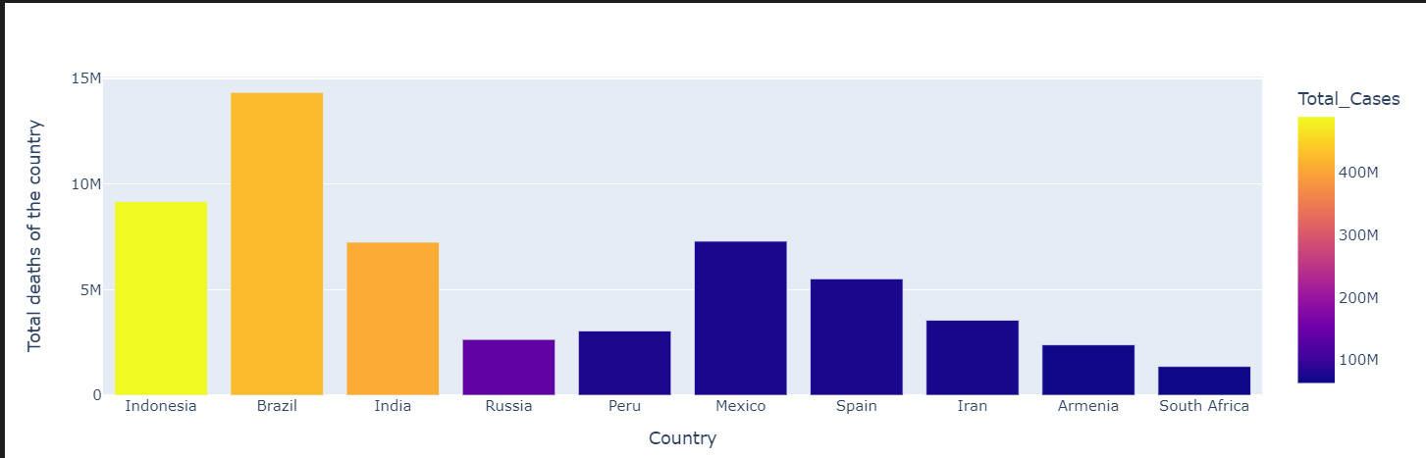
Data Analysis
Country and the deaths reported

Slide 16
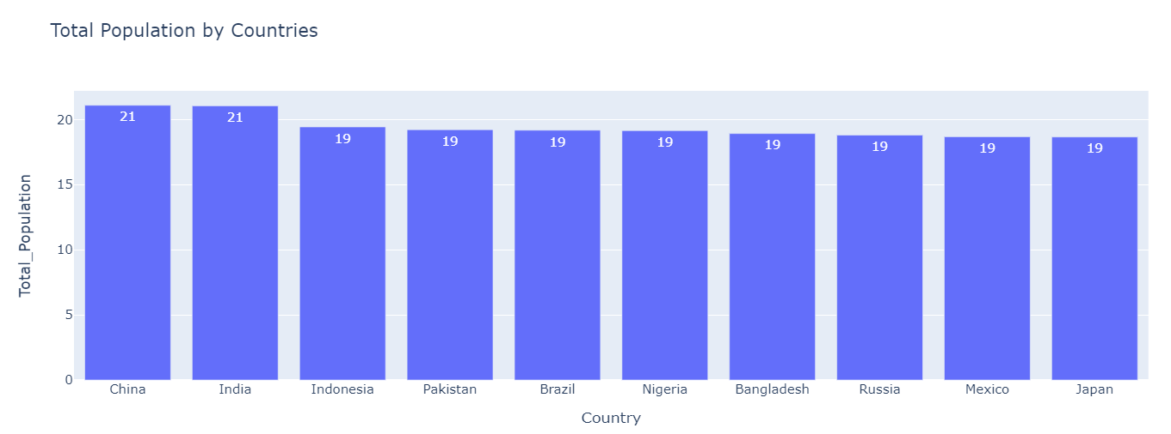
Country and its population

Slide 17
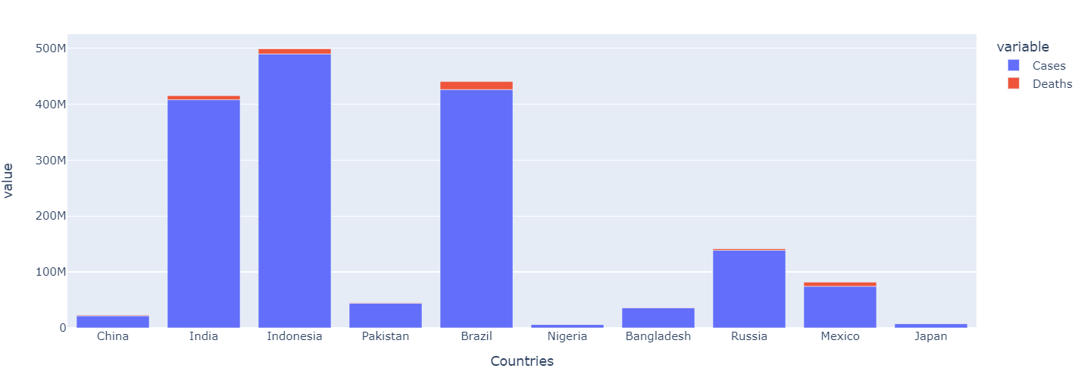
Country and its cases reported and deaths

Slide 18
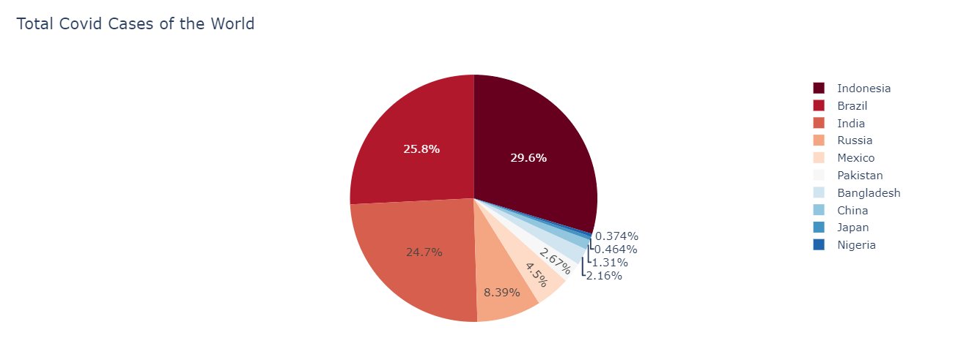
Country and its cases reported

Slide 19
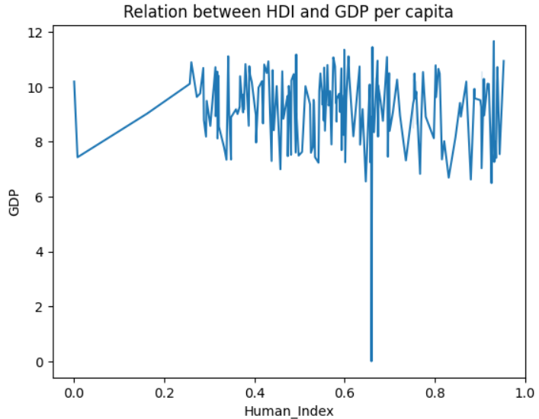
Human Index vs GDP(Gross Domestic Product)

Slide 20
Milestone 3

Slide 21
Data modeling
A good prediction is one that is accurate in the sense that it predicts the right thing for most or all instances.
One common goal of machine learning is to automate some aspects of data analysis.
it is the process of creating a visual representation of either a whole information system or parts of it to communicate connections between data points and structures.

Slide 22
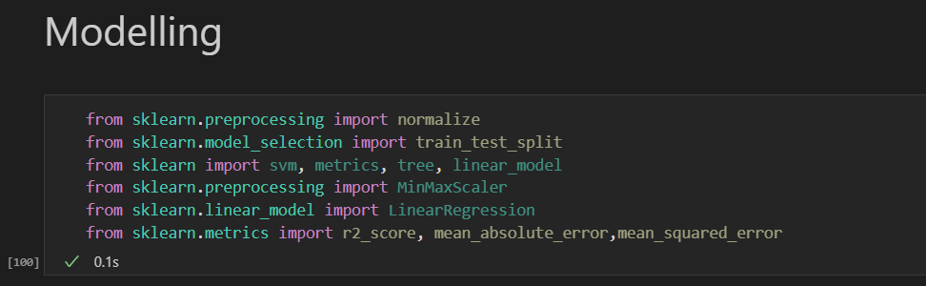
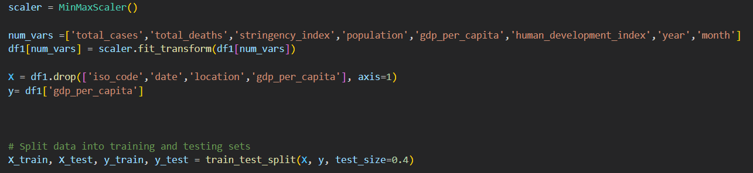

Slide 23
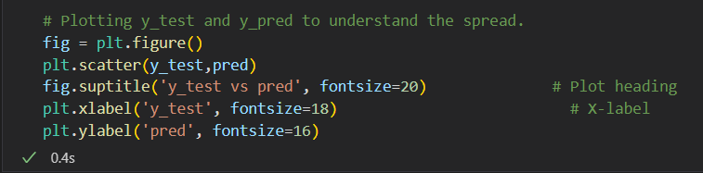
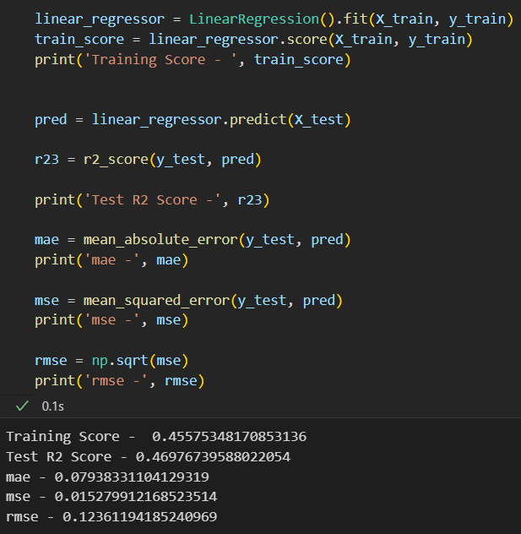
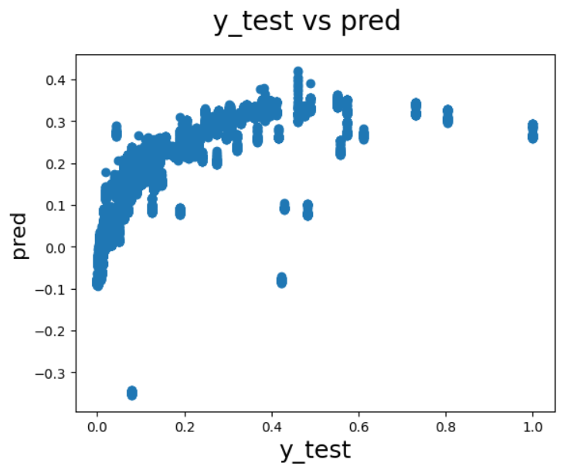
Linear Regressor

Slide 24
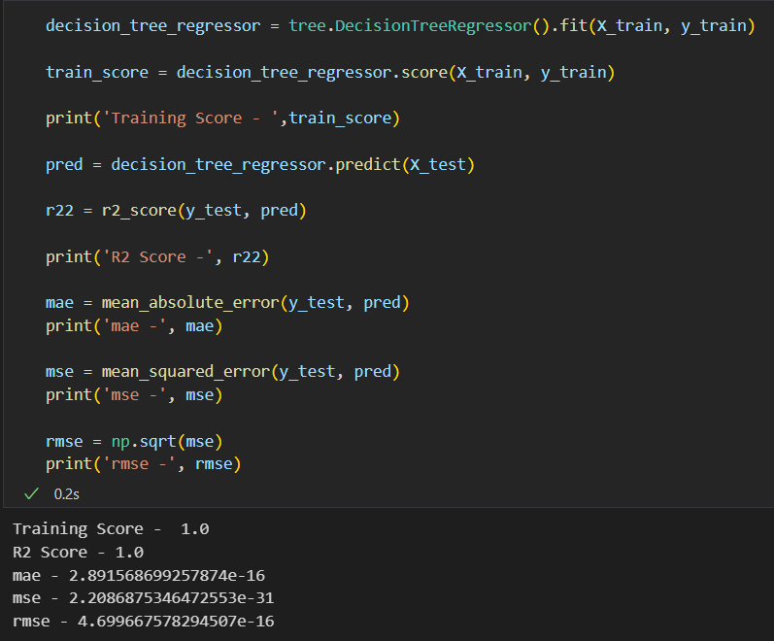
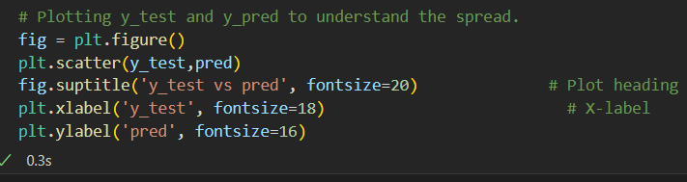
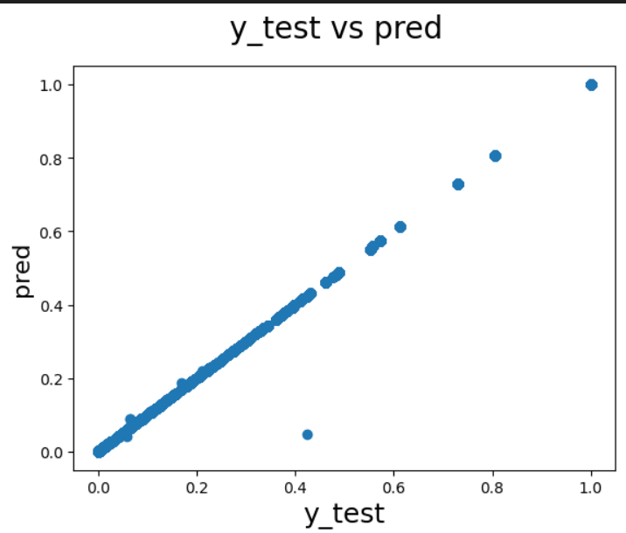
Decision Tree regressor

Slide 25
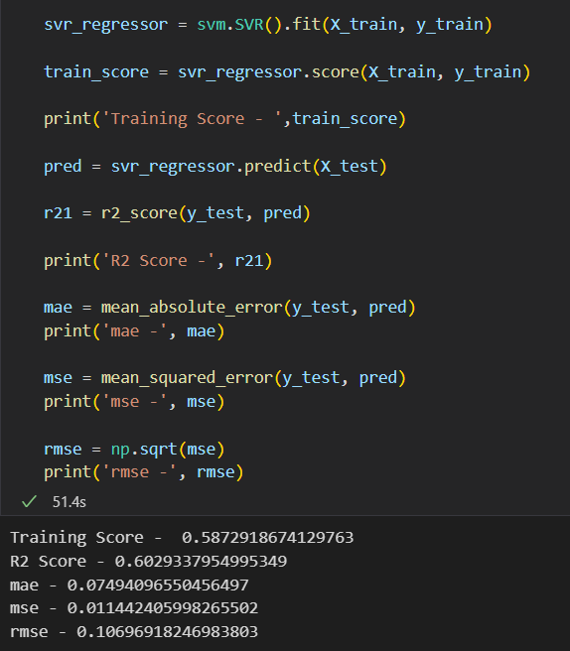
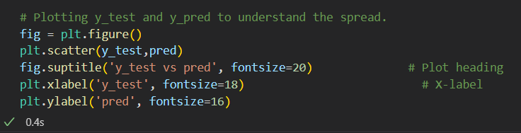
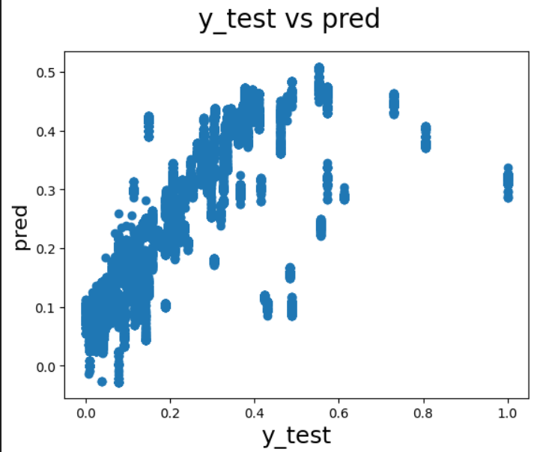
SVM

Slide 26
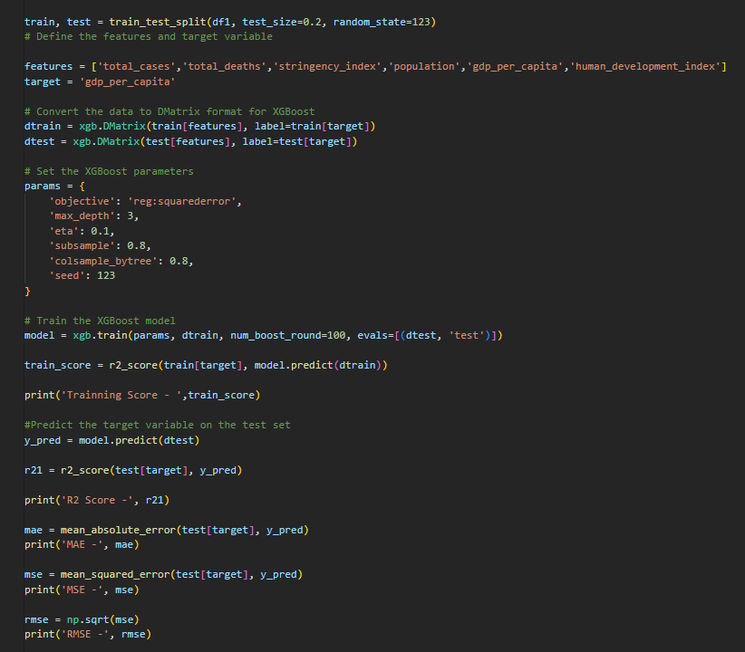
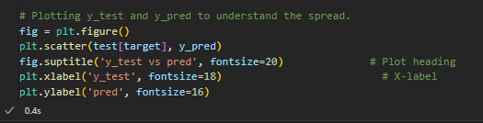
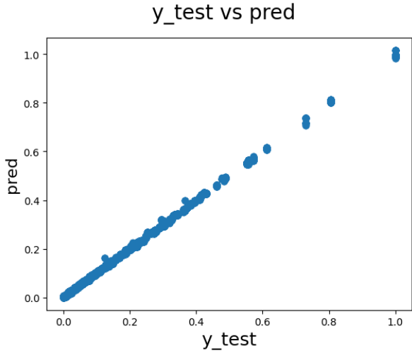
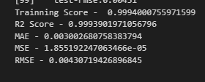
XG Boost

Slide 27
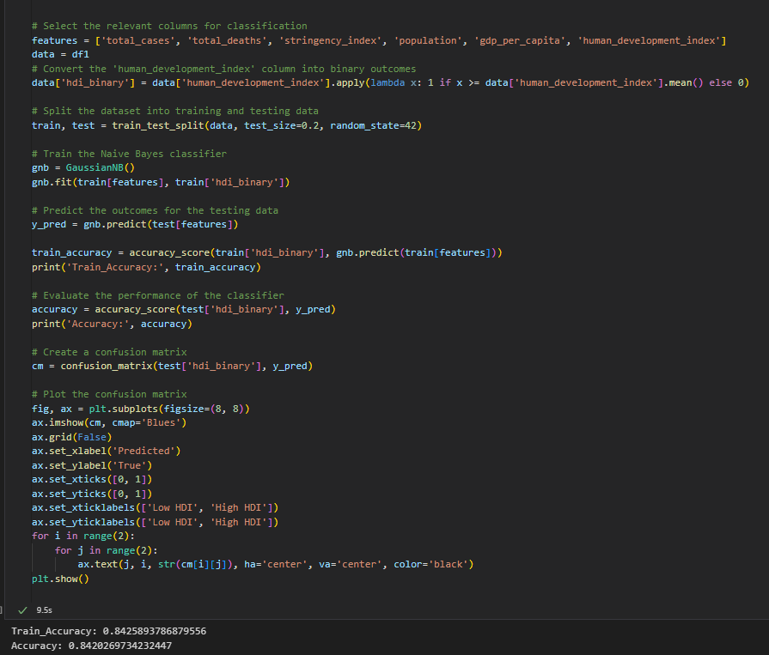
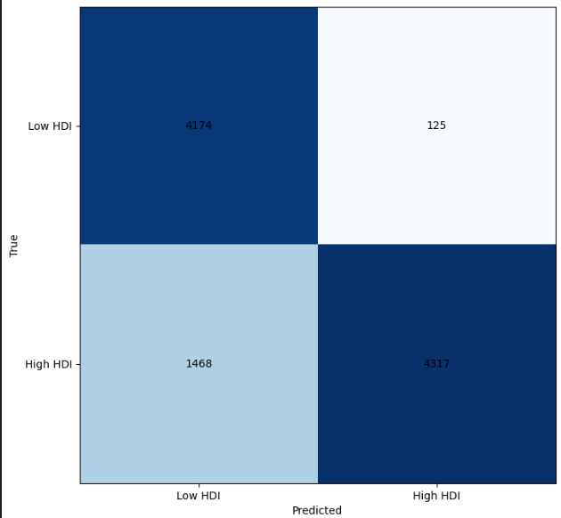
Naive Bayes classifier

Slide 28
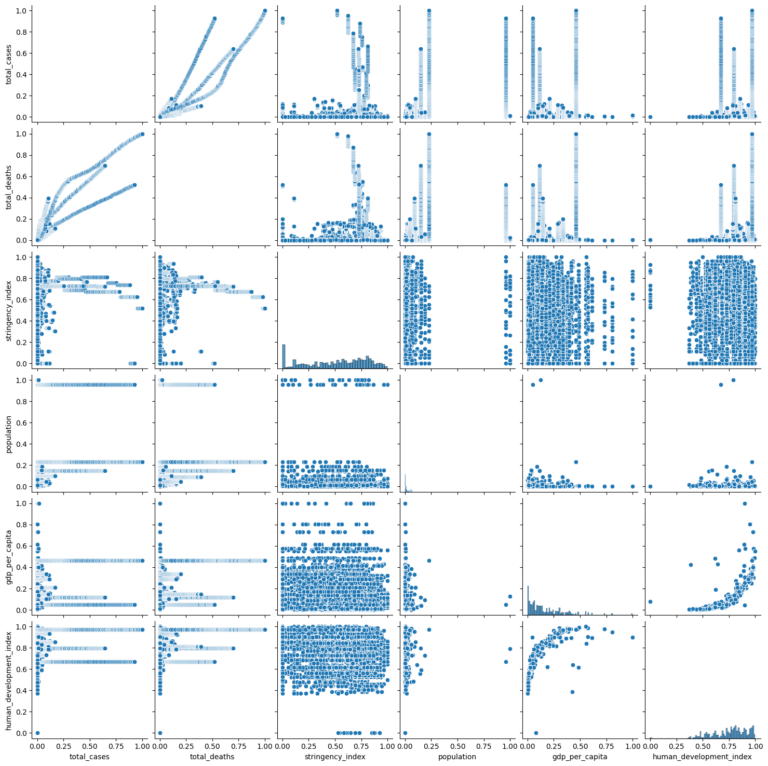
Correlation coefficients

Slide 29
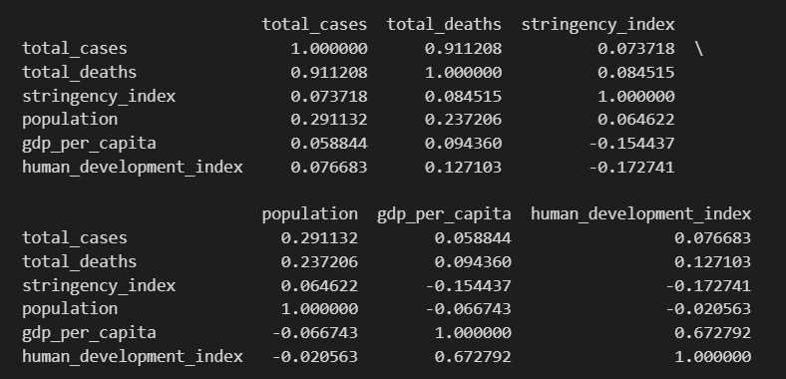
Correlation Matrix

Slide 30
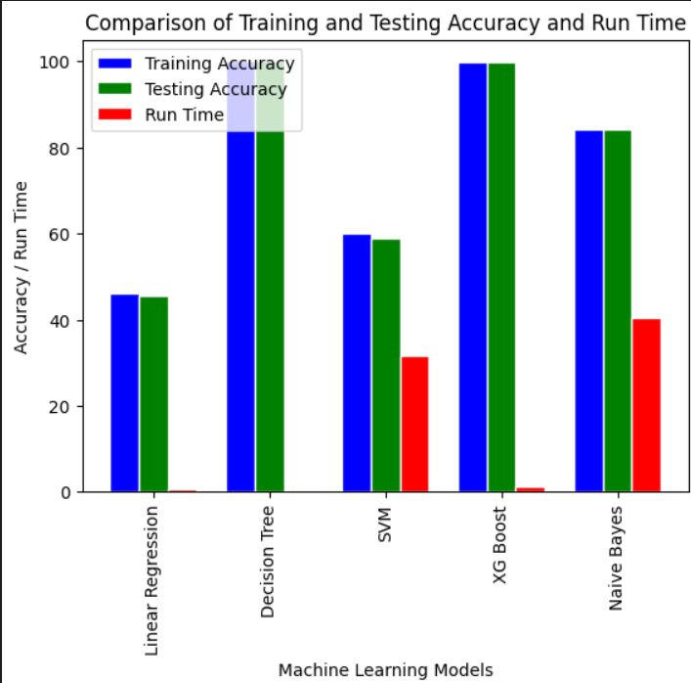
Comparison of Training and Testing Accuracy and Run Time

Slide 31
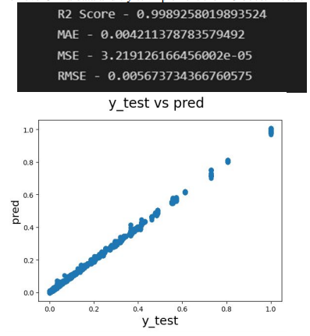
XGBoost without China Data
China Covid data is not that accurate so we are trying to remove China data and try to implement the XG boost model

Slide 32
THANK YOU

