Slide 2
Prediction of impact on GDP and Unemployment due to Covid-19
Presented by
Jashwanth Reddy Baggari - jbaggari@kent.edu
Nikhil Velakurthy- nvelakur@kent.edu
Jyothi Vasamsetty- jvasamse@kent.edu

Slide 3
Introduction
Forecasting has been one of the most successful statistical methods for detecting and analyzing patterns and predicting future events, allowing for early and mitigating action.
To determine the unemployment rate across the globe, due to COVID-19 pandemic.
We evaluate the spread under the economy’s effect using machine learning algorithms with linear regression models.

Slide 4
Milestone
Data collection
Data cleaning and integrating the libraries in Jupiter notebook.
Implementing Machine learning algorithms.
Training the algorithms with dataset.
Results.

Slide 5
Potential Customers
Policymakers, economists, business leaders, and researchers who are interested in understanding the economic effects of the pandemic.
End Users
Researchers may use these predictions to study the impact of COVID-19 on the economy and to develop new economic models and theories.

Slide 6
Dataset:
We have collected our dataset from the Kaggle source“Impact of Covid-19 Pandemic on the global economy”.
https://www.kaggle.com/code/sathianpong/covid19-economic-effect-on-unemployment

Slide 7
Literature Review
Kumari, Rajani, Sandeep Kumar, Ramesh Chandra Poonia, Vijander Singh, Linesh Raja, Vaibhav Bhatnagar, and Pankaj Agarwal. "Analysis and predictions of spread, recovery, and death caused by COVID-19 in India." Big Data Mining and Analytics 4, no. 2 (2021): 65-75.
Mohan, S., Abugabah, A., Kumar Singh, S., Kashif Bashir, A. and Sanzogni, L., 2022. An approach to forecast impact of Covid‐19 using supervised machine learning model. Software: Practice and Experience, 52(4), pp.824-840.

Slide 8
Project Background
Tools
Python
Jupyter Notebook
Seaborn
Numpy
Matplotlib
Aws SageMaker
Excel

Slide 9
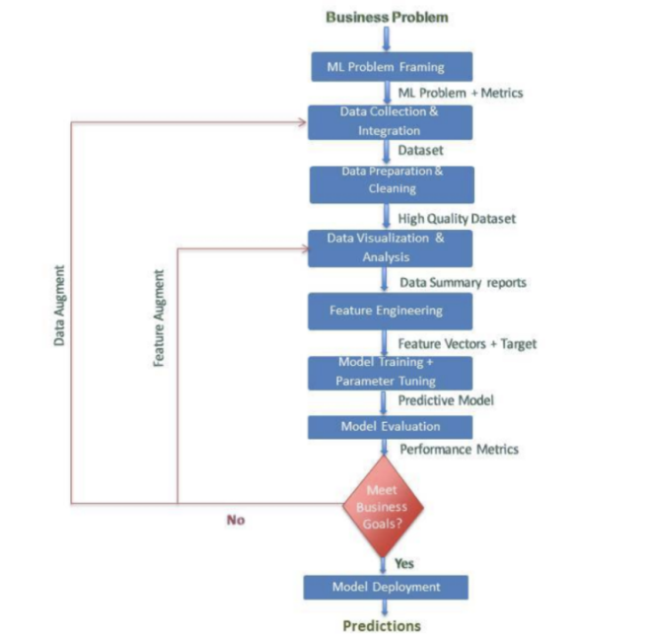
Flow

Slide 10
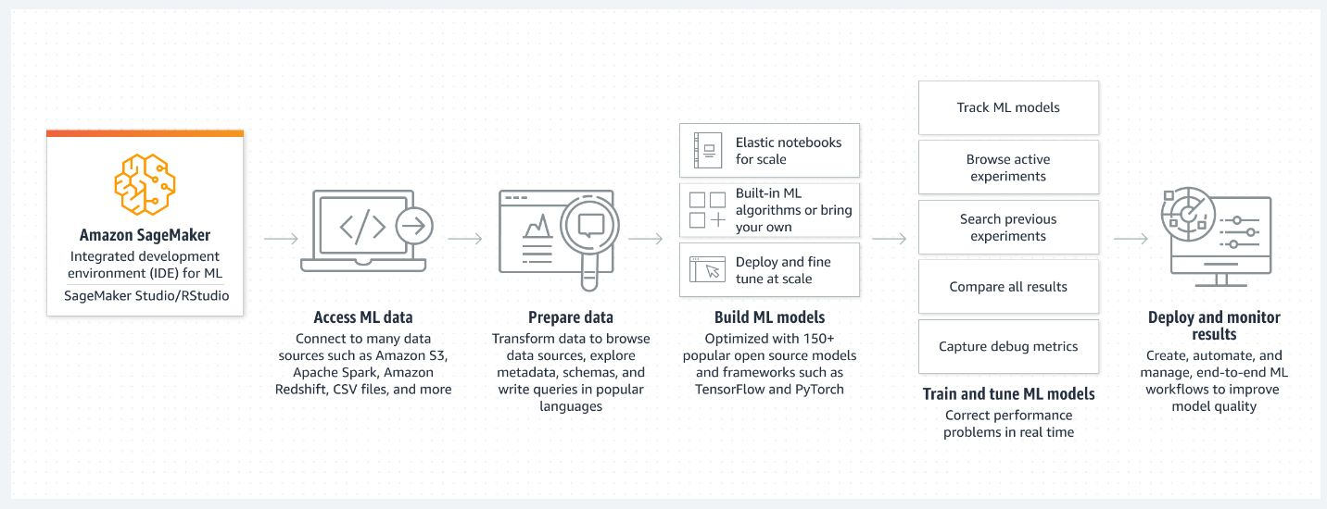
Cloud Deployment

Slide 11
THANK YOU

