Slide 1
Sri Venkateswara College of Engineering (Autonomous)
B.Tech / Computer Science and Engineering (Artificial Intelligence and Machine Learning)
ADAPTIVE MCQ GENERATION
USING DUAL LLMs
WITH STUDENT FEEDBACK
Study
material
Generator + Verifier
Mock demonstration
AI-Powered Adaptive Assessment Using RAG and Dual-LLM Verification
Adaptive practice
PROJECT TEAM 11
GUIDE
23BFA33318 V. NaveenKumar
23BFA33310 V. Jashwanth
23BFA33328 G. Sai Koushik
23BFA33295 P. Theja Bhuvan Reddy
Dr. D. Kavitha
Associate Professor
Dept. of CSE (AI & ML)
Academic Year 2026–2027
FINAL REVIEW • LOCAL SOFTWARE IMPLEMENTED • AI DEMO USES MOCKS
01
Notes:
Good morning. Our project is Adaptive MCQ Generation Using Dual LLMs with Student Feedback. We have implemented a local teacher/student assessment platform and its evidence-controlled workflows. This final review separates existing MCQGen research, implemented engineering, synthetic tests and future AI evaluation. On the supplied 8 GB Windows laptop, generation and advisory review remain in explicitly labelled mock mode. No generator/verifier LLM was downloaded or run, and we do not claim AI accuracy or learning improvement. The title states the intended AI architecture, not a completed independent-model experiment. Team names and roll numbers, guide, institution and academic year follow the supplied project abstract. Sources: supplied abstract; docs/phase-22-completion.md; docs/phase-23-completion.md.

Slide 2
Problem statement
Question quality and learner differences require more than automatic generation
Traditional
assessment
Static
questions
Limited
personalization
Learning
gaps
Authoring effort
Unreliable questions
Unequal learning needs
Manual creation and
balanced difficulty take time.
Hallucinations, weak distractors
and wrong math answers.
Fixed tests and unused
feedback miss individual gaps.
Design challenge: reliable questions and appropriate next practice
MOTIVATION
02
Notes:
Manual MCQ construction requires subject expertise and time. AI generation can help draft questions, but relevance, plausible distractors, answer correctness and mathematical answerability still require checking. A fluent question may be wrong. Fixed assessments can also miss differences between learners. Our problem combines reliable question construction with appropriate subsequent practice. The traditional-assessment diagram is a simplified problem framing, not a claim that every conventional assessment lacks personalization. The paper itself already addresses adaptation, so this slide must not be used to describe MCQGen as entirely static. Sources: MCQGen, Sections I, IV-B and VI, printed pages 102261â€“102262 and 102269â€“102271; supplied requirements.

Slide 3
Existing system: 2024 MCQGen
GPT-4 generation with RAG, CoT and self-refine prompting
Hang, Tan & Yu • IEEE Access, 2024
Instructor-designed +
student-created MCQs
RAG
Knowledge retrieval
GPT-4
MCQ generation
Student performance
+ instructor feedback
Adaptive
difficulty
CoT + self-refine
Prompt engineering
Research foundation for our project
DOI: 10.1109/ACCESS.2024.3420709 · Method: Section III · Adaptation: Section V
EXISTING RESEARCH
03
Notes:
Hang, Tan and Yu published MCQGen in IEEE Access, volume 12, pages 102261â€“102273, 2024, DOI 10.1109/ACCESS.2024.3420709. Its RAG knowledge base combines instructor-designed and student-created MCQs. The paper reports 605 knowledge-base questions: 530 instructor-created and 75 student-created. Self-refine improves the stem and key; chain-of-thought prompting supports distractor construction and review. Instructors use performance and feedback to adjust subsequent questions. Human involvement and student feedback are therefore existing features. Our project extends this foundation with an explicit local generator/verifier pipeline and operational controls. Source: paper Sections III-Aâ€“C and V, printed pages 102263â€“102270, Figures 1 and 3. This is a conceptual redraw, not a reproduction of implementation code.

Slide 4
Limitations supported by the paper
Small studies and quality challenges limit the strength of the evidence
60 MCQs
2 students
1 generator
3 lecturers + 3 model evaluators
Learning example over 12 lectures
GPT-4, no generator comparison
Evidence scope
Limited quantitative breadth; small samples
Coverage
Computer Science evaluation; English-only generation
Question quality
Diversity, complexity and math answerability challenges
Further development
Stronger checks and richer personalization warrant study
Sections IV–VII. The paper already includes instructor verification, adaptation and feedback.
EXISTING RESEARCH
04
Notes:
The paper does contain evaluation. It tests 60 generated MCQs, with 20 each for mathematics, concepts and coding, using three computer-science lecturers plus GPT-3.5, LLaMA-2 and PaLM 2 as machine evaluators. Its educational example describes two students across 12 lectures. Section VII explicitly identifies the absence of extensive numerical evaluation, small samples, a computer-science-only evaluation, GPT-4-only generation without generator-model comparison, and English-only generation. Sections IV-B and VI discuss weaker diversity, complexity and math answerability. The paper reports cases where the exact mathematical answer is absent from the options. Stronger automated verification and richer mastery tracking are our responses to these observations, not claims that the original authors did no verification or adaptation. Sources: Sections IVâ€“VII, printed pages 102268â€“102272.

Slide 5
Research gap and project response
Implemented controls and research hypotheses have different evidence requirements
2024 approach | Extension in this project | Current evidence
GPT-4 + self-refine | Generator / reviewer roles | Mock-tested; inference pending
Math answerability issues | Bounded exact-arithmetic gate | Implemented; limited math scope
Diversity / complexity limits | Difficulty + cognitive controls | Narrow concepts; breadth deferred
Small evaluation studies | Matched evaluation harness | Synthetic; real study planned
Response-based adaptation | Evidence-based topic profile | Candidate rules; not calibrated
English-focused study | Additional languages / domains | Future work
These are engineering responses; superiority over MCQGen has not been demonstrated.
IMPLEMENTED MECHANISMS / PLANNED RESEARCH
05
Notes:
The 2024 paper already uses teacher involvement, refinement, adaptation and student feedback. Its separate LLM evaluators are not the same as a production generator/verifier release workflow. Our project implements explicit generation/review contracts, bounded validation, immutable versions and operational controls. These additions are engineering responses to the paper’s limitations, not proof of improved question quality. Only a narrow conceptual generation contract and Remember/Understand controls are available; broad diversity and multilingual support remain future work. The adaptive policy exists but is uncalibrated. Controlled real model and human evaluations remain necessary. Sources: MCQGen Sections III–VII, DOI 10.1109/ACCESS.2024.3420709; docs/limitations.md, validation.md, attempts-and-adaptive.md, evaluation.md.

Slide 6
Implemented platform and AI boundary
The local website works; real generator/verifier inference remains unvalidated
A local assessment platform with explicit evidence and release gates
Teacher + Student
React web application
FastAPI backend
Local RAG + AI adapters
Validation + teacher review
Eligible versioned questions
Fixed tests + private practice
Performance + feedback
Adaptive engine + analytics
IMPLEMENTED PLATFORM • MOCK AI DEFAULT
06
Notes:
React communicates with FastAPI; PostgreSQL/pgvector and local PDF storage retain private records and provenance. Teachers organize courses, review versions, manage assessment drafts, participant permissions and classroom analytics. Students have private materials/drafts, admission and attempt workflows, feedback and learning views. Release requires eligible evidence. Normal mock drafts cannot be approved, published or selected for private practice; positive classroom workflows were exercised using isolated synthetic fixtures, not real AI output. The overview is an architecture, not a claim that every arrow runs automatically on every answer. There is no durable background generation queue or automatic feedback-driven model training. Sources: docs/user-guide.md, generator.md, teacher-review.md, phase-22-completion.md.

Slide 7
Objectives and delivery status
Software mechanisms are implemented; educational outcomes remain hypotheses
01
Context-aware generation
02
Separate review role
PDF provenance + local retrieval implemented.
Review contracts built; real quality untested.
03
Numerical reliability
04
Teacher control
Bounded exact arithmetic implemented.
Versioned review + publication gates built.
05
Personalized practice
06
Measurable quality
Candidate policy; learner benefit untested.
Harness built; AI experiments still planned.
ENGINEERING IMPLEMENTED • BENEFITS TO BE EVALUATED
07
Notes:
We distinguish mechanism from outcome for each objective. Source ingestion and local retrieval are implemented; generation quality is not measured. A separate review role exists, but independent-model correctness is unvalidated. Supported arithmetic can be checked deterministically, while unsupported mathematics cannot be certified. Versioned teacher decisions and classroom controls are implemented. Private adaptation uses a candidate policy that needs calibration. Evaluation tooling exists to collect future evidence, but does not itself supply real AI or student results. Sources: docs/limitations.md and the relevant implementation guides.

Slide 8
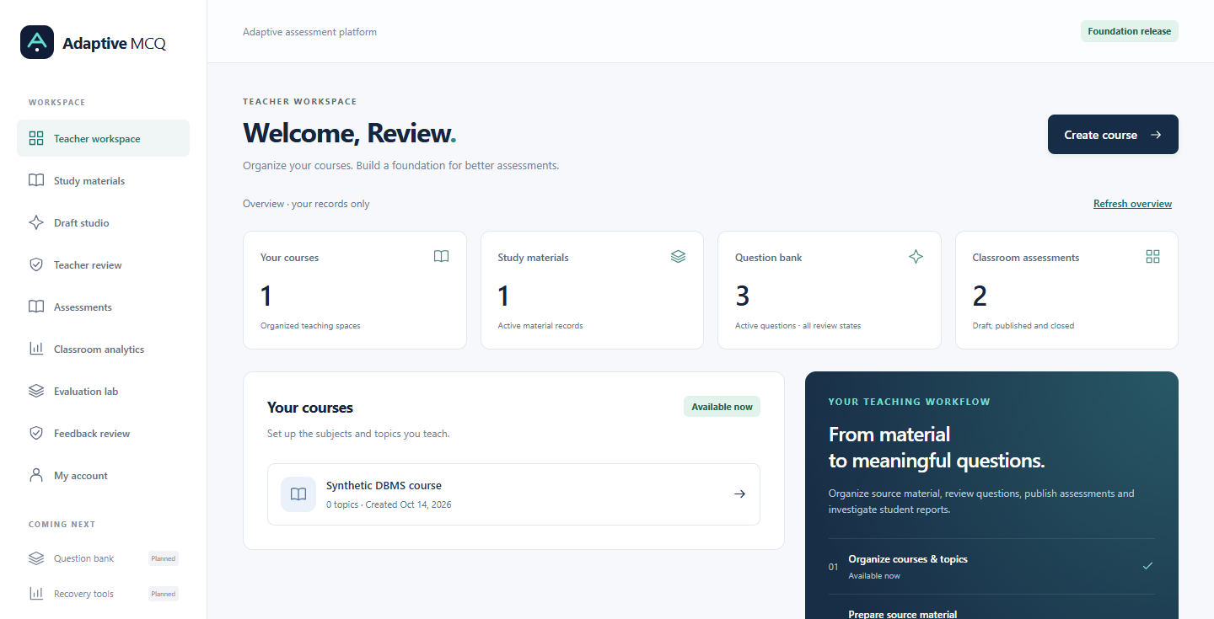
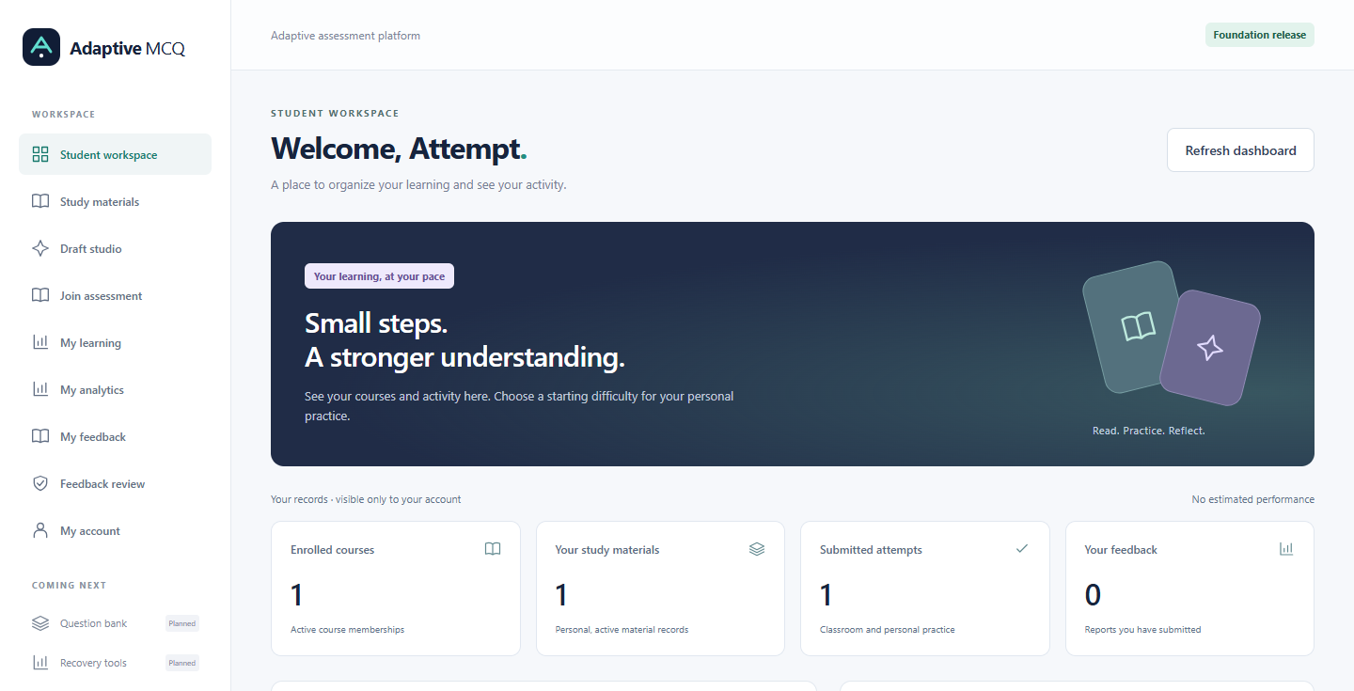
Users and actual frontend
Role-specific dashboards from the implemented application
TEACHER
STUDENT
Courses • PDFs • review • assessments
Participant access • classroom analytics
Private PDFs / drafts • join • save / submit
Released results • feedback • learning
Actual frontend screenshots • synthetic test records • no measured learner outcomes
ACTUAL UI • SYNTHETIC PHASE 20 TEST DATA
08
Notes:
These are actual frontend captures from Phase 20 browser tests, replacing the original concept wireframes. Their users, records and counters are synthetic fixtures; no numbers are learner-study findings. The teacher workspace supports courses/topics and navigation to materials, drafts, review, assessments and analytics. The student workspace supports own activity/preferences and navigation to materials, joining, attempts, feedback and learning. Backend identity and ownership checks enforce access; hiding navigation alone is insufficient. A dedicated Question bank screen and browser Recovery tools screen remain Planned, although questions persist and operator recovery commands work. Sources: docs/images/phase-20-teacher-dashboard-desktop.png, phase-20-student-dashboard-desktop.png; frontend/src/App.tsx; docs/user-guide.md.

Slide 9
Teacher workflow
Versioned review and publication checks protect classroom assessments
Login
Create assessment
Upload PDF + choose topic
Create private draft
Advisory review
Quality validation
Teacher review
Edit / reject / approve
Publish approved set
Create code + share
Edits require fresh checks. Mock drafts remain blocked from publication.
IMPLEMENTED WORKFLOW • MOCK PUBLICATION BLOCKED
09
Notes:
Teachers create courses and assessment drafts, upload authorized PDFs and choose a topic, target difficulty and cognitive level. Current default drafting produces a labelled fixture. Advisory review and deterministic validation save reports. Teachers may edit a new version or reject it; edits invalidate earlier eligibility and require fresh checks. Approval needs current passing real evidence, and publication separately rechecks all selected versions and participant settings. Mock origin persists through edits and remains blocked. Published assessment versions/settings are fixed. A reference code is displayed when issued and must be shared by the teacher. Automatic LLM regeneration is not started by feedback. Sources: docs/generator.md, teacher-review.md, assessments.md; native acceptance evidence.

Slide 10
Student workflow
Fixed classroom tests and eligible private practice are separate paths
A JOIN TEACHER ASSESSMENT
Code + validation
Access + attempt
Submit + score
Released feedback
Released eligible answers inform provisional private-practice recommendations
B STUDENT SELF-GENERATION
Own PDF + topic
Draft + review roles
Eligible real evidence
Practice + analysis
Classroom questions stay fixed. Mock drafts cannot enter eligible practice.
IMPLEMENTED WORKFLOW • SYNTHETIC CLASSROOM ACCEPTANCE
10
Notes:
A student must be registered, permitted by the teacher and holding a valid code. Starting an admitted assessment stores immutable version and option-order snapshots; joining alone does not start the timer. Save progress commits choices, and submission grades on the server. Results follow after-submit or after-close policy. Existing admitted attempts can finish to their original deadline after closure or code revocation; new starts are blocked. Eligible released first-exposure responses contribute to the candidate learning policy. Private practice requires a current eligible real-evidence question from the student’s own bank. Default mock drafts cannot enter that bank. Sources: docs/assessments.md, attempts-and-adaptive.md, user-guide.md.

Slide 11
Complete local system architecture
Native data, local services and explicit separation of AI roles
1 FRONTEND
React + Vite + Tailwind
2 BACKEND
FastAPI + auth + workflows
5 ADAPTIVE ENGINE
Profiles + next practice
3 RAG PIPELINE
PDF + local embeddings
Authorized retrieval
4 AI / LLM LAYER
Generator + verifier adapters
Mock mode; no LLM loaded
7 VALIDATION
Pydantic + exact arithmetic
Source + duplicate checks
6 DATA LAYER
PostgreSQL + pgvector + local uploads
8 DEPLOYMENT
Native Windows + recovery
IMPLEMENTED LOCAL STACK • INFERENCE DEFERRED
11
Notes:
The eight layers adapt the original supplied diagram to the later free/local requirement. Frontend: React/Vite/Tailwind. Backend: FastAPI, authentication and workflows. Retrieval: PyMuPDF, local Sentence Transformers and pgvector. AI: separately configured generator/verifier adapters, currently mock. Validation uses Pydantic, source/duplicate gates and bounded exact Python arithmetic; installed SymPy is not a general active proof engine. The adaptive service derives profiles from eligible answer evidence. Local files store PDFs. The dedicated PostgreSQL cluster and startup/backup/recovery tools passed native tests. No paid API, cloud database or mandatory hosted deployment is used; no durable generation-job queue is claimed. Sources: docs/local-deployment.md, limitations.md, generator.md.

Slide 12
Local RAG pipeline
PDF provenance and local semantic retrieval are implemented
PDF / document
Extract + clean
PyMuPDF
Page chunks +
token-window embeddings
Local embeddings
Sentence Transformers
Vector storage
PostgreSQL + pgvector
Semantic retrieval
Authorized sources
Relevant context + citations
Generator adapter
Question + source links
Real retrieval tested in Phase 9. Mock drafting uses keyword fixtures, not embeddings.
REAL RETRIEVAL TESTED IN PHASE 9 • MOCK DRAFTING IS SEPARATE
12
Notes:
PyMuPDF extracts text with page references. The ingestion splitter uses page-bounded character chunks, not a generator tokenizer. The local MiniLM embedding worker covers text through token windows and pools vectors; PostgreSQL/pgvector retrieves authorized chunks. Real offline CPU embedding and browser-to-retrieval were exercised in Phase 9. This is functional evidence, not a sustained hardware or retrieval-quality benchmark. Current mock drafting uses keyword-matched fixture text and does not invoke this embedding worker. Model files are local; startup checks their hashes without loading the model. Scanned PDFs need future OCR, and difficult tables/equations may extract imperfectly. Similarity and exact quotation alone do not prove truth. Sources: docs/materials.md, rag.md, generator.md; phase-9-completion.md.

Slide 13
Dual LLM architecture and current status
Hardware-validated model selection: pending • no LLM loaded
Retrieved study context
GENERATOR ROLE
Local adapter + mock
Candidate MCQ
VERIFIER ROLE
Local adapter + mock
Stem + four options
Key + explanation
Difficulty + cognitive level
Source references
Blind-answer stage,
then key / explanation critique.
Same checkpoint is not
independent-model evidence.
Correctness + clarity
Distractors + grounding
Difficulty + explanation
Answerability + duplication
ADVISORY
PASS / REGENERATE / REJECT
ADAPTERS IMPLEMENTED • REAL INFERENCE NOT VALIDATED
13
Notes:
The generator contract returns stem, four options, key, explanation, difficulty, cognitive level and citations. The verifier workflow first solves without the proposed key/explanation, then critiques them. Separate prompts can reduce anchoring but do not guarantee independent errors. Current generator and verifier modes are mock. The guarded adapter candidate for both roles is qwen2.5:0.5b-instruct-q4_K_M; no weights were downloaded or run, and it is not a quality recommendation. Exact tags are environment-configured but unsupported tokenizer/template profiles fail clearly. Any later authorized trial must be CPU-only, bounded and sequential, unloading between roles. Gemini names from earlier diagrams are not used as local Ollama checkpoints. PASS/REGENERATE/REJECT is an advisory recommendation, not automatic release or a background regeneration loop. Sources: docs/generator.md, verifier.md, limitations.md; backend/app/config.py.

Slide 14
MCQ quality validation
Generation alone does not establish eligibility for release
1 Schema validation
Independent math check
↓
2 Advisory verifier report
25% of 200 = 50
↓
3 Source grounding
↓
Exactly one matching option required.
Missing or ambiguous answer: reject.
Unsupported math: hold for review.
4 Duplicate detection
↓
5 Supported arithmetic checks
↓
6 Teacher review
RELEASE ONLY IF ELIGIBLE
Illustrative arithmetic. Mock ancestry blocks release even after a teacher edit.
GATES IMPLEMENTED • ILLUSTRATIVE ARITHMETIC
14
Notes:
Schema checks establish structure. Advisory review examines the candidate but is not proof of truth. Source checks preserve exact evidence, duplicates are checked against a versioned comparison corpus, and supported arithmetic is calculated independently. The example 25 percent of 200 equals 50 is illustrative arithmetic, not a generated experimental result. The bounded validator does not execute arbitrary model code or prove general mathematics; unsupported expressions remain blocked from certification. Classroom release also requires teacher review and current evidence. Normal mock ancestry, stale versions, rejection, quarantine or missing real reports prevent release. Sources: docs/validation.md, teacher-review.md; backend validation implementation.

Slide 15
Adaptive learning engine
A deterministic candidate policy; learning benefit has not been measured
Released answer evidence
Topic / difficulty profile
Eligible next private question
Candidate policy | Implemented rule
Evidence | First exposure; submitted, released, approved items
Minimum coverage | 3 eligible observations at a difficulty level
Harder recommendation | Estimate ≥ 0.75 and last 3 correct at current level
Easier recommendation | Estimate ≤ 0.40 and at least 2 of last 3 incorrect
No eligible evidence / bank | Insufficient evidence / no recommendation
Thresholds are design assumptions, not experimental findings. Classroom tests stay fixed.
IMPLEMENTED CANDIDATE POLICY • THRESHOLDS TO BE EVALUATED
15
Notes:
bounded-performance-v1 replays eligible topic/difficulty evidence from the saved starting preference. Eligible evidence is first exposure, submitted, released and from an approved version; skips, expired attempts, repeated exposure and quarantined items are excluded. Each difficulty uses prior correct/incorrect counts of one and decay 0.95 per later eligible topic response. An estimate is (1 + decayed correct)/(2 + decayed responses); coverage needs three observations. At the current difficulty, promotion needs estimate at least 0.75 and the last three correct; demotion needs at most 0.40 and at least two of three incorrect. At most one level changes; absent coverage stays Insufficient evidence. The weighted topic index is not a standardized ability score. Recommendations require eligible unseen private questions; classroom sets stay fixed. User-supplied illustrative mastery percentages were removed to avoid implying results. Source: docs/attempts-and-adaptive.md.

Slide 16
Student feedback and quarantine
Reports trigger review; confirmed defects prevent new use
Attempt + feedback
Classify + aggregate
Review weak questions
Confirm defect / quarantine
Review scores / correct version
Fresh checks before new use
REPORT CATEGORIES
Wrong answer / explanation
Ambiguous / poor wording
Weak distractor
Too easy / too difficult
Duplicate
Not from material
Mathematical error
No automatic retraining
or historical regrading
IMPLEMENTED • NO AUTOMATIC RETRAINING OR REGRADING
16
Notes:
A student reports/rates an exact question version from their own completed attempt. The owner reviews comments and distinct-reporter counts; repeated reports do not prove a defect. Explicit confirmation quarantines the version, blocks future use and creates a score-review task. Original attempts and scores remain; affected solutions are withheld and the learning replay excludes defective evidence. Acknowledging review does not change scores or restore a version. Teachers create corrected versions with fresh checks and new assessments. Feedback does not automatically fine-tune model weights or change prompts. Triage defaults of three unresolved reporters and ratio 0.20 are design assumptions, not measured optimal thresholds. Sources: docs/feedback.md, analytics.md.

Slide 17
Reference-code assessment system
Explicit participant permission and server-side access checks
TEACHER
Create assessment
Publish
Generate unique code
AI-ML-8F42K
Illustrative code • not an active invitation
Enter + validate
Join + attempt
Submit + results
Expiry Attempt limit Time limit Question and option randomization
Mock drafts cannot be published. Native classroom checks used isolated synthetic evidence.
IMPLEMENTED • EXAMPLE CODE IS NOT LIVE
17
Notes:
Teachers publish only an eligible fixed set and receive a code to share. Students need both a valid code and active participant permission using their registered account. Expiry, maximum attempts, time limits, randomization, current release state and account authorization are rechecked. The displayed AI-ML-8F42K code is illustrative and not an active invitation. Codes are shown on issuance; replacement invalidates old codes. Closing permanently ends new access and triggers after-close result release. Native classroom acceptance used synthetic evidence in isolated databases because normal mock drafts correctly cannot be published. Sources: docs/assessments.md, attempts-and-adaptive.md; docs/evidence/phase-22-native-acceptance.json.

Slide 18
Technology stack and laptop fit
Free local core with a ₹0 service/subscription target
Layer | FREE / OPEN SOURCE local core
Frontend / backend | React + Vite + Tailwind; Python + FastAPI
Data / documents | PostgreSQL 18.4 + pgvector 0.8.7; PyMuPDF; local PDFs
Retrieval | Sentence Transformers + local MiniLM; direct Python
AI roles | Mock default; guarded Ollama adapters; no LLM loaded
Validation / security | Pydantic + exact Python arithmetic; JWT + Argon2
Operation | Local startup, restricted DB roles, backup / separate restore
8 GB RAM, CPU only • Hardware-validated model selection: pending
₹0 service target. Free proprietary C++ build tools compiled pgvector; no paid API.
NATIVE DEPLOYMENT VERIFIED • MOCK AI DEFAULT
18
Notes:
The runtime is local and free/open source: React/Vite/Tailwind, Python/FastAPI, PostgreSQL/pgvector, PyMuPDF under AGPL, Sentence Transformers/MiniLM, Pydantic, PyJWT and Argon2. Direct Python orchestration is used; LangChain is not required. SymPy is installed as a dependency but active mathematical release checks are bounded exact Python arithmetic. Ollama adapters exist but the normal launcher refuses non-mock modes and does not start Ollama. PostgreSQL 18.4 and pgvector 0.8.7 were exercised natively; the approved Microsoft C++ build tools are free proprietary build-time software. The laptop has 8 GB RAM, i5-1035G1 and integrated Intel graphics. Real model selection and sustained memory/latency remain pending. The ₹0 claim excludes existing hardware, electricity and internet. Sources: docs/setup-guide.md, phase-22-completion.md and dependency lockfiles.

Slide 19
Database design and provenance
Immutable versions connect sources, attempts and feedback
Users
Ownership, version links and foreign keys preserve provenance and reproducible scoring.
Materials
Documents + chunks
Questions + versions
Options + source links
Verification records
Assessments
Question-version links
Reference codes
Attempts
Answers
Student profiles
Derived topic evidence
Feedback
Question-version reports
Analytics
Derived from attempts
12 migrations + 15 grant files applied. Topic mastery is derived; its cache table is reserved.
IMPLEMENTED • 12 MIGRATIONS / 15 GRANT FILES
19
Notes:
Users own private material/document/chunk records and question versions. Assessments pin exact versions; attempts save option permutations and answer state. Verification, deterministic validation, teacher decisions and release records form the evidence chain. Feedback refers to exact versions/attempts. The diagram is a simplified relationship view, not all fields/tables. Student profiles store preferences; current topic profiles are derived from eligible mastery_evidence, while topic_mastery remains reserved for a future cache. Analytics derive from authoritative attempts rather than competing mutable score totals. All 12 migrations and 15 grant sets were applied to the dedicated native cluster. Runtime login is restricted; backend ownership filters scope users. Sources: docs/database.md, attempts-and-adaptive.md, phase-22-completion.md.

Slide 20
Evaluation harness and planned studies
Synthetic engineering checks are separate from AI and learning experiments
A: Topic baseline
B: Frozen RAG context
C: Verify same B item
D: Add math gate
Item quality
Pedagogical quality
System / learner study
Correctness • answerability
Grounding • relevance
Distractor quality
Difficulty agreement
Diversity • complexity
Duplicate rate
Latency • retention / rejection
Satisfaction • learning benefit
Separate adaptive comparison
Implemented: synthetic harness, evidence export and blinded human-review packs
Planned: real model trials, independent ratings and learner study. Results: To be evaluated.
HARNESS IMPLEMENTED • REAL EVALUATION PLANNED
20
Notes:
The implemented matched harness has A topic-only generation, B generation with frozen local RAG context, C verification of that exact B candidate, and D bounded math validation of the same candidate. C/D do not regenerate easier replacements; failed/rejected candidates stay in the evidence, exposing retained yield. Website runs are synthetic only. The deliberate mock numerical error tests rejection plumbing, not verifier reliability. Human-review packs and a rubric are available, but no completed independent real-item ratings exist. Measure correctness, answerability, relevance, grounding, distractors, difficulty agreement, diversity, complexity, duplication, latency and rejection denominators. A separate controlled learner study is required for satisfaction and adaptive learning benefit; the current ablation does not measure the complete adaptive system. Sources: docs/evaluation.md; evaluation/RUBRIC.md.

Slide 21
Verified engineering evidence and contribution
Local workflow acceptance supports implementation claims, not AI accuracy
58 passed
14 passed
Restore passed
Targeted Phase 22 regressions
Native classroom browser checks
Records + 3 PDF hashes matched
Engineering contribution | Evidence boundary
Versioned review + access + feedback | Implemented; synthetic workflow acceptance
Native data + recovery + handover | Implemented and locally exercised
RAG + AI roles + bounded validation | Retrieval tested; real LLM quality unvalidated
Adaptive policy + evaluation tooling | Implemented candidate; learner effects unmeasured
Integration contribution; no claim of new algorithms or superiority over the paper.
RECORDED PHASE 22 EVIDENCE • ALL CLASSROOM DATA SYNTHETIC
21
Notes:
Phase 22 passed 58 targeted regression checks, including deployment, launcher, configuration and database boundaries. Its native classroom journey passed 14 browser checks. The eight grouped acceptance checks include that journey; do not sum groups as independent samples. An additional embedded journey passed 14 checks. Native transactions used independent connections and bounded row-lock contention. Immediate database restart preserved application fingerprints. Full database/PDF backup restored separately: all non-session table fingerprints and three PDF hashes matched; sessions were revoked and fresh login worked. Phase 21 separately recorded 288 backend tests, 115 frontend tests, 51 foundation browser checks and 14 classroom checks, with a real embedding test skipped. These are historical engineering results, not new Phase 24 runs or a statistical research sample. Our contribution is the auditable local integration. Sources: docs/phase-21-completion.md, phase-22-completion.md and evidence/phase-22-native-acceptance.json.

Slide 22
Conclusion and future scope
The local engineering deliverable is complete; research validation remains open
Local platform implemented and tested
Real AI quality and learning gains: To be evaluated
FUTURE SCOPE
Hardware-approved local model trials
Independent MCQ ratings and learner studies
Broader math, question types and languages
Question-bank / recovery screens
Calibrated learner modelling
OCR and multimodal questions
Thank You
Questions & Discussion
FINAL HANDOVER • REAL AI / LEARNER RESULTS TO BE EVALUATED
22
Notes:
We have implemented and documented the local assessment platform, its permission and quality gates, candidate adaptation, feedback/quarantine, evidence harness and recovery workflow. The 24-phase roadmap closes with this final-review evidence update; that does not mean every feature in the original research vision is finished. Default AI remains mock. Future work includes an explicitly hardware-approved small-model trial, independently rated real MCQs, calibrated adaptation and learner studies. Dedicated question-bank/recovery browser screens, broader mathematics, OCR, languages and multimodal questions remain deferred. No measured superiority over MCQGen or validated learning gain is claimed. Thank you; questions and discussion. Sources: docs/limitations.md, project-progress.md, phase-22-completion.md and Phase 24 evidence record.

