Slide 1
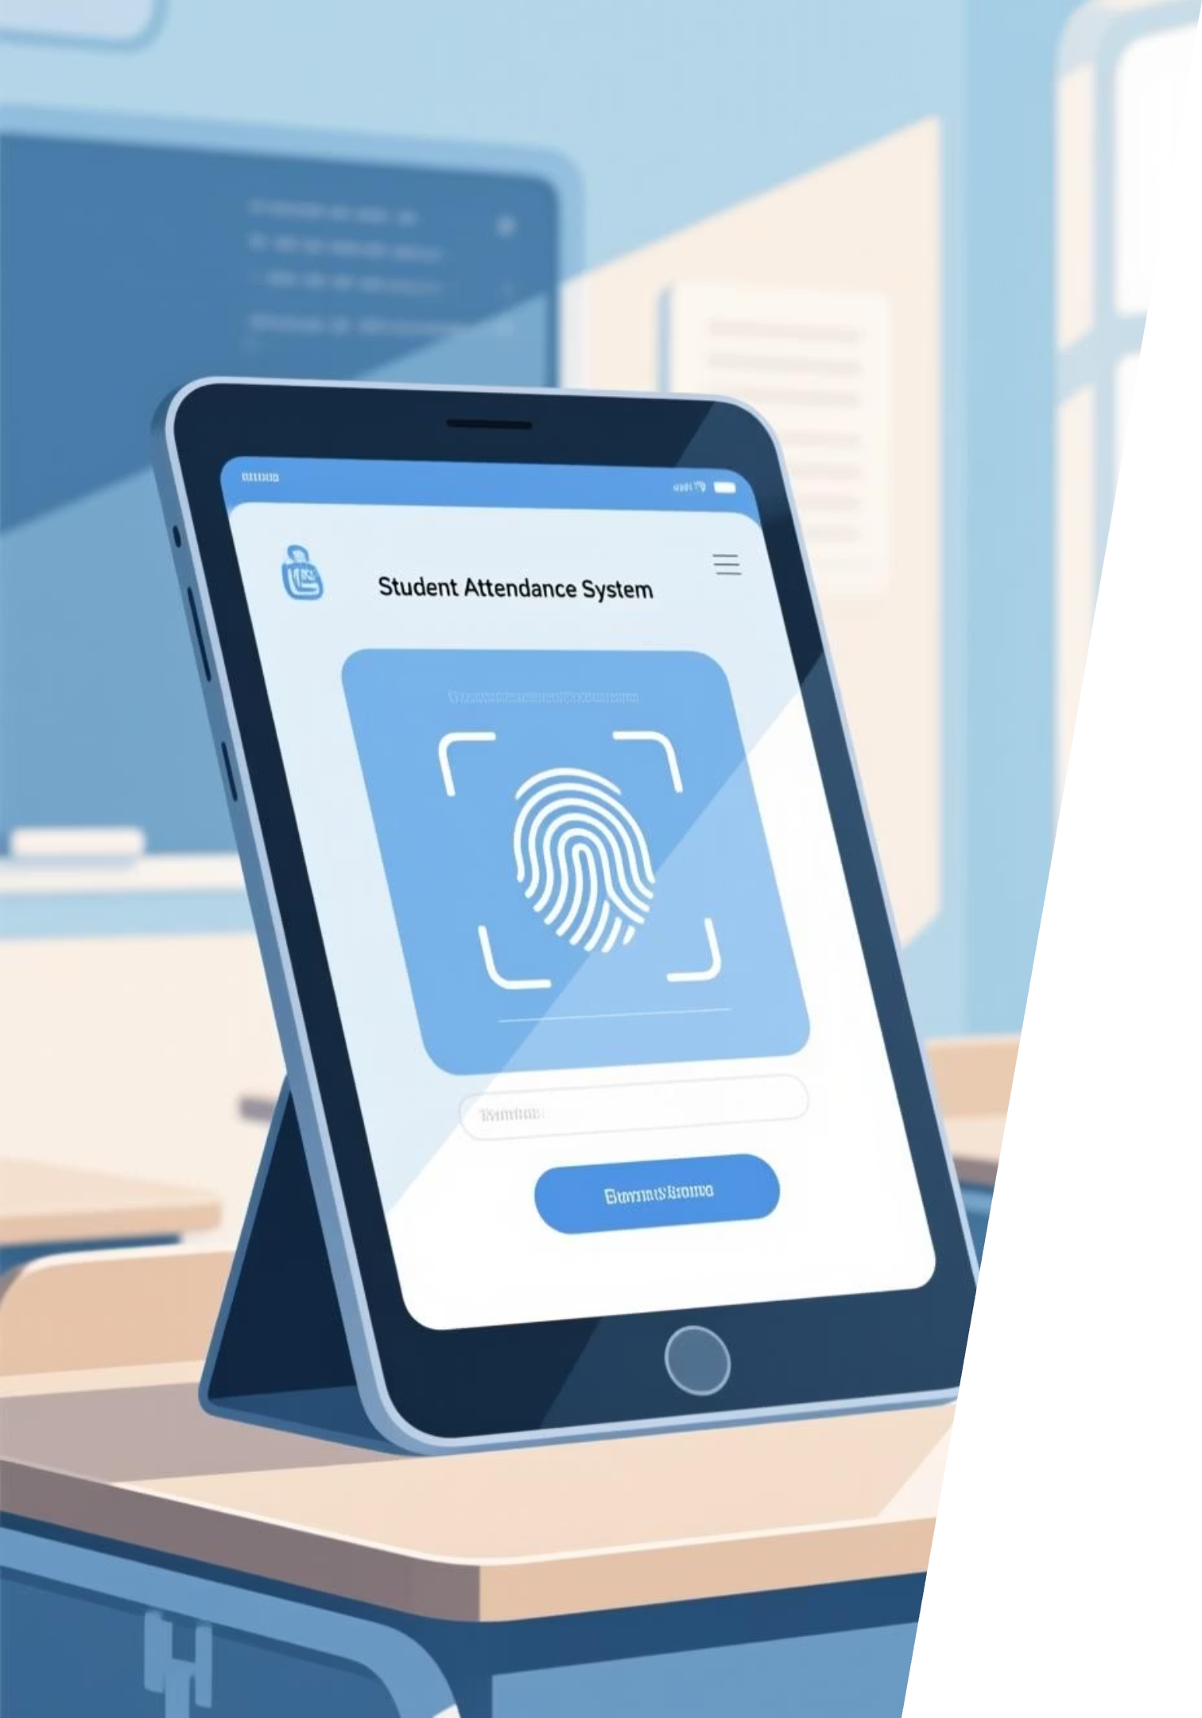
Student Attendance System
A digital solution to track daily and subject-wise attendance

Slide 2

The Challenge of Traditional Attendance
Traditional attendance methods, often relying on paper registers, pose significant challenges in educational institutions:
Manual attendance is time-consuming and prone to human errors.
Risks include proxy attendance and delayed reporting, compromising data integrity.
Teachers spend valuable class time on administrative tasks, detracting from core teaching responsibilities.

Slide 3

Why Accurate Attendance Matters
Student Performance
Operational Efficiency
Informed Decisions
Accurate attendance directly impacts student academic performance and fosters discipline.
Poor tracking leads to coordination issues and affects overall learning outcomes, creating administrative hurdles.
Institutions require reliable attendance data for strategic decision-making and to ensure compliance with regulations.

Slide 4
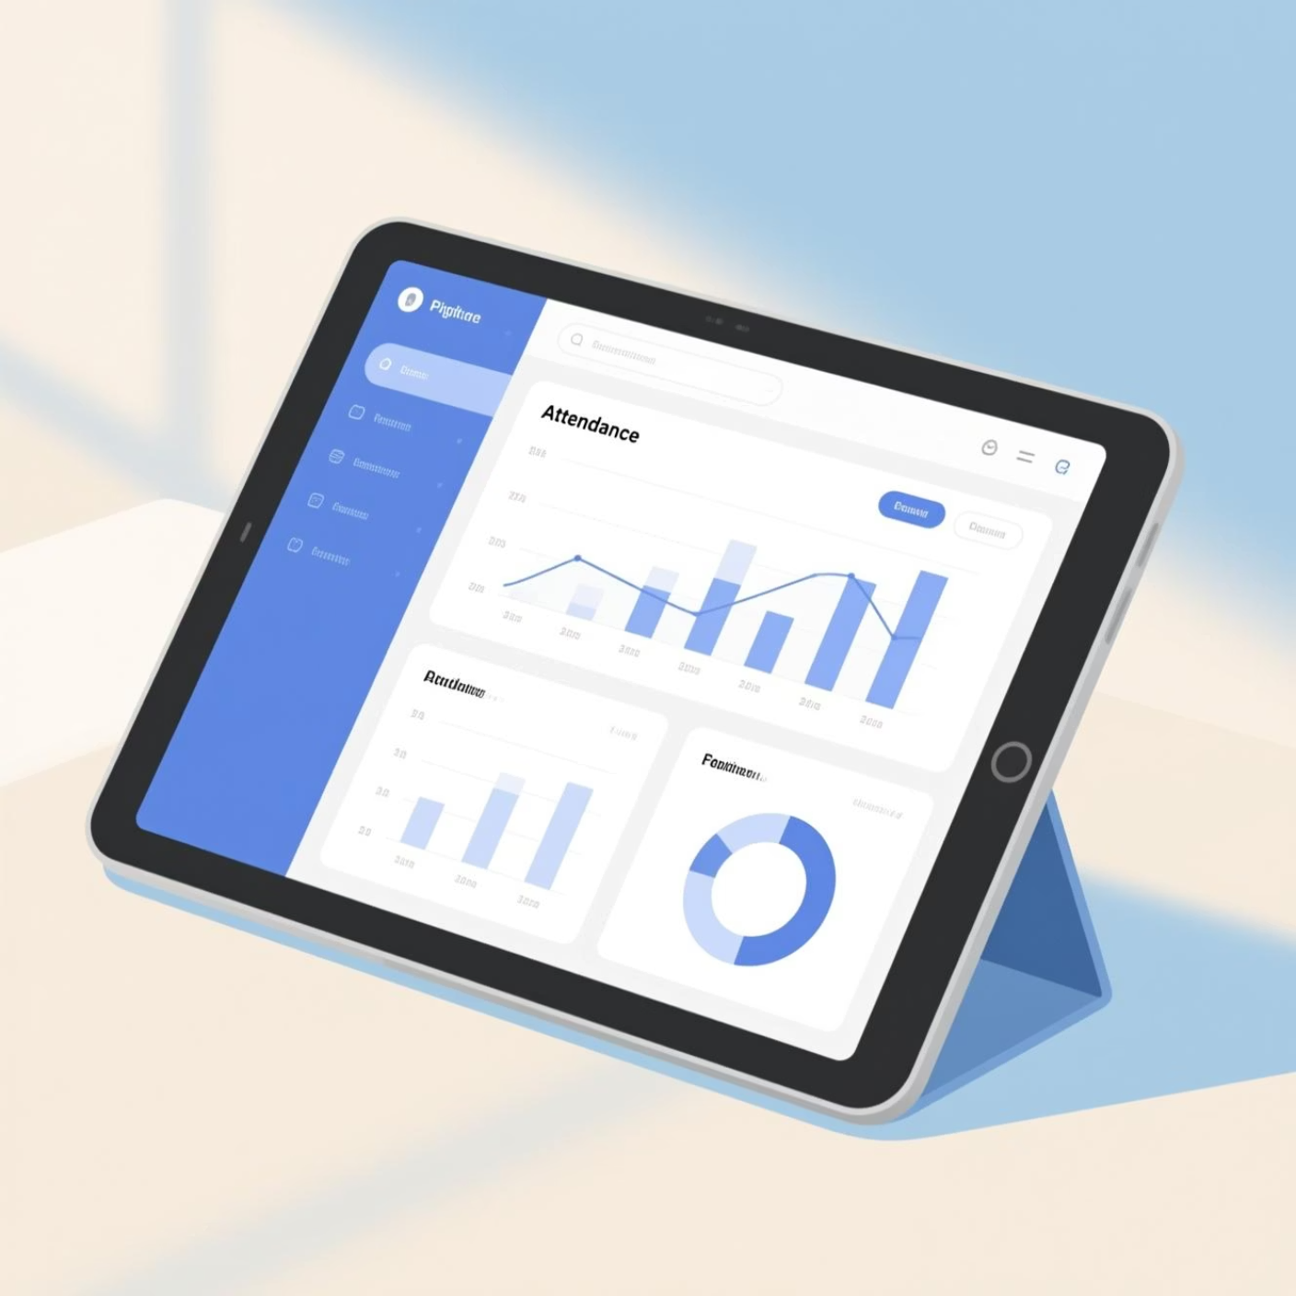

Introducing the Automated Student Attendance System
Our advanced system transforms attendance tracking with state-of-the-art technology:
Utilises biometric technologies such as fingerprint and facial recognition for precise identification.
Real-time attendance tracking is made possible by a strong digital platform that takes the place of laborious paper registers.
has an interface that is safe, quick, and easy to use, making it easy for administrators and teachers to use.

Slide 5




How It Works: Biometric & Digital Integration
Fingerprint Identification
Fingerprint readers uniquely identify students, effectively eliminating proxy attendance scenarios.
Facial Recognition
Advanced facial recognition technology matches student faces with images stored in a secure database.
Instant Data Storage
Attendance data is instantly recorded and securely stored within the central system for easy access and retrieval.

Slide 6




Key Features & Benefits
Automated Marking
Instant Reports
Reduces teacher workload and eliminates errors, allowing educators to focus on teaching.
Generates daily, monthly, and customisable attendance reports in real-time, aiding analysis.
Multi-Level Access
Eco-Friendly System
Provides tailored access for administrators, teachers, students, and parents, enhancing transparency.
A paperless solution that lowers maintenance costs and reduces environmental impact.

Slide 7

Real-World Impact & Efficiency Gains
Our system delivers tangible benefits, transforming daily operations:
Time Savings: Saves educators hours of manual work each week, reallocating time to student engagement.
Enhanced Accuracy: Boasts 89%+ biometric recognition success rates, ensuring reliable data.
Student & Parent Access: Enables online attendance monitoring for better engagement and accountability.
Policy Enforcement: Supports institutions in effectively enforcing attendance policies and standards.

Slide 8


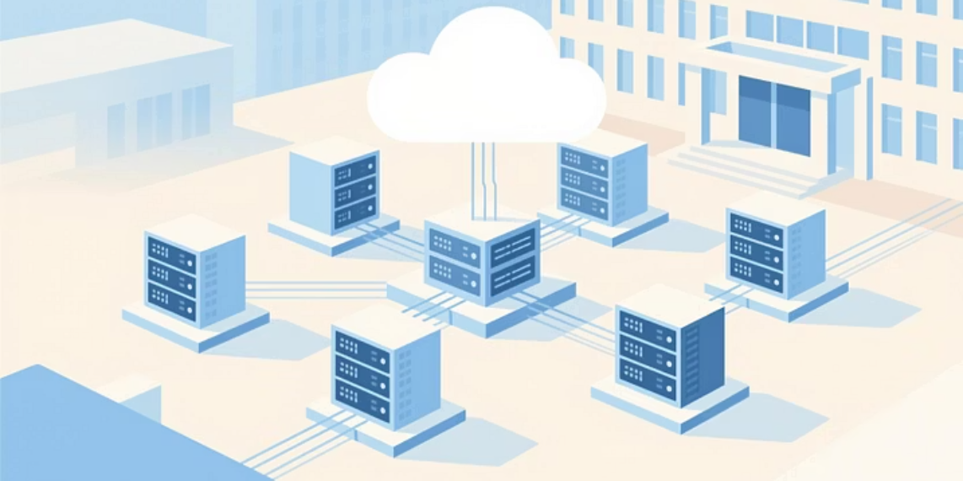
Future Scope & Innovations
The potential for our attendance system continues to expand:
1
2
3
Mobile Integration
AI-Powered Analytics
Cloud Scalability
Seamless integration with mobile applications for flexible, remote attendance marking.
utilizing AI to identify irregularities in attendance and forecast patterns for preventative action.
Cloud-based architecture ensures scalability for large institutions and multi-campus setups.

Slide 9


