Slide 1

Phishing Awareness Training
Presented By N.Jashwanth Reddy

Slide 2
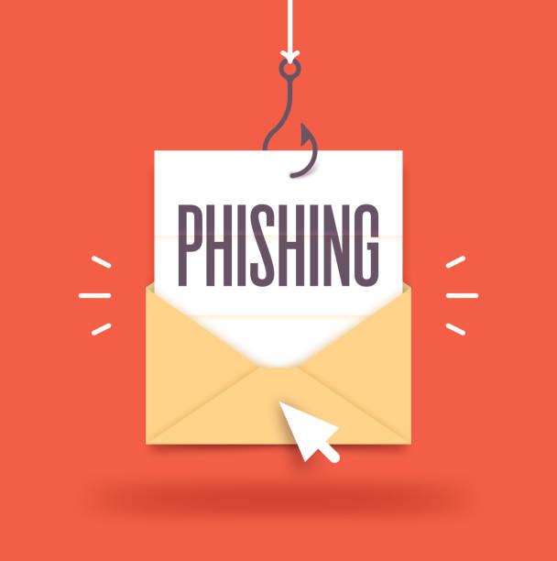
Contents
01
02
Understanding Phishing Attacks
Recognizing Phishing Emails
03
04
Recognizing Fake Websites
Best Practices for Avoiding Phishing

Slide 3
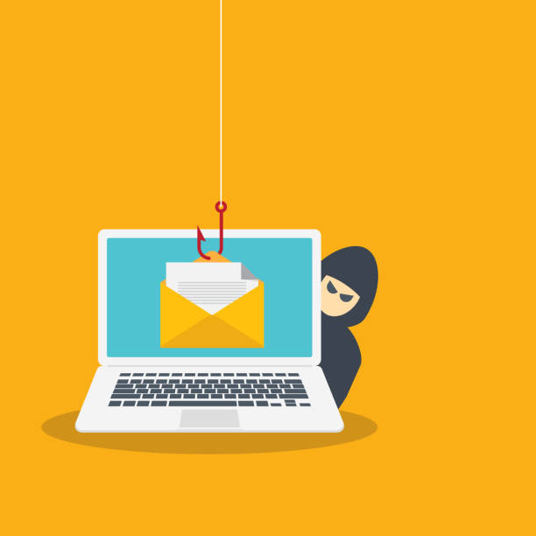
Contents
01
Understanding Phishing Attacks

Slide 4

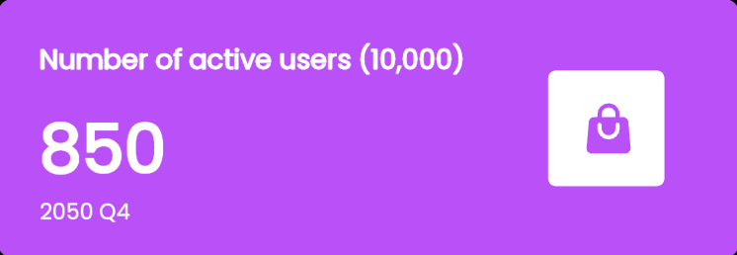
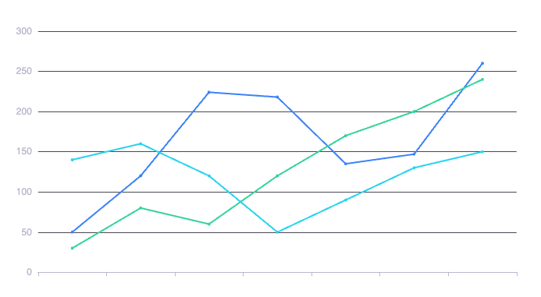

What is Phishing?
Definition of Phishing
Overview of Different Types of Phishing
Key Statistics on Phishing Attacks
Phishing is a malicious attempt to obtain sensitive information, such as usernames and passwords, by disguising as a trustworthy entity in electronic communications.
Phishing attacks include email phishing, spear phishing, whaling, vishing, and smishing, each employing tactics to deceive individuals into revealing sensitive information. Understanding these types is crucial for awareness and prevention.
Phishing attacks increased by over 400% in recent years, with 1 in 99 emails being a phishing attempt, making awareness essential to prevent data breaches and financial loss.

Slide 5
The Impact of Phishing
Real-World Consequences
Cost of Phishing to Organizations
Personal Impact on Victims
Phishing attacks can lead to identity theft, financial loss, unauthorized data access, and significant reputational damage for individuals and organizations, undermining trust and security.
Phishing attacks result in significant financial losses for organizations, including costs related to data breaches, system recovery, legal ramifications, and reputational damage, affecting overall business sustainability.
Phishing attacks can lead to identity theft, financial loss, emotional distress, and a breach of personal privacy, significantly impacting victims' trust in online interactions and security measures.

Slide 6
Contents
02
Recognizing Phishing Emails

Slide 7
Identifying Red Flags
Generic Greetings and Language Errors
Suspicious Email Addresses
Phishing emails often use generic greetings (e.g., &quot;Dear Customer&quot;) and contain language errors, indicating a lack of personalization and professionalism, which are red flags to identify.
Urgency and Threats in Phishing Messages
Examine email addresses for anomalies: look for misspellings, unusual domains, or addresses that impersonate legitimate sources. Verify the sender’s authenticity before engaging with any content.
Phishing emails often convey urgency, creating pressure to act quickly. Be wary of threats, such as account suspension, which are tactics to elicit immediate responses without critical thinking.

Slide 8
Analyzing Links and Attachments
Step 1
Step 2
Step 3
Hovering Over Links
Checking Attachments for Safety
Using URL Inspection Tools
Hovering over links reveals the actual URL. Ensure it matches the displayed link text and check for discrepancies, as fraudulent links often disguise their true destination.
Always scan attachments with antivirus software before opening. Check the file extension; unknown formats may indicate phishing. Avoid enabling macros unless verified with the sender.
Use URL inspection tools to verify link authenticity. Analyze domain names, check for HTTPS, and inspect redirects to identify potential phishing threats before clicking.

Slide 9
Contents
03
Recognizing Fake Websites

Slide 10
Visual Clues of Fraudulent Websites
Domain Name Examination
Inconsistencies in Branding and Design
Lack of Secure Connection Alerts
Examine the domain name for inconsistencies, such as misspellings or unusual extensions. Genuine sites typically use standard top-level domains (.com, .org) and precise branding.
Look for mismatched logos, inconsistent color schemes, and differing font styles. Authentic websites maintain uniform branding; discrepancies may indicate fraudulent sites. Always verify source authenticity.
Look for secure connection alerts in your browser. Websites lacking HTTPS and showing warnings may indicate fraudulent activity. Avoid engaging with such sites to protect personal information.

Slide 11
Tools for Verification
01
02
03
Bookmarking Legitimate Sites
Using HTTP/HTTPS Indicators
Online Web Safety Tools
Bookmark legitimate sites to quickly access trusted resources. Verify URLs carefully and avoid search engine links to reduce the risk of visiting counterfeit websites.
Examine the URL for &quot;HTTP&quot; versus &quot;HTTPS.&quot; Secure sites use &quot;HTTPS,&quot; indicating encryption. Always verify this before entering personal information to mitigate phishing risks.
Utilize online tools like URL checkers, SSL validators, and domain reputation services to verify website authenticity, ensuring secure browsing and protection against phishing attacks.

Slide 12
Contents
04
Best Practices for Avoiding Phishing

Slide 13

Security Measures
01
02
Use of Strong, Unique Passwords
Enabling Multi-Factor Authentication
Employ strong, unique passwords for each account, using a mix of letters, numbers, and symbols. Regularly update them and utilize password managers for secure storage and management.
Enable Multi-Factor Authentication (MFA) to enhance security by requiring multiple verification methods. This significantly reduces the risk of unauthorized access and protects sensitive information from phishing attacks.
03
Regularly Updating Software
Regularly update software to patch vulnerabilities, ensuring protection against phishing attacks. Utilize automatic updates whenever possible to maintain the latest security features and prevent exploitation.

Slide 14
Creating a Culture of Awareness
Regularly update training on phishing tactics, promote email verification methods, encourage skepticism towards unsolicited requests, and incorporate real-world examples to enhance awareness and skill retention.
Training and Continued Education
Implementing a Phishing Test Program
Regularly educate students on identifying phishing tactics, implement simulated phishing tests, encourage reporting suspicious emails, and foster an environment where inquiries about emails are welcomed.
Encouraging Employees to Report Phishing Attempts
Encourage prompt reporting of suspicious emails through clear guidelines, reinforcing that early detection minimizes risk and empowers a proactive response to potential phishing threats.

Slide 15


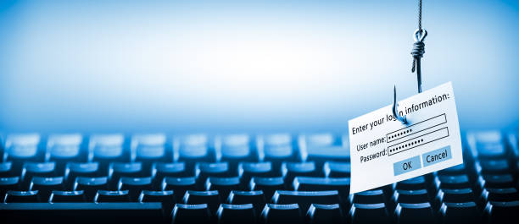
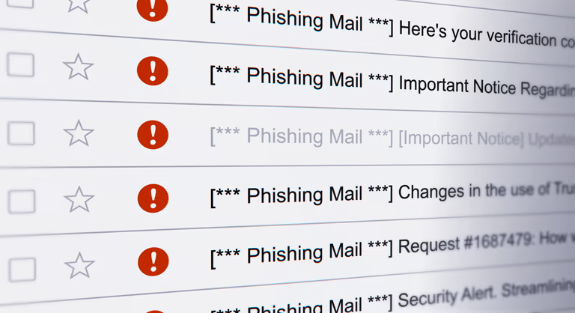

Interactive Learning
Real-World Phishing Scenarios
Interactive Quizzes and Assessments
Discussion of Recent Phishing Incidents
Implement robust email filtering, scrutinize sender addresses, avoid clicking on unknown links, verify requests for sensitive information, and regularly update security software. Always trust your instincts.
Utilize interactive quizzes to reinforce phishing knowledge, assess comprehension, and simulate real-world scenarios, enhancing retention and practical application for students. Regular assessments promote vigilance against phishing threats.
Verify sender identities, scrutinize unexpected attachments/links, enable multi-factor authentication, and stay informed about recent phishing trends to mitigate risks effectively.

Slide 16
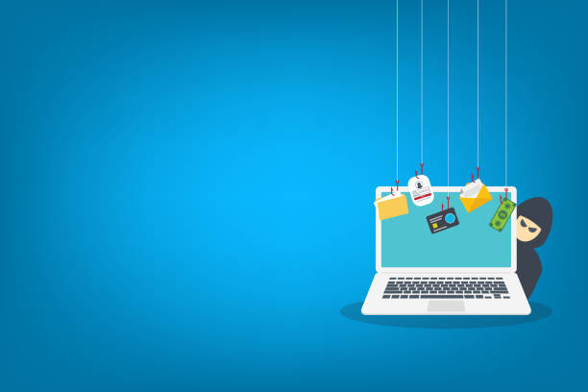

Thank You
Presented By N.Jashwanth Reddy

