Slide 1


Final Year Project
Wheat Rust Guard
Supervised By: Mr. Zeeshan Ali (Lecturer)

Slide 2
Project Team
Naqi Turab-Ul-Hassnain (36520)
Haider Ali Sammar (38192)
Jasim Sagheer (32676)

Slide 3
Table of Content
Introduction and Background
Literature Review and Summary Table
Problem Statement
Methodology
Progress Report Summary
Requirements
Software System (Design + Implementation + Testing)
Endeavour (Team)
Next Steps
Prototype / Report

Slide 4
INTRODUCTION AND BACKGROUND

Slide 5
Introduction & Background [1/3]
Overview
The Wheat Rust Guard project aims to create a robust system capable of identifying wheat leaf diseases using state-of-the-art deep learning technique, particularly Convolutional Neural Networks (CNN).
Focus: Disease prediction through user-captured field images for accurate and accessible crop health analysis.
Targeted Wheat Leaves:
1. Brown Rust.
2. Healthy.
3. Yellow Rust.

Slide 6
Introduction & Background [2/3]
Framework Overview
Wheat Rust Guard integrates multiple technologies into a robust framework for wheat leaf detection.
Data Collection: Wheat leaf diseases dataset from kaggle.
Preprocessing: To increase dataset image augmentation and bicubic interpolation is used to resize the images .
Model Training: Hybrid Model of Inception V3 with Custom-CNN
architecture evaluated for optimal performance.
Mobile Application: User-friendly APP for disease detection and pesticides suggestions.

Slide 7
Introduction & Background [3/3]
Addressing Challenges
Dataset Challenges
a. Region of Interest Variation
b. Illumination Variation
Model Challenges
a. Gradient Vanishing
b. Dead Neurons
c. Over fitting

Slide 8
LITERATURE REVIEW AND SUMMARY TABLE

Slide 9
Literature Review and Summary Table [1/5]
Existing Systems
Traditional disease detection: They are Time-intensive and Prone to error.
AI-Based Identification
Dataset Limitations
Models are trained on datasets with insufficient data diversity.
Activation functions Limitations
Relu cause "dead neurons," limiting model accuracy.

Slide 10
Literature Review and Summary Table [2/5]
Name | Year | Input | Accuracy | Description
Mamatha Mandava et al. | 2024 | Annotated wheat leaf images. Sample Images: 15000 | 96.49% | Compared CNN models (ResNet50, DenseNet121, VGG19, EfficientNetB3).
Habib khan et al. | 2022 | Field-collected wheat leaf images. Sample Images: 3000 | 99.8% | ML models with segmentation and resizing; focused on yellow and brown rust classification.
Cuenca- Romero et al | 2024 | Hyperspectral imaging. | 70% | Addressed dataset imbalance using SMOTE; focused on spectral reflectance for early detection.

Slide 11
Literature Review and Summary Table [3/5]
Wang et al. | 2023 | High-resolution single-leaf images. Sample Images: 9087 | 82-98% | Feature selection (Relief-F, PCA) and ML models for rust detection across multiple wheat varieties.
Shafi et al. | 2023 | 1640 collected images. | 96% | Edge AI for real-time monitoring; background removal with U2-Net.
Nguyen et al. | 2023 | Sample Images 700 plots. | 79% | 3D-CNN using VI and GLCM texture features for yellow rust

Slide 12
Literature Review and Summary Table [4/5]
Liu et al. | 2024 | Smartphone images. Sample Images 5737. | 86.08% | Developed StripeRust-Pocket app; reduced annotation time; enabled on-site rust monitoring.
Alharbi et al. | 2023 | Few-shot learning with CGIAR dataset. Sample Images 1450. | 93.19% | Combined EfficientNet with attention mechanism for wheat disease detection under data-constrained scenarios.
Kumar & Kukreja | 2023 | Augmented wheat leaf images. Sample Images 800 before augmentation. | 95.6% | Hybrid STARGAN-CNN model for wheat yellow rust detection.

Slide 13
Literature Review and Summary Table [5/5]
Tolba et al. | 2024 | High resolution wheat leaf images. Sample Images: 14,155 | 94% | Mobile-DNN-Net combining MobilNet and DCNN for early disease classification.
Jiang et al. | 2022 | Field acquired wheat leaf photographs. Sample Images: 13,223. | 92.5% | Transfer learning for wheat disease detection using multiple CNN architectures.
Romain Bebronne et al. | 2020 | Sample Images: 562 | 81% | Methodology integrating reflectance and textural data with ANN / PLSR for fungal disease severity detection.

Slide 14
PROBLEM STATEMENT

Slide 15
Problem Statement [1/2]
Wheat rust diseases, particularly yellow and brown rust, pose a severe threat to wheat crops in Pakistan, leading to significant yield losses and economic challenges, especially in regions like Tando Allahyar, Sindh, and Chakwal, Punjab. The primary issue lies in the limitations of current diagnostic methods—many rely on controlled environments or small-scale datasets, which fail to address the complexities of real-world field conditions.
As a result, disease detection models struggle when deployed in dynamic, outdoor settings where environmental factors like varying lesion scales, inconsistent lighting, and complex neural networks (such as CNNs) with high computational demands come into play.

Slide 16
Problem Statement [2/2]
Key Challenges Include:
Varying Lesion Scales: Rust symptoms may present differently depending on disease progression.
Inconsistent Lighting Conditions: Natural sunlight and shadows can distort image quality in field environments.
Complex Deep Learning Models: Deep neural networks require large datasets, long training times, and substantial computational power.
These challenges hinder the accuracy and speed of wheat disease detection, making it difficult to implement real-time solutions for early diagnosis and effective pest control, thus contributing to overuse of pesticides and economic losses. There is a critical need for a more efficient, scalable, and cost-effective system that can adapt to environmental variations and ensure accurate disease prediction

Slide 17
METHODOLOGY

Slide 18
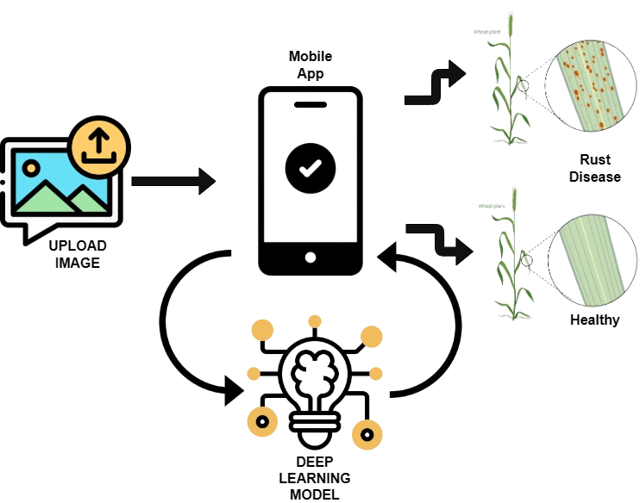
Methodology [1/7]

Slide 19
Methodology [2/7]
Dataset Collection:
Wheat Leaf Disease Dataset publicly available on Kaggle is used.
Data Augmentation:
Python build-in library imgaug is used for augmentation.
Horizontal Flipping: Random horizontal flipping of images.
Affine Transformations (Rotation): Random rotations applied to images.
Gaussian Blur: Random application of Gaussian blur to images.
Brightness Multiplication: Random adjustment of the image brightness

Slide 20
Methodology [3/7]
Image Resizing:
Bicubic-Interpolation is used to resize image to 224x224.
Dataset Partition:
Dataset is divided into 70% training, 10% validation and 20% testing.
Disease Classes | Images
 | Training | Validation | Testing | Total
Brown Rust | 1400 | 200 | 400 | 2000
Yellow Rust | 1400 | 200 | 400 | 2000
Healthy | 1444 | 206 | 413 | 2063

Slide 21
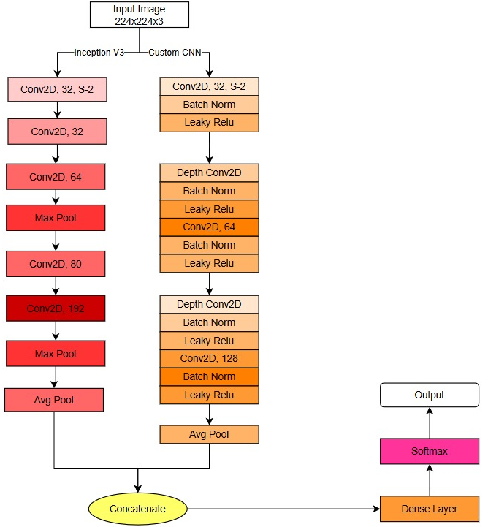
Methodology [4/7]

Slide 22
Methodology [5/7]
Input Image:
A 224x224x3 image is passed through both models.
InceptionV3 Path:
Multiple convolutional layers extract features with increasing depth.
Includes max pooling and average pooling for dimensionality reduction.
Custom CNN Path:
Layers alternate between standard and depth-wise convolutions, combined
with batch normalization and Leaky ReLU activation.
Average pooling reduces dimensions while retaining essential features.

Slide 23
Methodology [6/7]
Concatenation:
Features from both paths are combined to leverage their strengths.
Classification:
The concatenated features pass through a dense layer.
A softmax layer produces the final output for classification.
This hybrid approach enhances feature learning, ensuring accurate predictions.

Slide 24
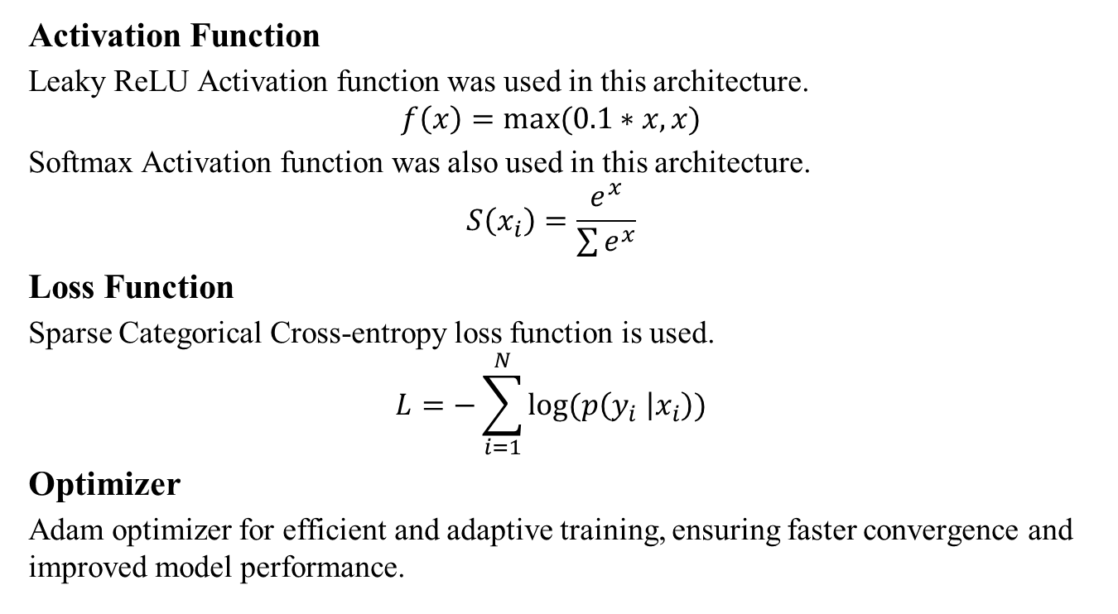
Methodology [7/7]
Activation Function
Leaky ReLU Activation function was used in this architecture.
$$f\left(x\right)=max⁡(0.1∗x, x)$$
Softmax Activation function was also used in this architecture.
$$S\left(x_{i}\right)=\frac{e^{x}}{\sum{e^{x}}}$$
Loss Function
Sparse Categorical Cross-entropy loss function is used.
$$L=−\sum_{i=1}^{N}{log⁡(p\left(y_{i} | x_{i}\right))}$$
Optimizer
Adam optimizer for efficient and adaptive training, ensuring faster convergence and improved model performance.

Slide 25
PROGRESS REPORT SUMMARY

Slide 26
Requirements
Use Cases:
FARMER
Sign Up
Login
Manage Profile
Image
View Results
Give Feedback
Offline Mode
Admin
Login
Monitor System
Manage
Backup
Manage Users
Recommendation

Slide 27
System Architecture Diagram
Front-End UI
Flutter & Dart
Sign Up & Login
Image Upload Screen
Disease Detection
Presentation Layer
Error Handling
Seamless UI
Login Credentials
Upload Image
Scan Image
Business Layer
InceptionV3 + Custom-CNN
Validates Image
Detects Image
Data Layer
Admin Profile
Manage Users
Give Feedback
User Profile
Update Profile
Database
Firebase
saves
Accounts
Operating Environment
Mobile Device
AI Model
Firebase DB

Slide 28
Implementation
Programming Language: Python for model development and testing. Dart for mobile application development.
Framework and Libraries:
TensorFlow/Keras: For implementing CNN architectures
Flutter: Frontend and backend development.
Development Platforms:
Google Colab: For leveraging GPU resources.
Visual Studio Code: For local coding and debugging.
Version Control: Git and GitHub for code versioning and collaboration.

Slide 29
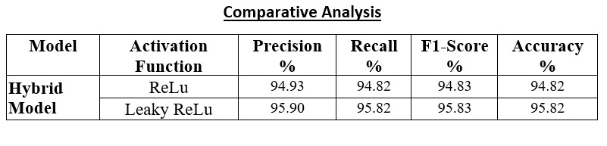
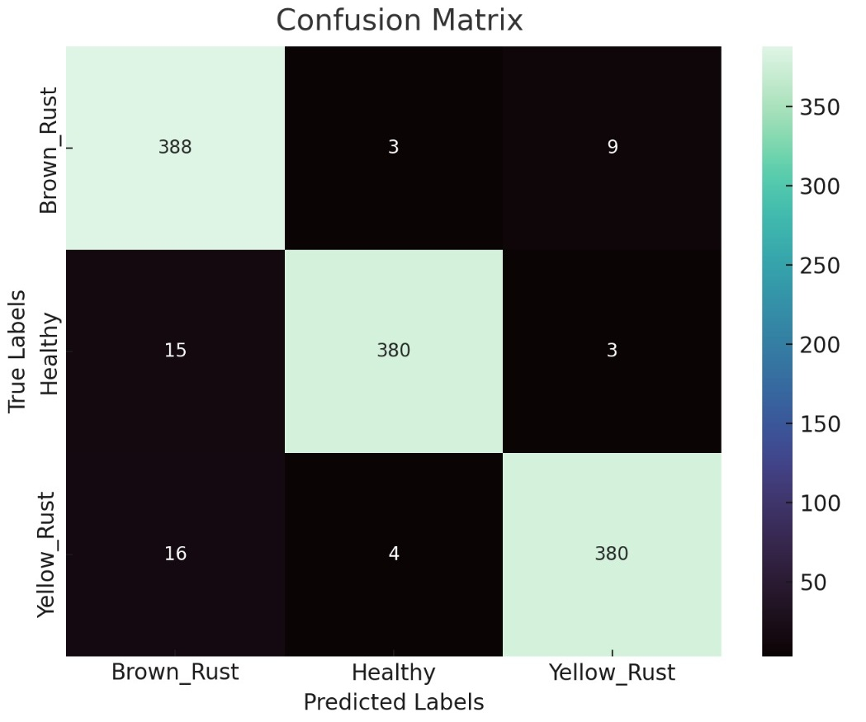
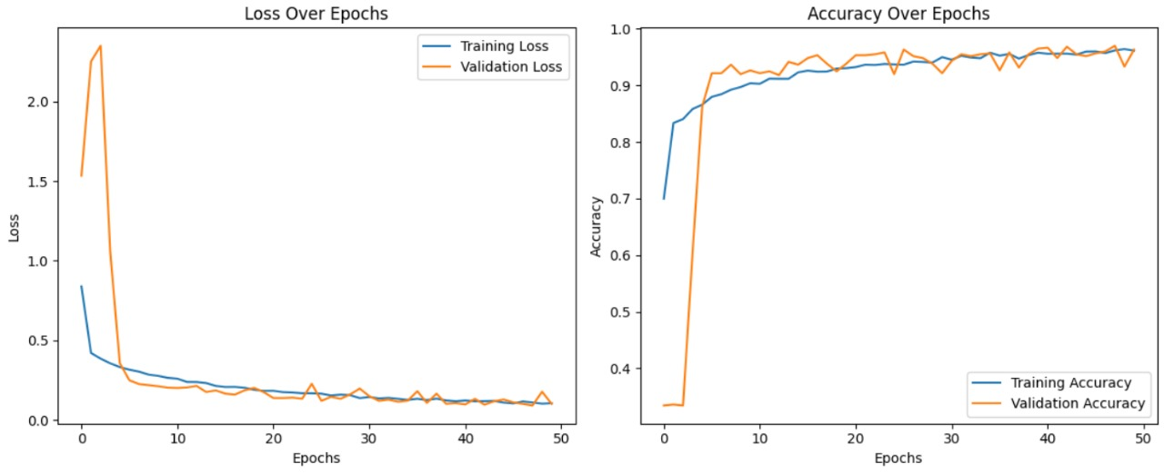
Testing

Slide 30
ENDEAVOUR

Slide 31
Endeavour
Haider Ali Sammar:
Model Implementation & Testing
Documentation Jasim Sagheer:
Dataset Collection Preprocessing of Dataset UI/UX Design Model Training
Naqi Turab:
UI/UX Design
Mobile App Development Documentation
Collaboration:
All team members collaborated on system integration and testing to ensure seamless interaction between the mobile application and machine learning backend.

Slide 32
Endeavour
Way of Working as a Team
Communication:
Regular team meetings to discuss progress, challenges, and next steps.
Used tools like GitHub for version control and collaboration.
Problem Solving:
Brainstormed solutions for challenges, such as dataset limitations and performance optimization.
Clear Role Assignments:
Tasks are assigned based on team members' strengths.
Communication & Tracking:
Regular updates to ensure alignment and progress.

Slide 33
NEXT STEPS

Slide 34
Work Breakdown Structure (List of all Deliverables / Strikethrough Completed Deliverables)
Data Collection & Preprocessing
Collecting Wheat rust disease dataset
Data Augmentation
Data Preprocessing
Data Partitioning
Model Training
Training of Hybrid model on preprocessed dataset
Performance Evaluation of hybrid model
Mobile App Development
Creating User-friendly screens(UI)
Integration of model and app
Testing & Validation
Documentation

Slide 35
Challenges
Dataset
Model
Application

Slide 36
PROTOTYPE & REPORT

Slide 37
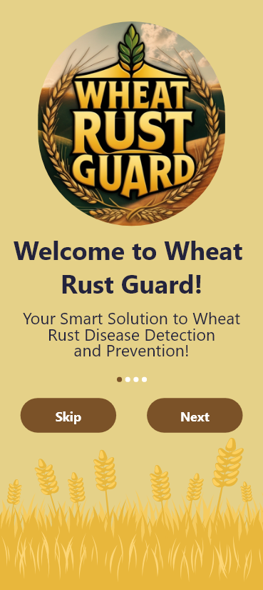
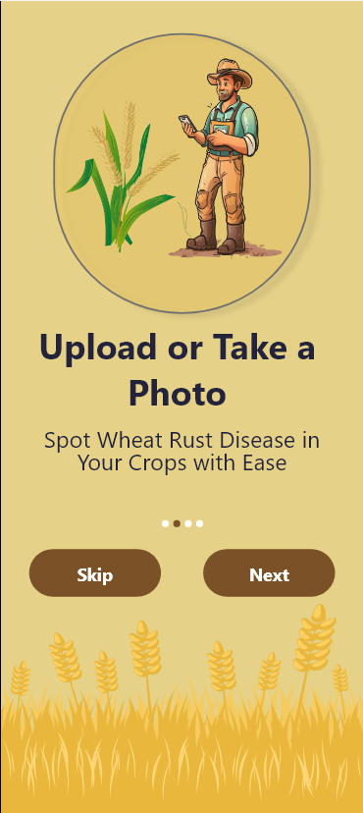
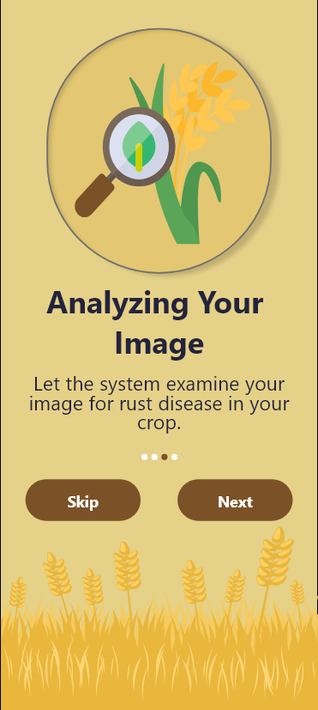
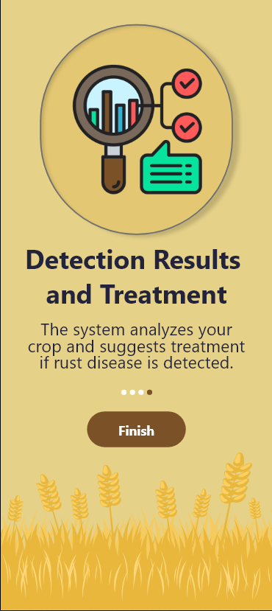
Prototype

Slide 38
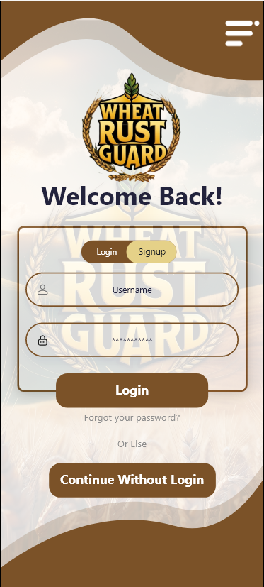
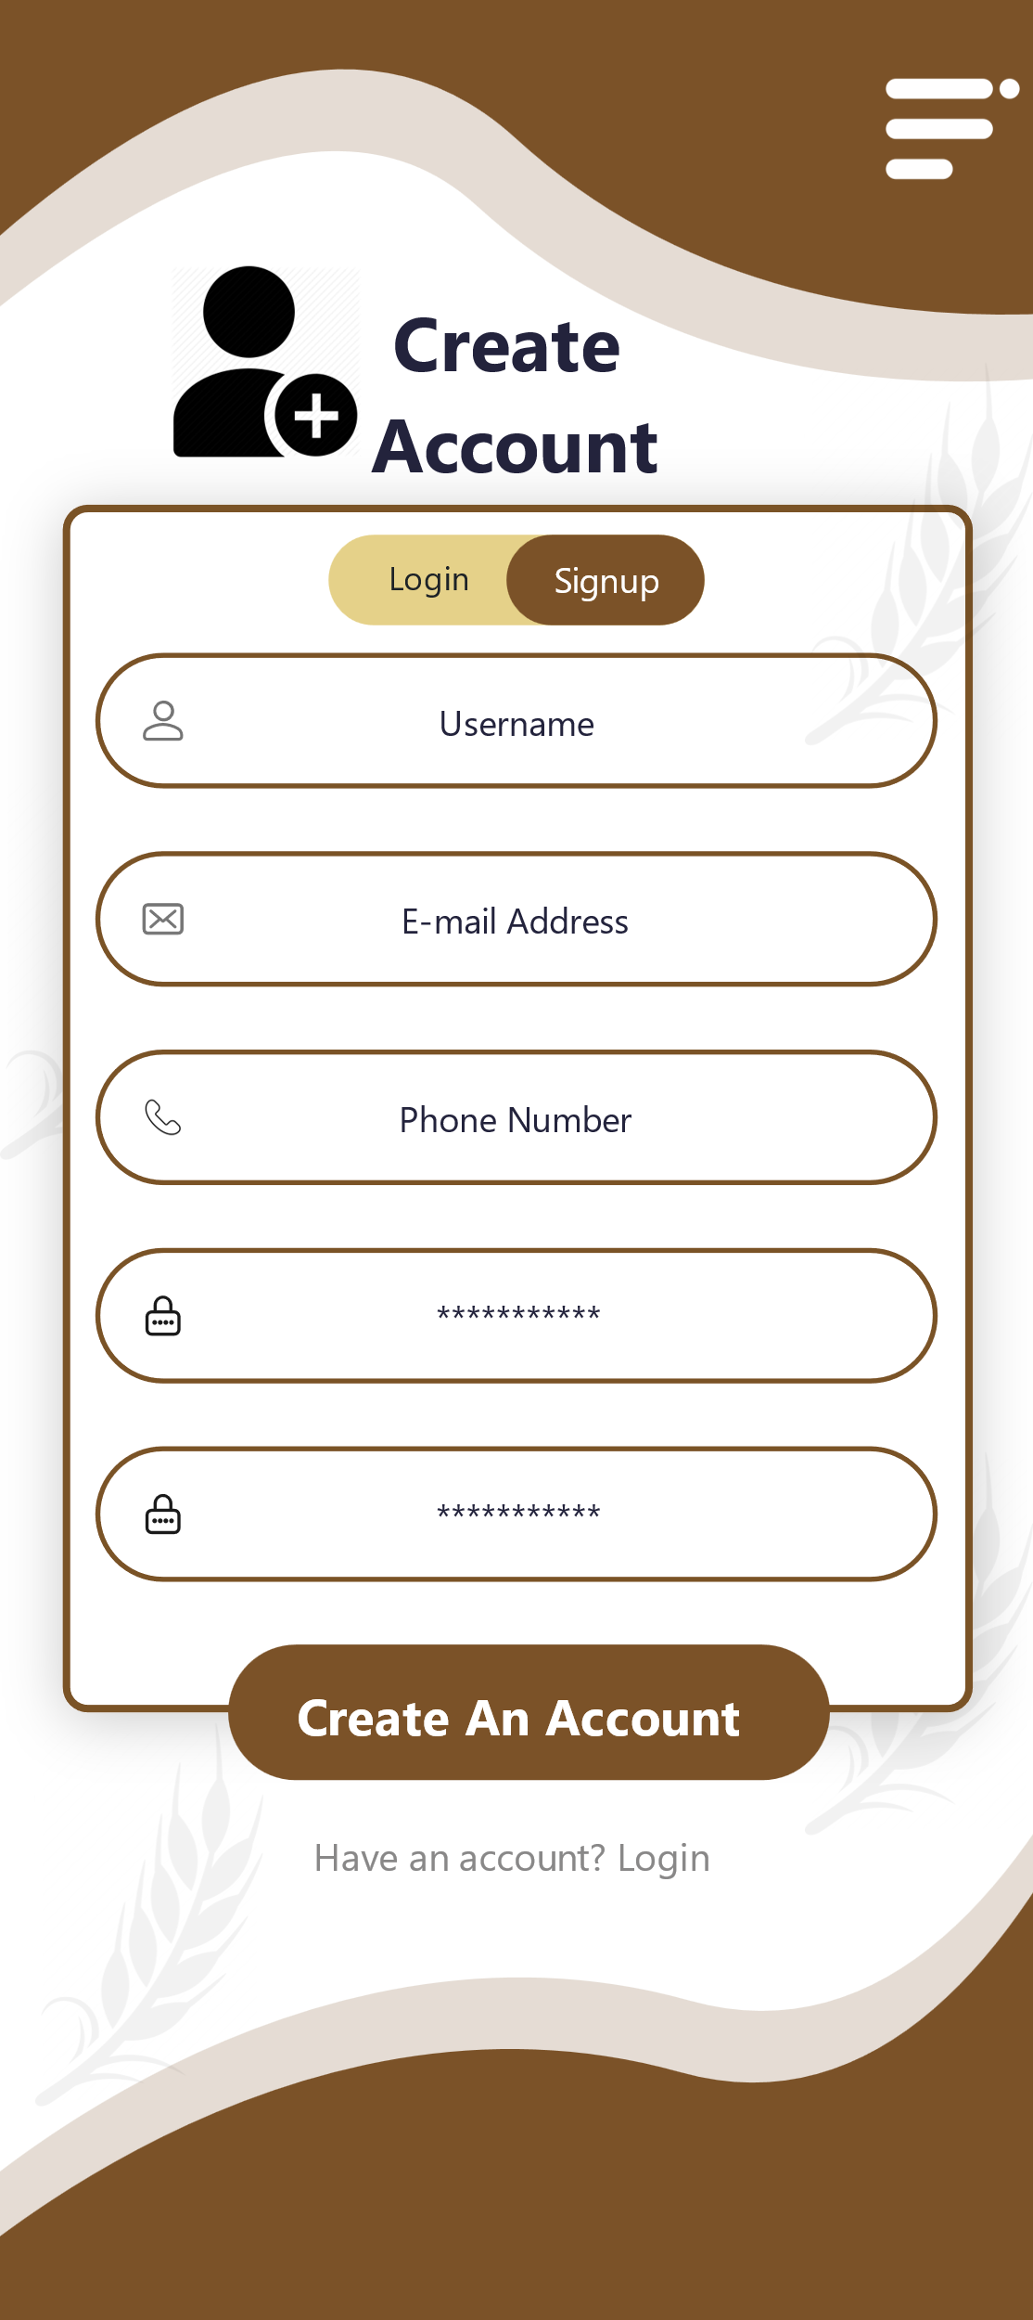
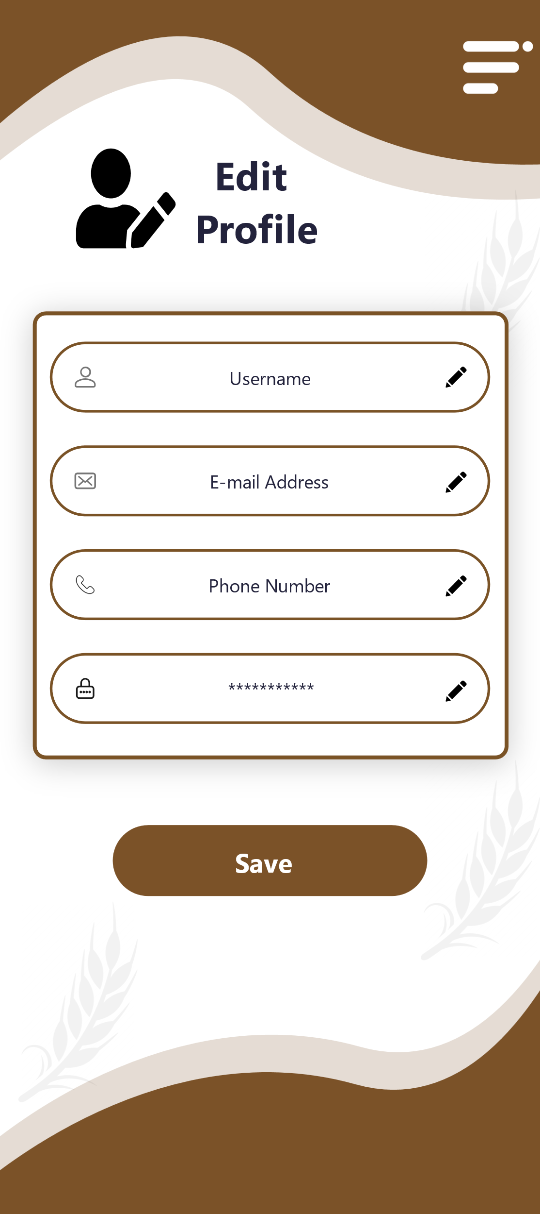
Prototype

Slide 39
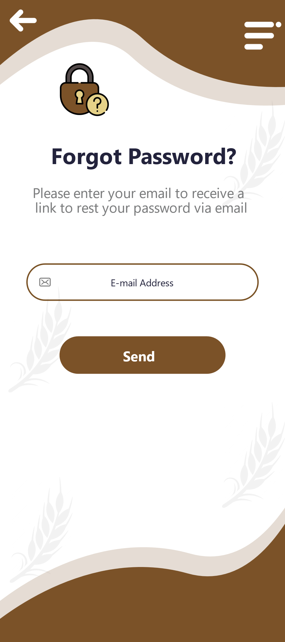
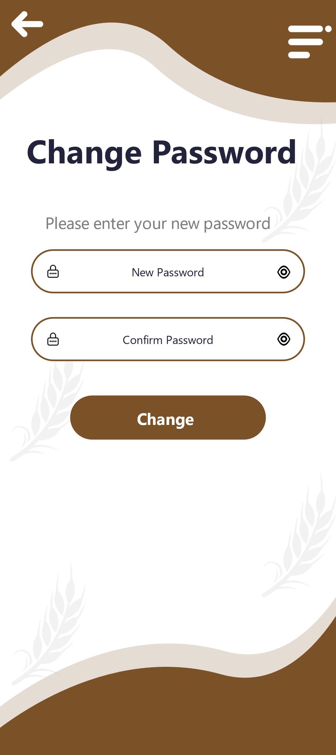
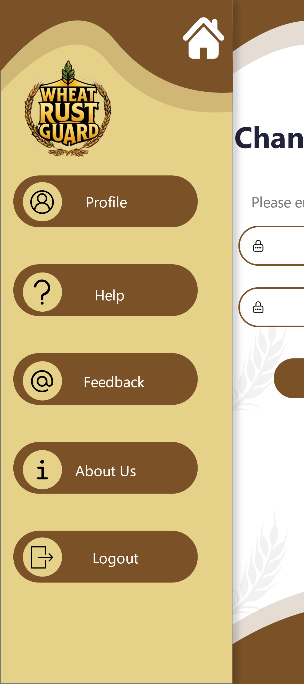
Prototype

Slide 40
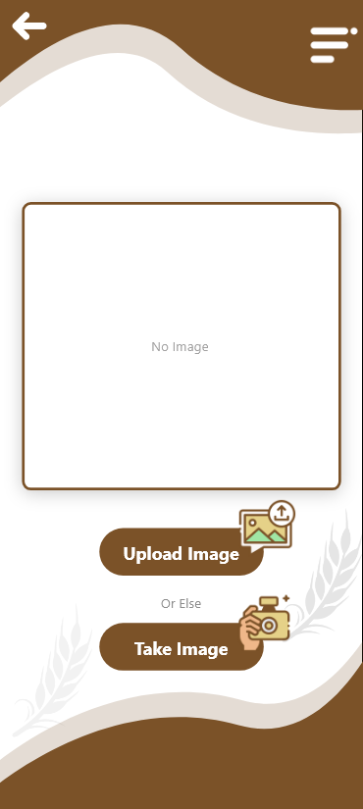
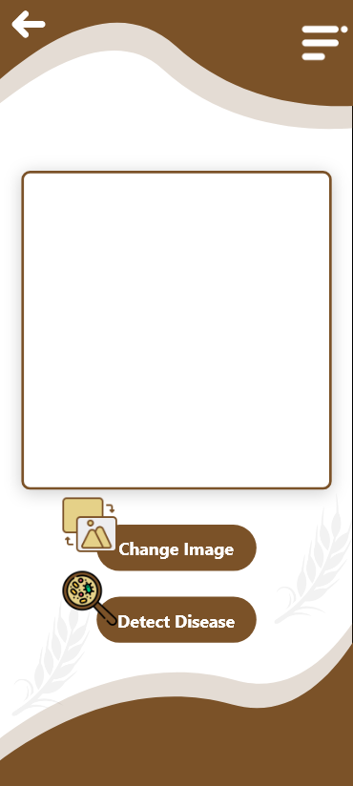
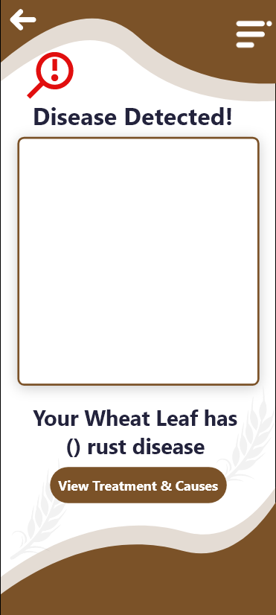
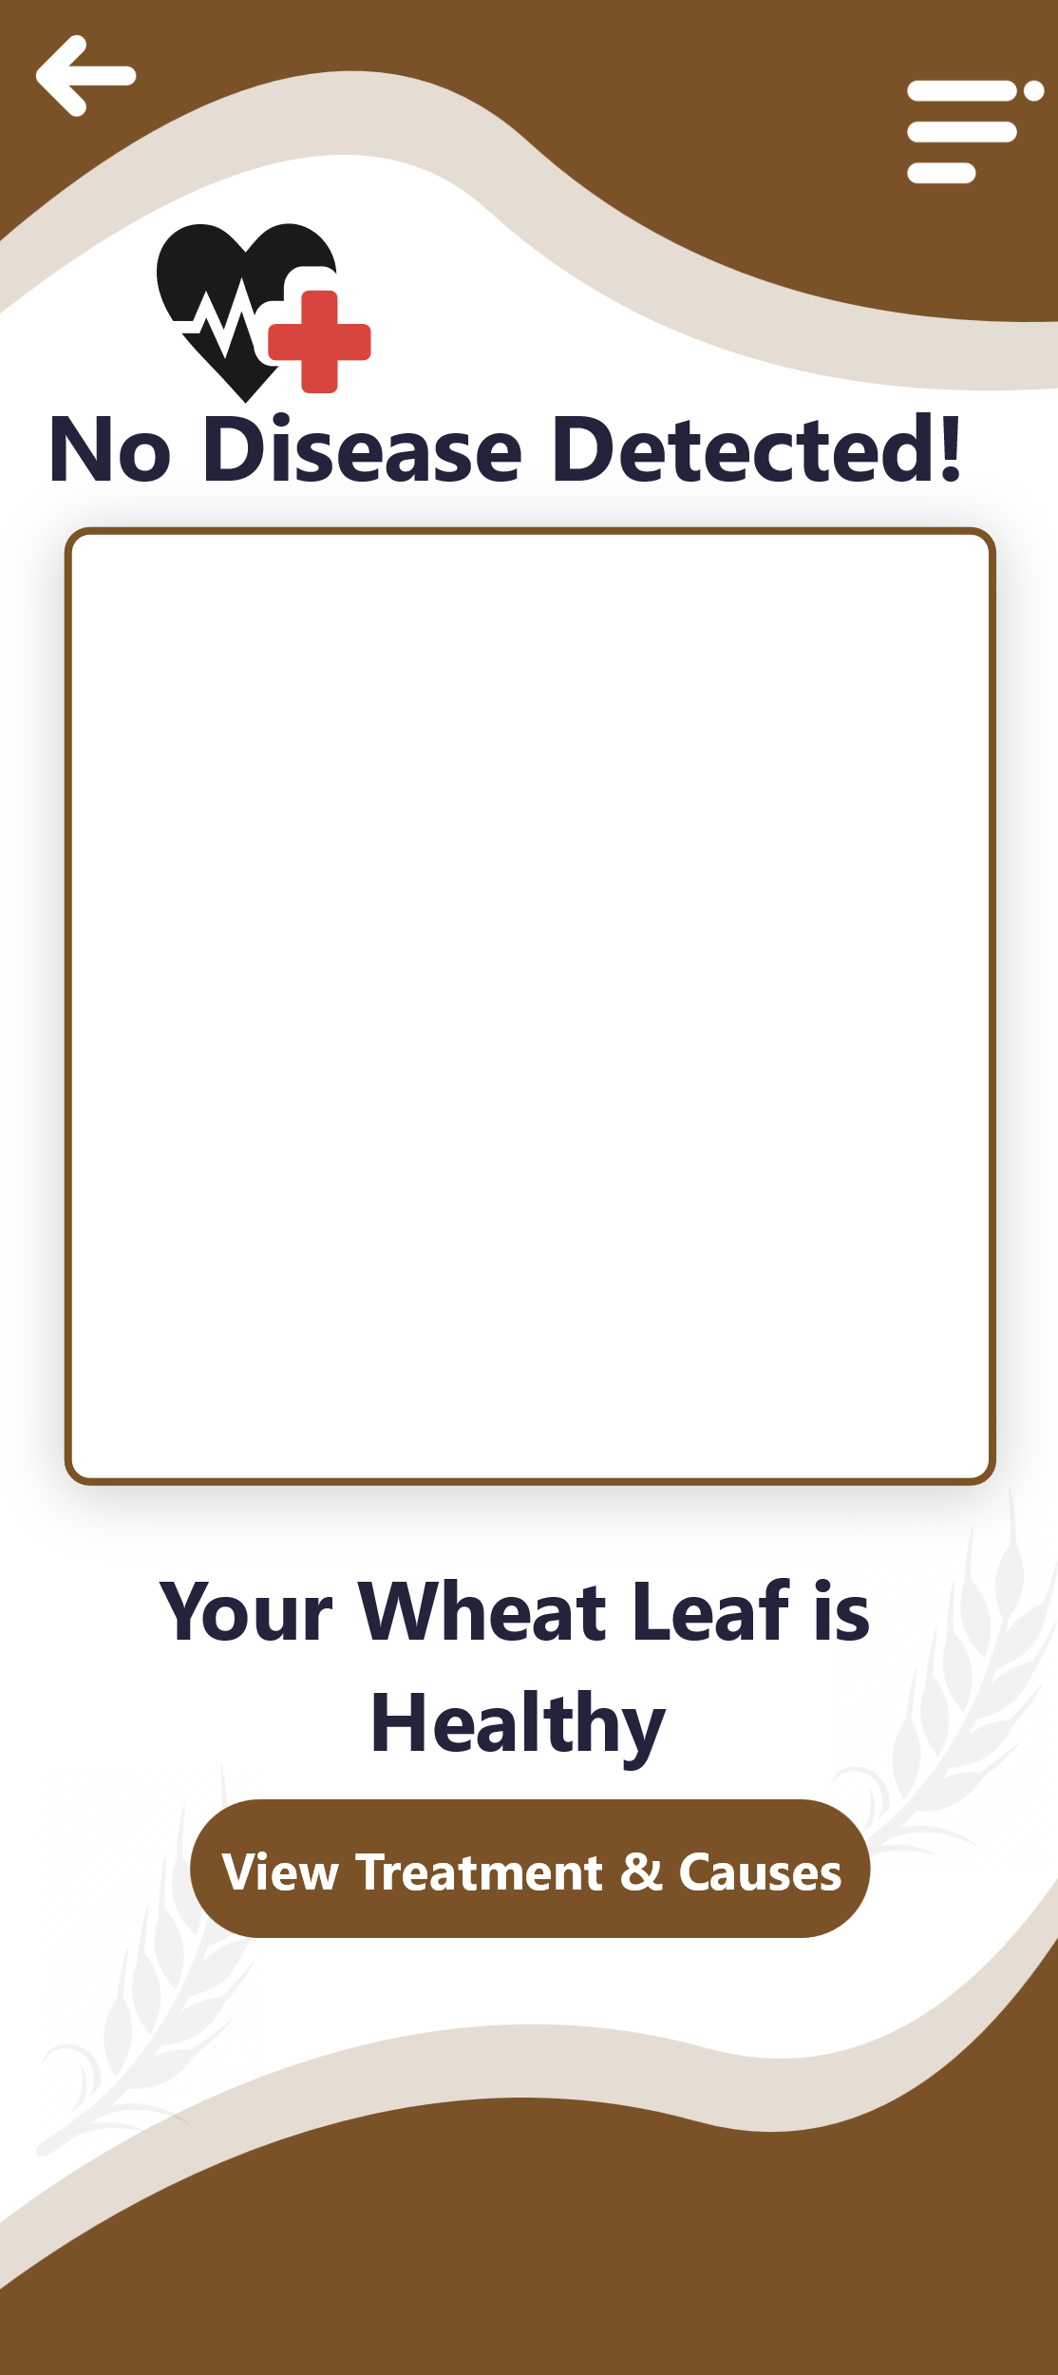
Prototype

Slide 41

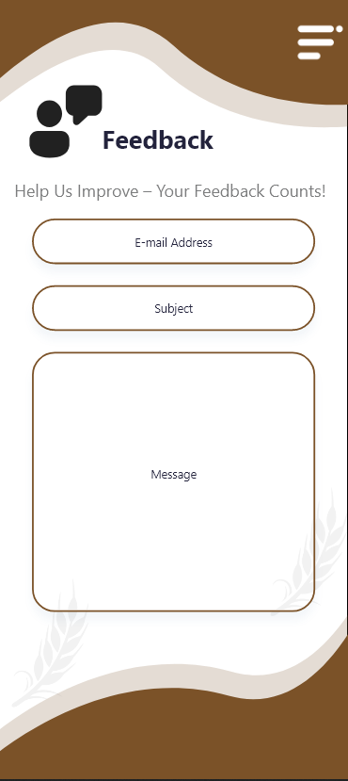
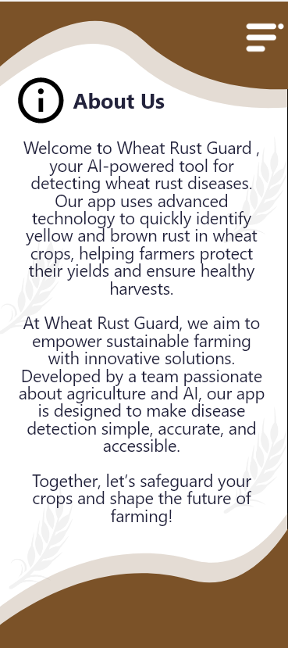
Prototype

Slide 42
Report
Chapter 1: Introduction
Chapter 2: Literature Review / Market Survey
Chapter 3: Requirements and Design
Chapter 4: Implementation and Test Cases
Chapter 5: Experiment Results and Analysis
Chapter 6: Conclusion & Future Direction

