Slide 1
Distributional Semantics Model for Metaphor Detection
Presenters: Jasim Ahmed, Mustansar Baig
Supervisor: Jelena Mitrovic

Slide 2
Linguistic Items as ML classification problem
Distributional Semantic Models
Compositional DSMs
Preprocessing
Feature Detection
Classification
Results and Conclusion
Introduction

Slide 3

Similes

Slide 4

Metaphors

Slide 5
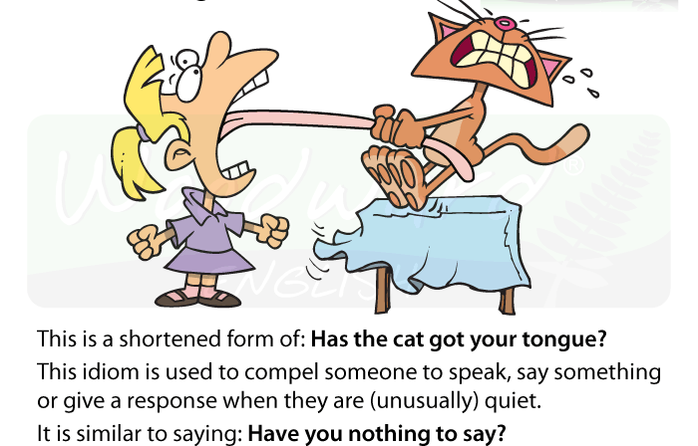
Idioms

Slide 6
Distributional hypothesis
A word is known by the company it keeps.
Distributional Semantic Models
Notes:
The distributional hypothesis in linguistics is that words that occur in similar contexts tend to have similar meanings (Harris, 1954). This hypothesis is the justification for applying the DSM to measuring word similarity. A word may be represented by a vector in which the elements are derived from the occurrences of the word in various contexts. If words have similar row vectors in a word context matrix, then they tend to have similar meanings.
<number>

Slide 7
Tokenization
Normalization
Annotation
Linguistic processing for DSM
Notes:
An accurate English tokenizer must know how to handle punctuation (e.g., don't, Jane's, and/or), hyphenation (e.g., state-of-the-art versus state of the art), and recognize multi-word terms
Normalization include case folding (converting all words to lower case) and stemming (reducing inflected words to their stem or root form). In general, normalization increases recall and reduces precision.
Annotation is the inverse of normalization. Just as different strings of characters may have the same meaning, it also happens that identical strings of characters may have different meanings, depending on the context. Common forms of annotation include part-of-speech tagging (marking words according to their parts of speech), word sense tagging (marking ambiguous words according to their intended meanings), and parsing.
<number>

Slide 8
Building the Frequency Matrix
Word-Context Matrix
Mathematical Processing for DSM
Notes:
Different types of frequency matrices: Document-Term, Term-Document, Term-Term, Word-Context
<number>

Slide 9
Compositional Metaphor Theory
Conceptual Metaphors
Linguistic Metaphors
Compositional Distributional Semantic Models
Notes:
the phrases half-baked idea, food for thought, and spoon-fed information are LMs that instantiate the CM IDEAS ARE FOOD. These phrases reflect a mapping from the source domain of FOOD to the target domain of IDEAS
<number>

Slide 10
Brown Corpus
Lemmatization
Stopwords Removal
Common Sentence Retrieval
Corpus and Pre-processing

Slide 11
A data set of adjective and noun phrase Along with their annotated tags from 23 adjectives.
AN-Phrase Dataset

Slide 12
TF-IDF feature extraction technique.
Co-occurrence Matrix

Slide 13
Multinomail Naïve Bayes
Decision Tree
Random Forest
Logistic Regression
Classification

Slide 14
Processing Flow

Slide 15
Demo will be given
Results

Slide 16
Distributed Semantic Models provide an approach to find the metaphors in a document(Sentence) based on the context of a phrase that needs to be classified as literal or metaphorical.
This paper features an approach to classify a sentence from a set of corpora to be either literal or metaphorical.
Features are extracted based on TF-IDF extraction technique.
In order to perform the classification, four different classifiers are used namely "Multinomial Naive Bayes", "Decision Tree", "Random Forest" and Logistic Regression(Multinomial) were used.
Our experimental results show that out of these classifiers, Multinomial Naive Bayes stands out with accuracy of 84\%
Conclusion

Slide 17
From Frequency to Meaning: Vector Space Models of Semantics by Peter D. Turney peter. National Research Council Canada Ottawa and Ontario,Canada
Literal and Metaphorical Senses in Compositional Distributional Semantic Models
http://studentweb.cortland.edu/kayla.fivie/proj5/similes.html
https://medium.freecodecamp.org/how-to-process-textual-data-using-tf-idf-in-python-cd2bbc0a94a3
http://www.statsoft.com/textbook/naive-bayes-classifier
https://towardsdatascience.com/train-test-split-and-cross-validation-in-python-80b61beca4b6
https://classeval.wordpress.com/introduction/basic-evaluation-measures/
http://mines.humanoriented.com/classes/2010/fall/csci568/portfolio_exports/lguo/decisionTree.html
References

