Slide 1
Tracking vulnerable JARs
Ruxcon 2012
David Jorm
djorm@redhat.com

Slide 2
Contents
JAR (security) hell
Example (CVE-2010-1622)
JBoss products
Solution
jboss-manifest
Victi.ms DB
Enforce-victims-rule maven plugin
Demonstration
Notes:
I'll begin with an overview of some of the challenges our customer see with virtualization solutions today. I'll then cover an overview of RHEV, and walk you through some of its key features and functionality. After that, I will cover our pricing and packaging model - And I will also contrast it with some of the other products in the market. Finally, I'll discuss our vision for RHEV and the virtualization market in general with a brief overview of our virtualization infrastructure roadmap - and then we will open the line up for questions. So, lets begin ...

Slide 3
JAR (security) hell
Java/J2EE apps rely on a large number of libraries
There are several ways of handling this, but all rely on the application bundling its own dependencies.
Similar to every binary on a system being statically compiled, with no dynamically linked libraries
Library JARs are typically included as dependencies using build tools like maven that draw them from public repositories
The maven central repo is the most “canonical” source of compiled JARs

Slide 4
JAR (security) hell
¹ https://www.aspectsecurity.com/uploads/downloads/2012/03/Aspect-Security-The-Unfortunate-Reality-of-Insecure-Libraries.pdf
Aspect Security performed a study¹ in March 2012 that showed 29.8 million (26%) of library downloads from the maven central repository are for versions with known flaws
The study recommends app developers:
  Provide tailored security policies that can be leveraged by the Java Security Manager to ensure limited impact of any exposure.
  Enforce scans of dependencies against a known vulnerability DB.
  Internalize and self manage Maven repositories to ensure absolute control of dependencies.

Slide 5
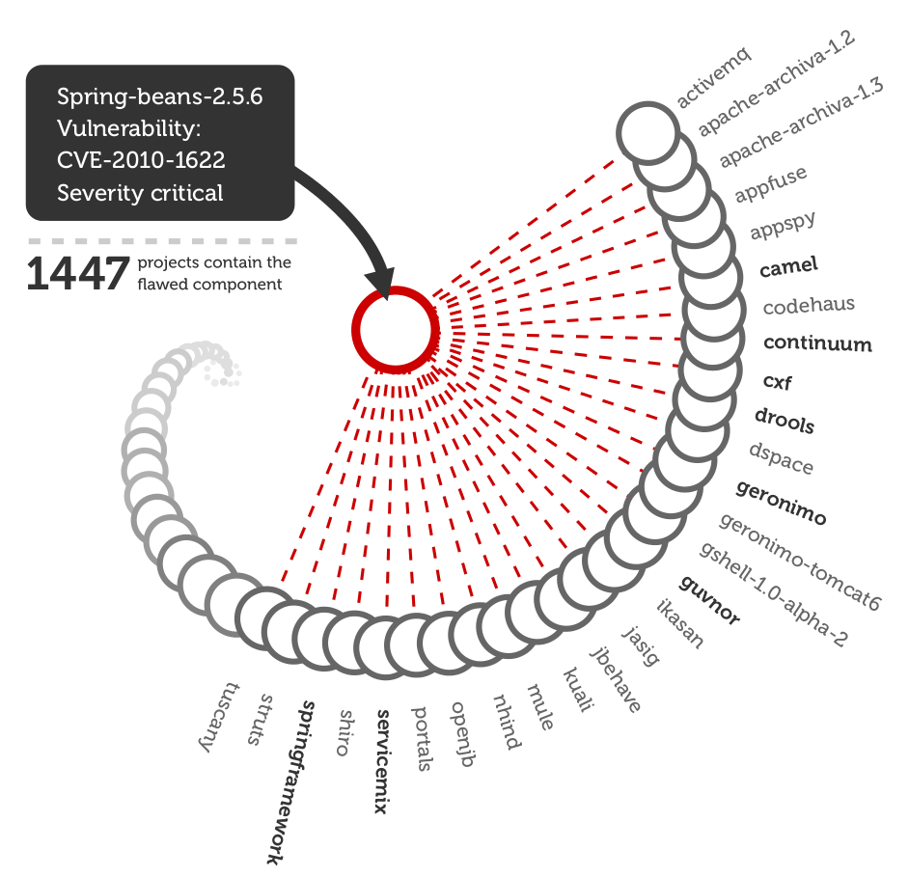
Example: CVE-2010-1622 in Spring (hi Meder)
Source: http://www.sonatype.com/Products/Why-Sonatype/Reduce-Security-Risk/Security-Brief

Slide 6
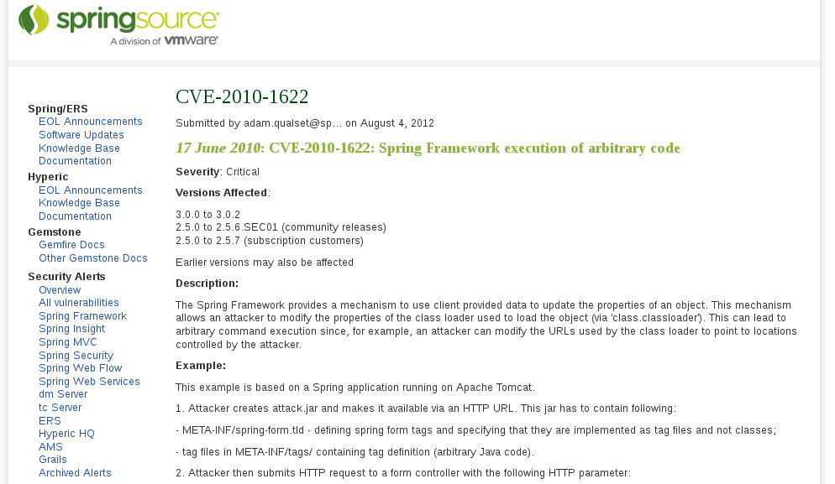

Example: CVE-2010-1622
How do you know your application is vulnerable and needs to be recompiled? How do you know to update your dependencies?

Slide 7

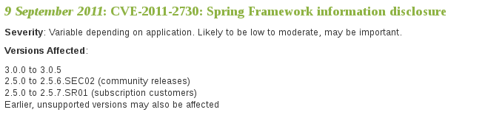
Example: CVE-2010-1622
Track upstream website? Use alert service? Secunia, iSight, etc.?
How to communicate this to developers? How to map dependencies to CVEs?

Slide 8
JBoss Products
JBoss products are bundled with all dependent JARs, rather than using a dependency management system
Components within JBoss products bundle their own JARs
We often have multiple copies and/or multiple versions of the same JAR within one product
When a vulnerability is found in a JAR, how do we patch our products comprehensively?

Slide 9
Solution
Collate all released/engineering product builds
Recursively unpack them and generate a complete manifest database cataloging the JARs used by each build
Match the manifest database against a database of known vulnerable JARS
Perform a check against the database at build time

Slide 10
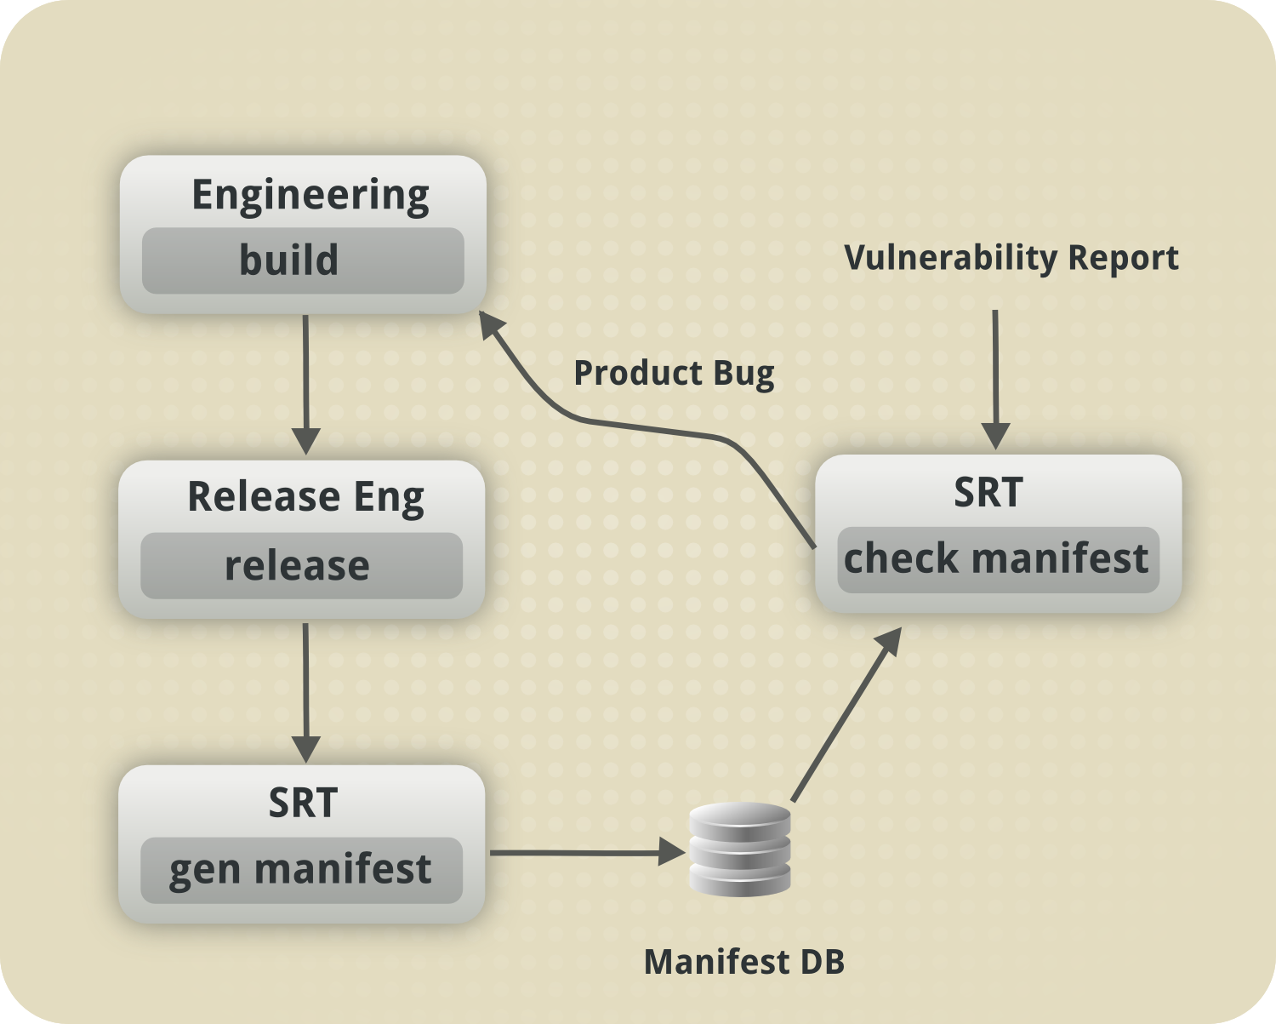
Solution

Slide 11
Solution
Requires three components:
jboss-manifest: a JAR manifest generator that recursively unpacks projects distributed as zip files to generator a text and SQL-based manifest of their packaged JARs
victims database: a canonical database of known-vulnerable JARs, identified by sha-512 fingerprints and linked to CVE IDs
enforce-victims-rule: a maven plugin to detect known-vulnerable JARs at build time based on the victi.ms database

Slide 12
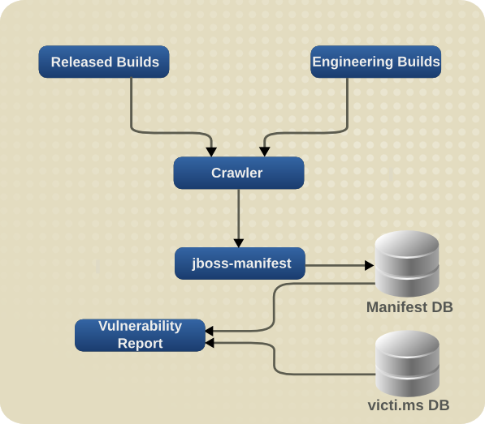
jboss-manifest

Slide 13
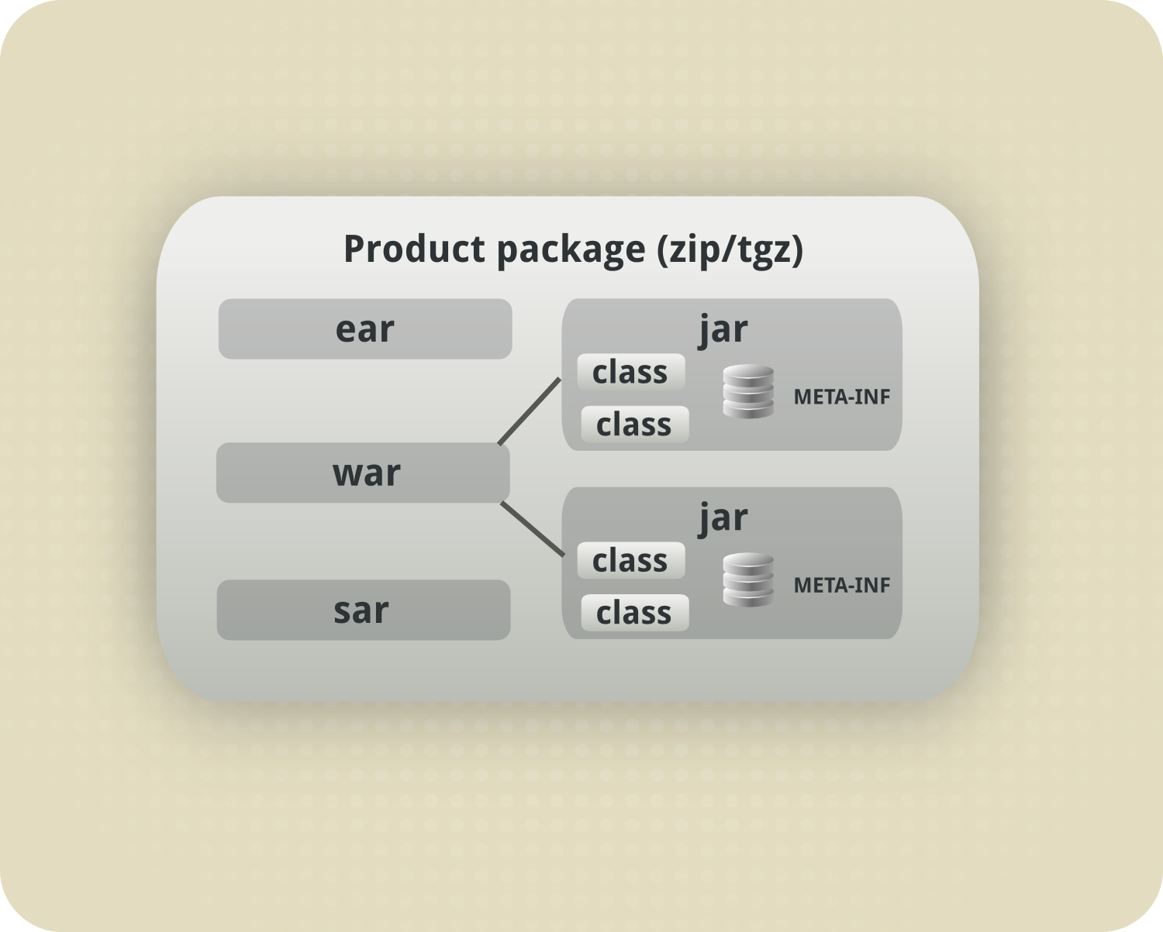
jboss-manifest

Slide 14
jboss-manifest
1) Recursively unpack archives – zip, war, ear etc.
2) Within each archive, find all jar files
3) For each jar file get information from:
  The file itself
  The contents of META-INF/MANIFEST.MF
  The signer information in META-INF/*.DSA/RSA
  Checksum
4) For each jar file write a record to the manifest DB, matching the record to the product build containing this jar

Slide 15
jboss-manifest
Jenkins used to run scheduled job to check for newly released software
New artifacts are automatically run through jboss-manifest
System sends email alerts to SRT
When the victi.ms DB is updated, a jenkins job can be triggered to check for vulnerabilities in released software

Slide 16
Victi.ms DB
Open source project by Steve Milner
Maintains a web-based canonical database of vulnerable JARs, open to submissions from the community
By querying across the manifest and victi.ms databases, we get a report on all vulnerable builds
Code available here: https://bitbucket.org/ashcrow/victims/overview
Hosted instance here:
http://victi.ms/

Slide 17
Victi.ms DB
Red Hat maintains hashes for all flaws that affect components we ship
More community effort needed to make the database comprehensive
Potential for future automation, linking CVE/CPE (SCAP) mappings to JARs in the central repo

Slide 18
Enforce-victims-rule maven plugin
Builds on the maven enforcer plugin to check a maven project's dependencies against the victi.ms database of known vulnerable artifacts.
Checks are based on both metadata (artifact name and version) and JAR file hashes
Checks can be configured to trigger either warnings or fatal errors

Slide 19
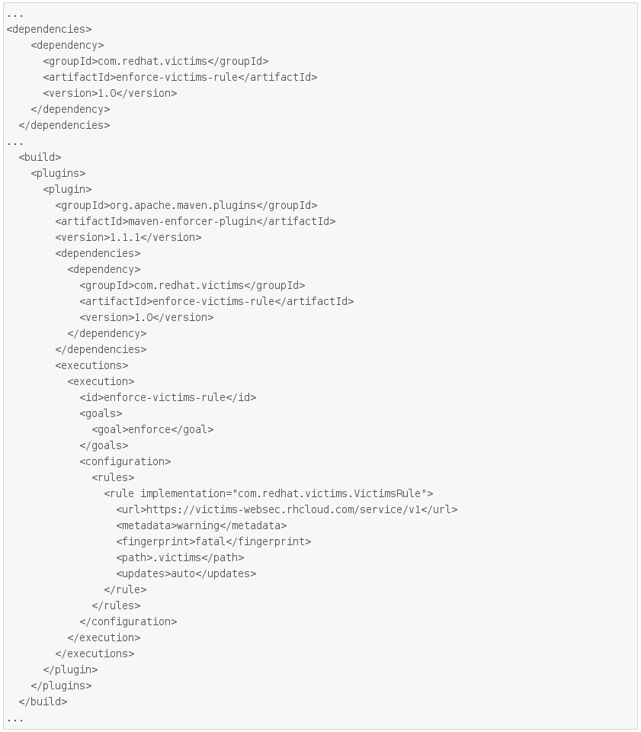
Enforce-victims-rule maven plugin

Slide 20
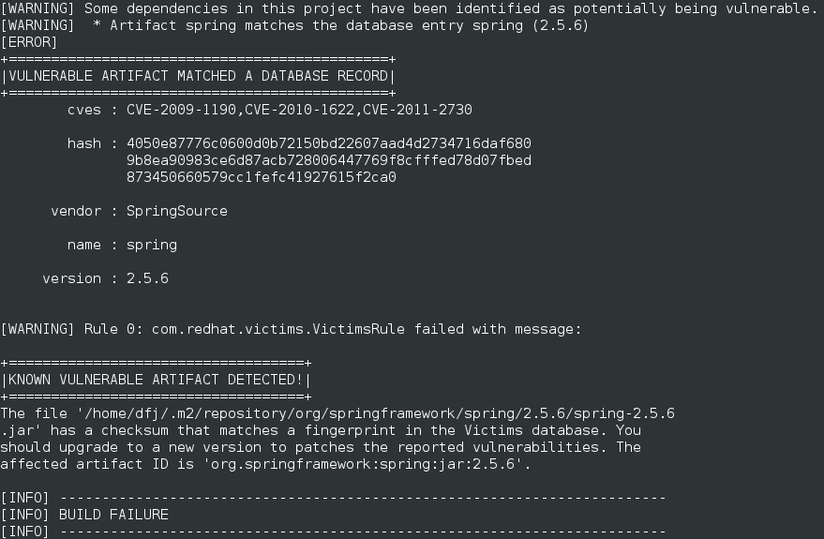
Enforce-victims-rule maven plugin

Slide 21
Demonstration

Slide 22
Commercial tools
Sonatype “Insight App Health Check”
  Includes source licensing and security checks
  Available as GUI/maven plugin
  Operates using remote service
  $499 (per app?)
Aspect Security “Contrast”
  Identifies flaws in your own code
  Maven plugin
  Doesn't handle known flaws in dependencies yet
  Free version, commercial $199-399/mo

Slide 23
Resources
http://victi.ms
https://bitbucket.org/ashcrow/victims/overview
http://search.maven.org/#artifactdetails|com.redhat.victims|enforce-victims-rule|1.0|jar

Slide 24

Questions?
Notes:
With RHEV for Servers, Red Hat provides a robust virtualization platform optimized to give you the performance, scalability, security and ecosystem you need with a price structure that truly enables pervasive datacenter virtualization.
For more information, visit our web page which includes a library of datasheets, feature demos, and a link to a TCO calculator where you can calculate how much RHEV can save you in your datacenter. The address is www.redhat.com/rhev
Thank you for your time today, and now I will take any questions.

