Slide 1
Task-2
Title: Automatic Vulneribility Scanner (using Nikto)
Domain: Webappsecurity.com
Subdomain: zero.webappsecurity.com

Slide 2
Impact:
A malicious user can act as a middleman between the data being sent between a client (user) and your servers. There are multiple types of MitM(Man in the Middle) attacks such as ARP Spoofing, IP Spoofing and DNS Spoofing which can sniff the data being sent, hijack the session and take control of it or even inject packets to compromise the original data package. An unwanted user gains privileges in your database.

Slide 3
Information & Mitigation:
Server used is Apache-Coyote/1.1
The anti-clickjacking X-Frame-Options header is not present.
The X-XSS-Protection header is not defined. Hence, X-XSS-Protection header can hint to the user agent to protect against some forms of XSS.
The X-Content-Type-Options header is not set.

Slide 4
Hence, this could allow the user agent to render the content of the site in a different fashion to the MIME type.
Server banner has changed from 'Apache-Coyote/1.1' to 'Apache/2.2.6 (Win32) mod_ssl/2.2.6 OpenSSL/0.9.8e mod_jk/1.2.40‘.
This may suggest a WAF, load balancer or proxy is in place.

Slide 5
Allowed HTTP methods are GET, HEAD, POST, PUT, DELETE, TRACE, OPTIONS, PATCH:
OSVDB-397: HTTP method ('Allow' Header): 'PUT' method could allow clients to save files on the web server.
OSVDB-5646: HTTP method ('Allow' Header): 'DELETE' may allow clients to remove files on the web server.
HTTP method: 'PATCH' may allow client to issue patch commands to server.
OSVDB-561: /server-status: This can reveal Apache information. Comment out appropriate line in the Apache conf file or restrict access to allowed sources.

Slide 6
Last error: opening stream: can't connect (timeout): Transport endpoint is not connected.
15 error(s) and 12 item(s) reported on remote host.
Hence rescan the website and server to ensure all the vulnerabilities are mitigated or patched.

Slide 7
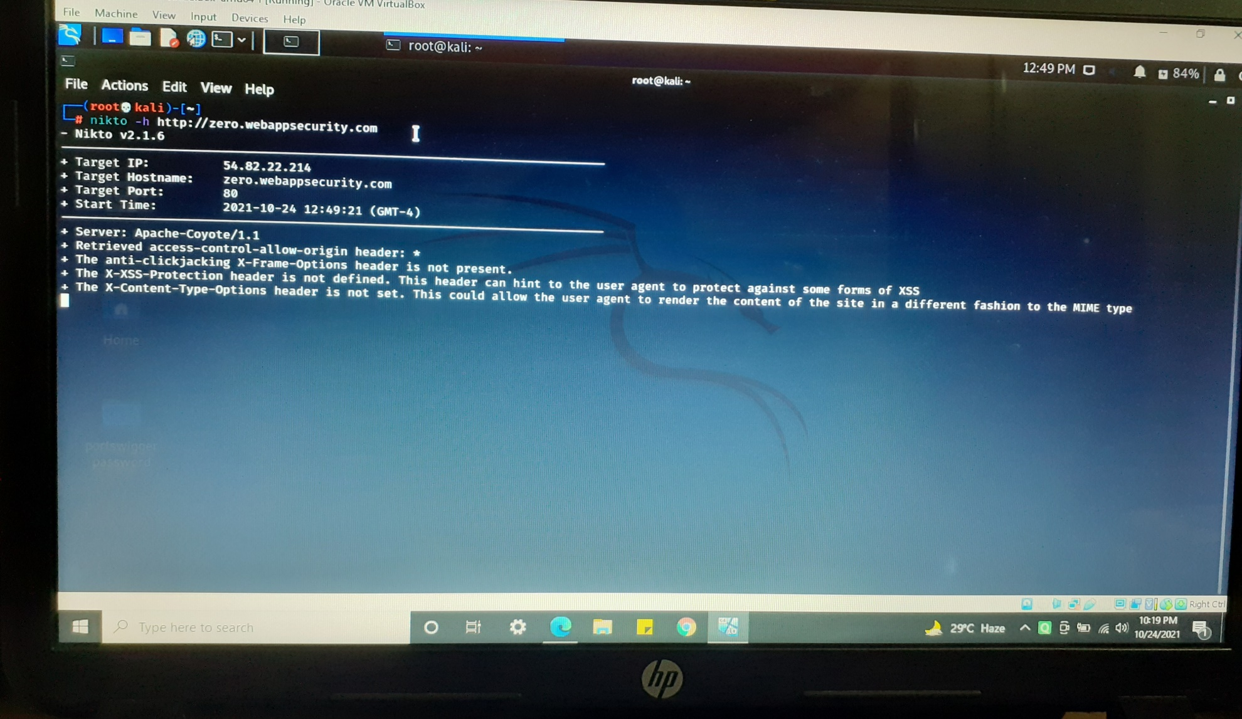
POC screenshots are included in the Report which is attached below:

Slide 8
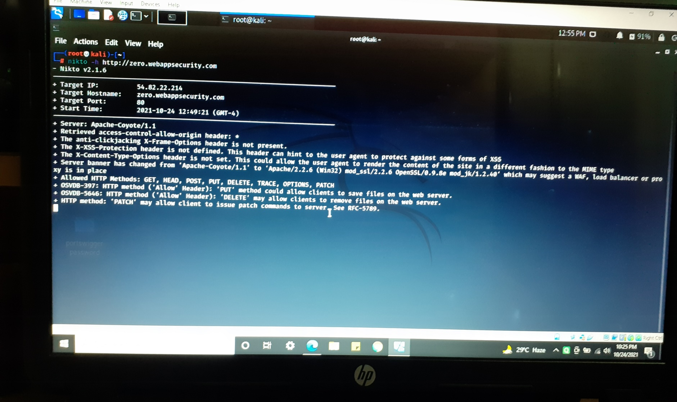

Slide 9
