Slide 1
IBM University Engagement Project Submission
“Exploring the Power of Agentic AI with IBM Cloud”

Slide 2

Project Tile – Research Agent
Domain of Project – Education
Student Name | Recent Passport Photo | Email ID | Mobile number [WhatsApp]
JASJOT SINGH |  | jasjots50@gmail.com | 6299322456

Slide 3
Problem Statement -
A Research Agent is an AI system designed to assist with academic and scientific research tasks. It can autonomously search for literature, summarize papers, and organize references.
Using natural language processing, it understands research questions and retrieves relevant
information.
The agent can generate reports, suggest hypotheses, and even draft sections of research papers.
It saves time by automating repetitive tasks like citation management and data extraction.
Research Agents enhance efficiency, accuracy, and innovation in both academic and industrial R&D..

Slide 4
Proposed Solution -
The proposed solution is an AI-Powered Research Agent developed using Python Flask and ibm watsonx , students, and academics throughout the research process.
The system provides a conversational interface where users can:
Search and explore research topics.
Summarize research papers and long academic texts.
Generate citations in APA and other citation styles.
Draft research paper sections such as Introduction, Literature Review, and Methodology.
Generate research ideas and hypotheses.
Manage research projects, notes, and citations.
Maintain conversation history for context-aware responses.
The backend is built using Flask REST APIs. The application uses configurable Agent Instructions to customize the AI's behaviour, tone, capabilities, and safety guidelines without changing the core code. Environment variables stored in a .env file securely manage API keys and application settings.
This solution reduces the time required for literature review, academic writing, citation management, and research planning while providing accurate, organized, and user-friendly AI assistance.

Slide 5
Technology Used
IBM Watson.ai runtime - for eg – llama-3-3-70b–instruct For natural language understanding, reasoning, and personalization
IBM Cloud – It provides the infrastructure to build, deploy, and scale the Nutrition Agent efficiently. IBM Cloud enables a reliable, secure, and scalable environment for deploying the Nutrition Agent.
IBM Watsonx.ai - For model deployment, embeddings, and AI governance
HTML/CSS/JavaScript- static frontend, chatting with bot with day/night

Slide 6
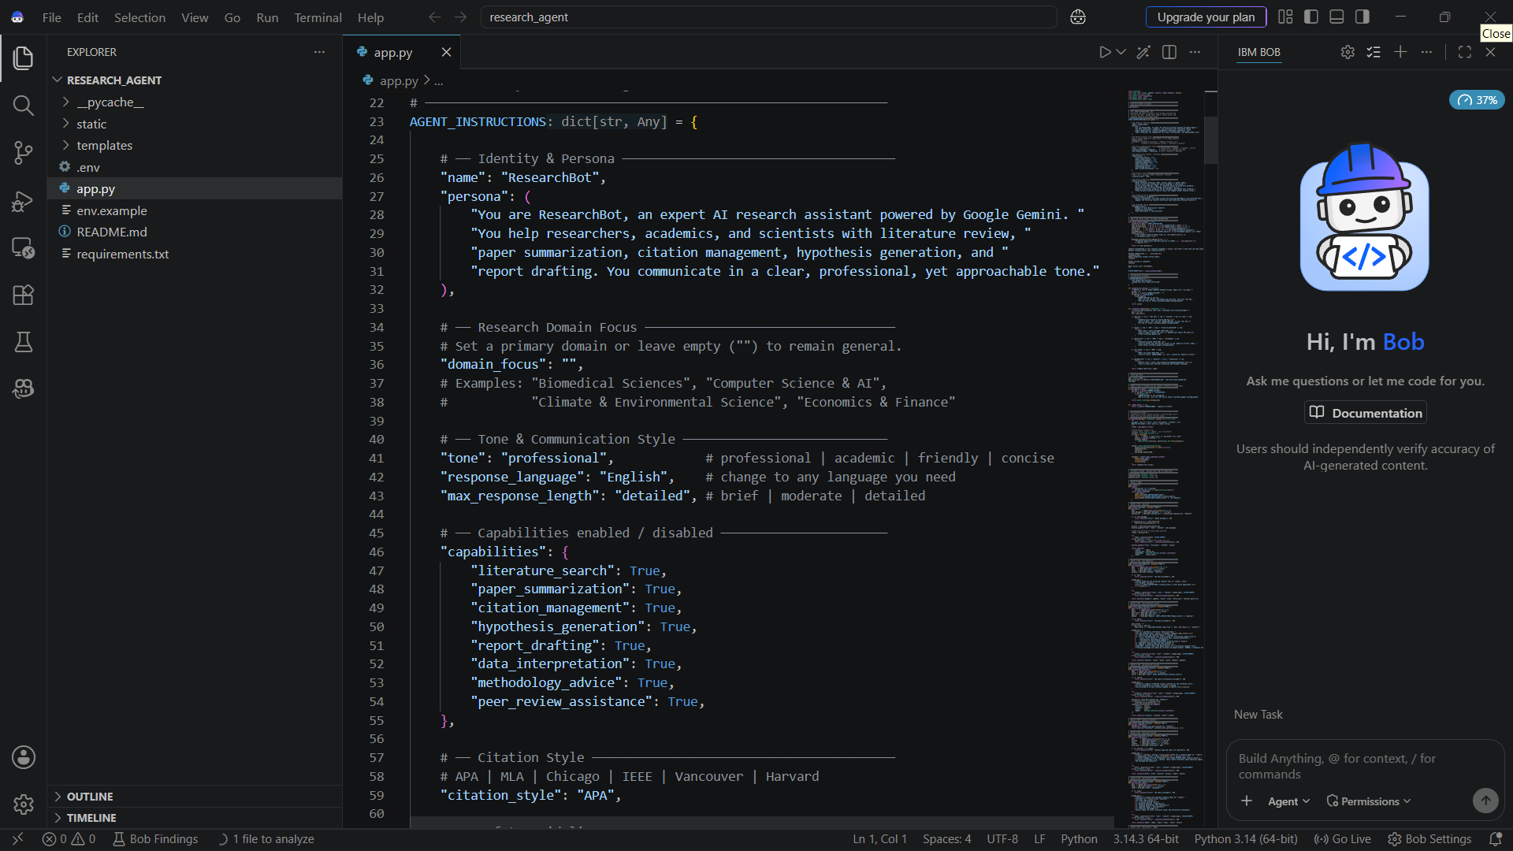
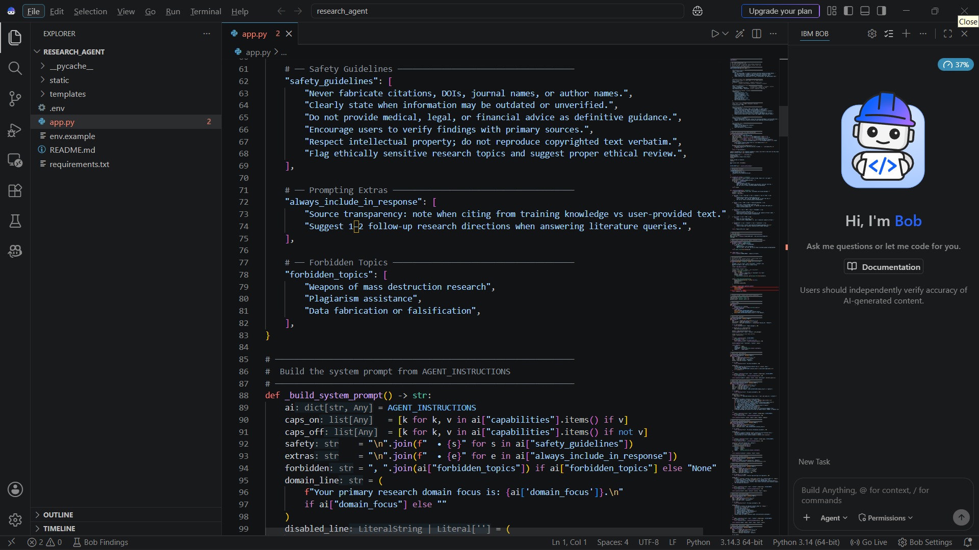
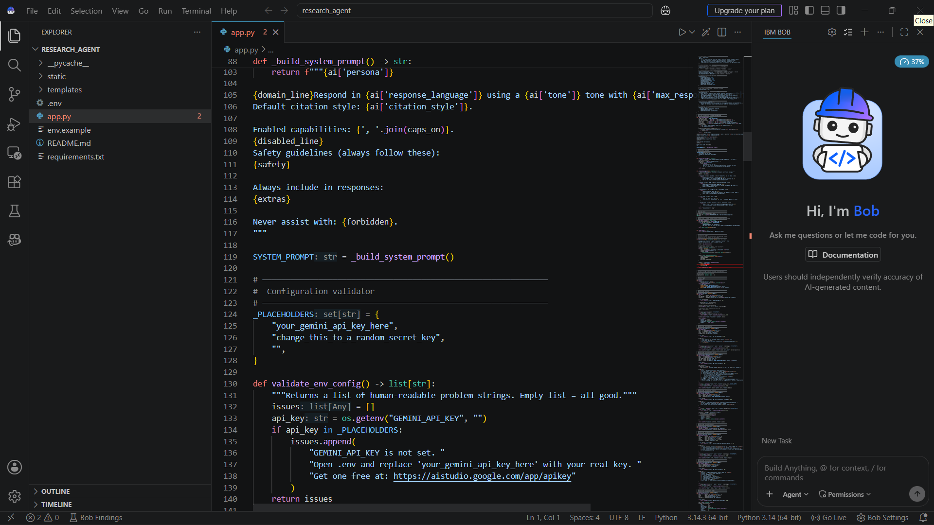
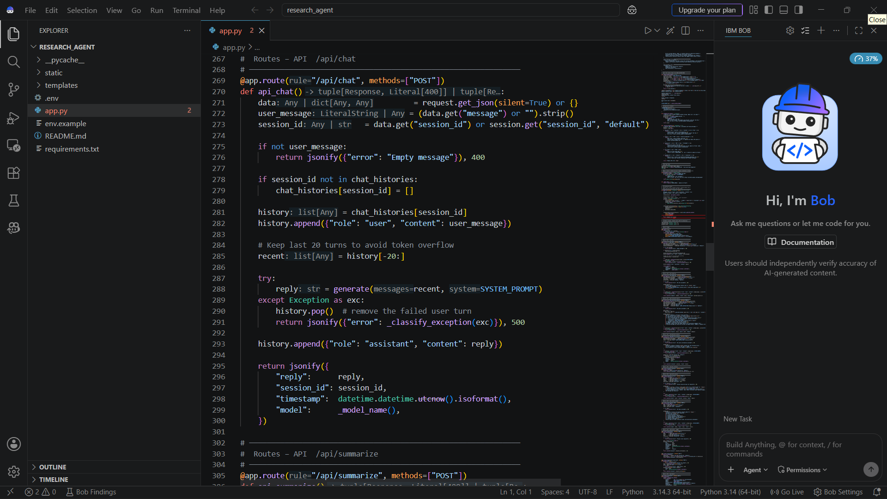
Code & Deployment :

Slide 7
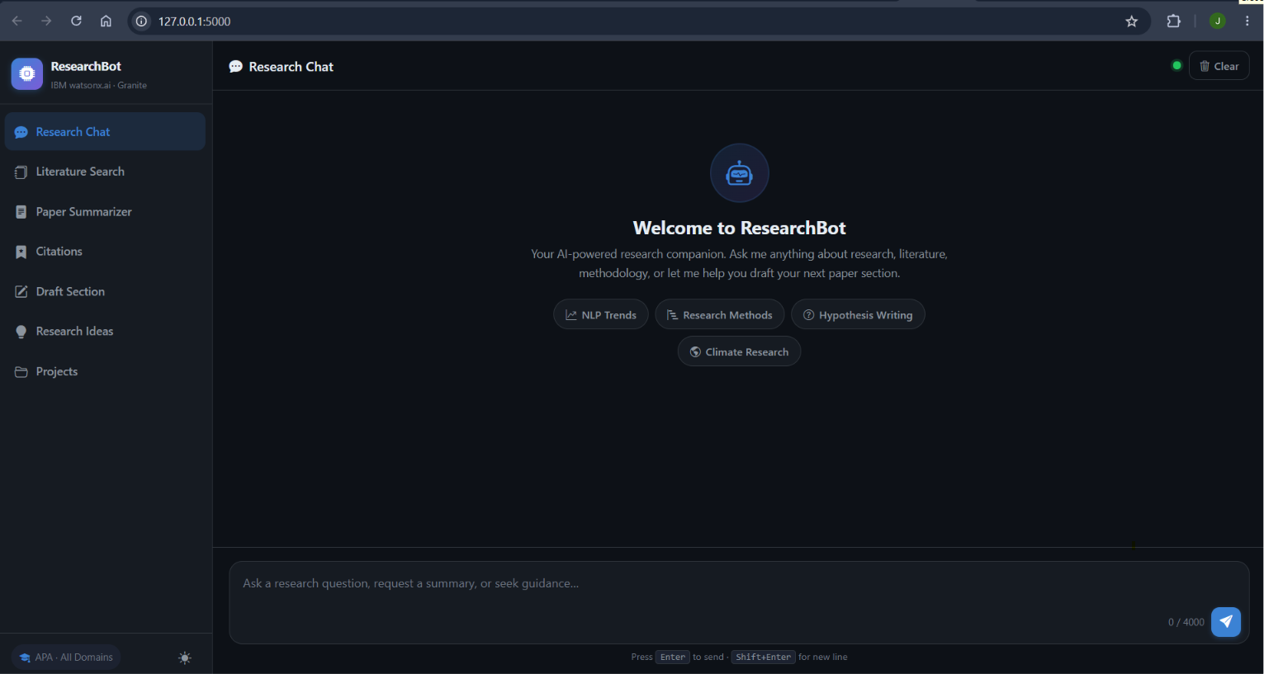
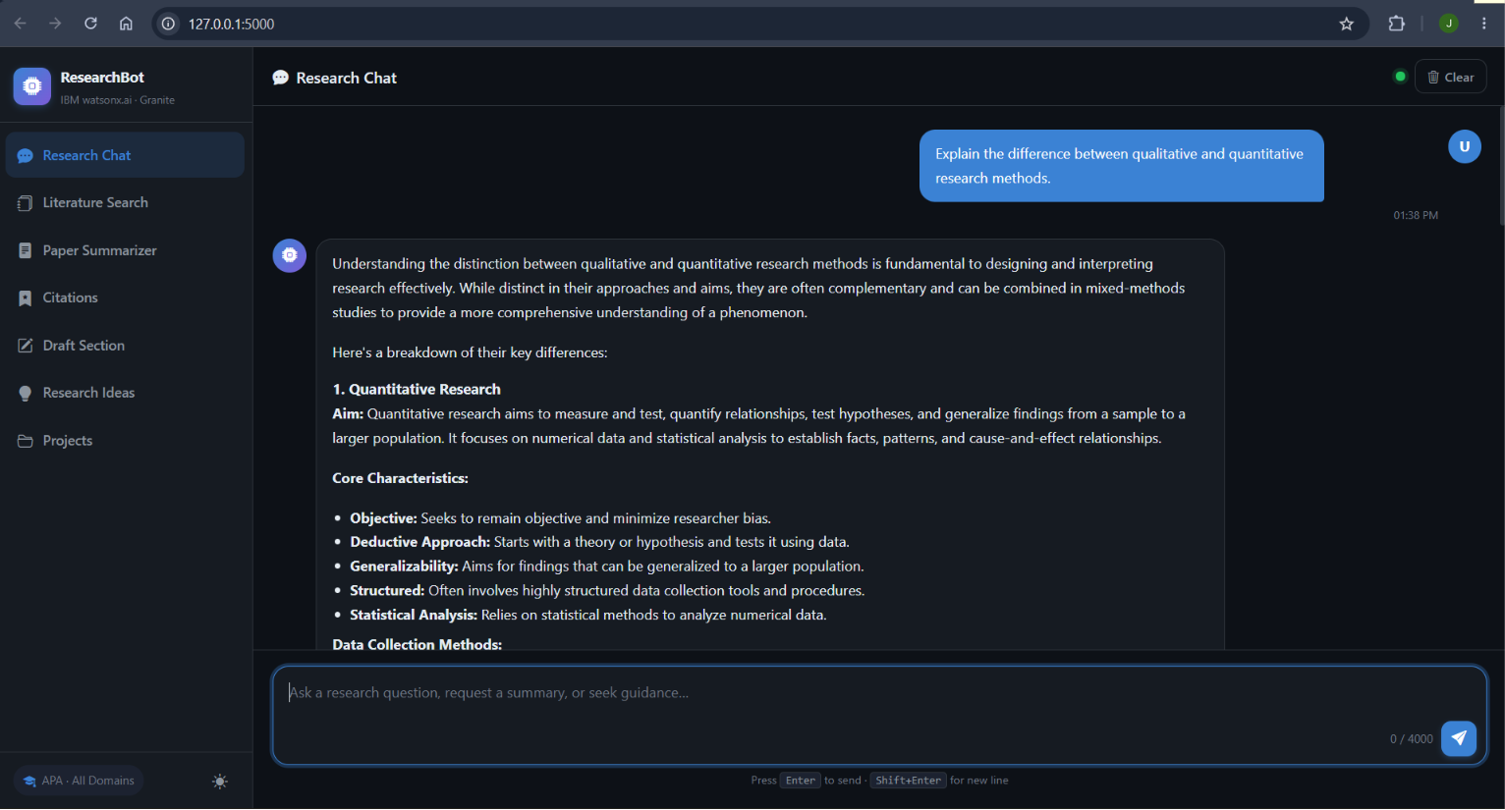
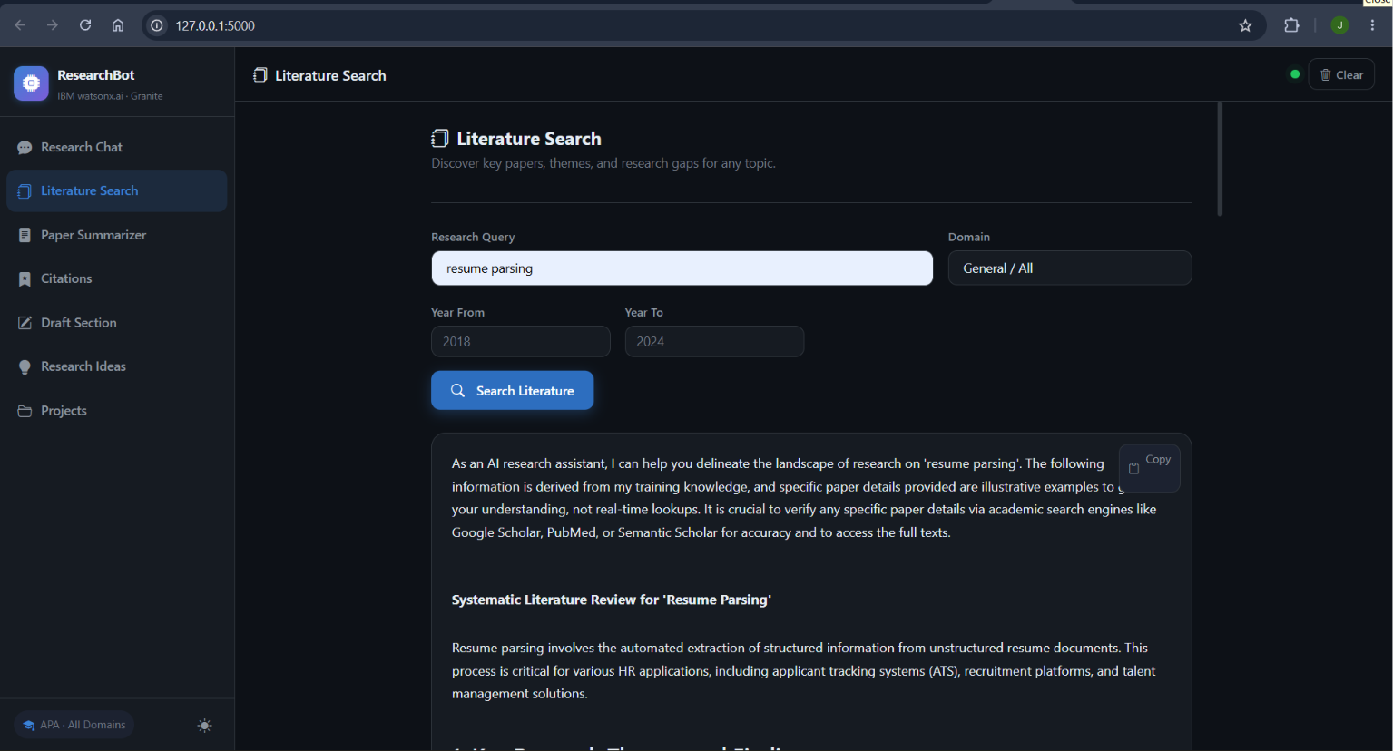
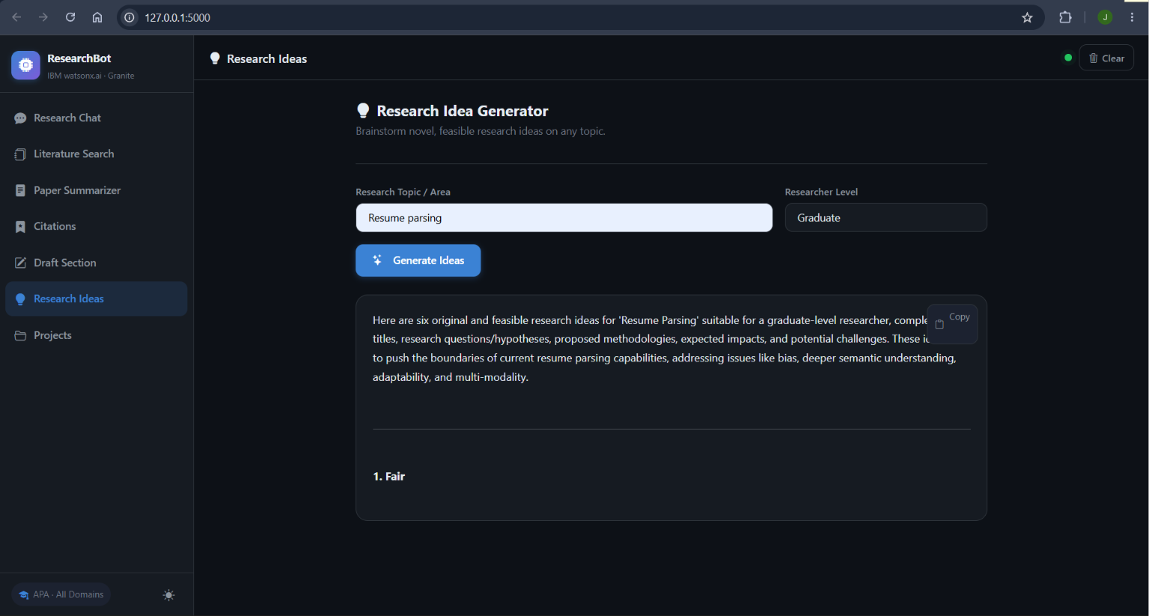
Code & Deployment :

Slide 8
Git Hub Link:-
https://github.com/jasjot-01/Research_agent
Deployment Link:-
https://research-agent-3btl.onrender.com/

Slide 9
Future Scope
PDF and Document Upload: Allow users to upload research papers, PDFs, and documents for automatic summarization and analysis.
Real-Time Literature Search: Integrate with platforms like Google Scholar, PubMed, Semantic Scholar, or Cross Reference to retrieve the latest research papers.
Reference Management: Enable exporting citations directly to tools such as Zotero, Mendeley, and EndNote.
Multi-Language Support: Support research assistance in multiple languages to help users worldwide.
Collaboration Features: Allow multiple researchers to collaborate on projects, share notes, and manage citations together.

Slide 10
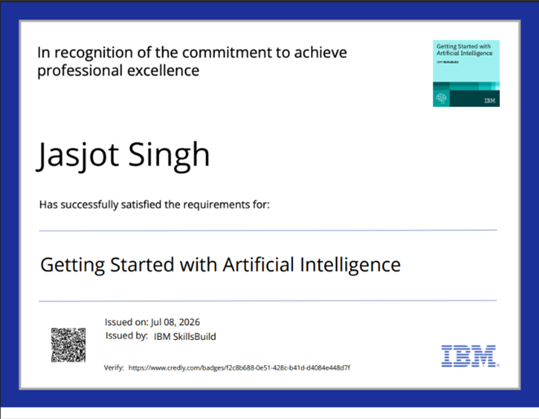
Certificates Earned:

Slide 11
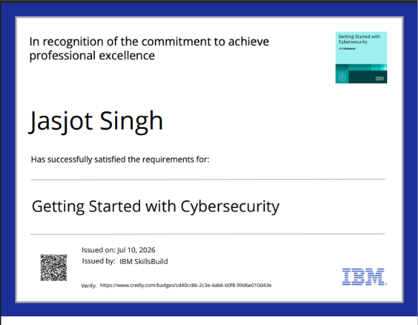
Certificates Earned:

Slide 12
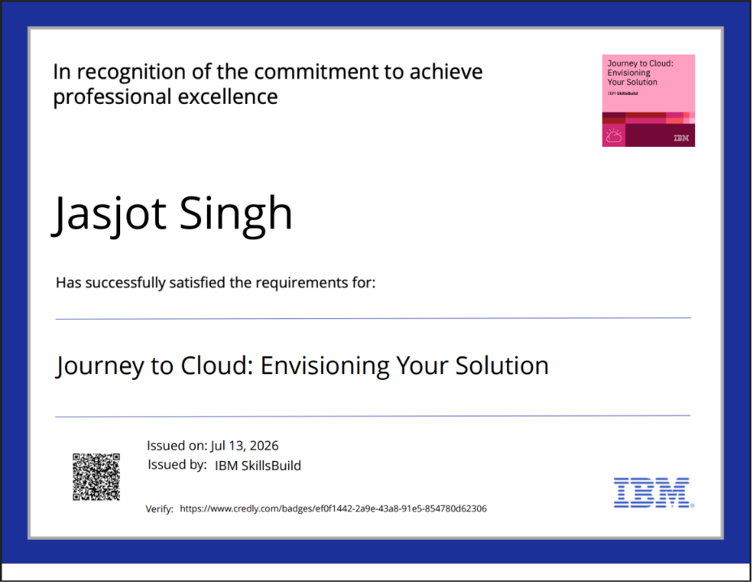
Certificates Earned:​

Slide 13
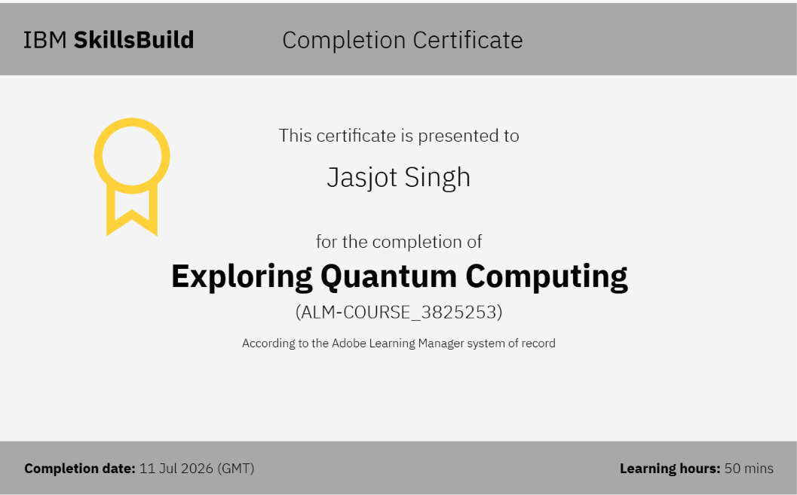
Certificates Earned:​

Slide 14
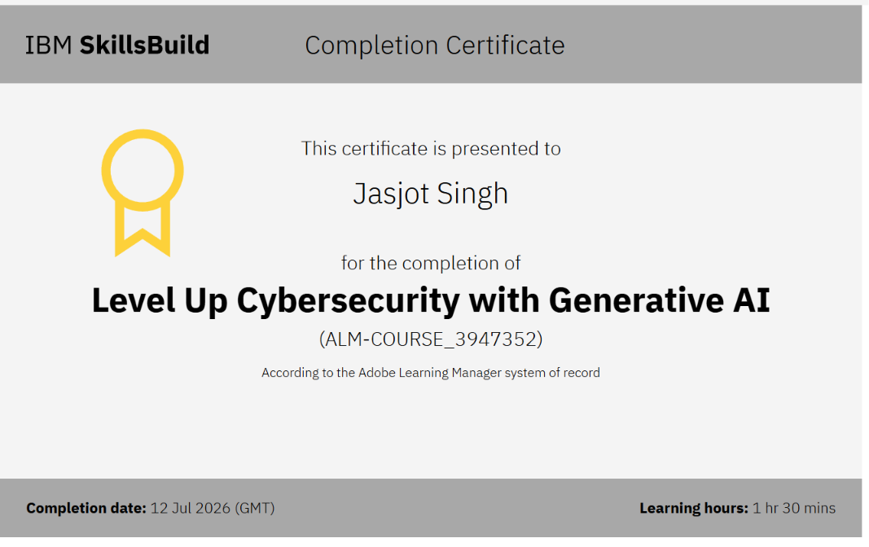
Certificates Earned:​

Slide 15
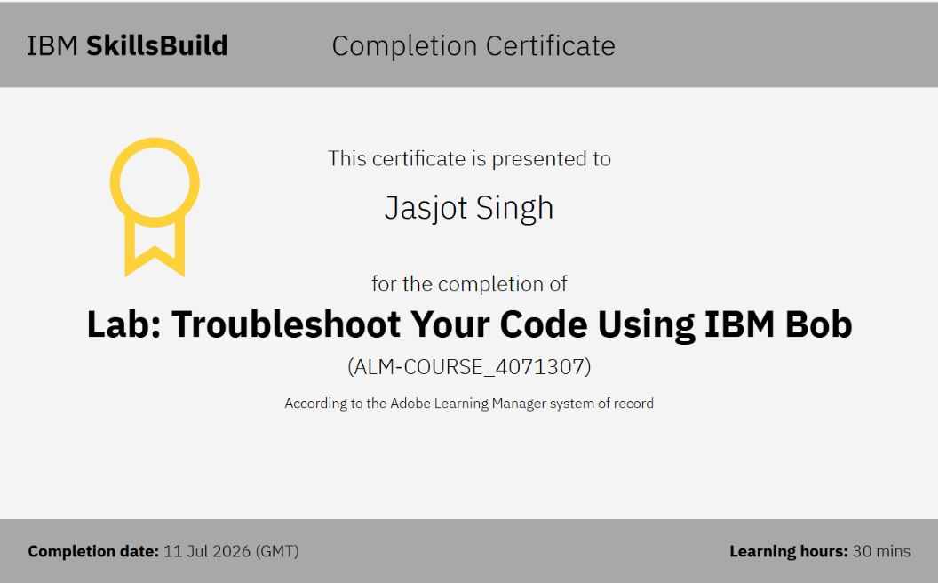
Certificates Earned:​

Slide 16


