Slide 1
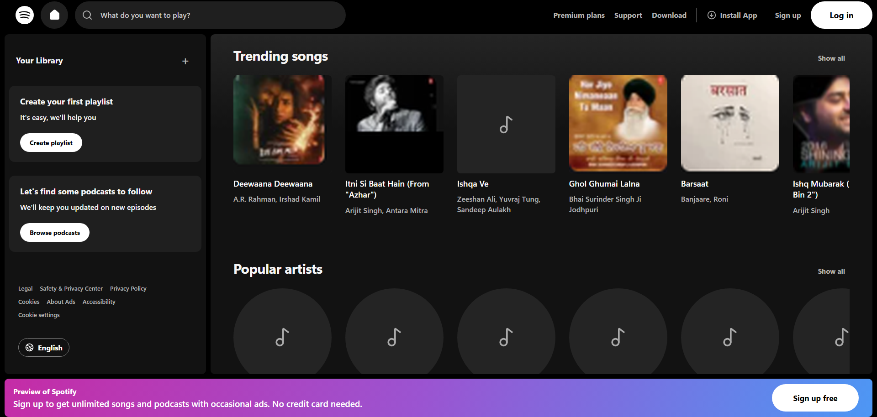
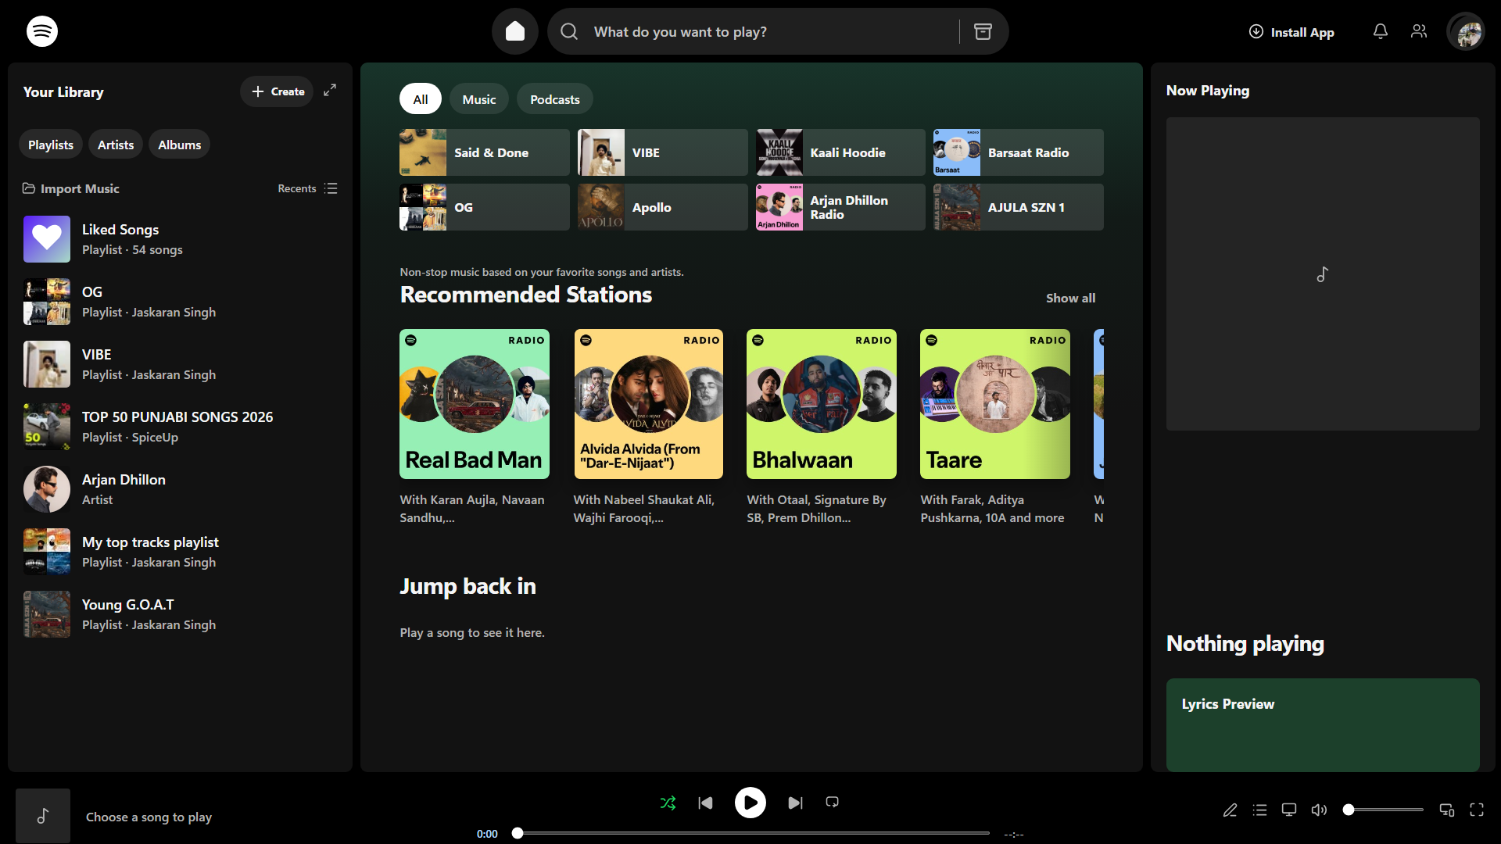
FRONT END ENGINEERING-II / PROJECT PRESENTATION
Pulsewave
A Spotify-inspired music streaming web application
A frontend demonstration of music discovery, playlists, playback controls, and local audio import.
Existing project capture • empty player state
Student: [Your name]
Registration no.: [Your registration number]
University / Faculty: [Your university and faculty]
Existing project captures, not taken during this presentation task.
FRONT END ENGINEERING-II / PULSEWAVE

Slide 2
PULSEWAVE PROJECT
Project overview
Pulsewave brings the familiar parts of a music app into one React interface.
The project demonstrates how a frontend can organize discovery, playlists, playback controls, personal likes, and music files selected by the listener. It is a local browser experience, not a production streaming service.
Discover
Listen
Personalize
Browse featured tracks, stations, and artist collections.
Choose sample or imported tracks and use shared playback controls.
Save likes, queue tracks, and revisit recent playback.
FRONTEND DEMO • NO STREAMING BACKEND • NO REAL ACCOUNT OR PAYMENTS
FRONT END ENGINEERING-II / PULSEWAVE

Slide 3
PULSEWAVE PROJECT
Project objectives
01
02
03
Music-player interface
Component-based React
Interactive navigation
Create a dark, familiar desktop listening layout.
Separate public pages, player views, and shared state.
Connect public pages, playlists, search, and player routes.
04
05
06
Track discovery
User preferences
Local music
Present demo tracks, stations, and playlist collections.
Persist likes, recent tracks, and volume in the browser.
Read supported audio files and available ID3 metadata locally.
FRONT END ENGINEERING-II / PULSEWAVE

Slide 4
PULSEWAVE PROJECT
Technology stack
React 19
JavaScript + JSX
Component rendering and UI composition.
Application logic, event handling, and React markup.
CSS
Vite
Responsive dark interface and component styling.
Development server and production build tooling.
Context API + hooks
Browser storage
Shared player state with useState, useEffect, useMemo, and useCallback.
localStorage for preferences; IndexedDB for the directory handle.
lucide-react supplies interface icons. No Redux or backend service is used.
FRONT END ENGINEERING-II / PULSEWAVE

Slide 5
PULSEWAVE PROJECT
Application architecture
src/main.jsx
src/App.jsx
PublicExperience.jsx
Player UI + Context
StrictMode
PlayerProvider wraps App
Route selection
Player shell and views
Landing, auth, Premium, account demo
App.jsx uses usePlayer()
Shared player state
Music data
Persistence
Track, audio, queue, likes, volume, shuffle, repeat, and recent IDs.
musicData.js supplies sample tracks and VIBE playlist IDs. Imported tracks join at runtime.
localStorage stores likes, volume, and recent IDs. IndexedDB stores a folder handle.
File names and component relationships are taken from the current source.
FRONT END ENGINEERING-II / PULSEWAVE

Slide 6
PULSEWAVE PROJECT
Public homepage
Header navigation, library prompts, song discovery cards, artist rail, and sign-up banner.
Existing project capture from an earlier session. Not a fresh browser render.
FRONT END ENGINEERING-II / PULSEWAVE

Slide 7
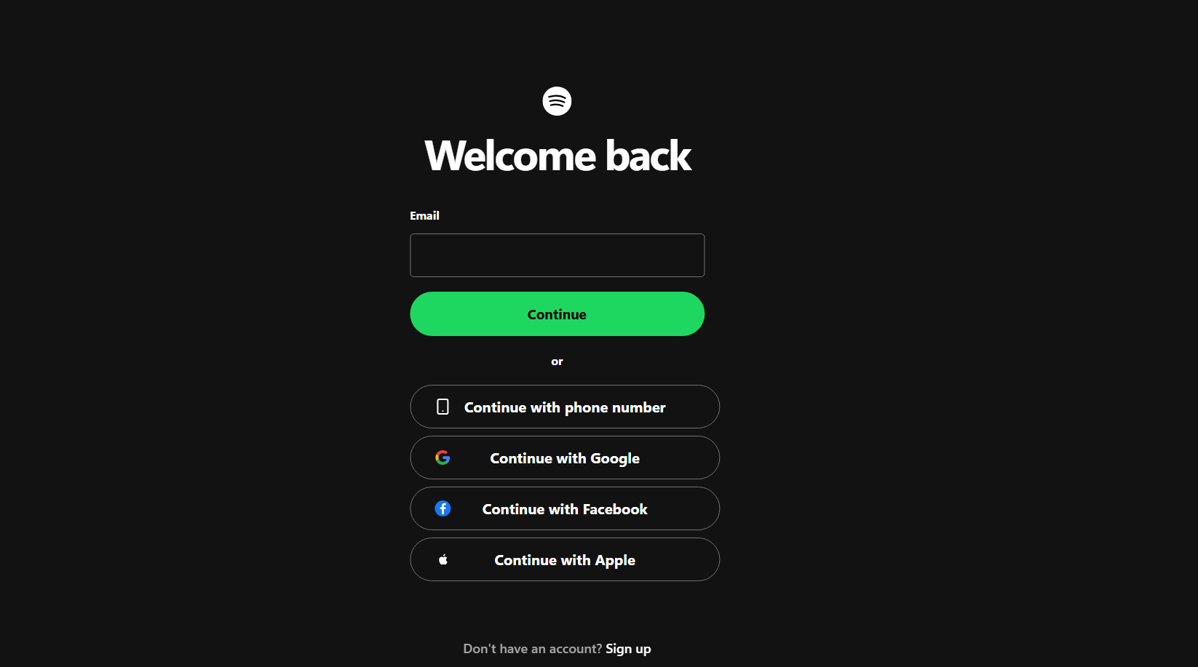
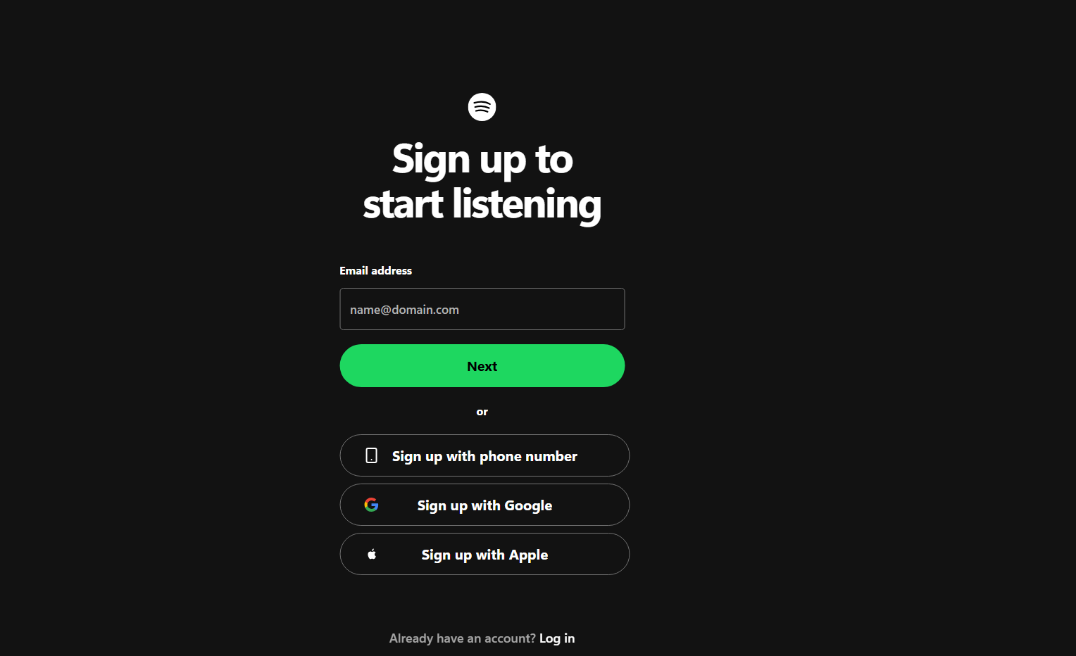
PULSEWAVE PROJECT
Login and sign-up
Both forms use controlled email state, trim input, validate format, and respond without a backend.
Login
Sign-up
Existing project capture
Existing project capture
Valid email shows a demo-only message. No password is requested, no account is created, and email is not saved.
FRONT END ENGINEERING-II / PULSEWAVE

Slide 8
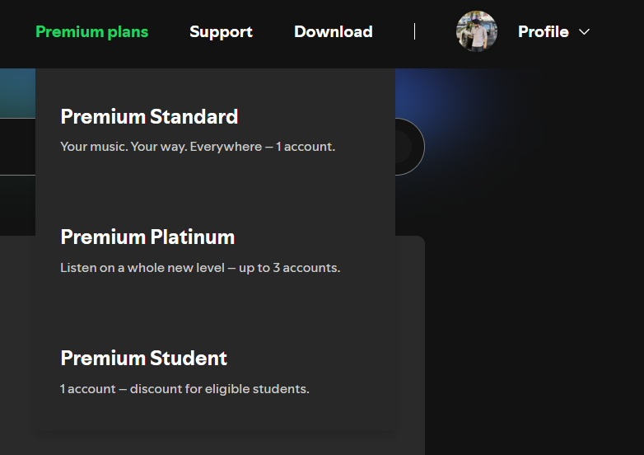
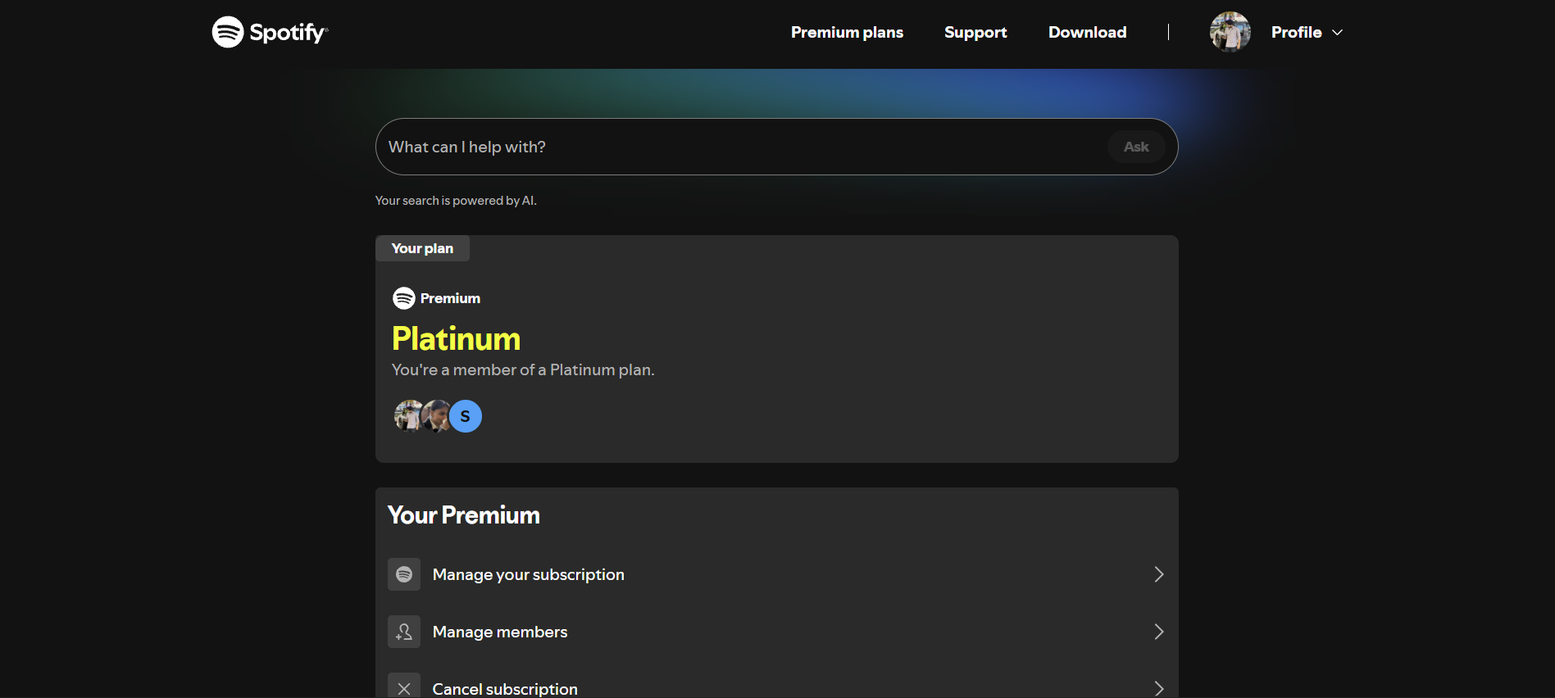
PULSEWAVE PROJECT
Premium plans and account dashboard
Public route opens plan options; account route provides clearly labeled frontend-only demo controls.
Premium plans
Account dashboard
Supplied reference image, not a fresh app capture
Supplied reference image, not a fresh app capture
No payment, subscription change, or real account data is connected.
FRONT END ENGINEERING-II / PULSEWAVE

Slide 9
PULSEWAVE PROJECT
Music player
App.jsx composes the library, main content, optional Now Playing panel, and bottom audio controls.
Controls
Play / pause
Previous / next
Seek and volume
Shuffle / repeat
Queue and likes
Prior capture shows the empty player state.
Current browser interaction and responsive rendering were not tested for this deck.
FRONT END ENGINEERING-II / PULSEWAVE

Slide 10
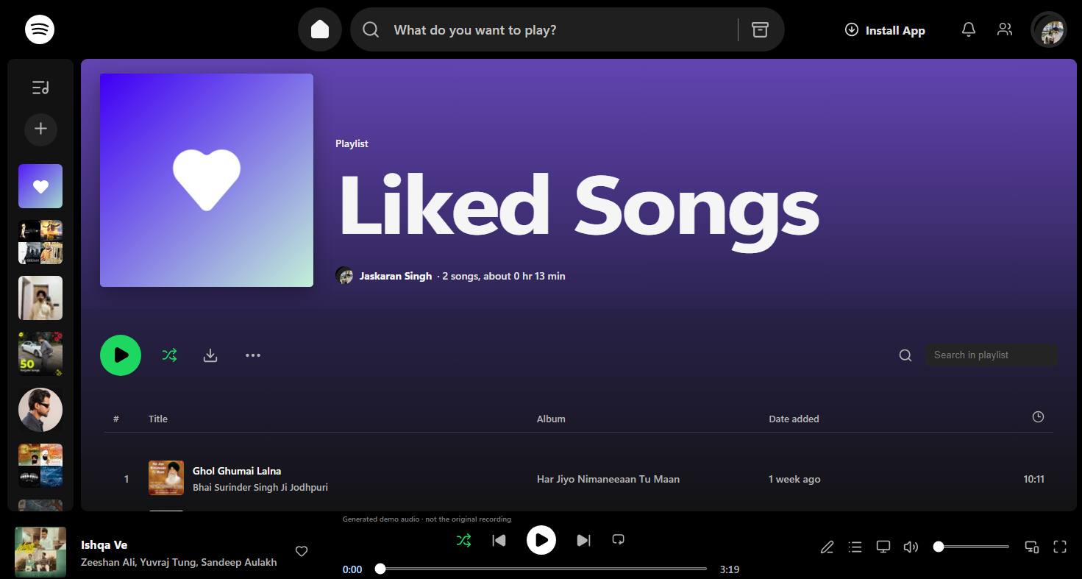
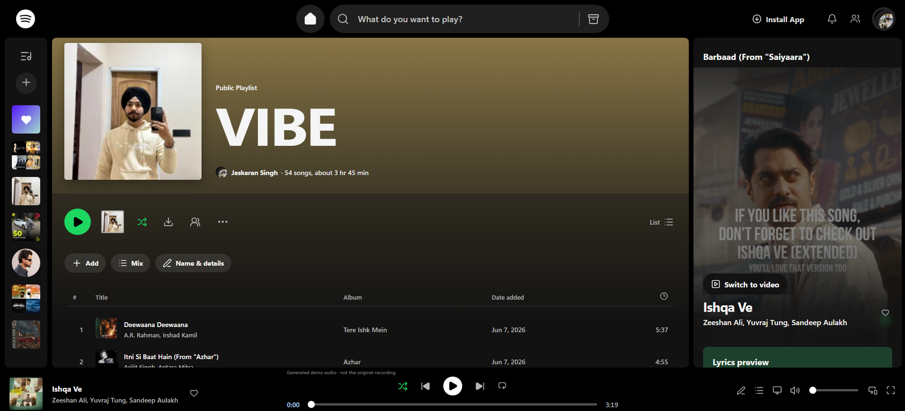
PULSEWAVE PROJECT
Playlists and search
VIBE maps to sample track IDs. Liked Songs is built from the saved liked-ID list.
VIBE playlist
Liked Songs
Search matches title, artist, album, and imported filename. Selecting a result calls playTrack().
Existing captures; not freshly browser-verified.
FRONT END ENGINEERING-II / PULSEWAVE

Slide 11
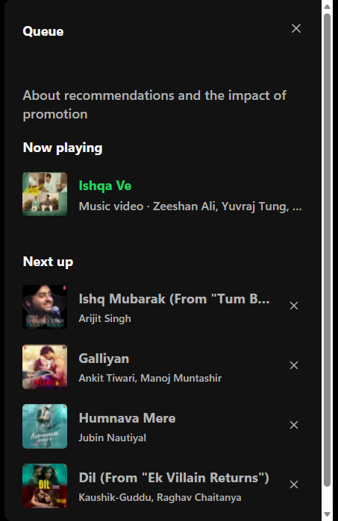
PULSEWAVE PROJECT
Queue and recently played
Queue
Queue IDs live in PlayerContext. Next playback consumes the first available queued track.
Recent history
playTrack() moves the selected stable ID to the front, removes duplicates, and keeps up to 12 IDs.
Persistence
Recent IDs are restored from and written to localStorage under pulsewave-recent-tracks.
Existing queue panel capture
FRONT END ENGINEERING-II / PULSEWAVE

Slide 12
PULSEWAVE PROJECT
Local music import
Audio files are selected by the listener and processed in the browser.
01
Choose a folder
File System Access API when available; directory-input fallback otherwise.
What persists?
IndexedDB stores the directory handle.
Audio files remain in their original folder.
Imported tracks use in-memory object URLs and may need re-import after reload.
02
Read supported files
Audio extensions and audio MIME types are accepted.
03
Read tags and cover
ID3 title, artist, album, and APIC/PIC artwork are parsed when present.
04
Add to player
Stable ID, duration, metadata, and object URLs become runtime track data.
No personal music files were accessed. End-to-end import and playback were not tested for this presentation.
FRONT END ENGINEERING-II / PULSEWAVE

Slide 13
PULSEWAVE PROJECT
React concepts in the code
Source-based examples: shared state, hook usage, and controlled form handling.
Shared playback state
Controlled email form
// main.jsx
<PlayerProvider>
<App />
</PlayerProvider>
// PlayerContext.jsx
const [currentId, setCurrentId] = useState(null)
const [recentTrackIds, setRecentTrackIds] = useState(readRecentTracks)
const [email, setEmail] = useState('')
const trimmedEmail = email.trim()
if (!trimmedEmail) {
setError('Enter your email address.')
return
}
// Demo message only; not sent or saved.
usePlayer() exposes provider state and actions to player views.
AuthPage handles submit, labels, and accessible error text.
FRONT END ENGINEERING-II / PULSEWAVE

Slide 14
PULSEWAVE PROJECT
Testing and limitations
REPORTED VALIDATION FROM THE EXISTING PROJECT PASS
Build
npm.cmd run build passed during this presentation task.
Lint
npm.cmd run lint passed during this presentation task.
Static routes
Routes were inspected; Vite returned HTTP 200 for checked destinations.
Rendering
HTTP 200 confirms an app shell response, not a rendered React route.
Browser QA
Rendered layouts, interactions, console, and responsive behavior remain unverified.
Local import
Importing and playing personal files was not tested.
No browser automation or screenshot rendering tool was available in this environment.
FRONT END ENGINEERING-II / PULSEWAVE

Slide 15
PULSEWAVE PROJECT
Conclusion and future scope
Pulsewave demonstrates a connected, component-based frontend for music discovery and playback.
The application combines public-facing pages with a local player, playlists, queue, likes, search, recent history, and browser-based audio import.
IMPLEMENTED IN THIS FRONTEND DEMO
FUTURE SCOPE
Public homepage and demo account pages
React player with shared state
Playlists, search, queue, likes, and history
Local audio import workflow
Real authentication and backend
Remote licensed music catalogue
Cloud library persistence
Subscription integration
Thank you
FRONT END ENGINEERING-II / PULSEWAVE

