Slide 1



Cash Deposit Illustration
Confidential
05-03-2020
Powered by
01420 479 463
www.churchsfp.co.uk

Slide 2
Name | jaskaran100 | Reference | ICS-20200304-125424
Account type | 0 | Date | 05-03-2020
As a Client of Church’s Financial Planning we have reduced your fee by 0.05% to %
Illustration Summary
Total Deposit | 1255002 | Gross Annual Yield | 1.3735056199113626910554724200%
Protection Eligibility | % | Gross Annual Interest | 17237.523000
Fee Charge | % | Net Annual Yield | 1.2235056199113626910554724200%
 |  | Net Annual Yield | 15355.020000
Institution | Term | Rate (AER) | Deposit | Annual interest
Aldermore Bank | 18 Month Bond (Term) | 1.75% | 85000.00 | 1487.500000
OakNorth | 18 Month Bond (Term) | 1.60% | 85000.00 | 1360.00000
Bank and Clients | 1 Year Bond (Term) | 1.61% | 85000.00 | 1368.500000
Charter Savings Bank | 1 Year Bond (Term) | 1.60% | 85000.00 | 1360.00000
Arbuthnot Latham Bank | 1 Year Bond (Term) | 1.50% | 85000.00 | 1275.00000
Hodge Bank | 1 Year Bond (Term) | 1.45% | 85000.00 | 1232.500000
Investec Bank plc | 1 Year Bond (Term) | 1.35% | 85000.00 | 1147.500000
Lloyds Bank | 1 Year Bond (Term) | 0.95% | 85000.00 | 807.500000
The Cambridge | 100 Day (Notice) | 1.25% | 85000.00 | 1062.500000
Cambridge & Counties Bank | 95 Day (Notice) | 1.25% | 85000.00 | 1062.500000
Nationwide Building Society | 95 Day (Notice) | 1.10% | 85000.00 | 935.00000
Teachers Building Society | 35 Day (Notice) | 1.00% | 85000.00 | 850.0000
Shawbrook Bank | Instant Access | 1.19% | 85000.00 | 1011.500000
National Savings & Investments | Instant Access | 1.15% | 65002.00 | 747.523000
This illustration is only intended to provide you with an indication of the banks, accounts and likely interest rates that can be obtained via Insignis Cash Solutions and is not advice or recommendation of the banks and/or accounts in which to deposit your funds. You are responsible for the selection of the banks and accounts to suit your own circumstances.
All interest rates shown are correct as of the illustration date. All interest rates are subject to change up to the time a deposit is placed.
The Protection Eligibility calculation assumes that you are eligible for FSCS protection and have no other deposits with the banks in the illustration. For more information please see the FSCS website www.fscs.org.uk
Any funds in NS&I accounts are separately protected in full by HM Treasury
The availability of your cash will depend on the notice period for deposits in the individual accounts. You should expect that any money placed in Term accounts will not be available before the maturity date.
01420 479 463
www.churchsfp.co.uk

Slide 3
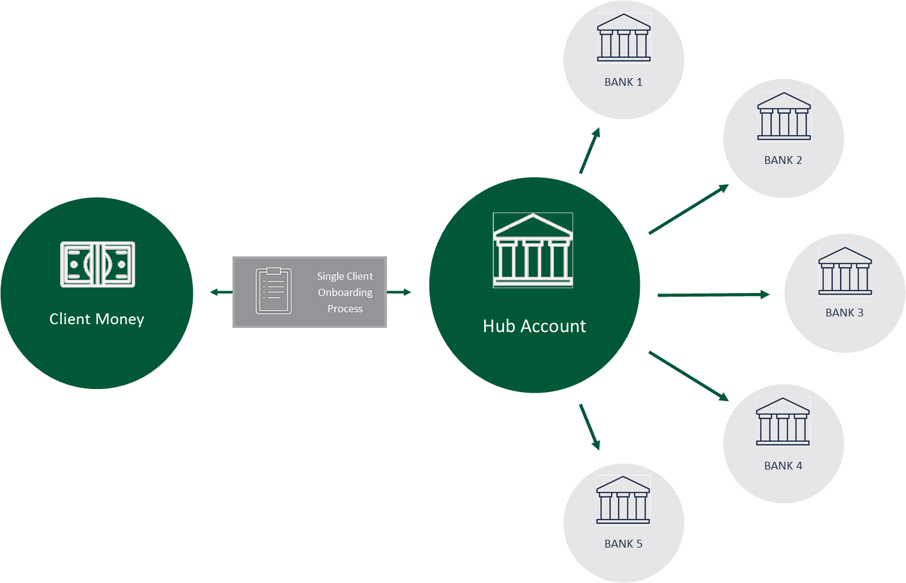





How it Works
Benefits
FSCS Protection
Government-backed FSCS protection eligibility of up to £85,000 per individual for each account opened.
A Managed Account
Ongoing management and proactive communication means always getting better returns for your cash.
Your Money
You remain the beneficial owner of your money regardless of how many savings accounts you open.
One-time Sign Up Process
The gateway to multiple savings accounts now and in the future.
FCA Approved
Insignis is independent and fully regulated by the FCA under the new payment service regulations.
01420 479 463
www.churchsfp.co.uk

Slide 4



Next Steps
Fees
The fee is based on the size of your deposit per annum. It’s charged quarterly in arrears, taken directly from your portfolio. It’s reflected in your balance transaction with no invoicing process. There are no sign up fees or charges of any other nature.
This is a VAT exempt service as it is classified as a ‘financial intermediary service’.
COMPLETE A SINGLE SIGN UP PROCESS
All we need is an application form and ID, we’ll do the rest!
ACCOUNT SETUP AND FUND TRANSFER!
You’ll receive a Welcome Letter with your Insignis platform details.
We’ll now need the deposit, either by bank transfer or cheque.
LOGIN AND START SAVING
Login to the Insignis platform to view and manage your savings accounts in one place and watch your interest grow!
01420 479 463
www.churchsfp.co.uk

