Slide 1



Cash Deposit Illustration
Confidential
12 February 2020
Powered by
info@ebury.com
+44 (0) 20 3872 6670
www.ebury.com

Slide 2
Name | Jaskraan
Account type | 0
Reference | ICS-20200313-105735
Date | 13-03-2020
Illustration Summary
Total Deposit | 100000 | Gross Annual Yield | 1.198500%
Protection Eligibility | % (TO BE FILLED IN) | Gross Annual Interest | 1198.500000
Fee Percentage | % | Net Annual Yield | 0.948500%
 |  | Net Annual Yield | 948.500000
Institution | Term | Rate (AER) | Deposit | Annual interest
Shawbrook Bank | Instant Access | 1.19% | 15000.00 | 178.500000
This illustration is only intended to provide you with an indication of the banks, accounts and likely interest rates that can be obtained via Insignis Cash Solutions and is not advice or recommendation of the banks and/or accounts in which to deposit your funds. You are responsible for the selection of the banks and accounts to suit your own circumstances.
All interest rates shown are correct as of the illustration date. All interest rates are subject to change up to the time a deposit is placed.
The Protection Eligibility calculation assumes that you are eligible for Bank protection and have no other deposits with the banks in the illustration.
Any funds in NS&I accounts are separately protected in full by HM Treasury
The availability of your cash will depend on the notice period for deposits in the individual accounts. You should expect that any money placed in Term accounts will not be available before the maturity date.
info@ebury.com
+44 (0) 20 2872 6670
www.ebury.com

Slide 3

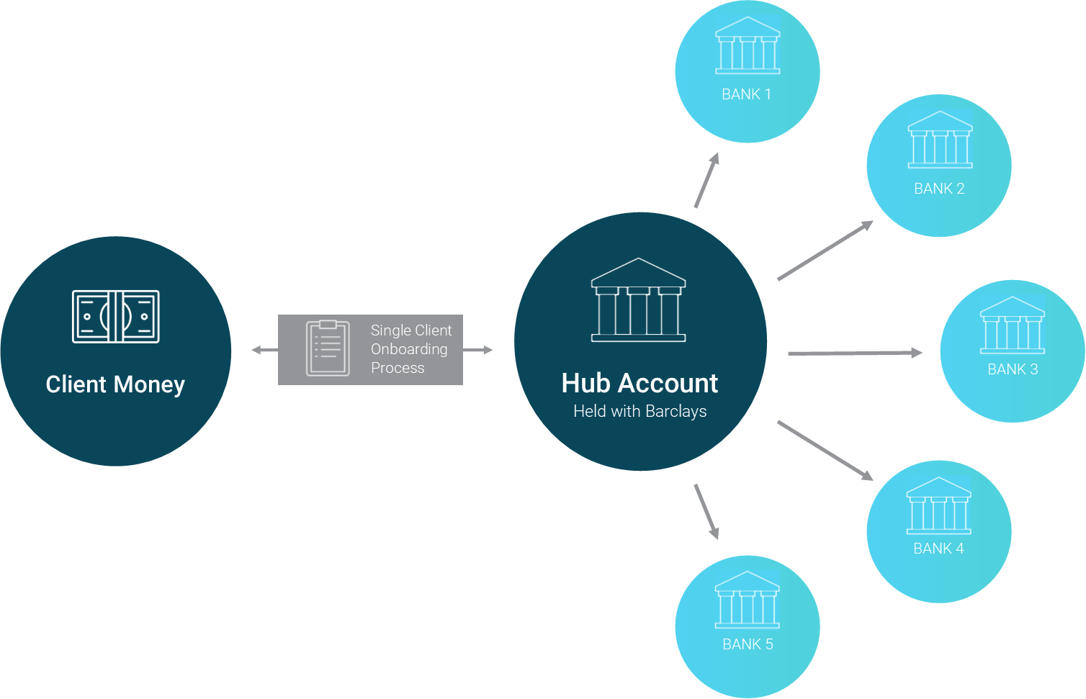




Benefits
How it Works
FSCS Protection
Government-backed FSCS protection eligibility of up to £85,000 per individual for each account opened.
A Managed Account
Ongoing management and proactive communication means always getting better returns for your cash.
Your Money
You remain the beneficial owner of your money regardless of how many savings accounts you open.
One-time Sign Up Process
The gateway to multiple savings accounts now and in the future.
FCA Approved
Insignis is independent and fully regulated by the FCA under the new payment service regulations.
info@ebury.com
+44 (0) 20 2872 6670
www.ebury.com

Slide 4



Fees
Next Steps
The fee is based on the size of your deposit per annum. It’s charged quarterly in arrears, taken directly from your portfolio. It’s reflected in your balance transaction with no invoicing process. There are no sign up fees or charges of any other nature.
This is a VAT exempt service as it is classified as a ‘financial intermediary service’.
COMPLETE A SINGLE SIGN UP PROCESS
All we need is an application form and ID, we’ll do the rest!
ACCOUNT SETUP AND FUND TRANSFER!
You’ll receive a Welcome Letter with your Insignis platform details.
We’ll now need the deposit, either by bank transfer or cheque.
LOGIN AND START SAVING
Login to the Insignis platform to view and manage your savings accounts in one place and watch your interest grow!
info@ebury.com
+44 (0) 20 2872 6670
www.ebury.com

