Slide 1


WeWork.com Work in your spare time and get paid!
Team Members: Akshay Kacharaj Jagtap Bo Li Jaskaran Singh Khushboo Gupta Malhar Ujawane Manushi Sheth Nidhi Prakash Sakthi Priya Rajendran Vaibhav Kumar
Unzule Sari

Slide 2

Introduction!
WeWork,
is a crowdsourcing platform for individuals to find work or post a job and find workers
has a coin-based system which allows you to pay an individual in coins for your work
individuals can find short term or time-based employment for on-demand services

Slide 3

Project Features
Same user (one account) can be both employee and employer
Coin Based Transactions - between employer and employee
Display most recent job postings on the home page
Wallet for coins/credits, verification of payment
Adding categories to jobs

Slide 4

Technology Stack
HTML 5.0 – HTML 5.0 is used to design web pages
CSS 3.0 – CSS 3.0 is used for styling of the web pages
JavaScript – Function handling, validations are handled by JavaScript
PHP – PHP is used to as server-side scripting language
MySQL – MySQL is used to design database
Bootstrap – In addition to CSS, Bootstrap is also used for the styling of the webpages. It is also used to make website compatible with different devices i.e. mobile, desktop and laptop
AWS – AWS is used to host database online so that it can be more accessible
JQuery – JQuery libraries are used to simplify client-side scripting and it is also used to implement sliders on the webpage
Git – GitHub is used for version control and collaboration
RestAPI

Slide 5

Process Flow
myjobs.php
Index.
php
SignUp
Account_home.php
applied
jobs.php
post-jobs.php
Payments.php
Login
Logout

Slide 6
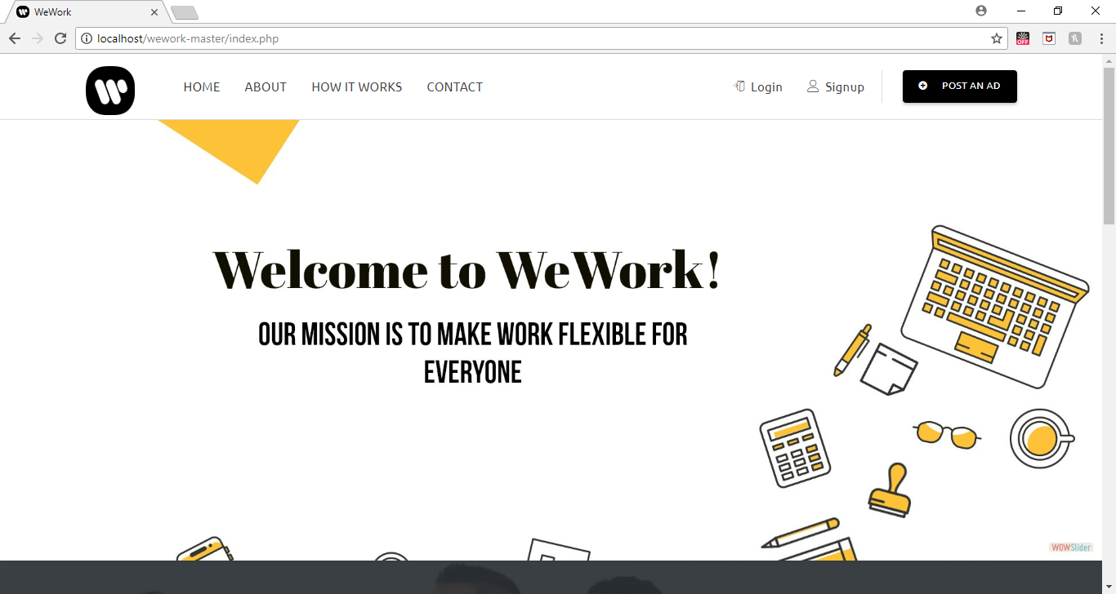
Home Page

Slide 7
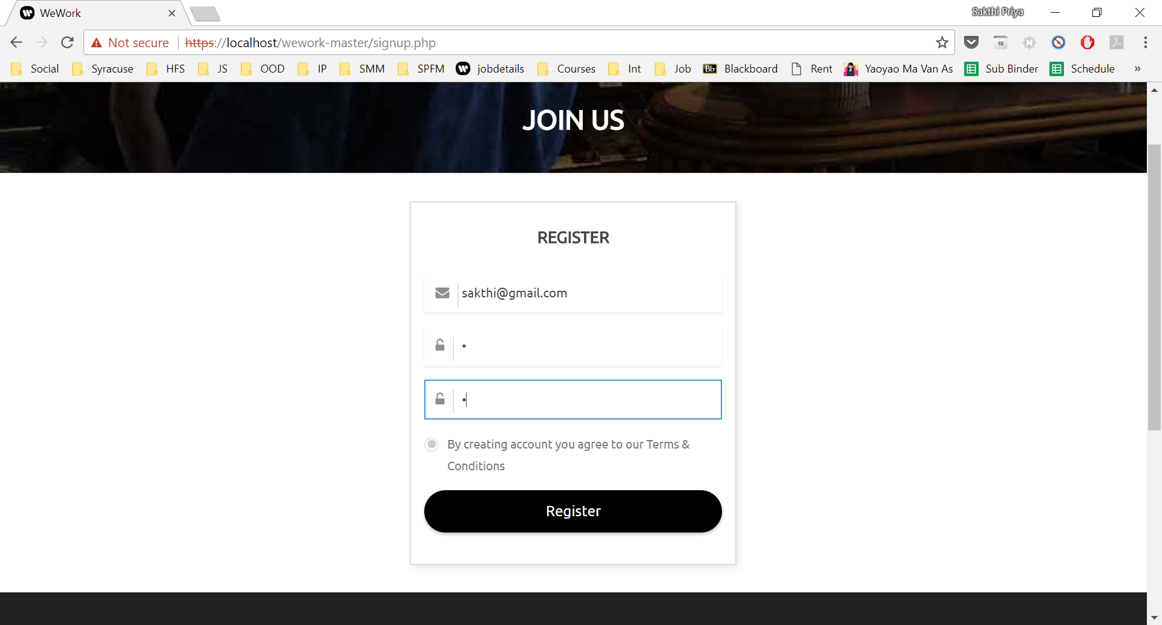
Login Page Login and Job Applicant: Sakthi Rajendran

Slide 8
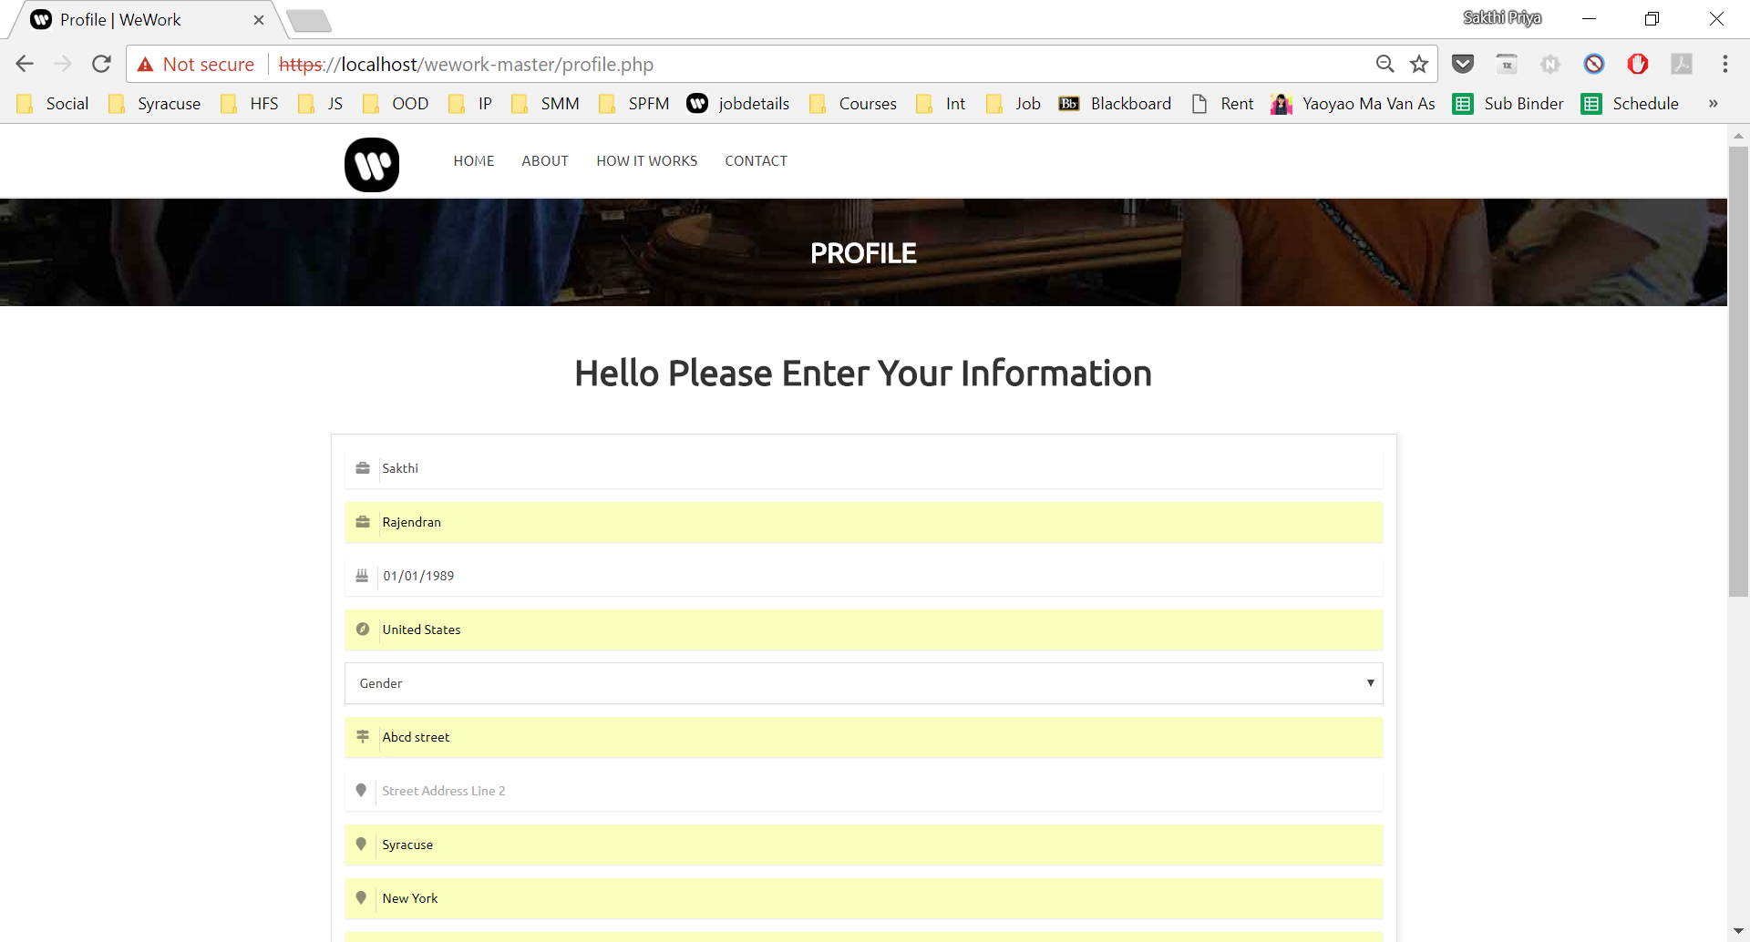
Profile creation Page

Slide 9
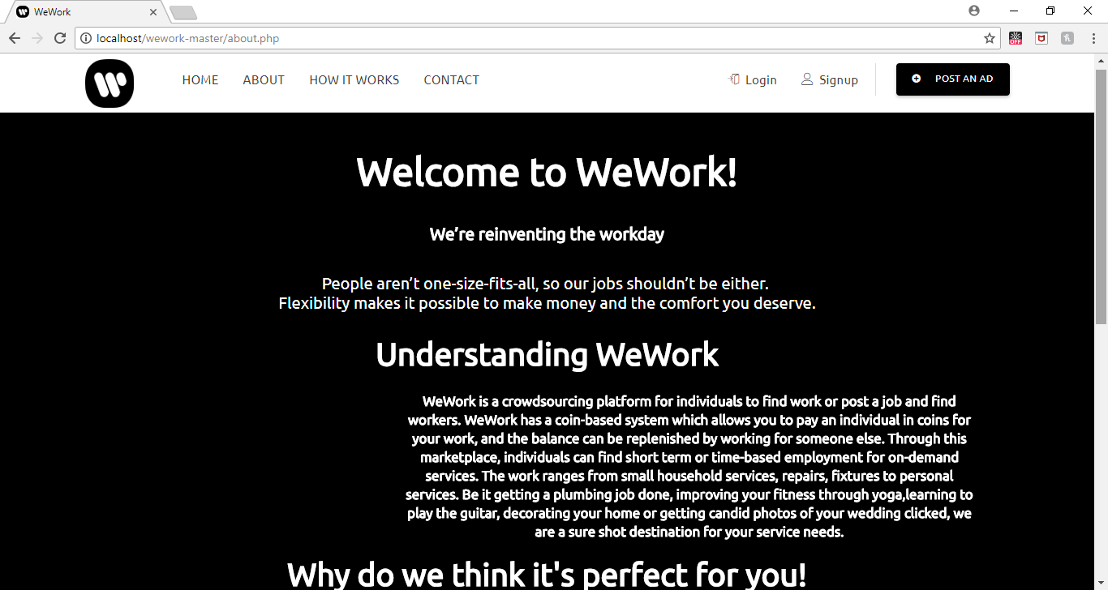
About Page

Slide 10
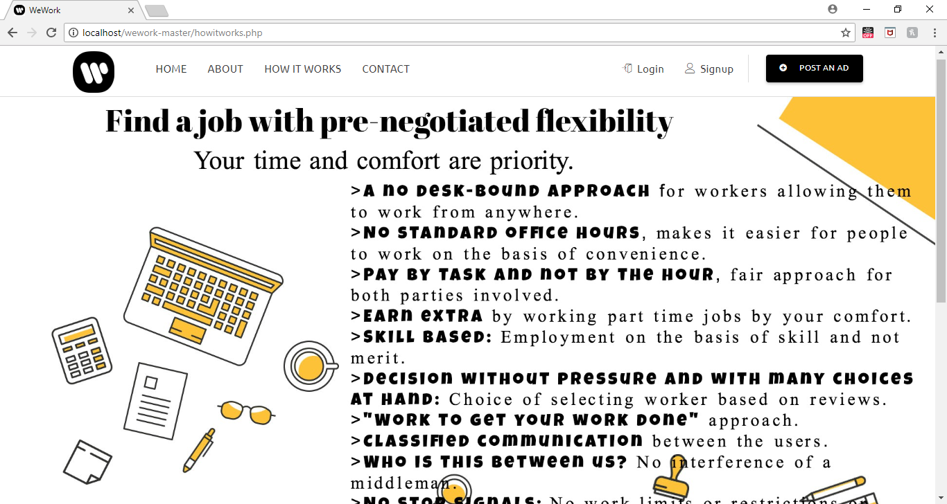
How it works Page

Slide 11
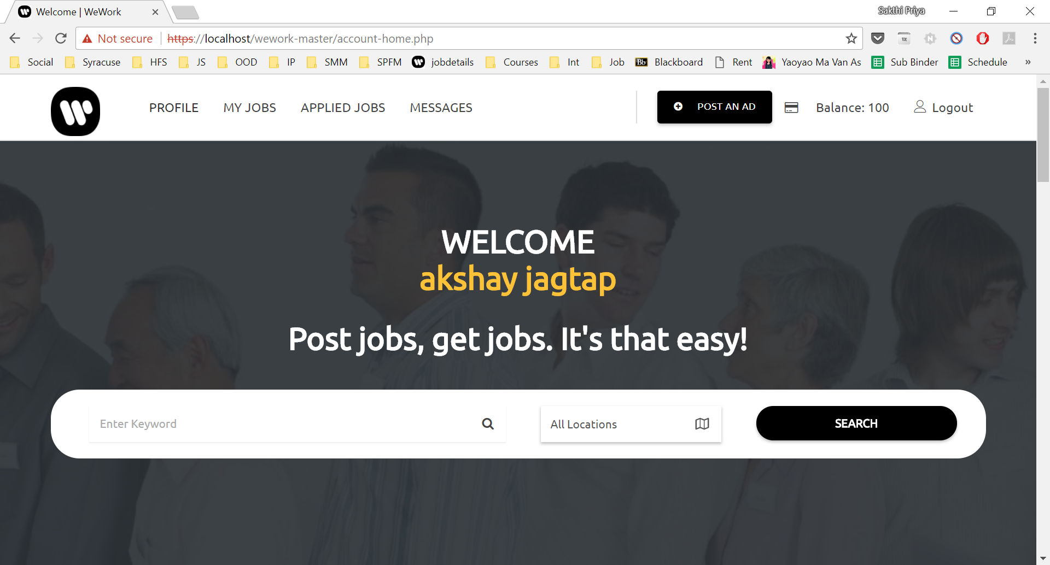
User Home Page after successful login

Slide 12
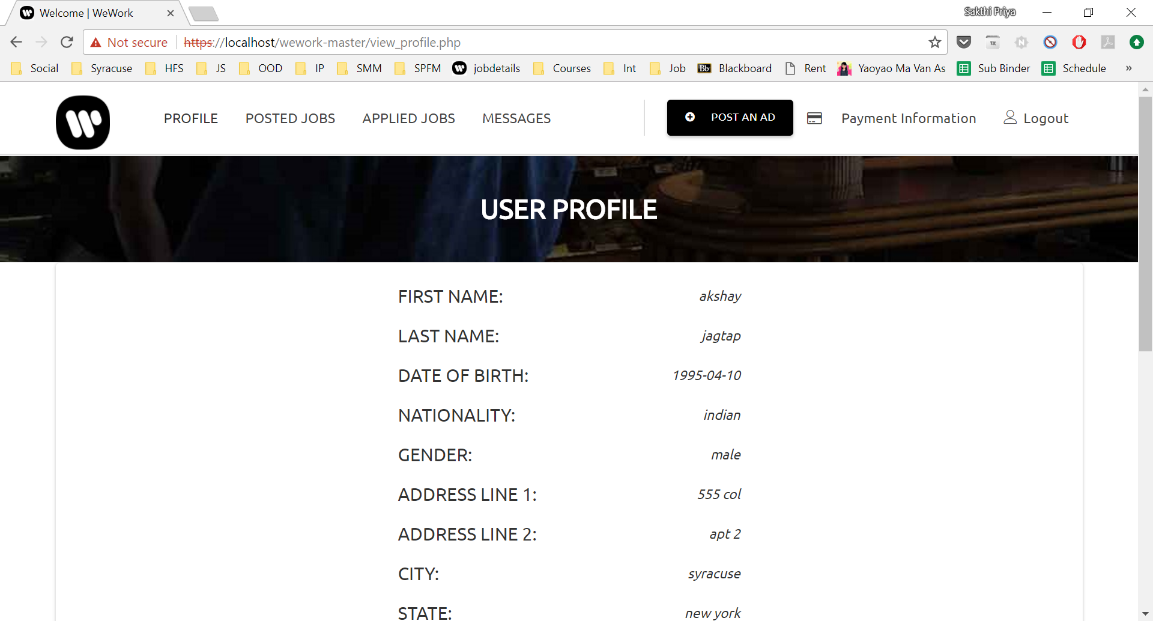
User Profile Page

Slide 13
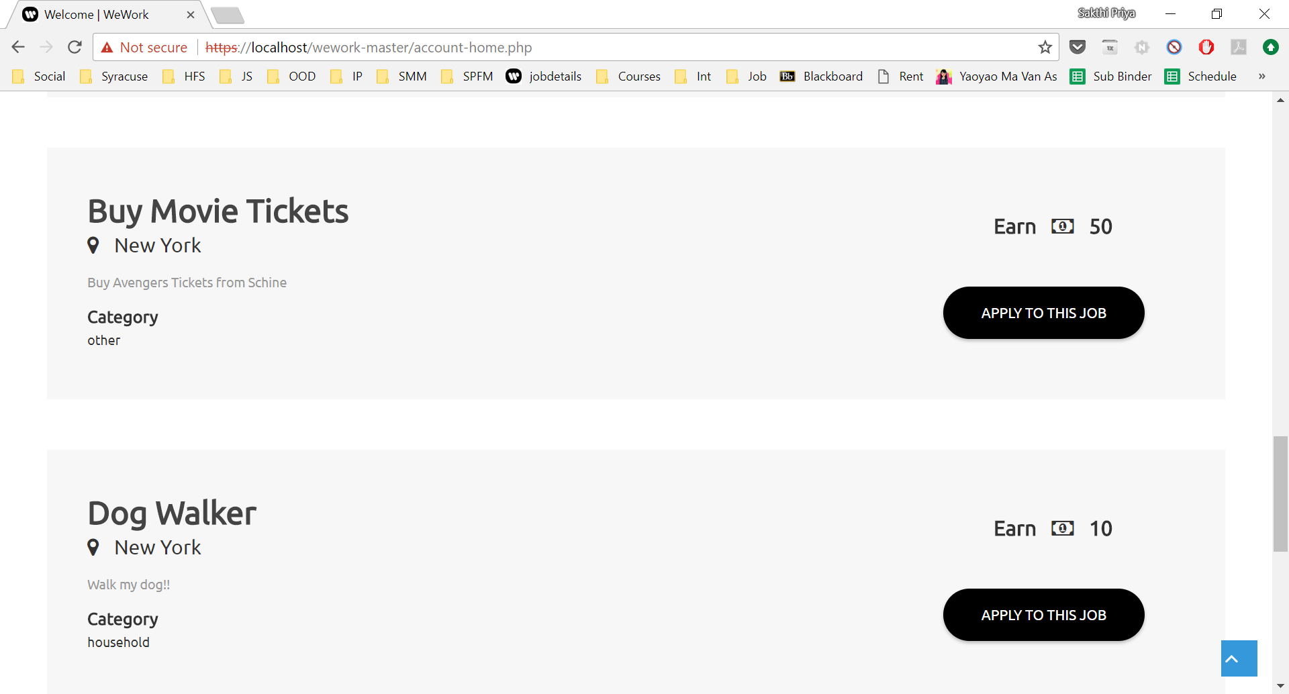
Account Home Page with list of latest jobs

Slide 14
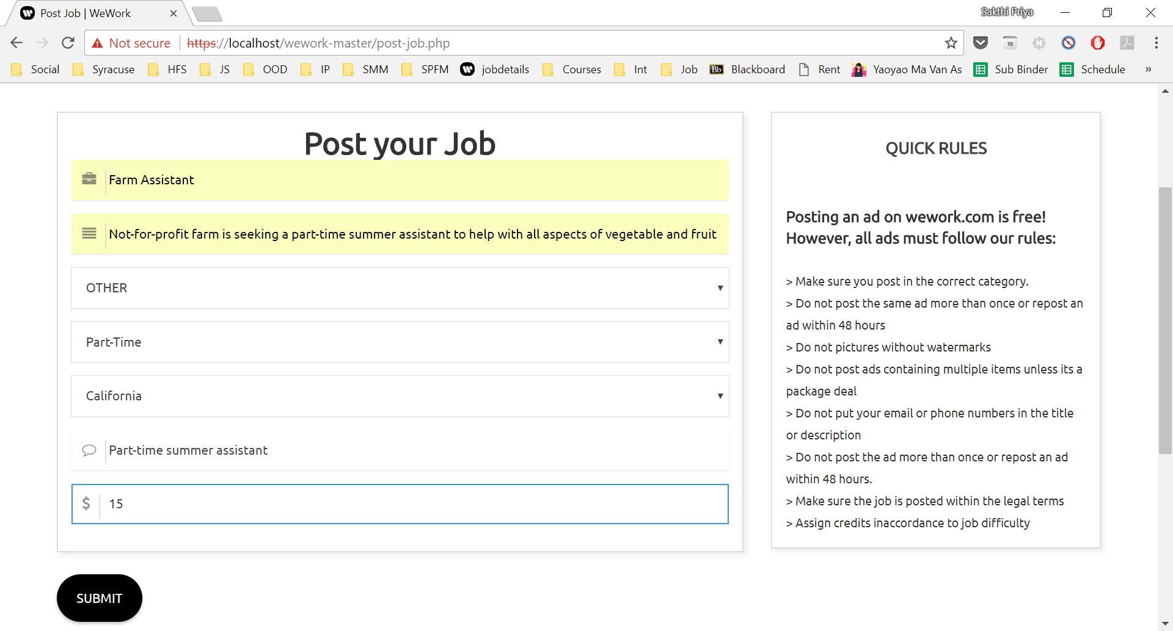
Job Posting Page

Slide 15
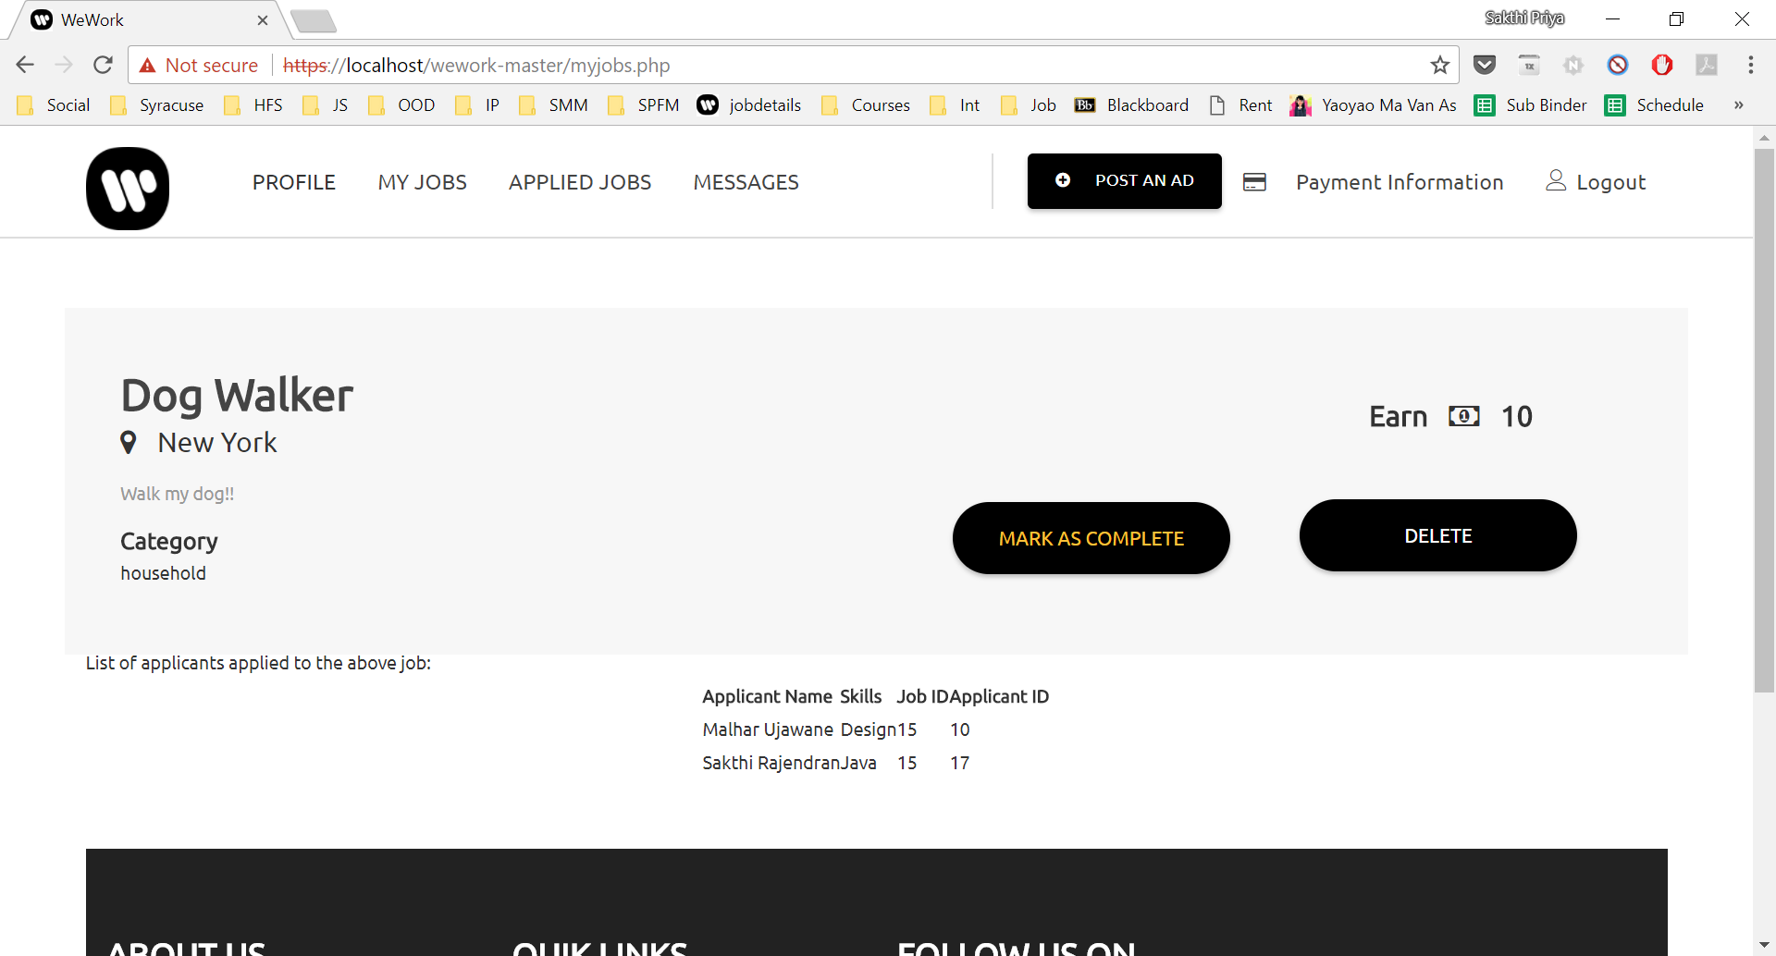
Job poster view of his posted jobs, with the list of applicants applied to that job Login and Job Poster: Akshay Jagtap

Slide 16
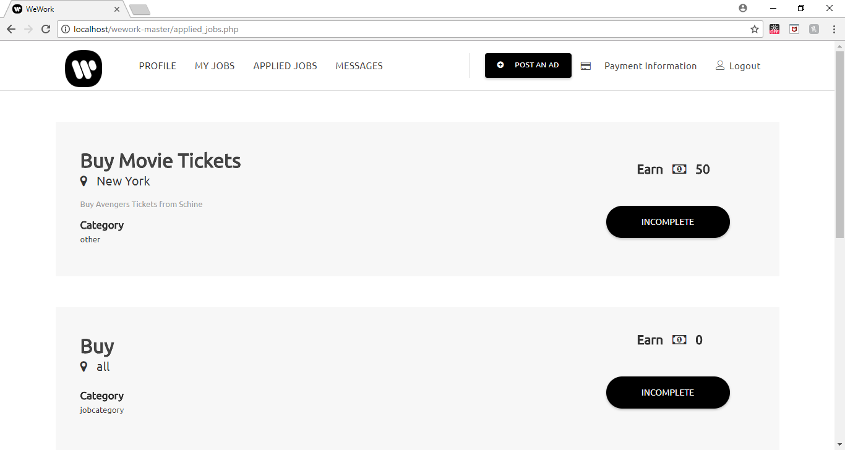
Applied Jobs Page for the applicant view

Slide 17
Future Scope
Real time chat between the employers and the employee
Time sheet
Report employer/employee
Notification Support
Employee availability (is he/she on a leave or not available)
Profiling - for both employer and employee, add previous work history to the profile

Slide 18
Thanks!
Any questions ?

