Slide 1
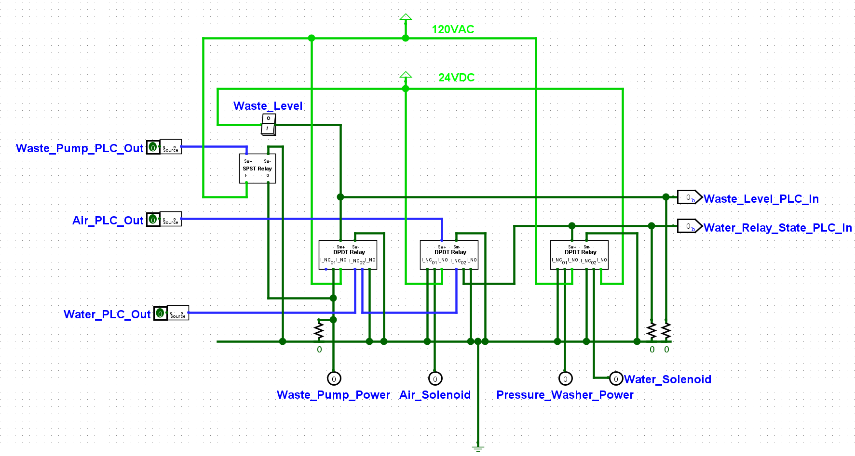

Slide 2
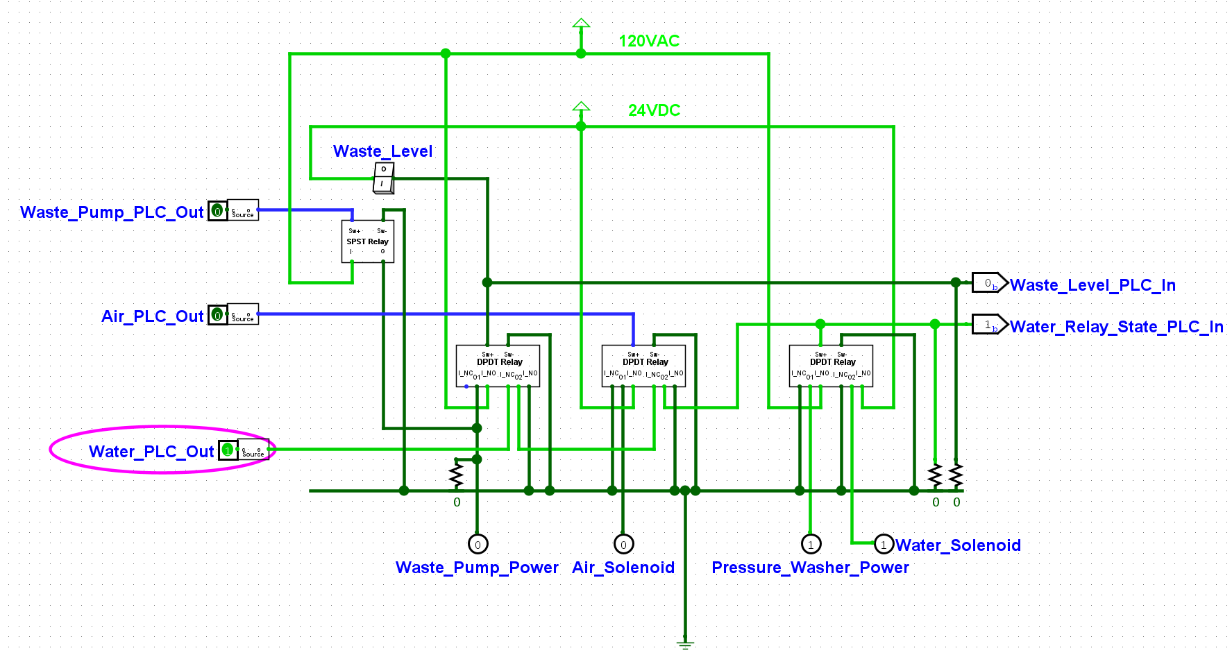
PLC Turns Water On
Main Water Solenoid
Receives 24VDC
Pressure washer receives 120VAC

Slide 3
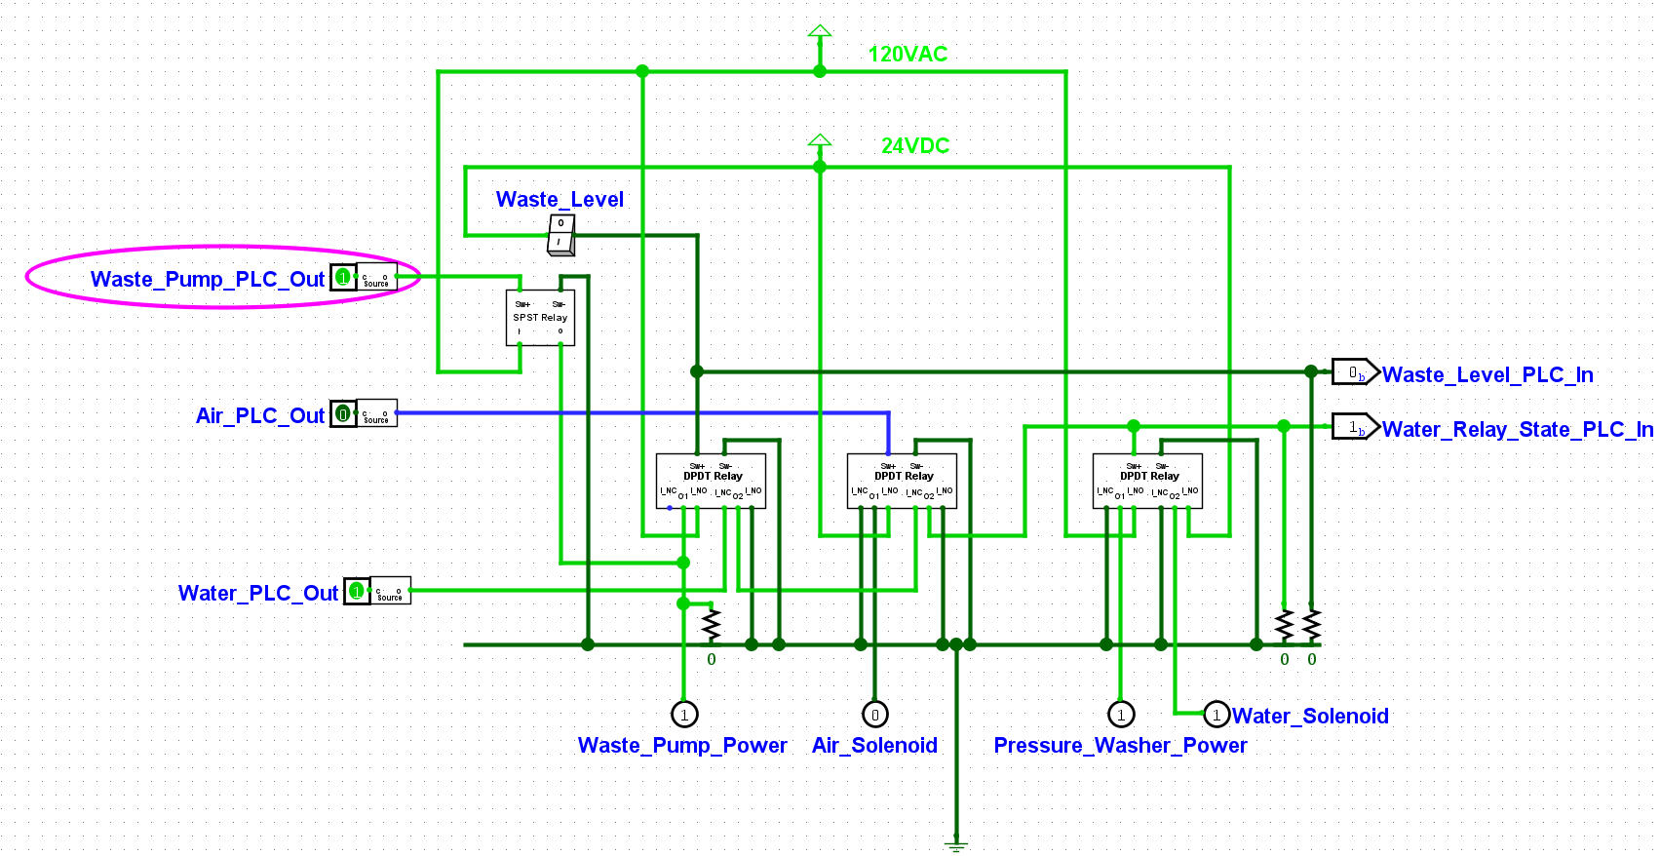
Waste pump enabled with short delay
Waste pump receives 120VAC

Slide 4
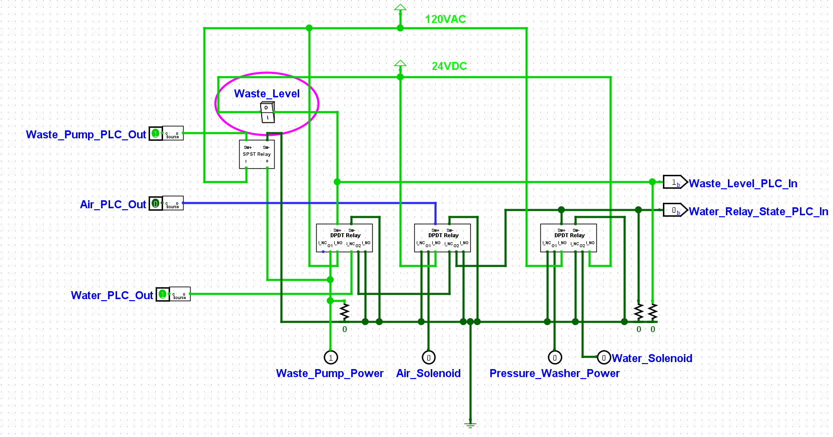
Waste level switch triggered
PLC can read switch state
Pressure Washer instantly turns off
and the solenoid is closed

Slide 5
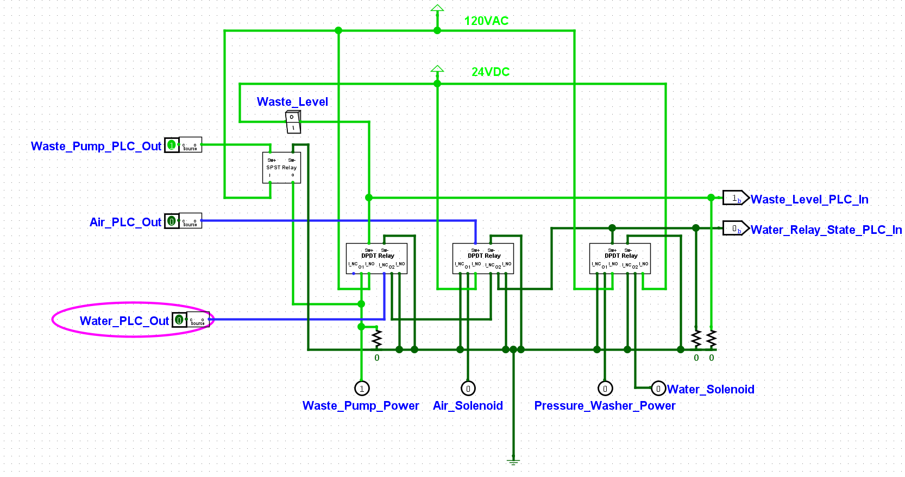
PLC holds pump on for set time
If level switch is still triggered after this time, throw critical error
PLC Switches its water output off
And pauses wash cycle

Slide 6
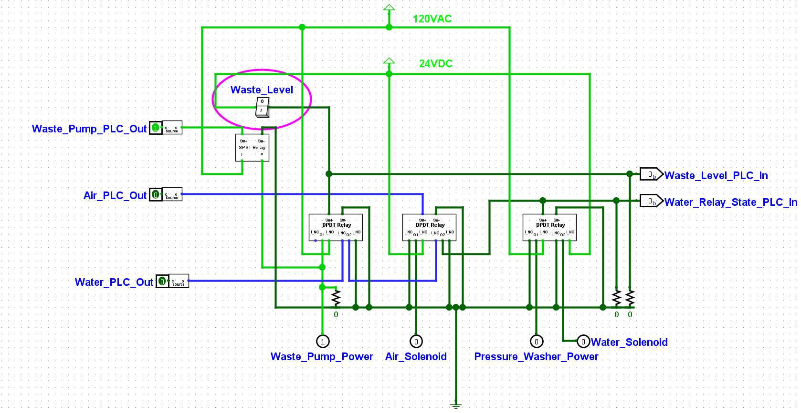
Level switch returns to normal position
PLC recognizes change in switch state

Slide 7
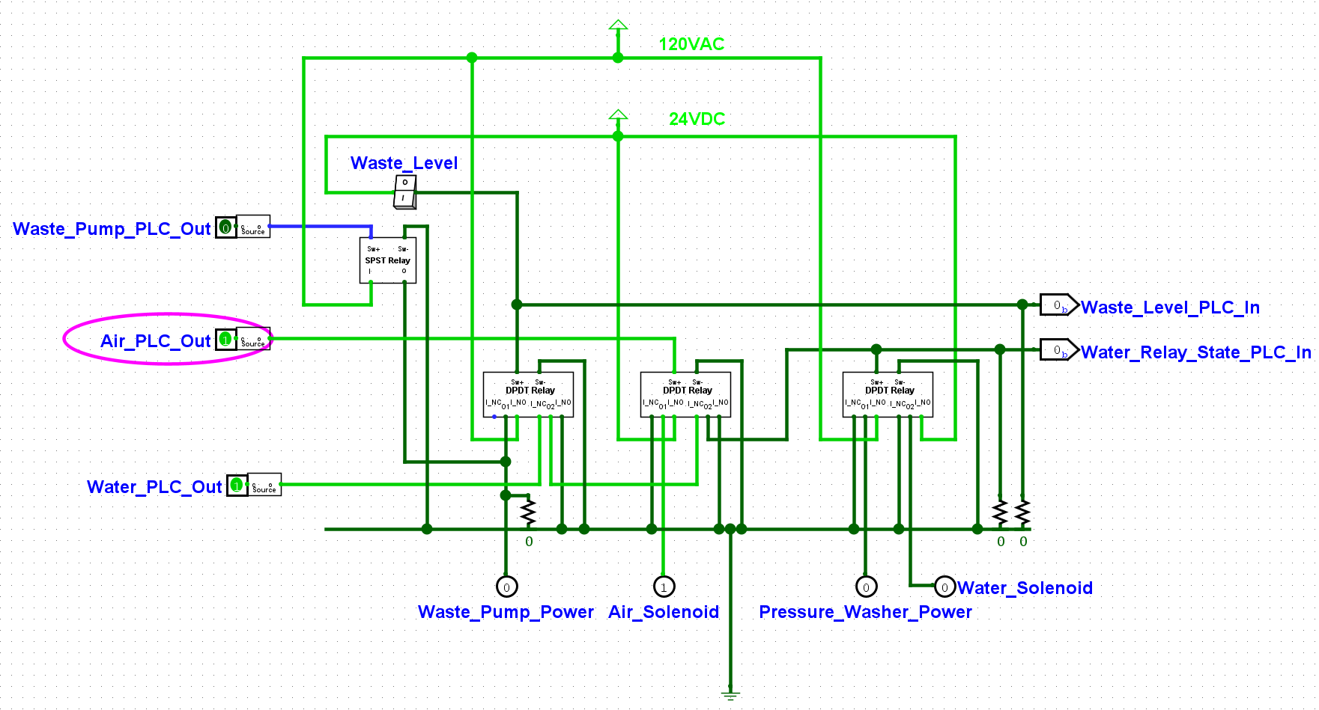
PLC disables waste pump in response to error
Software bug/PLC or Relay failure
opens air solenoid
PLC can recognize this error
Pressure washer turned off
Water solenoid closed

Slide 8
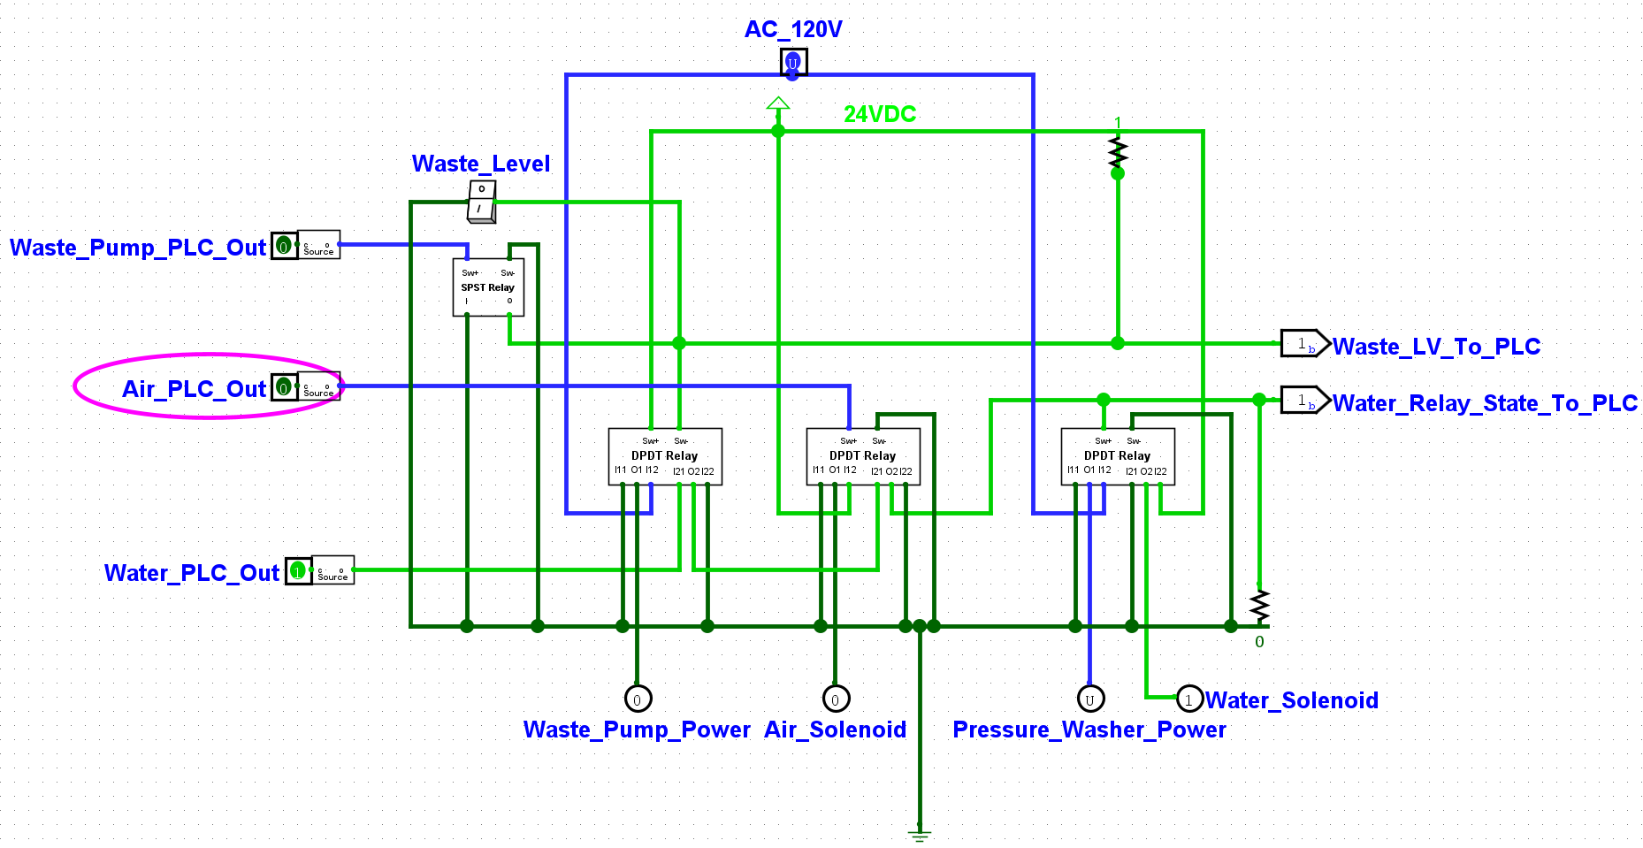
Bug is resolved
Resume Wash Cycle

