Slide 1
Defining Styles

Slide 2
Defining Styles
Three ways of defining styles
As mentioned in the previous presentation, there are 3 ways of defining style sheets. They are:
External
Embedded
Inline

Slide 3





Defining Styles
External style sheets
By far the most common method for outlining your styles is to use an external style sheet. External style sheets are created in a separate file and then linked into all of the Web pages in your site. This allows you to centrally and globally manage all of the styles for every element in your site.
.heading {
color:red;
font-size:1.6em;
}
styles.css

Slide 4

Defining Styles
Embedded style sheets
In this method, styles are placed within a <style> tag which resides within the <head> tag of the web page. The style is still utilized by the tag in exactly the same way as the external method but the style only becomes available to that web page and no others within the site.
<head> <style>
.heading {
color:red;
font-size:1.6em;
}
</style>
</head>
<body>
<h1 class="heading">Welcome</h1> </body>
Web Page
index.html

Slide 5

Defining Styles
Combining external with embedded style sheets
Of course, you could also combine external and embedded style sheets. Consider the following scenario:
vProspect Web Page
.heading {
color:red;
font-size:1.6em;
}
Embedded
vConvert Web Page
styles.css
vRetain Web Page

Slide 6
Defining Styles
Inline styles
Inline styles are a quick way of applying style to elements within your web pages. The upside to using inline styles is that you can quickly switch to the source and apply a style to any tag. The downside however is that the style is only applied to that tag and no others within the page or site. Furthermore, because inline styles are applied to tags, they tend to get lost and forgotten about throughout the design process.
<body>
<h1 style="color:red;font-size:1.6em;"> Welcome </h1> </body>
Web Page
index.html

Slide 7
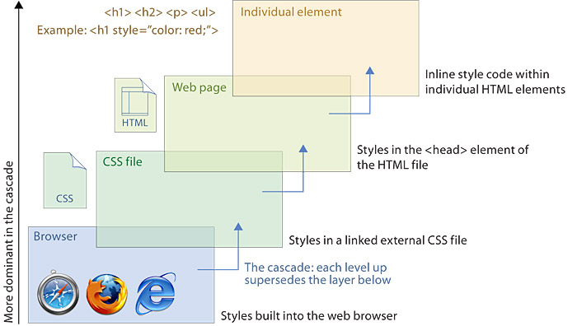
Defining Styles
Hierarchal precedence
Often times you'll find yourself working on projects that combine all three methods of defining styles within the same project. Most WordPress sites come to mind. When this is the case, you should be aware of how the browser determines style precedence. The figure below outlines CSS hierarchy and what takes precedence.

