Slide 1
Common Box Properties

Slide 2
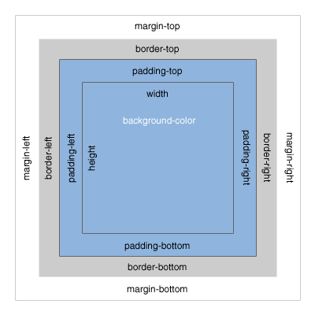
Common Box Properties
Introduction to The Box Model
Most HTML elements can be considered boxes. In CSS, the term "box model" refers to the design and layout of these elements using various CSS properties that control margins, borders (covered in the next presentation), paddings, widths, heights, and more. Box properties are an important part of web design and you'll find that you'll be using these properties with great regularity regardless of whether you're using the DIV+CSS or the HTML5+CSS method of design and layout (covered later).

Slide 3
Common Box Properties
CSS 1 and CSS 2 properties
Property | Description | Values
margin<-side> | Sets the amount of margin for a side of the box. | Width in pixels or percent
padding<-side> | Set the amount of padding for a side of the box. | Width in pixels or percent
width | Sets the width of the box. | length, percentage, auto
min-width | Sets the minimum width of the box. | length, percentage, auto
max-width | Sets the maximum width of the box. | length, percentage, auto
height | Sets the height of the box. | length, percentage, auto
min-height | Sets the minimum height of the box. | length, percentage, auto
max-height | Sets the maximum height of the box. | length, percentage, auto

Slide 4
Common Box Properties
Example
This example uses a type selector to set various box properties for the <section> tag:
section { width: 460px; min-height: 200px; padding: 5px; margin-right: 20px; }

Slide 5
Common Box Properties
CSS 3 properties
Property | Description | Values
overflow-x | Specifies whether or not to clip the left/right edges of the content if it overflows the element's content area. | visible, hidden, scroll, auto, no-display, no-content
overflow-y | Specifies whether or not to clip the top/bottom edges of the content if it overflows the element's content area. | visible, hidden, scroll, auto, no-display, no-content

