Slide 1
Bootstrap

Slide 2
Bootstrap
Bootstrap is an open-source framework and mobile-first approach for developing responsive websites.
It is a front-end framework programmed to support both HTML5 and CSS3.
It comprises the list of components such as Typography, Code, Table, Forms, Button, Images, Icons, etc.
A responsive website is a website that automatically adjusts the screen size and looks good on all devices, from smartphones to a desktop.
It is easy to use, saves time and customizable.
Bootstrap 4 is the newest version of Bootstrap.

Slide 3
How to Download Bootstrap?
There are two ways to download and start using Bootstrap for our website:
Download Bootstrap 4 - You can download the bootstrap from getbootstrap.com.
Include Bootstrap from a CDN - You can skip the download with BootstrapCDN by copying the links and paste it in the head section of the html code.

Slide 4
Bootstrap grid systems
Bootstrap grid system consists of series of containers, rows, and columns to layout and align content.
It creates a responsive layout and built with grid and flexboxes.
Bootstrap classifies the screen sizes ranging from extra small to extra large based on the pixels.
The transition between the various screen sizes is known as breakpoints.
Bootstrap grid system provides a set of responsive classes to specify the screen size.

Slide 5
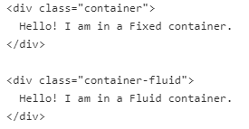
Bootstrap containers
Containers are the basic layout elements used to wrap the content in the website.
The container is the root of the Bootstrap 4 grid system which consists of all the elements and controls the layout width of a page.
Bootstrap provides two container classes:
.container - used to provide the responsive fixed width container
.container-fluid - used to provides a full-width container that spans the entire width of the viewport.

Slide 6

Bootstrap rows
Bootstrap rows are horizontal slices of the screen.
They are only used for containing columns or a wrapper for columns.
They have to be placed in containers to avoid the horizontal scroll on the page.
The bootstrap columns should be children for the row, to align properly. .row class is used to create the rows inside the container.

Slide 7
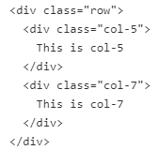
Bootstrap columns
.col class sets the width for the column dynamically that means we can set the width of each column in a row.
Grid system supports a maximum of 12 columns in a row and anything after that will be shifted to a next row.
You can set the size for the column (ranging from 1 to 12).
For example: The .col-4 class creates 3 equal columns (because 12/4= 3 columns).
The col-6 class creates 2 equal columns.
We can also set different sizes for them

Slide 8
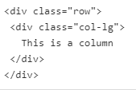
Bootstrap columns
You can set the Breakpoints for columns and used to specify the screen resolution. .col-[breakpoint] class is used to deine the behaviour for the columns in the displayed devices.
There are 4 different breakpoint class listed below:
.col-sm - used for small devices where the screen width is equal to or greater than 576px
.col-md - used for medium devices where the screen width equal to or greater than 768px
.col-lg- used for large devices where the screen width equal to or greater than 992px
.col-xl - used for extra-large devices where the screen width equal to or greater than 1200px

Slide 9
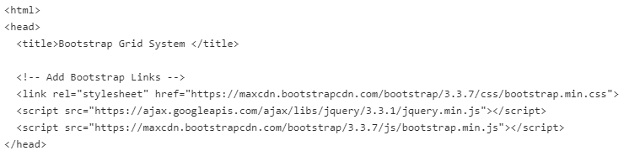
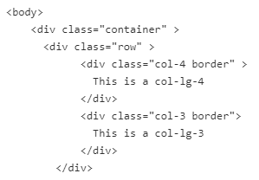
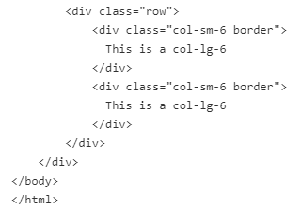
Bootstrap - Example

Slide 10
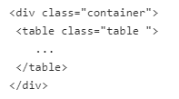
Bootstrap Tables
The bootstrap provides classes to style of HTML tables.
To change the default style of HTML table, add bootstrap .table class to the <table> element.
Bootstrap table classes used to create striped table rows, add borders to the cell and the tables, add the colors to the table rows, table headers and also allow us to differentiate handover rows, etc.

Slide 11
Bootstrap Tables
The following classes are used with .table class like <table class="table [class-name]"> to add styles to the table:
.table-dark - used to get a dark background table with the light text.
.table-bordered - adds the border on all sides of the table and cells.
.table-striped - used to add zebra-stripes table rows.
.table-hover - applies the hover effect to the table rows and cells, i.e, you will get grey background when a cursor rolls over a cell or a row.
.thead-light - used within <thead>, it makes the table header to appear light.
.thead- dark - used within <thead>, it makes the table header to appear dark gray.

Slide 12
Bootstrap Tables
Contextual classes is used to color the table rows <tr> and cells <td> individually.
We can used these contextual classes in <tr> and <tr> of the <table> element:
.table-warning, .table-primary, .table-info, .table-success, .table-danger, .table-active, .table-light, .table-secondary and .table-dark.
(for example: <tr class="table-primary">).

Slide 13
Bootstrap Alerts
Bootstrap alerts provide the contextual feedback messages for user actions on the page.
Alert boxes contain text that needs the user's attention.
The .alert class is display the alert message on website.
The .alert class is used as base class then followed by contextual classes
The contextual alert classes are:
.alert-success, .alert-info, .alert-warning, .alert-danger, .alert-primary, .alert-secondary, .alert-light and .alert-dark. .

Slide 14

Bootstrap Alerts
We can dismiss/close any alert messages by using .alert-dismissible class.
We can animate alerts when dismissing by using .fade and .show classes. Just add the data-dismiss="alert" attribute and class = "close" attribute to the <button> element to close the alert message boxes.

Slide 15
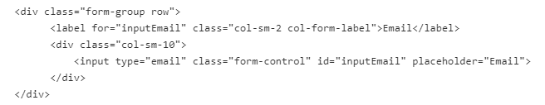
Bootstrap forms
Bootstrap forms allow us to create elegant forms on the website.
We can style the all textual form controls like input, select, textarea, etc., by using .form-control class.
There are 3 different types of form layout –
Vertical Form layout
Horizontal Form layout
Inline Form layout.

Slide 16
Bootstrap forms
Vertical Form Layout - This is a default default form layout provided by Bootstrap.
Horizontal Form Layout - In this layout, labels and form controls are aligned side-by-side by using the Bootstrap grid classes. The .row class and the .col-*-* grid classes used on the form groups to define the width of the layout. Also, to center them vertically we use .col-form-label on the <label>elements.
Inline Form layout - In this layout, a series of labels, form controls, and buttons are displayed in a single horizontal row. The .form-inline class is used within <form> element to create inline form layout.

Slide 17
Bootstrap buttons
Bootstrap includes several button styles in which each styles serves a semantic purpose.
The .btn classes are designed to be used with the <button>, <a> and <input> element.
The contextual classes used with the .btn classes are btn-primary, btn-secondary, btn-success, btn-danger, btn-warning, btn-info, btn-dark, btn-light, and btn-link.

Slide 18
Bootstrap buttons
When using button classes on <a> elements, we should use role="button" attribute to convey the purpose.
The .btn-outline-* used to remove all background colors on any button.
The .btn-lg or.btn-sm classes are used to create larger and smaller buttons.
The .active and .disabled class are used to represent the active and disabled state programmatically.

Slide 19
Bootstrap Navbar
Bootstrap allows us to create a responsive navigation header that includes support for navigation, branding, collapse plugin and more.
Navbars require a wrapping .navbar with .navbar-expand{-sm|-md|-lg|-xl} for responsive collapsing and color scheme classes.

Slide 20
Bootstrap Navbar
Some of the navbars sub-components are listed below with their purposes.
.navbar-brand - used with most elements that contain the name of the company, product, or project.
navbar-toggler - used for collapse plugin and other navigation toggling behaviors (allows to change the position on mobile devices)
.form-inline - used with any form-controls and actions.
.navbar-text - used to align the text vertically also makes it centered.
.collapse.navbar-collapse - used for grouping and hiding navbar contents depending upon the screen resolution.

Slide 21
Bootstrap Colors
Bootstrap provides color utility classes that support for styling links with hover states.
Text color - used to set the color for text of an element.
The contextual text color classes are
.text-muted, .text-primary, .text-success, .text-info, .text-warning, .text-danger, .text-secondary, .text-white, .text-dark, .text-body, and .text-light.
Background color - used to set the background color for an element.
The contextual background color classes are similar to the contextual text color classes, here we use .bg-* instead of text-*.

Slide 22
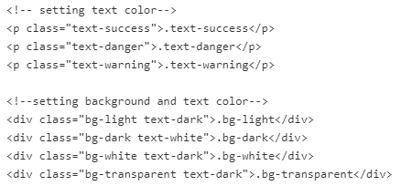
Bootstrap Colors

