Slide 1
What I learnt from 28 people about healthy eating pain
I built this because I meal-prepped quinoa on a Sunday and ordered biryani by Tuesday.

Slide 2
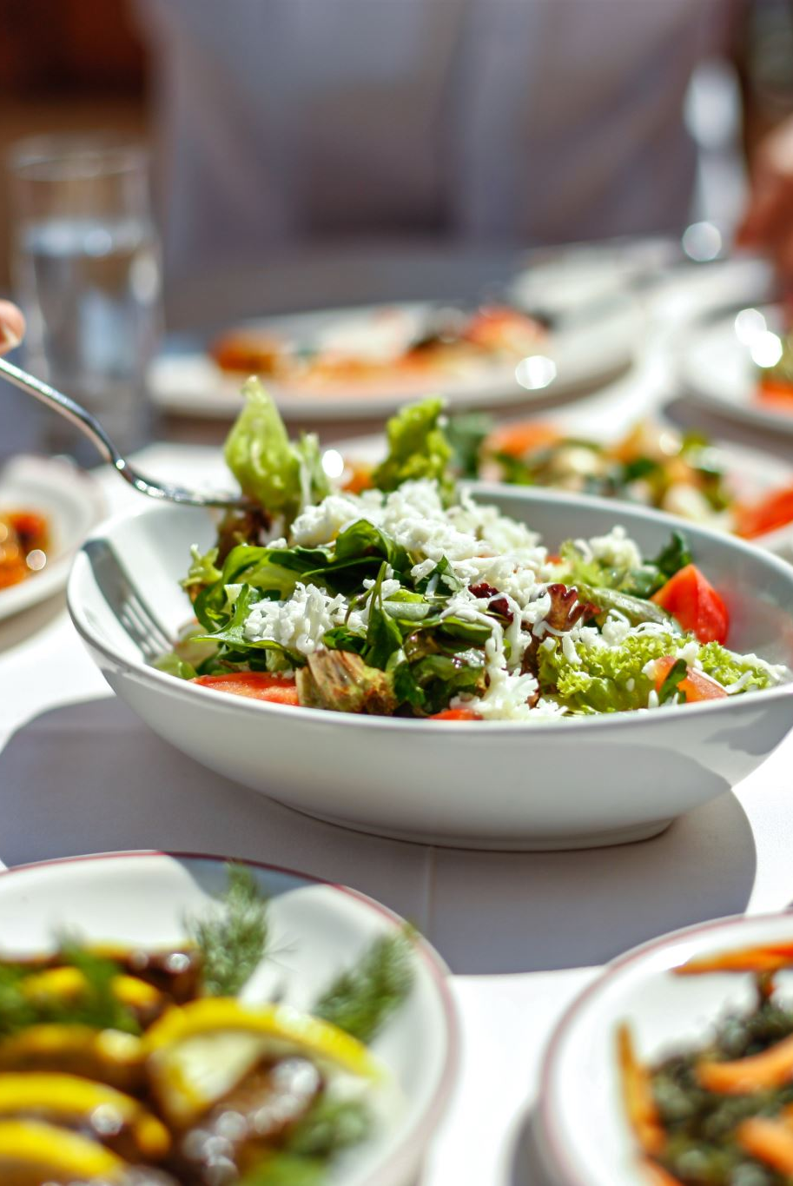
The story
Do you try to bring healthy meals to the table at home?
Do you struggle with it?
Do you wish that something would just make it easy for you?
This is what I faced everyday. So, I thought why not solve it for others too. But do people even want it?
Let’s see how we can figure that out.

Slide 3
The end goal…
Is this a valid need?
Will people pay for this?
What are the chances of business success?
How successful can it potentially become?

Slide 4
What I could do with a small survey…
User research - “Who is the target customer?”
Validate if a genuine need exists- “Do people need this? Why? How many?”
Segment the customer base- “Who needs this?”
Determine users' willingness to pay- “How much will they pay?”
Market research - “Who is solving this problem for whom?”
Competitor analysis – “Who am I competing with?”
Market sizing – “TAM, SAM, SOM: How big, how reachable, how mine?”

Slide 5
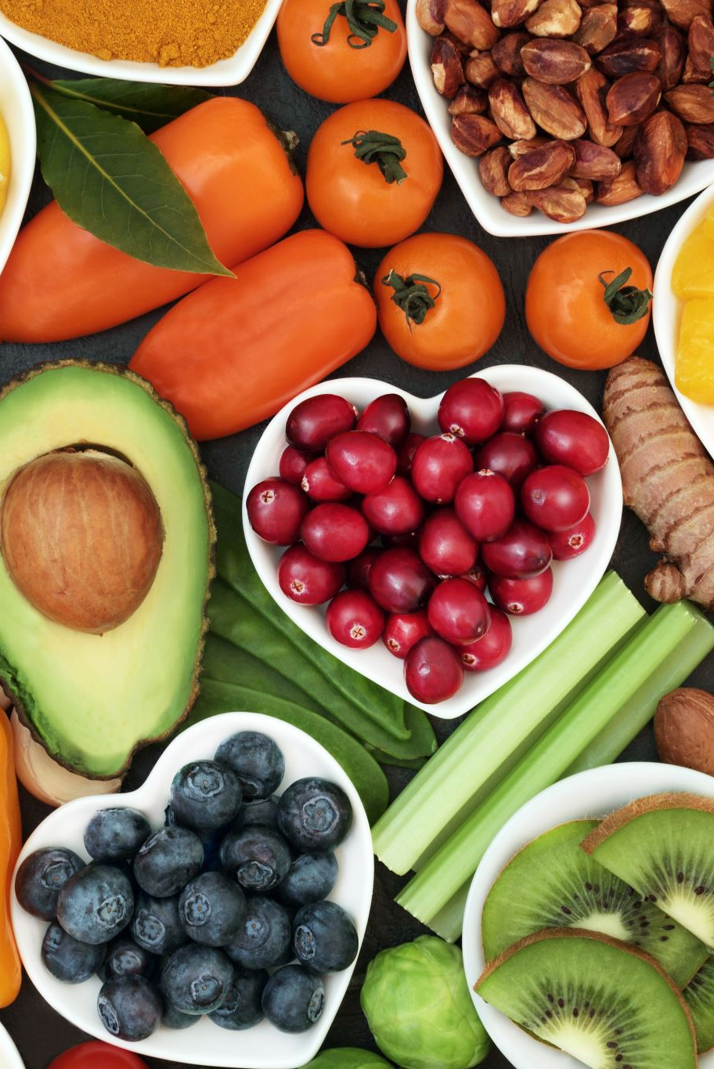
Who is the target customer?
Do people need this? Why and how many?
89% of users face at least one of the three core frictions: Time, Nutrition uncertainty, or Coordination overload
63% face two or more.
Who needs this?
Goal-oriented couples (15%)
Balance focused small families(7%)
How much will they pay for it?
In terms of % of their current monthly spend
Goal-oriented couples (37%)
Balance focused small families(7%)

Slide 6
Who is solving this problem for whom?
Conservative aim
for Goal-oriented couples in Bangalore at Rs. 230 per meal- 5x weekly
Hiring a Cook with a Diet Plan - ₹17,000/month
Fitness-Focused Meal Delivery- ₹12,000/month
We offer expert based personalized plans, no generic meals, just what you need.
Healthy Cafes (On-Demand) - ₹22,500/month
We cut the cost, deliver at home, and provide daily consistency
We remove the hassle, reduce cognitive load, ensure consistency, take no leaves, offer pause days to save you money.
Our service - ₹15,000/month
We become your personal nutrition partner — from test-based meal planning to expert-designed, portion-controlled meals, progress tracking, and guilt-free cheat days.
SAM(2.3M users)
TAM (37M users)
SOM (300-900 users)
Rs. 2.5 crores annually

Slide 7
The end goal revisited…
Is this a valid need? Yes! Figure out what Goal-oriented couples want.
Will people pay for this? Yes! 37% of their current food budget at least.
What are the chances of business success? Differentiation needed for quality and expert based nutrition.
How successful can it potentially become? Conservative annual revenue- Rs. 2.5 crores.

Slide 8

Now what?
Assess
Assess yourself- SWOT.
Choose
Choose your customer segment.
Define
Define your business model.
Test
Develop and test early-stage prototype.
Refine
Refine the problem to be solved and redo the research.

Slide 9
Congratulations!
You might have just achieved two things today:
28 responses → 2 clear personas → ₹2.5Cr opportunity in one city
Learnt something real about market research.
That’s rare. Most people just swipe.
Let’s talk — share your thoughts, challenge mine, or just drop a “👋”.
Thanks for sticking around.

