Slide 1

YAY! - Celebrating Education

Slide 2
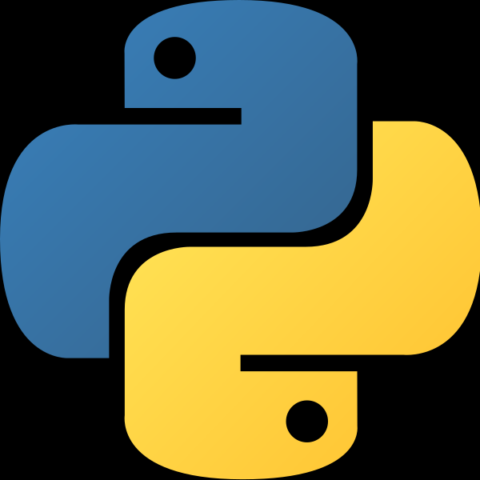

Python Course
(Basics)

Slide 3
Continuation of Object Oriented Programming
(OOPs)

Slide 4
Course Agenda for Today
Revision: Assignment Topics
Self Keyword
Magic Methods
Polymorphism
Method Overloading
Method Overriding
Abstraction
Encapsulation
Inheritance

Slide 5
Revision: Assignment Topics
1. List Comprehension and Dictionary Comprehension
2. Functions and Lambda Functions
3. Classes and Objects
4. Constructors and Destructors
5. Multilevel and Hierarchical Inheritance

Slide 6
1.What is List and Dictionary Comprehension?
List comprehension is an elegant way to define and create lists based on existing lists. List comprehension is generally more compact and faster than normal functions and loops for creating list.
Like List Comprehension, Python allows dictionary comprehensions. We can create dictionaries using simple expressions.
A dictionary comprehension takes the form {key: value for (key, value) in iterable}

Slide 7
2. Functions and Lambda Functions
In Python, a function is defined using the def keyword:
def my_function():
print("Hello from a function")
my_function()
In Python, an anonymous function is a function that is defined without a name.
While normal functions are defined using the def keyword in Python, anonymous functions are defined using the lambda keyword.
Hence, anonymous functions are also called lambda functions.

Slide 8
3. Classes and Objects
Python is an object oriented programming language.
Almost everything in Python is an object, with its properties and methods.
A Class is like an object constructor, or a "blueprint" for creating objects.

Slide 9
4.Constructors and Destructors
Constructors are generally used for instantiating an object. n Python the __init__() method is called the constructor and is always called when an object is created.
Syntax of constructor declaration :
def __init__(self):
# body of the constructor
Destructors are called when an object gets destroyed. In Python, destructors are not needed as much. The __del__() method is a known as a destructor method in Python.
Syntax of destructor declaration :
def __del__(self):
# body of destructor

Slide 10
5. Multilevel and Hierarchical Inheritance
Inheritance allows us to define a class that inherits all the methods and properties from another class.
Parent class is the class being inherited from, also called base class.
Child class is the class that inherits from another class, also called derived class.
In multilevel inheritance, features of the base class and the derived class are inherited into the new derived class.

Slide 11
Lets see the solutions in the IDE!

Slide 12
Self Keyword
By using the “self” keyword we can access the attributes and methods of the class in python. It binds the attributes with the given arguments. The reason you need to use self. is because Python does not use the @ syntax to refer to instance attributes.
Self is a convention and not a real python keyword.
class Employees:
def printdetails(self):
return f"Name is {self.name}. Salary is {self.salary}. Role is {self.role}."
jasleen = Employees()
jasleen.name = "Jasleen Sondhi"
jasleen.salary = 15000
jasleen.role = "Mentor"
print(jasleen.printdetails())

Slide 13
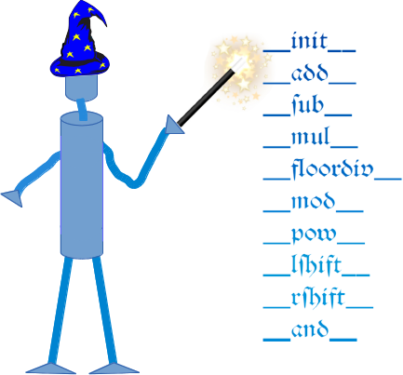
Magic Methods
Dunder or magic methods in Python are the methods having two prefix and suffix underscores in the method name. Dunder here means “Double Under (Underscores)”. These are commonly used for operator overloading. Few examples for magic methods are: __init__, __add__, __len__, __repr__ etc.

Slide 14
Magic methods are not meant to be invoked directly by you, but the invocation happens internally from the class on a certain action. For example, when you add two numbers using the + operator, internally, the __add__() method will be called.
Magic methods are most frequently used to define overloaded behaviors of predefined operators in Python. For instance, arithmetic operators by default operate upon numeric operands. This means that numeric objects must be used along with operators like +, -, *, /, etc. The + operator is also defined as a concatenation operator in string, list and tuple classes. We can say that the + operator is overloaded.

Slide 15
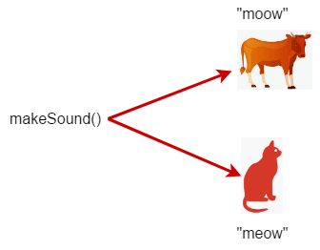
Polymorphism
The word polymorphism means having many forms. In programming, polymorphism means same function name (but different signatures) being uses for different types.

Slide 16
Example of inbuilt polymorphic functions-
# Python program to demonstrate in-built poly-
# morphic functions
# len() being used for a string
print(len("geeks"))
# len() being used for a list
print(len([10, 20, 30]))
Polymorphism with Inheritance
In Python, Polymorphism lets us define methods in the child class that have the same name as the methods in the parent class. In inheritance, the child class inherits the methods from the parent class. However, it is possible to modify a method in a child class that it has inherited from the parent class.

Slide 17
Polymorphism with Functions and Objects
It is also possible to create a function that can take any object, allowing for polymorphism..
Let’s check out this implementation in the IDE…….
The two types of Polymorphism are- 1) Method Overloading 2) Method Overriding

Slide 18
Method Overloading
Method overloading is one concept of Polymorphism. It comes under the elements of OOPS. It is actually a compile-time polymorphism. It is worked in the same method names and different arguments. Here in Python also supports oops concepts. But it is not oops based language. It also supports this method overloading also.
Normally in python, we don’t have the same names for different methods. But overloading is a method or operator to do the different functionalities with the same name. i.e methods differ their parameters to pass to the methods whereas operators have differed their operand.
Here some advantages of Method Overloading in Python-
Normally methods are used to reduce complexity. Method overloading is even it reduce more complexity in the program also improves the clarity of code.
It is also used for reusability

Slide 19
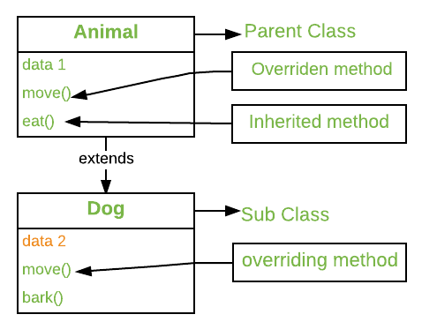
Method Overriding
Method overriding is an ability of any object-oriented programming language that allows a subclass or child class to provide a specific implementation of a method that is already provided by one of its super-classes or parent classes. When a method in a subclass has the same name, same parameters or signature and same return type(or sub-type) as a method in its super-class, then the method in the subclass is said to override the method in the super-class.

Slide 20
# Python program to demonstrate
# method overriding
# Defining parent class
class Parent():
# Constructor
def __init__(self):
self.value = "Inside Parent"
# Parent's show method
def show(self):
print(self.value)
# Defining child class
class Child(Parent):
# Constructor
def __init__(self):
self.value = "Inside Child"
# Child's show method
def show(self):
print(self.value)
# Driver's code
obj1 = Parent()
obj2 = Child()
obj1.show()
obj2.show()

Slide 21
Using Super(): Python super() function provides us the facility to refer to the parent class explicitly. It is basically useful where we have to call superclass functions.
# to demonstrate the use of super
class Parent():
def show(self):
print("Inside Parent")
class Child(Parent):
def show(self):
# Calling the parent's class
# method
super().show()
print("Inside Child")
# Driver's code
obj = Child()
obj.show()
By using the super() function, you do not have to use the name of the parent element, it will automatically inherit the methods and properties from its parent.

Slide 22
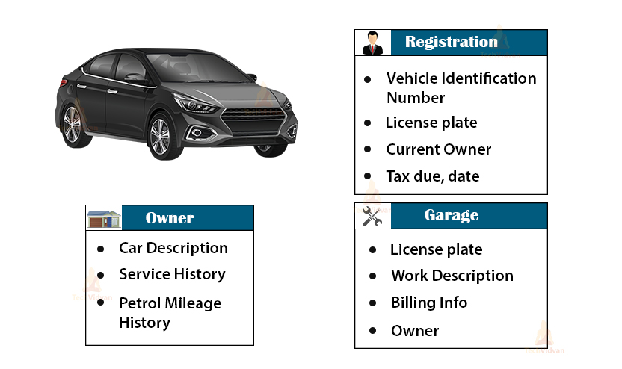
Abstraction
Abstraction focuses on hiding the internal implementations of a process or method from the user. In this way, the user knows what he is doing but not how the work is being done.

Slide 23
For example, people do not think of a car as a set of thousands of individual parts. Instead they see it as a well-defined object with its own unique behavior. This abstraction allows people to use a car to drive without knowing the complexity of the parts that form the car. They can ignore the details of how the engine transmission, and braking systems work. Instead, they are free to utilize the object as a whole.
The point is that we manage the complexity of the car (or any other complex system) through the use of hierarchical abstractions.
This can also be applied to computer programs using OOP concepts. This is the essence of object-oriented programming.

Slide 24
Implementing Abstraction through Abstract Classes
An abstract class can be considered as a blueprint for other classes. It allows you to create a set of methods that must be created within any child classes built from the abstract class. A class which contains one or more abstract methods is called an abstract class. An abstract method is a method that has a declaration but does not have an implementation.
By default, Python does not provide abstract classes. Python comes with a module which provides the base for defining Abstract Base classes(ABC) and that module name is ABC. ABC works by decorating methods of the base class as abstract and then registering concrete classes as implementations of the abstract base. A method becomes abstract when decorated with the keyword @abstractmethod.
Let’s check out this implementation in the IDE…….

Slide 25
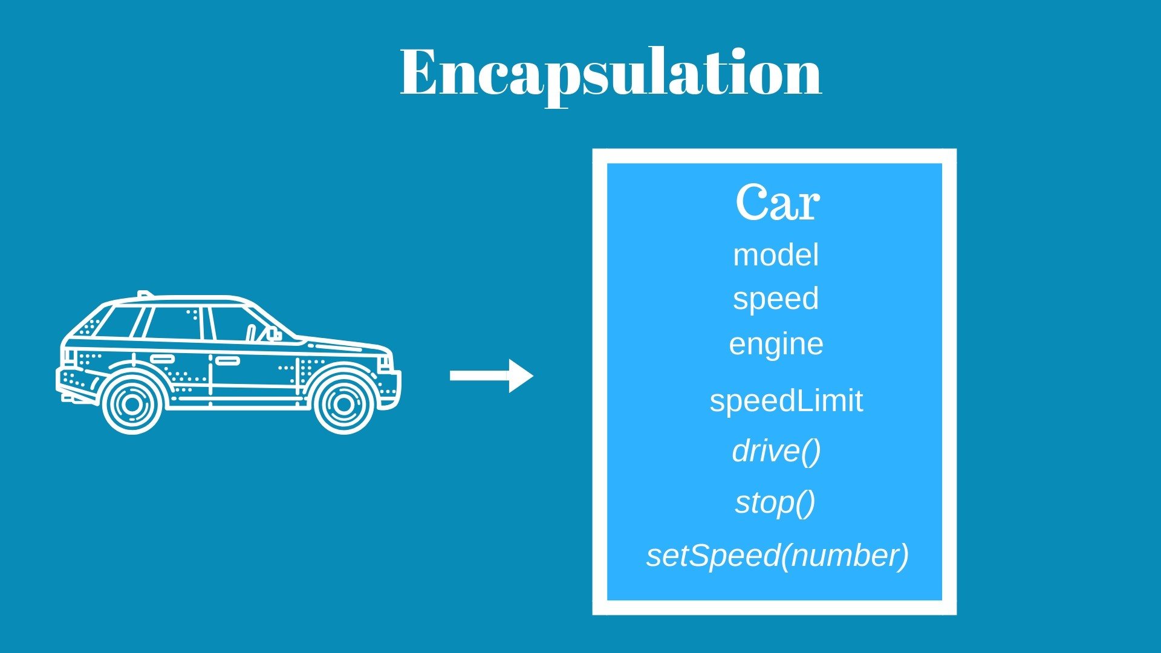
Encapsulation
Encapsulation is one of the fundamental concepts in object-oriented programming (OOP).
It describes the idea of wrapping data and the methods that work on data within one unit.

Slide 26
Consider a real-life example of encapsulation, in a company, there are different sections like the accounts section, finance section, sales section etc. So all the departments maintain their work individually. The Sales section keeps track of the sales while the Finance department maintains the financial records.
Now, in case, a situation arises where the sales department needs some data from the finance department. They cannot directly access it. They will have to contact someone in the finance section.
This is what encapsulation is. Here the data of the finance section and the employees that can manipulate them are wrapped under a single name “finance section”. Using encapsulation also hides the data.
This gives rise to concept of private members.

Slide 27
Protected Members
Protected members (in C++ and JAVA) are those members of the class that cannot be accessed outside the class but can be accessed from within the class and its subclasses. To accomplish this in Python, just follow the convention by prefixing the name of the member by a single underscore “_”.
Private Members
Private members are similar to protected members, the difference is that the class members declared private should neither be accessed outside the class nor by any base class. In Python, there is no existence of Private instance variables that cannot be accessed except inside a class. However, to define a private member prefix the member name with double underscore “__”.

Slide 28
Inheritance
The method of inheriting the properties of parent class into a child class is known as inheritance.
Following are the benefits of inheritance.
Code reusability- we do not have to write the same code again and again, we can just inherit the properties we need in a child class.
It represents a real world relationship between parent class and child class.
It is transitive in nature. If a child class inherits properties from a parent class, then all other sub-classes of the child class will also inherit the properties of the parent class.
When we add the __init__() function in a parent class, the child class will no longer be able to inherit the parent class’s __init__() function. The child’s class __init__() function overrides the parent class’s __init__() function.

Slide 29
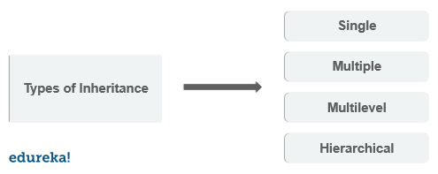
Types Of Inheritance

Slide 30
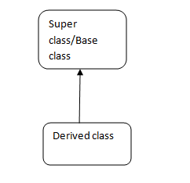
Single Inheritance
class Parent:
def func1(self):
print("this is function one")
class Child(Parent):
def func2(self):
print(" this is function 2 ")
ob = Child()
ob.func1()
ob.func2()

Slide 31
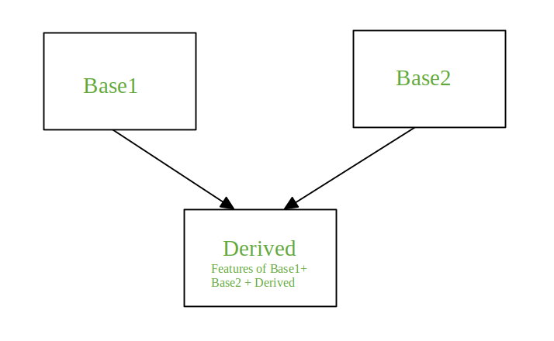
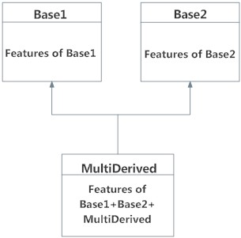
Multiple Inheritance
When a class is derived from more than one base class it is called multiple Inheritance. The derived class inherits all the features of the base case.
class Parent:
def func1(self):
print("this is function 1")
class Parent2:
def func2(self):
print("this is function 2")
class Child(Parent , Parent2):
def func3(self):
print("this is function 3")
ob = Child()
ob.func1()
ob.func2()
ob.func3()

Slide 32
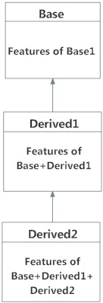
Multilevel Inheritance
class Parent:
def func1(self):
print("this is function 1")
class Child(Parent):
def func2(self):
print("this is function 2")
class Child2(Child):
def func3("this is function 3")
ob = Child2()
ob.func1()
ob.func2()
ob.func3()

Slide 33
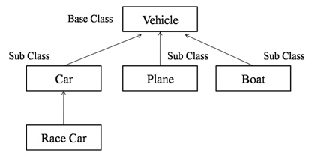
Hierarchical Inheritance
class Parent:
def func1(self):
print("this is function 1")
class Child(Parent):
def func2(self):
print("this is function 2")
class Child2(Parent):
def func3(self):
print("this is function 3")
ob = Child()
ob1 = Child2()
ob.func1()
ob.func2()

Slide 34
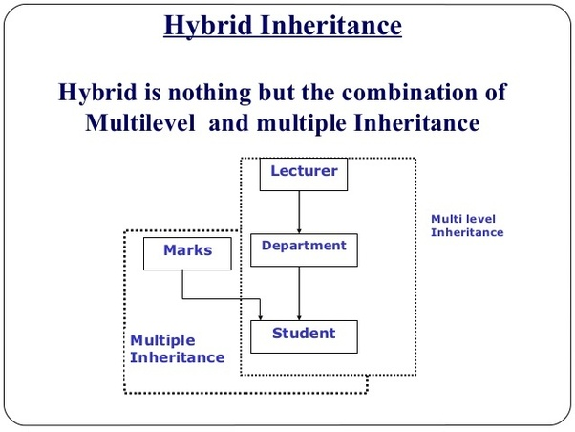
Hybrid Inheritance
class Parent:
def func1(self):
print("this is function one")
class Child(Parent):
def func2(self):
print("this is function 2")
class Child1(Parent):
def func3(self):
print(" this is function 3"):
class Child3(Parent , Child1):
def func4(self):
print(" this is function 4")
ob = Child3()
ob.func1()

Slide 35
Thank You!
See you in the next class!

