Slide 1
Incidence of malaria by country from 2000-2019
By: Jasleen Binning

Slide 2
Introduction
Malaria is a parasitic disease usually spread by mosquito’s
The symptoms of Malaria are typically fever, tiredness, vomiting, and headaches
Malaria exists primarily in the tropical and subtropical regions that exist around the equator
Malaria is commonly associated with poverty and regions where healthcare is hard to access

Slide 3
Data
Incidence of malaria (per 1000 population at risk) Source: Data World Bank
Which looks at the occurrence of Malaria in each country from 2000-2019, for each group of 1000 people in the country
Not all countries have data for every year between 2000-2019
Those that didn’t have data for every year were excluded from my research in order to have a level of continuity across the board

Slide 4

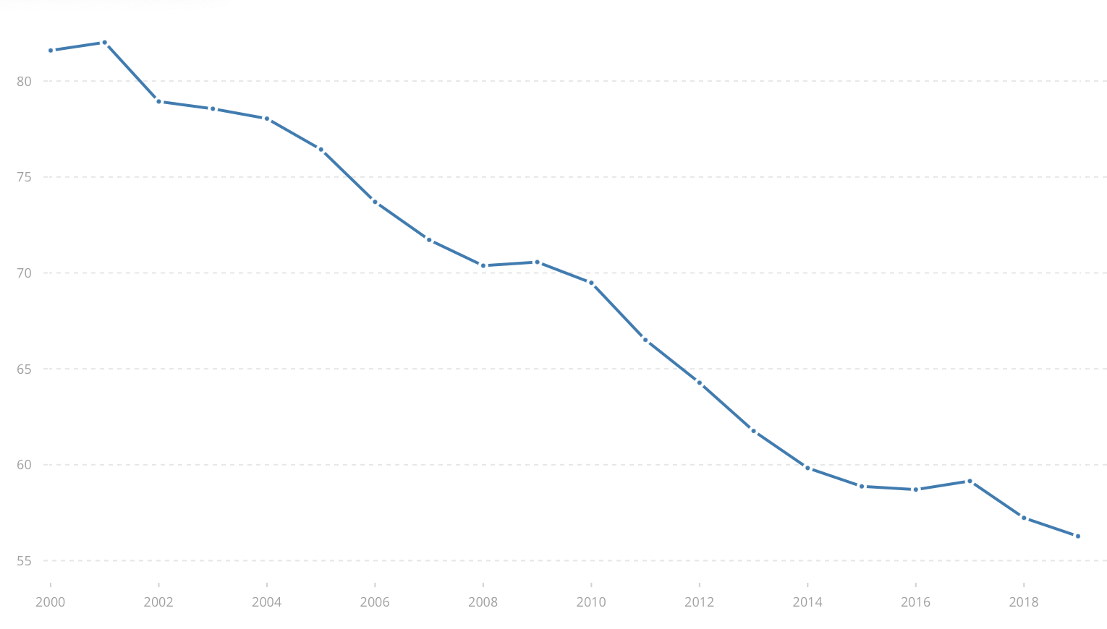
Brief Summary
Incidence of Malaria (per 1000 people)
In 2000 there were 81.6 cases of malaria per 1000 people in the world
In 2019 there were 56.3 cases of malaria per 1000 people in the world
Steady decline in the number of Malaria cases
Cases per 1000 people
year

